Slide 1


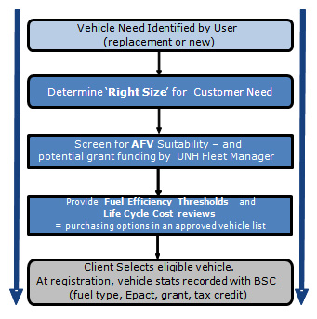
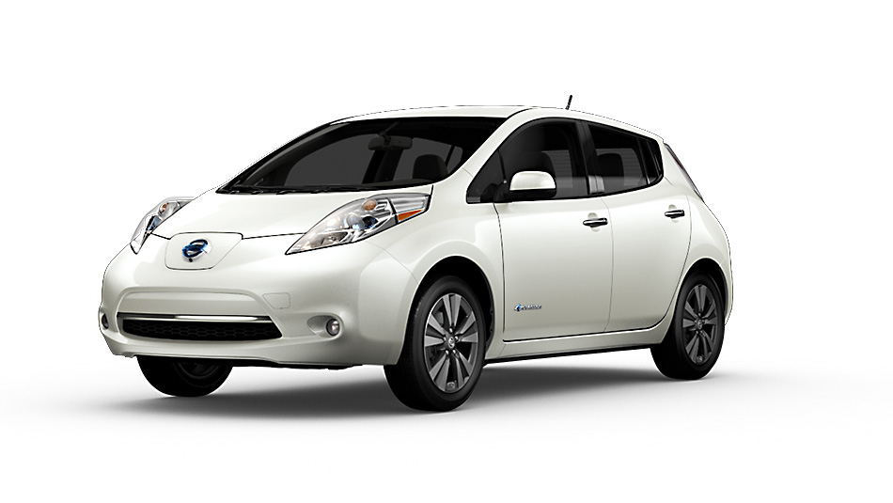
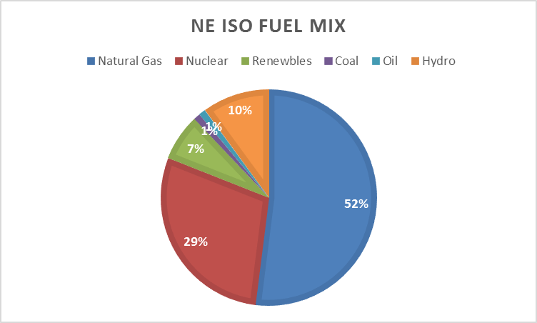
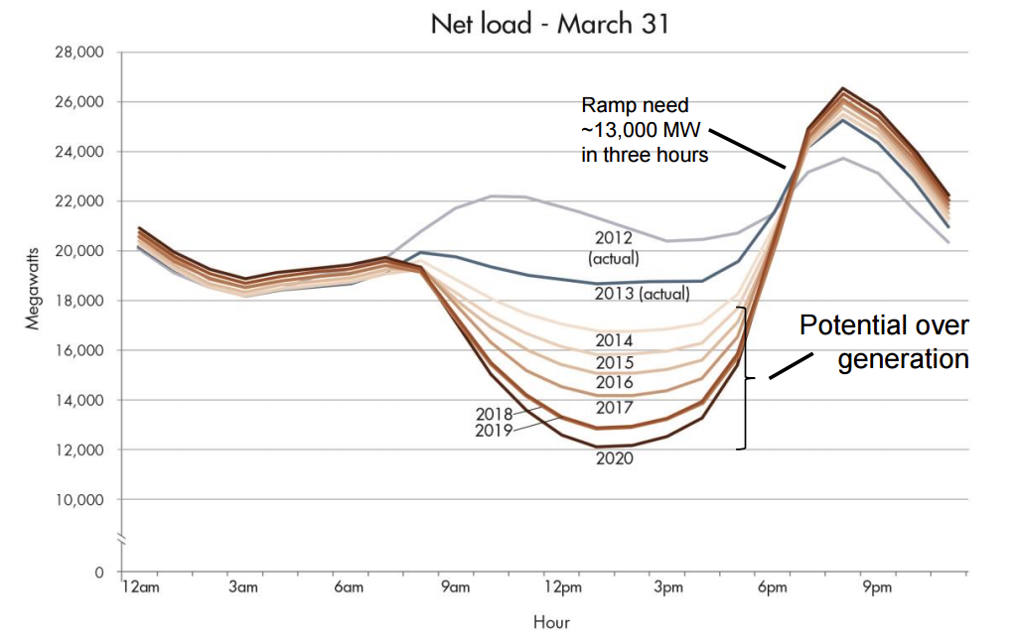
ECOCat Vehicle Selection Calculator
Joseph Verro, Stephen Pesci, and Dr. Clayton Mitchell
Departments of Chemical Engineering and Campus Planning, University of New Hampshire, Durham
Background
The UNH Mobile Fleet
Conclusions
The UNH mobile fleet consists of over 325 vehicles
In FY 2017 the fleet traveled over 2.2 million miles and used over 225,000 gallon equivalents of fuel.
Fuel costs were over $490,000 and emissions of 2,600 tons of CO²
ECOCat vehicles used over 49,000 gallon equivalents of CNG and over 69,000 gallons of B20 replacing 50,000 gals of petroleum fuel and saving UNH an estimated $100,000 while reducing CO² emissions by more than 650 tons
EcoCat is the logo for UNH-Durham fleet that run on alternative fuel (AF) such as compressed natural gas (CNG), biodiesel (B20) and electricity.
Fleet vehicles are frequently kept for 10+ years and small differences in MPG can result in large fiscal and emissions impacts
The cheapest vehicle up front can have a much greater life-cycle cost (fuel and emissions) than a higher efficiency vehicle
Alternative Fuel Vehicles will help the university become carbon neutral by 2100
The calculator supports the EV Infrastructure Policy
Plug-In Hybrids and fully Electric Vehicles will become a greater part of the UNH fleet
The time of day charging is critical to the price of fueling an EV and the upstream emissions
Figure 1: UNH screening process for new fleet vehicles
Figure 2: The UNH fleet currently contains five Nissan Leafs
“Enter Your Data Sheet”
Future Work
Introduction
Customize Values in Yellow which carry over to ALL tabs |  |  |  |  |  | Input your fuel cost | (UNH Default Prices) | Enter Estimated Escalation
 |  |  |  |  |  | CNG (gge) | $ 1.65 | -2.00%
INPUT ESTIMATED ANNUAL MILEAGE FOR VEHICLE BEING CONSIDERED: |  |  |  | 5000 |  | Regular Unleaded Gasoline (gal) | $ 2.28 | 2.00%
 |  |  |  |  |  | B20 (gal) | $ 2.13 | 2.00%
INPUT ESTIMATED DAILY MILEAGE FOR VEHICLE BEING CONSIDERED: |  |  |  | 14 |  | kWh rate (Nighttime) | $ 0.05 | 0.00%
 |  |  |  |  |  | kWh rate (Daytime) | $ 0.16 | 2.00%
 |  |  |  |  |  | Estimated nightime charging | 90%
Add your own vehicle : www. fueleconomy.gov/
Car | Fuel type | MPG | MSRP | Emission Score* |  |  |  | Are you eligble for EV tax rebate?
Vehicle Name | gasoline |  |  |  |  |  |  | Yes
For plug-in hybrid/electric vehicle | Battery Size (kWh) | Range (MI) | MPGe (Elec) | MPG (Gas) | Vehicle Charge Rate (kW) | Charge Time (hrs at 220V) |  | $ 7,500
Comparison to Popular Vehicles
 |  |  |  |  | Number of Years in Life Cycle Projection |  |  | 10
Category | Vehicle name | MSRP-Federal Rebate | Model Fuel Cost (Per Gallon) | Annual Fuel Cost | Fuel Cost | Capital and Fuel Cost | Annual Ave Cap and Fuel Cost | Estimated Total CO2 Emissions (tons) (4)
Your Own | Vehicle Name | $ - | $ 2.50 | #DIV/0! | #DIV/0! | #DIV/0! | #DIV/0! | #DIV/0!
Electric | 2017 Nissan Leaf | $ 27,500 | $ 2.11 | $ 84 | $ 836 | $ 28,336 | $ 2,834 | 0
Hybrid | 2018 Toyota Prius Eco | $ 25,165 | $ 2.50 | $ 215 | $ 2,152 | $ 27,317 | $ 2,732 | 10
Plug-in Hybid | 2017 Toyota Prius Prime | $ 19,600 | See EV | $ 79 | $ 792 | $ 20,392 | $ 2,039 | 6
Conventional ICE | 2018 Chevrolet Sonic | $ 16,870 | $ 2.50 | $ 499 | $ 4,993 | $ 21,863 | $ 2,186 | 23
Biodiesel | 2018 Chevrolet Cruze | $ 16,975 | $ 2.33 | $ 376 | $ 3,762 | $ 20,737 | $ 2,074 | 15
CNG | 2015 Honda Civic | $ 24,150 | $ 1.51 | $ 446 | $ 4,458 | $ 28,608 | $ 2,861 | 21
SUV Hybrid | 2018 Toyota Rav4 | $ 27,135 | $ 2.50 | $ 367 | $ 3,671 | $ 30,806 | $ 3,081 | 17
Truck | 2018 Colorado 2.5L | $ 20,000 | $ 2.50 | $ 624 | $ 6,241 | $ 27,343 | $ 2,734 | 29
Van 1/2 Ton | 2018 Chevrolet City Express | $ 22,405 | $ 2.50 | $ 520 | $ 5,201 | $ 27,606 | $ 2,761 | 24
Van 3/4 Ton | 2017 Chevrolet 2500 4.8L | $ 31,940 | $ 2.50 | $ 693 | $ 6,935 | $ 38,875 | $ 3,887 | 32
Van 1 Ton | 2017 Chevrolet 3500 6.0L | $ 33,140 | $ 2.50 | $ 1,248 | $ 12,483 | $ 45,623 | $ 4,562 | 58
Police | 2018 Ford Utility 3.5L Ecoboost (AWD) | $ 32,205 | $ 2.50 | $ 832 | $ 8,322 | $ 40,527 | $ 4,053 | 38
Police Hybrid | 2019 Ford Hybrid Responder 2.0L | $ 30,035 | $ 2.50 | $ 312 | $ 3,121 | $ 33,156 | $ 3,316 | 14
* From USDOE/EPA website 10 is best in class tailpipe emissions http://www.fueleconomy.gov/
Evaluate the long-term maintenance costs of ICE’s vs EV’s
Present tool to fleet managers and AF companies at GSCCC “Green Your Fleet Workshop”
Educate the Durham community and Public on life-cycle costs of AFV’s vs. conventional vehicles
Continue to show positive effects of fleet electrification
“Perfection is a moving target”
UNH has incrementally introduced AFV’s to help push towards WildCAP Goals
Through the Clean Fleet Program UNH promotes low emission, high efficiency vehicles to replace the existing fleet
The University has developed a tool to facilitate wise fiscal and environmental decision making regarding campus mobility needs.
The tool incorporates vehicle price, MPG, and CO² emissions to calculate full lifecycle costs and emissions.
The calculator promotes sustainability while focusing on sizing based on need
Acknowledgements
Thank you to Stephen Pesci, Ray Myatt, Matt O’Keefe, Dr. Clayton Mitchell for their project collaboration
Thank you to the UNH ETF and SI for their support
Thank you to the GSCCC DES for helping spread the leading work UNH is doing with its fleet
Thank you to Dr. Kang Wu, Dr. Russell Carr, and Dr. Paul Tsang for allowing this project to have academic affiliation
Data
Graphs, Etc… Here
The Selection Calculator is a spreadsheet tool preloaded with vehicles screened by the UNH fleet manager
Evaluated categories include passenger cars, vans and pickups, and special purpose vehicles
The calculator also provides details on available electric vehicles to educate subjects on the emerging technologies
The ‘Data’ sheet is set up for conditions on the UNH campus, but can be customized for personal use
References
"Find and Compare Cars - FuelEconomy.gov". [Online]. Available: https://fueleconomy.gov/feg/findacar.shtml. [Accessed: 2018].
"Alternative Fuels Data Center: Tools". [Online]. Available: https://www.afdc.energy.gov/tools. [Accessed: 2018].
"WildCAP - UNH's Climate Action Plan | Sustainability Institute". [Online]. Available: https://sustainableunh.unh.edu/wildcap. [Accessed: 2018].
"EcoCat Vehicle Selection Calculator | University of New ...". [Online]. Available: https://www.unh.edu/facilities/ecocat-vehicle-selection-calculator. [Accessed: 2018].
Figure 3: Fuel mix for electricity generation for the New England Region
Figure 4: Electricity Demand Curve on a normal load day

