Slide 1

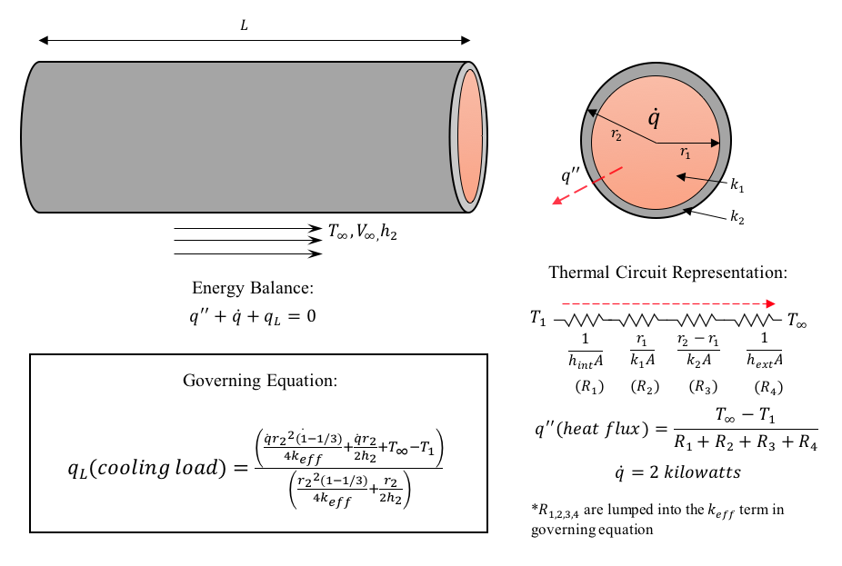
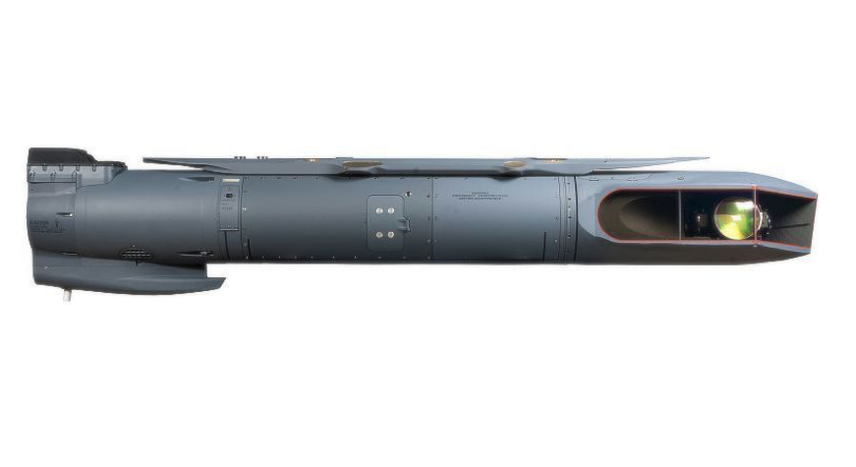
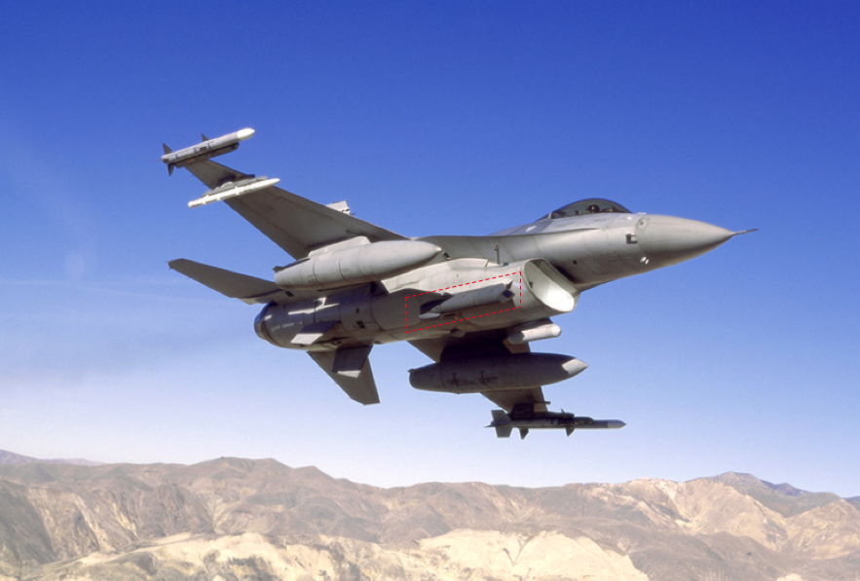

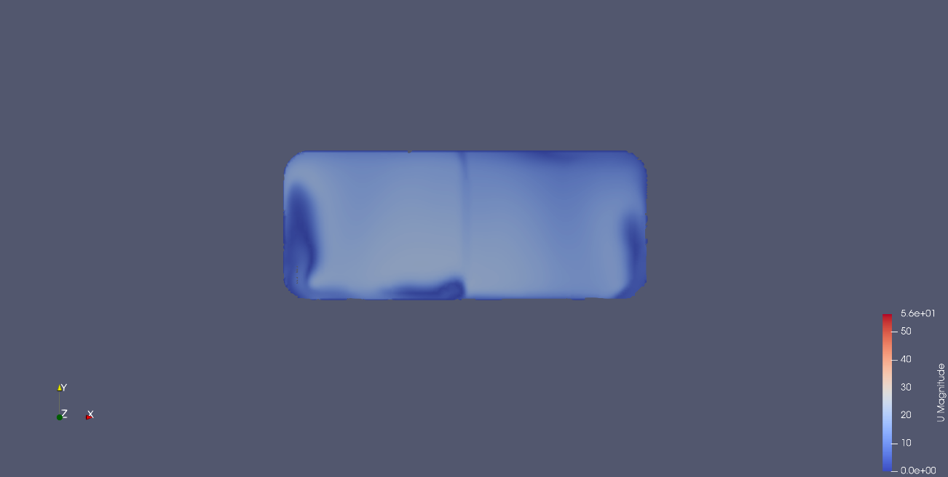
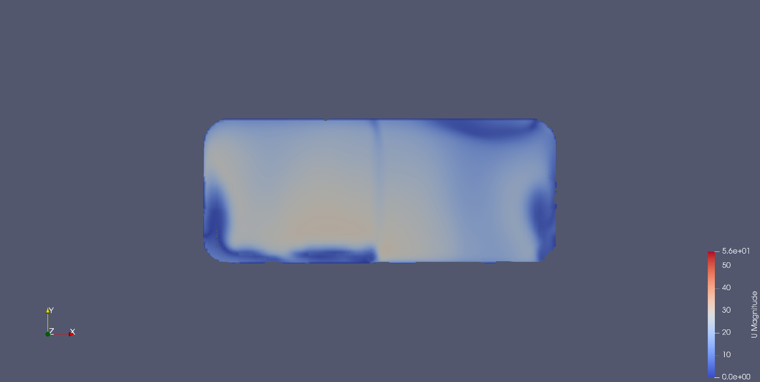
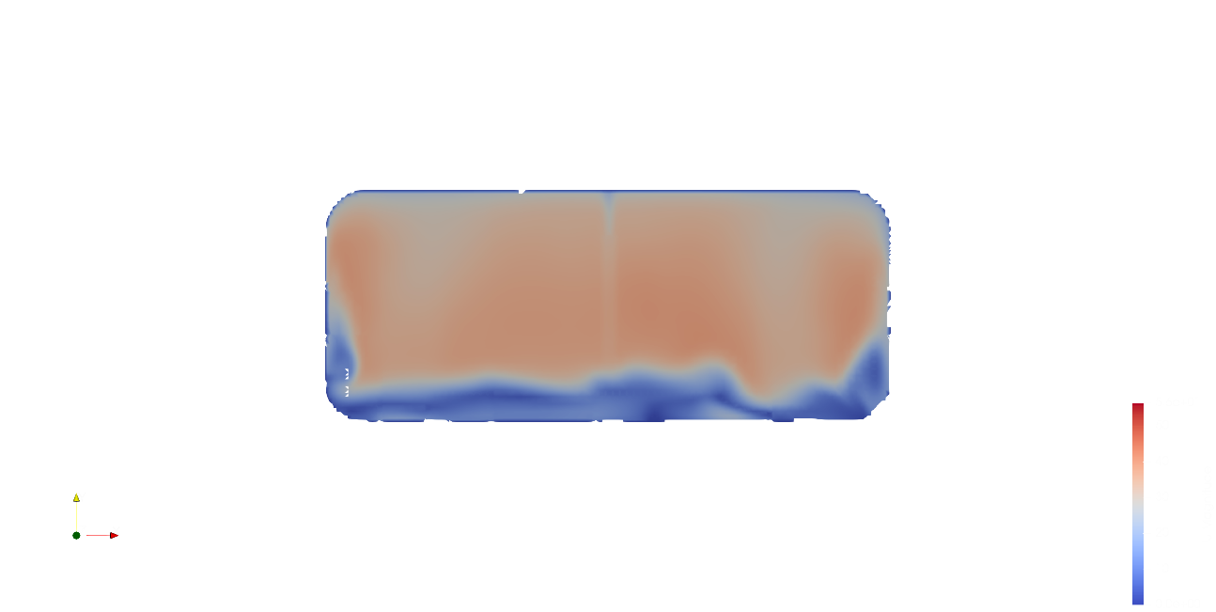
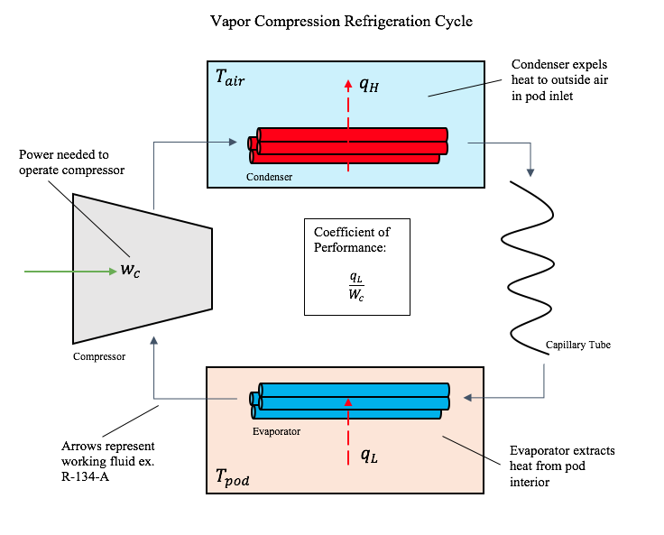
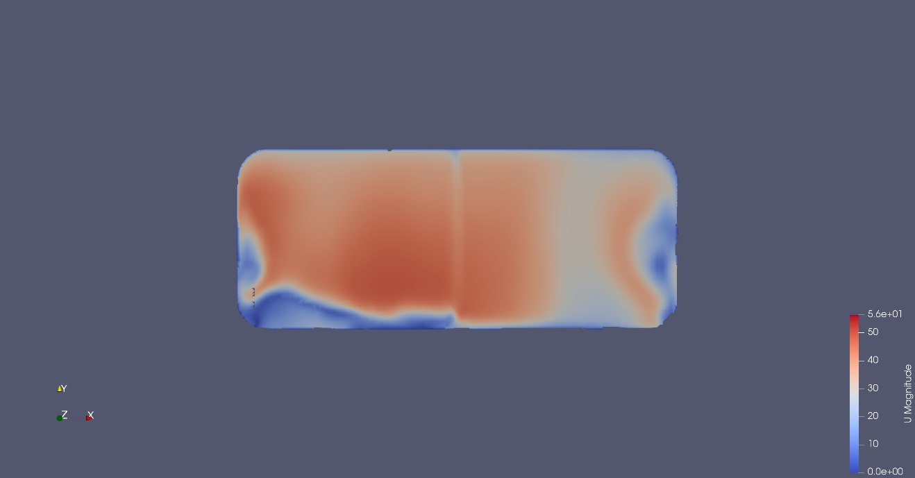
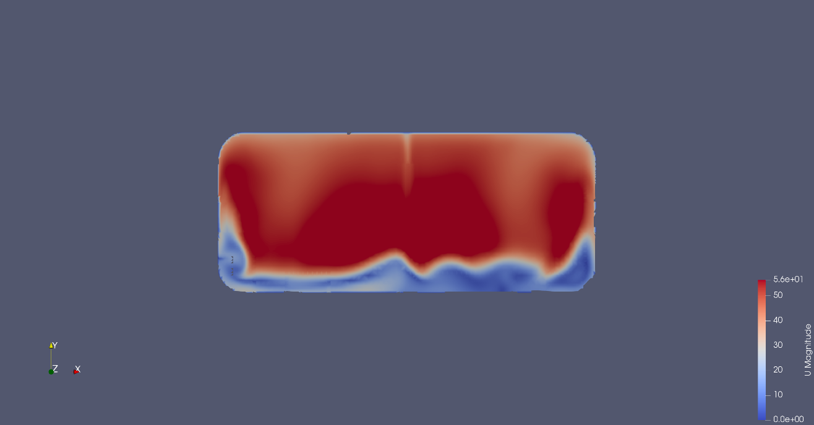
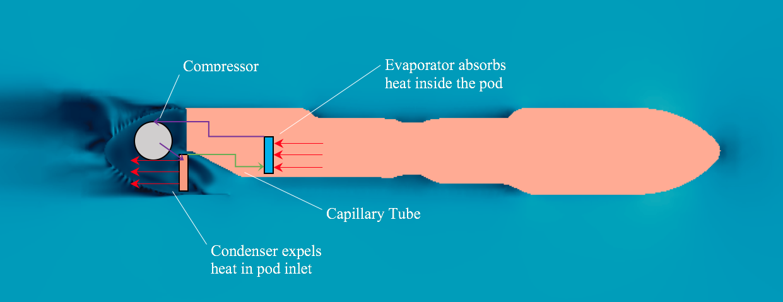
UAV Electronics Cooling System
Samuel Whitmore | Nicholas Doiron
Advisor: Chris White
Background and Objective
Theoretical Modeling
Numerical Results
In recent years there has been a transition towards unmanned aerial vehicles (UAVs) to carry out military operations. These UAVs have significantly less power than traditional combat vehicles. Their missions are carried out by electronic equipment that is temperature sensitive and must be actively cooled. Because of the UAV’s low power, off the shelf cooling systems are too heavy. Our efforts are geared toward reducing this systems cooling load, therefore allowing it to be more lightweight.
To gain a better understanding of the physics of our system, we performed analytical heat transfer simulations to find cooling load requirements under various operating conditions.
External temperature was varied from 0-40 °C (32-104 °F)
UAV speed was investigated from 0-60 m/s (0-134 mph)
Our numerical work focused on analyzing the external flows around the pod to find mass flow rate through the inlet scoop as a function of UAV speed. This determines mass flow rate of air through the condenser of a future vapor compression cycle, which determines in part the cooling capability of the cycle.
Normalized Mass Flow vs. Wind Speed
Mass flow through the inlet remains between 80% and 90% of possible mass flow depending on speed. These losses are due to the air flow’s interaction with the pod geometry.
Non-Insulated Cooling Load
Normalized Mass Flow
A current Lockheed Martin payload pod.
Weight: 446 lb
The results of our initial evaluation show that the cooling load varies dramatically as a result of the external conditions. In addition, a heating load is required with cold external temperatures at high speeds. To avoid this, providing a layer of insulation to the pod was investigated.
Wind Speed (m/s)
Cooling Load (W)
Below are simulations of air velocity passing through the pod inlet at different UAV speeds. There is a clear speeding up of the air as the UAV gains speed, which is the anticipated result.
A traditional military vehicle like this F-16 has the appropriate power to operate with a currently available pod.
Temperature (°C)
Air Speed (m/s)
10 m/s UAV Speed
20 m/s UAV Speed
Insulated Cooling Load
With a 1” thick layer of insulation applied, the need for heating has been eliminated. In addition, the highest level of cooling required has been significantly reduced.
30 m/s UAV Speed
40 m/s UAV Speed
Cooling Load (W)
50 m/s UAV Speed
60 m/s UAV Speed
The vapor compression cycle is the most common modern form of a cooling cycle. It is the basis for our cooling considerations.
Temperature (°C)
Air Speed (m/s)
Note: All “U Magnitude” values are in meters per second.
Experimental Results
Conclusions/Future Work
Our main findings:
  Forcing convection within the pod is an effective method of reducing cooling requirements.
  Insulating the pod is a necessity to avoid a heating requirement
  Over the operating range of speeds, mass flow rate over the condenser is linearly related to UAV speed
Future work:
  Numerically simulate the natural convective effects as well as forced convection inside pod
  Incorporate this year’s findings into sizing and design of vapor compression cycle components
Effects of Air Speed on Pod Temperature
Effects of Air Speed on Pod Temperature
To test the validity of our theoretical analysis, a model pod was created for testing in a wind tunnel. The effects of varying wind speed over the pod as well as operating an internal fan were investigated.
Our findings reinforced our theoretical model, showing that increasing wind speed results in lower internal temperature. The fan moved the high temperature regions within the pod toward the walls so that heat would be more effectively transferred.
Average Internal Temperature (°C)
Average Internal Temperature (°C)
Above is a schematic of our pod. Cold air passes through the inlet and over the condenser, extracting heat from the pod. The amount of heat transferred is proportional to the amount of flow here.
Time (minutes)
Time (minutes)

