Slide 1
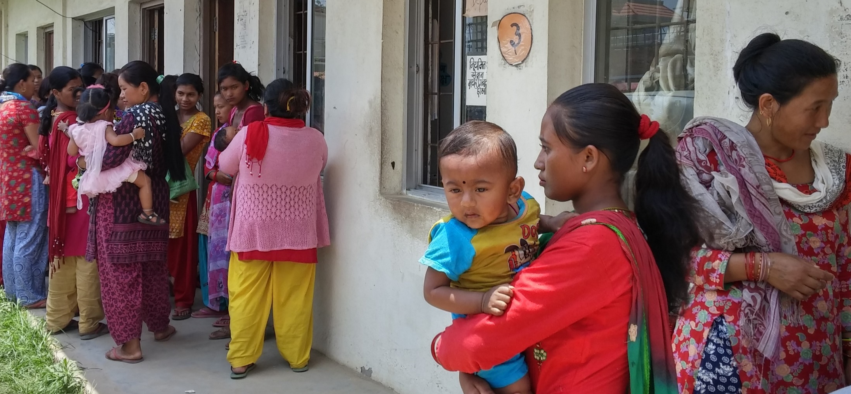
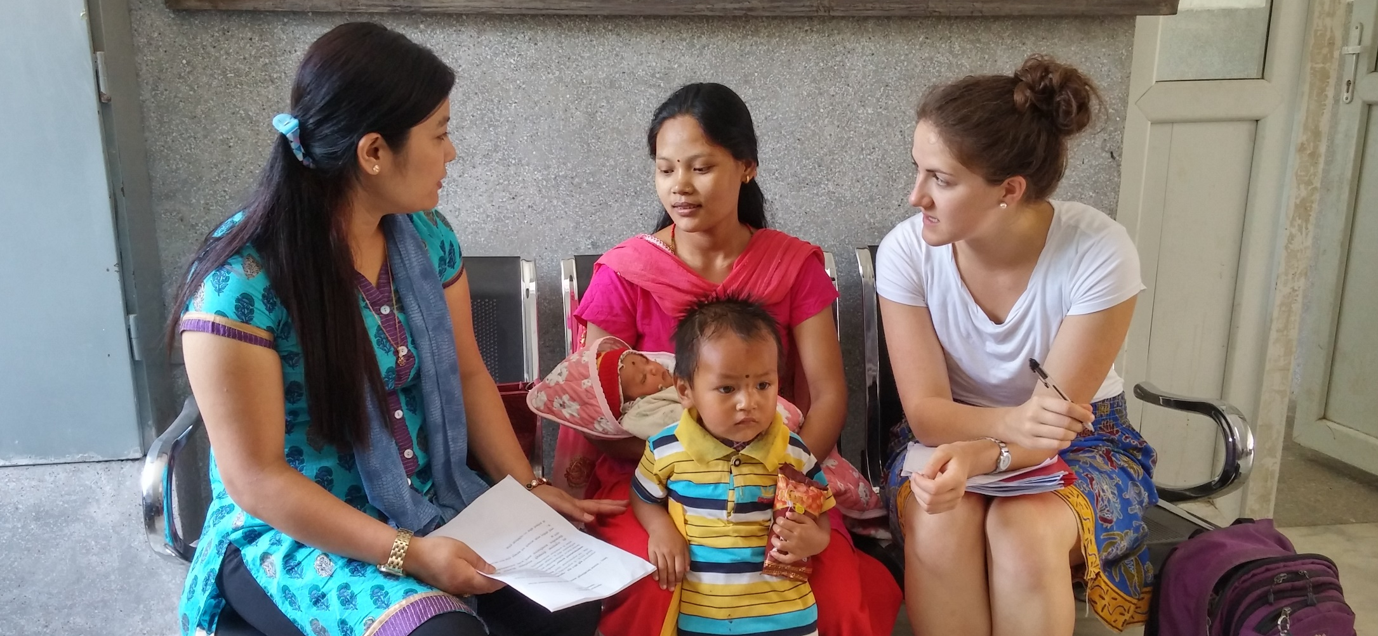
Care Seeking Behaviors of Nepali Mothers
Marin Strong
Department of Nursing
University of New Hampshire
Funded by UNH – SURF Abroad
Introduction
Results
Mothers’ Narratives
6 million children under-five died from preventable illness in 2015
Sustainable Development Goal 3:
  Reduce the under-five child mortality rate to 25 deaths per 1,000 live births
  Nepal’s under-five mortality rate in 2015 was 36 deaths in 1,000 live births
Delay in appropriate care-seeking behaviors contribute largely to the number of child deaths in developing countries
Challenges
  Waiting, long distances, financial strain, lack of resource/facility
Enabling Factors
  Free of cost, good treatment, good doctor, proximity to home
Suggestions
  Reduce waiting time, improve resources, increase services & available treatment, change reliability of doctors, make emergency services available
Mother (n=25) | Mean
Age | 25 yrs
Age at marriage | 20 yrs
Age at birth 1st child | 21 yrs
Education grade | 10th grade
Family income | Rs 29,826 ($288.72)
Occupation | Housewife
Child (n=25)
Female | 56%
Male | 44%
Age | 1.5 yrs
Birth order | First born
Aim
Conclusions
Describe how mothers report their care-seeking behaviors when their child, under the age of five, suffers from an illness
Do you think your child’s illness was severe?
Complex factors influence mothers’ decisions to seek care for their ill child including
  Traditional healing beliefs and practices
  Gaps in knowledge about childhood illness danger signs
Theory
58% Yes
48% No
Adapted from “A Behavioral Model of Health Services Use”
Did you seek care within 24 hours?
Discussion
Contextual Characteristics
Individual Characteristics
Health
Behaviors
Outcomes
29% Yes
71% No
10% Yes
90% No
Engagement of communities to improve recognition of danger signs of childhood illness
Further research to capture the relationship of the traditional healer within the Nepali health care system
  First Action Once Ill
  36% Traditional home treatment
  16% Purchase medication from a pharmacy
  16% Visit a traditional healer
  Reason for first action
  44% Personal belief
  24% Access barrier
  20% Convenience
Limitations
Methods
Translation/language barrier
Small sample size
Being an outsider
Short data collection period
Mixed methods: quantitative and qualitative
Survey questionnaire adapted from Sreeramareddy, et al. (2006) with permission
Interpreter assisted with data collection
Semi-structured interviews
Convenience sample of women waiting in health post/primary health center
  Inclusion Criteria: child <5 years old, ill ≤30 days
  Exclusion Criteria: child >5 years old, ill >30 days ago
  Verbal informed consent
Do you believe in traditional healers?
67% Yes
33% No
Have you visited a traditional healer before?
94% Yes
6% No
44% Yes
56% No
  Tell me more about visiting the traditional healer
  28% Visiting was dependent on situation
  24% Visited in order to worship/pray
  20% Visited due to a previous experience
  12% Visited without it being their own choice
Danger Signs of Childhood Illness
Acknowledgements
Seven Danger Signs
  Mean correct identification = 3.92
Five False Danger Signs
  Mean correct Identification = 1.92
Many thanks to:
Dr. Gene Harkless, UNH mentor
Mamata Sherpa Awasthi, Nepal mentor
Dr. Joanne Samuels, Honors mentor
Hamel Center for Undergraduate Research

