Slide 1

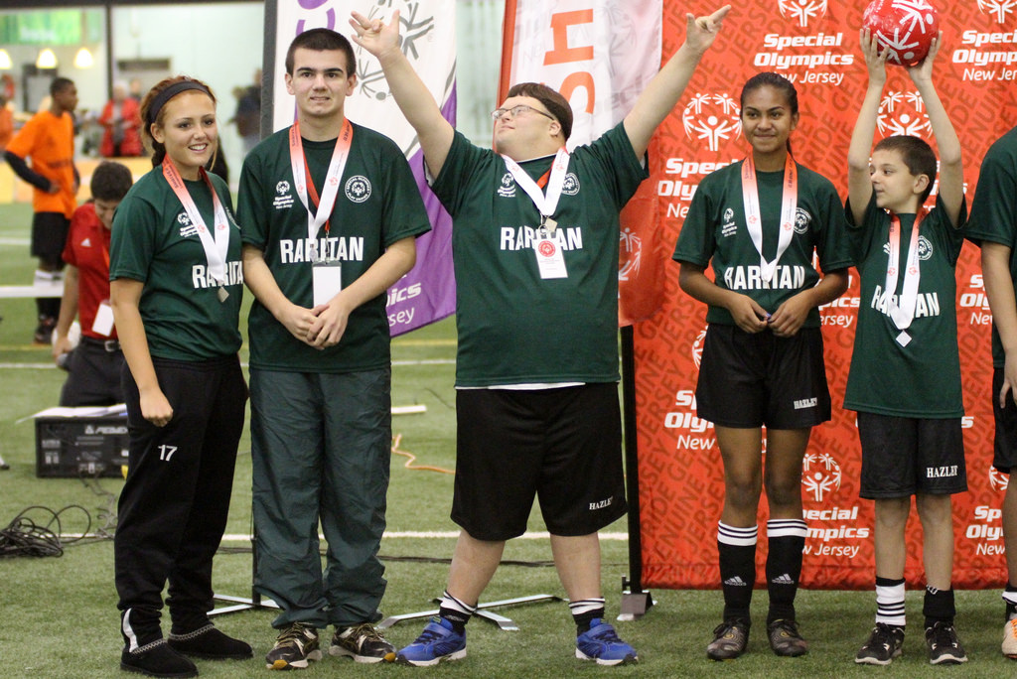
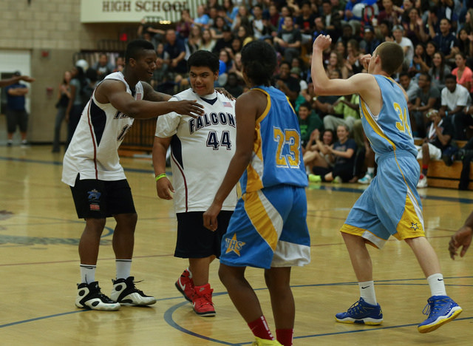
Including Students with Disabilities in High School Athletics in Northern New England
Molly Wotton, Robert J. Barcelona, Matthew Frye
Department of Recreation Management & Policy, University of New Hampshire
background
methodology
More than 25 years have passed since the Americans with Disabilities Act (ADA) became law in the United States.
More than 40 years have passed since the Individuals with Disabilities Education Act (IDEA) was enacted by Congress
  Despite legislation supporting access and inclusion with persons with disabilities, opportunities to participate in high school athletic programs are still limited
8 state high school athletics associations report having at least one member school with an adapted sports program
4 state associations reported having at least one member school offering unified sport opportunities
One state association reported having at least one member school offering allied sports
People with disabilities have been found to be less likely to engage in regular moderate physical activity (found in organized sports), than people without disabilities
UNH institutional Review Board (IRB) permission was sought and granted to conduct the study
A request to participate in the study and a link to an online survey measuring perceptions of inclusion efforts for students with disabilities in high school athletics programs was sent to all NH high school athletic directors with publicly listed emails
31 of 94 (33%) athletic directors responded to the survey
Responses were representative of geographic location, school size, and job experience
Both photos above represent the Special Olympics Unified sports that occur in high schools around the country, combing students on teams with and without intellectual or physical disabilites.
discussion
Athletic Directors are interested in including more AWD’s in high school sport programs
More knowledge, resources, and support are needed to facilitate inclusion
Opportunities exist for policy-oriented solutions (awarding varsity letters, partnering across district lines, referral processes)
Knowledge
Knowledge on a scale from 0 to 7 (0 being no knowledge and 7 being knowledgeable)
Athletic Director knowledge: 6.95 (SD 1.74)
Coach Knowledge: 5.61 (SD 2.09)
Facilitators of inclusion: Disability related training for coaches; Staffing support (paraprofessionals); Financial support; Material support (adaptive equipment, training aides, etc.); Access to expert conclusion
Study purpose
This study seeks to understand the current practices related to the inclusion of students with disabilities in high school sports in Northern New England
To identify the specific needs of high school athletic directors that may facilitate the further inclusion of youth with disabilities in sport programs & identify barriers/ constraints to inclusion.
The results from this research will be used to assist school districts and high school athletic departments better meet the physical, cognitive, emotional, and social needs of students with disabilities through more active participation in high school sports programs
Future research
Expand study to include other athletic departments in Vermont and Maine
Understand the barriers to inclusion for AWD’s
AD Responses | Percent | N
Plan to increase inclusion of AWD’s in next 3 years | 74.1% | 20
Have met with administration to develop inclusion process for AWD’s | 51.7% | 15
Would partner with other schools to create teams for AWD’s | 64.3% | 18
Would/ consider using a referral process to community sport programs for AWD’s | 96.4% | 27
Would allow AWD’s to earn Varsity letters for participating in non-school sports | 96.2% | 25
Acknowledgements
I would like to thank my advisor, Robert J. Barcelone, and Matthew Frye, M.S., for their help with data analysis and coding. I would also like to thank all athletic directors who participated in this study.

