Slide 1


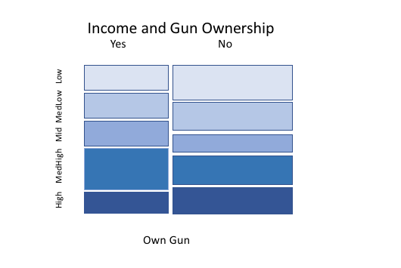
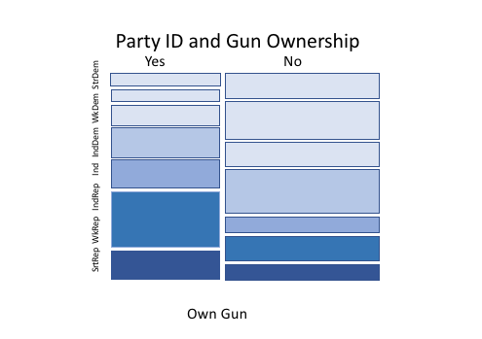
INCOME & GUN OWNERSHIP
Does income have an effect on gun ownership?
Bryce Cahill
Department of Political Science, University of New Hampshire
Introduction
Results
Discussion
.
.
Hypothesis: In a comparison of individuals, those with lower income will be more likely to own a gun .
Income (rincom06_5) and gun ownership (owngun) were compared in the GSS dataset
.
.
.
Based on the methods tested, weather one owns a gun or not is more dependent on party identification than income. For party ID we see a high chi-square (109.5) and a low P-value (<2e-16). Where for the income this is opposite (chi2=14.6, P-value= .07). This high chi-square value for party ID shows us that this variable has a more profound effect on gun ownership, and less likely to be random sampling error. For income this is opposite.
The Somers D value for party ID is .12 and for income it is .04. This shows that we can increase our predictions by 12% and 4%.
For party ID because the P-value is less than .05 we can reject the null hypothesis and for income the P-value (.07) is greater than .05 so we can accept the null hypothesis.
Methods
.
.
.
.
.
Gun ownership is more common among men than women
Those in rural areas are more likely to own a gun
Republican and republican learning independents are more likely to own a gun than democrats
For those with a single gun, handgun ownership is most common
67% of gun owners say their primary reason for owning a gun is for protection
.
.
.
.
To test income’s effect on gun ownership R Studio was used. This software is used to compare different variables in certain data sets
Cross tabulations and mosaic plots are used to provide a visual comparison of variables
The Chi-Square and Somers D test show the strength between the dependent and independent variable. Values of the chi-square test that are close to 0 are within the domain of the null hypothesis, as chi-square increases the null hypothesis (“it all happened by chance”) becomes increasingly implausible. Somers D shows a value that allows one to improve their prediction by a certain percentage. It also shows weather the relationship between the dependent and independent variables are negative or positive.
The P-Value is the probability of attaining the sample difference under the assumption that the null hypothesis is true
Income level
References
Party Identification
Contacts
Mitchell, Travis. “1. The Demographics of Gun Ownership.” Pew Research Center’s Social & Demographic Trends Project, 22 June 2017, www.pewsocialtrends.org/2017/06/22/the demographics-of-gun-ownership/.
      Email: brc2005@wildcats.unh.edu
      Phone: (978)-395 -1508
“This Is What the Modern Gun Owner Looks Like.” The Trace, Harvard, 20 Sept. 2016, www.thetrace.org/2016/09/modern-gun-owner harvard-northeastern-survey/.

Slide 2

This poster template provided courtesy of
UNH ESRC Poster Printing Services
Trust us to make your poster look GREAT!
Website: http://posters.unh.edu
Poster Guide: http://goo.gl/1E7TJY
DELETE THIS SLIDE BEFORE PRINTING

