Slide 1

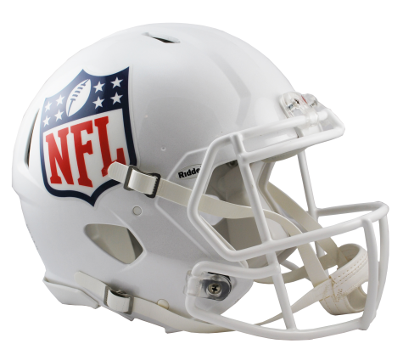
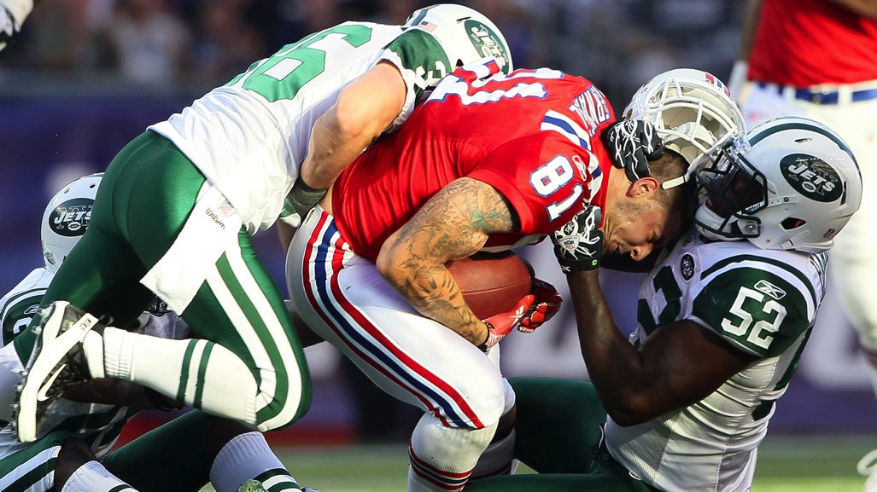
Concussions, C.T.E., and Professional Sports
By: Connor MacLean
Contact: cm2010@wildcats.unh.edu
Homepage
Background Info
Impact/Significance
Different Levels of Sport
Interviews
About Me/ Interest
Solutions
Polls
Risks
Photos/Videos
Statistics
Legal Issues
Introduction:
C.T.E. or Chronic Traumatic Encephalopathy is a degenerative brain disease that can affect motor skills, cognitive ability, and retention of memory. C.T.E. is caused by repeated concussions (head injuries). Concussions are extremely common in contact sports like football. C.T.E. is a hot topic right now as the brain disease affects many former and current players. In addition, there have been several large lawsuits filed against the NFL due to the harmful nature of the disease. CTE and its harmful effects got increased attention after former NFL player Junior Seau commit suicide and preserved his brain in order for scientists to study the effects of the harmful disease.
Concussions and head injuries have always been apart of contact sports, but we are now uncovering the harmful long-term health effects associated with them. Scientists have studied many deceased players brains in order to learn more about the disease. So far, scientists have linked 110 deceased players to C.T.E. In fact, even one living player has been linked to C.T.E. Overall, C.T.E. is a very important topic in the sports world right now as it effects: player health, safety rules, how football is played, and the overall operation of the NFL as a whole. C.T.E. is not a disease that only affects professional athletes; youth and collegiate football players are at risk of this crippling disease as well. As one can see, C.T.E. is an extremely harmful disease and ultimately a viable solution to the issue must be found.
Website Design:
Purpose:
Hello, my name is Connor MacLean and I am a senior at the University of New Hampshire. For my professional and technical writing class I have been assigned to design a website on a topic of my choice. After careful consideration, I decided to make my website and topic about C.T.E. in professional football. Being a huge sports fan I wanted to make my website about a topic that was interesting to me, but also about something that is recognizable to a wide audience. Professional sports are a massive industry in the United States and brain injuries such as C.T.E. are an extremely controversial and hot topic. C.T.E. is a degenerative brain disease that occurs due to repeated hits suffered in contact sports. My topic is important because brain injuries are extremely harmful to players and are often overlooked by many fans, owners, and players themselves.
Methods:
The website will be made using a template from the online platform Wix. In addition, I will use Microsoft word to write and insert my textual information into my website. For my tables and graphs I will also use Microsoft word to create them and insert them into my website. I will use Google and other search engines to do further research about the topic (also to include photos). In addition, I will use YouTube as I found many relevant videos that illustrate the C.T.E. issue as a whole.
Research:
This topic was researched and presented through a number of key steps:
A careful analysis identifying the different target audience groups involved
Identifying the needs and problems that must be addressed
The 20 Website Analysis, looking at a number of websites that are relevant to the topic
Research for Proposal
Website Design
The steps listed above were crucial in identifying the important issues surrounding the topic and helped organize the relevant information.
Conclusion:
After doing preliminary research and carefully analyzing related websites, there are several key conclusions that can be made. The major audience groups that are targeted within the topic are: the general public, parents of youth athletes, NFL players, and NFL owners/executives. All of these groups have interest in the topic and play different roles in solving the C.T.E. issue. One large group that was underrepresented was fans. Fans play a large role in the operation of the league and ultimately care about the league’s integrity. Overall, C.T.E. is an extremely harmful disease and the groups identified must come together and work towards a solution for head injuries in contact sports. The league has taken several steps in combating the issue, such as banning certain helmet models.
Works Cited:
Goldman, Tom. “Repeated Head Hits, Not Just Concussions, May Lead To A Type Of
Chronic Brain Damage.” WPSU, radio.wpsu.org/post/repeated-head-hits-not-
concussions-may-be-behind-type-chronic-brain-damage.
http://www.riddell.com/nfl-shield-logo-nfl-on-field-authentic-full-size-helmet-1.html
https://unh.edu/cpa/logos/

