Slide 1

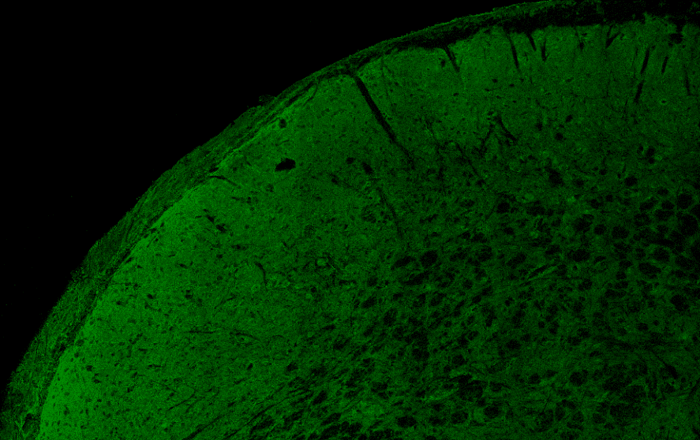
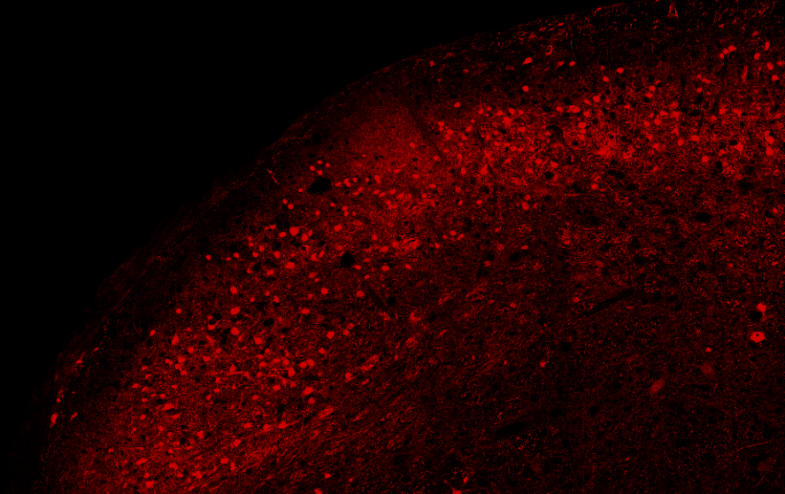
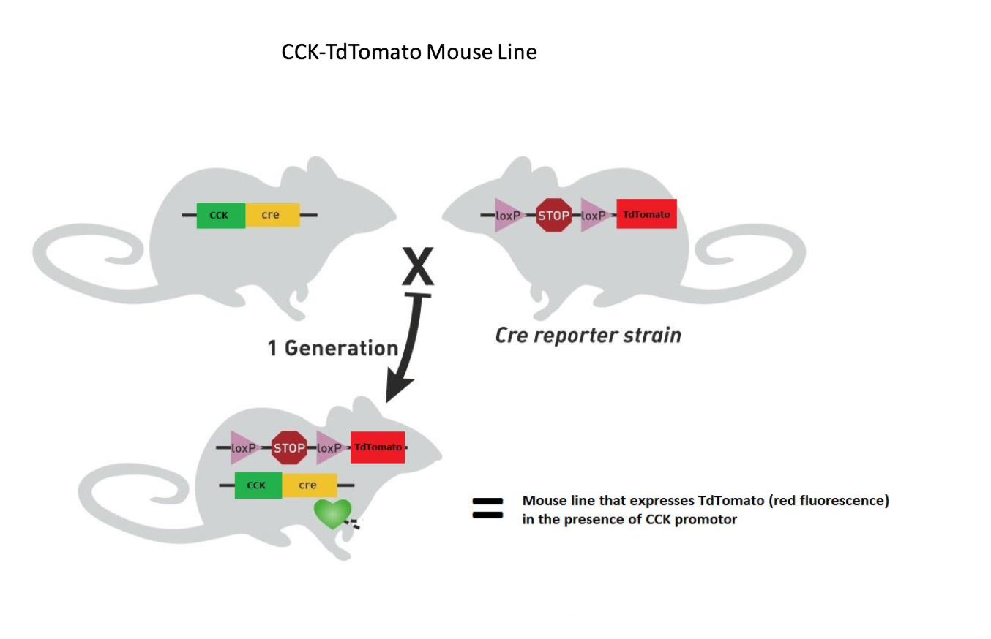
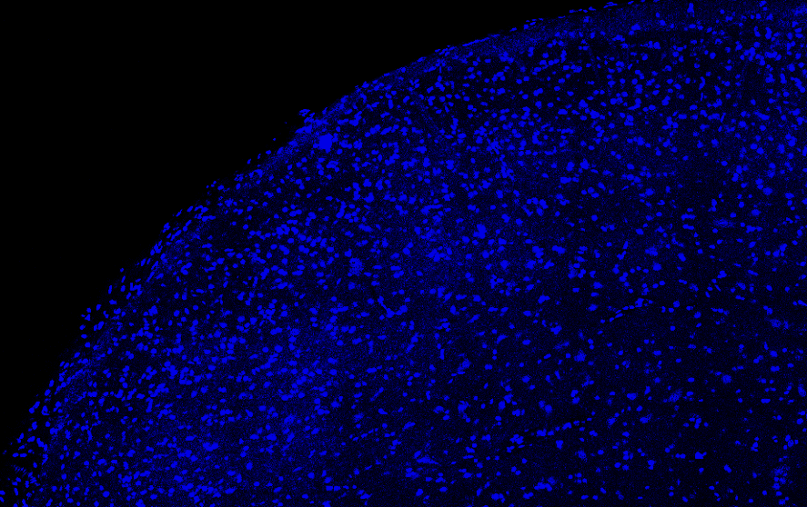
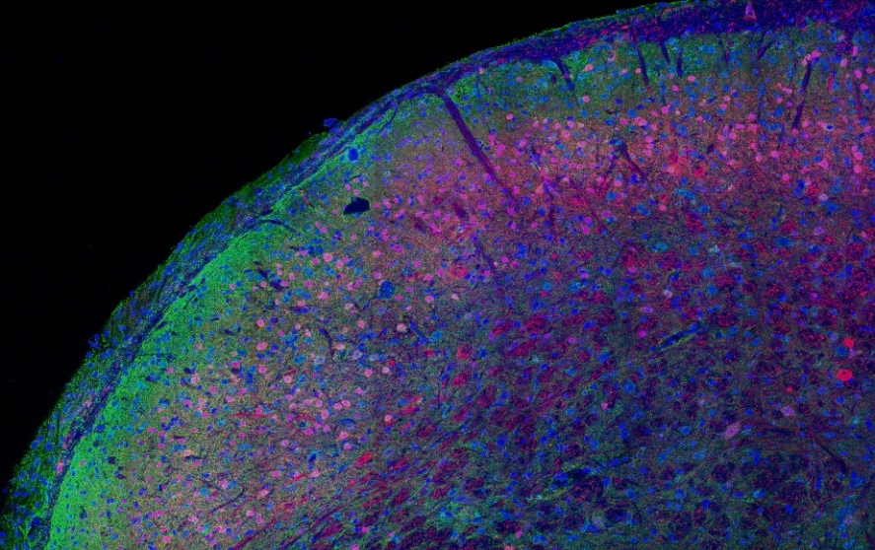
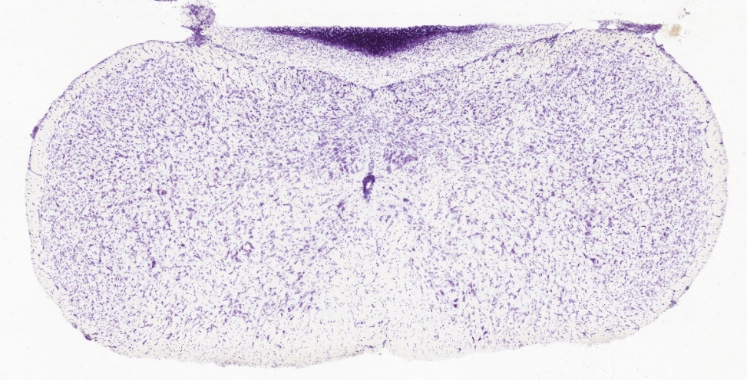
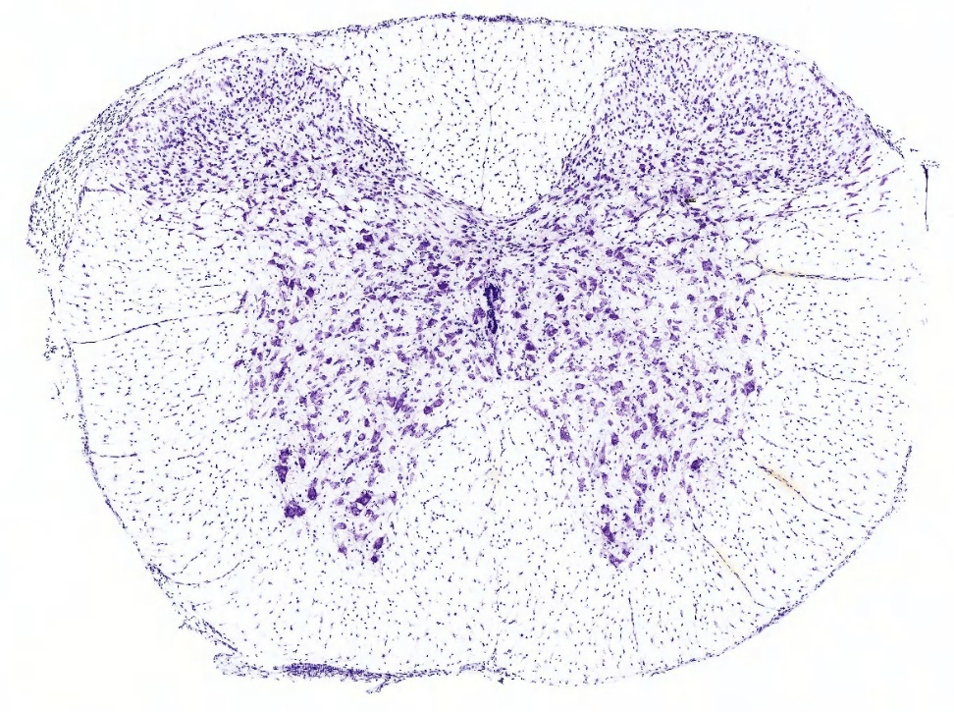
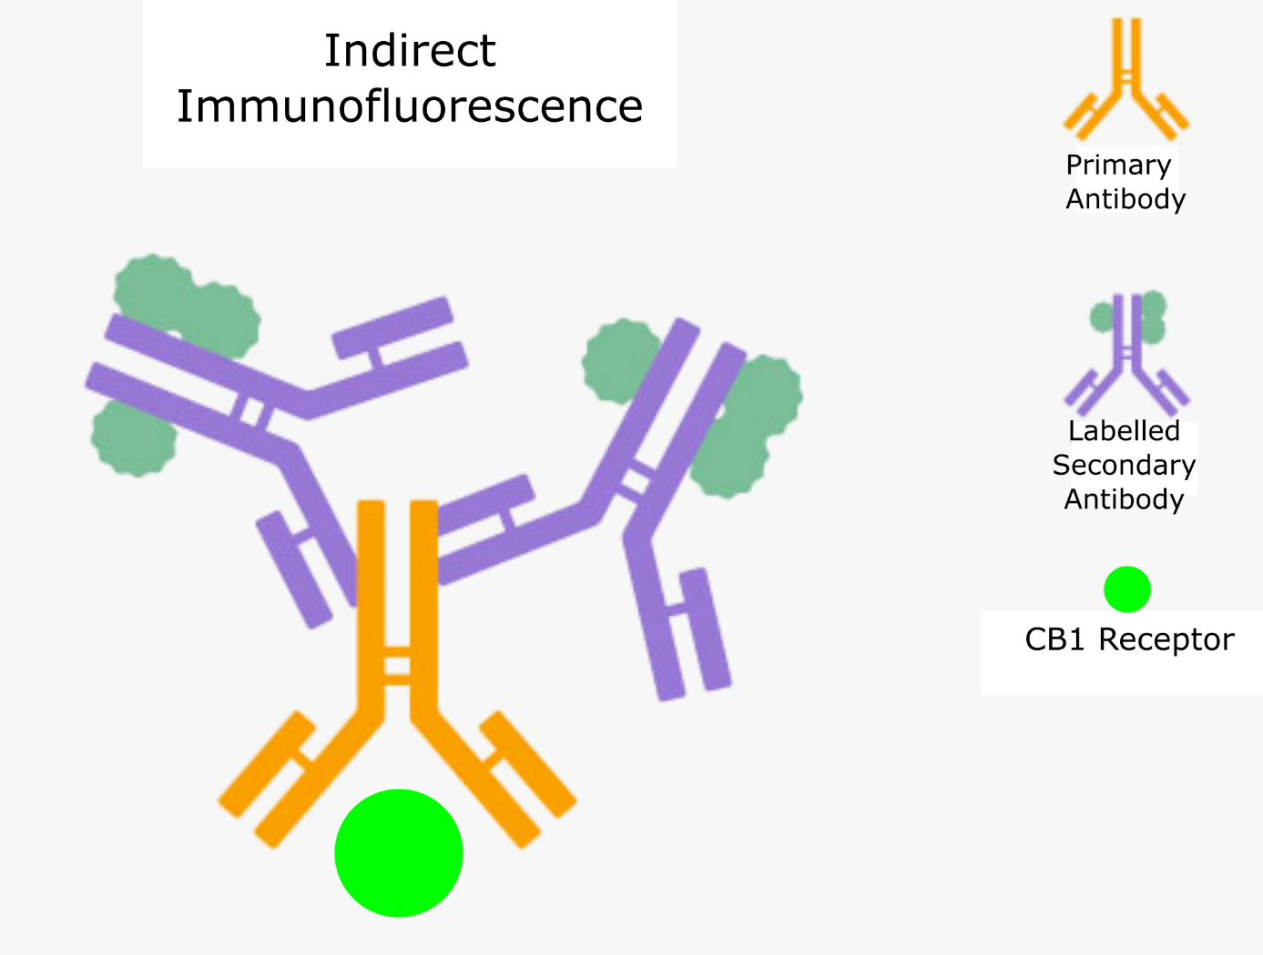
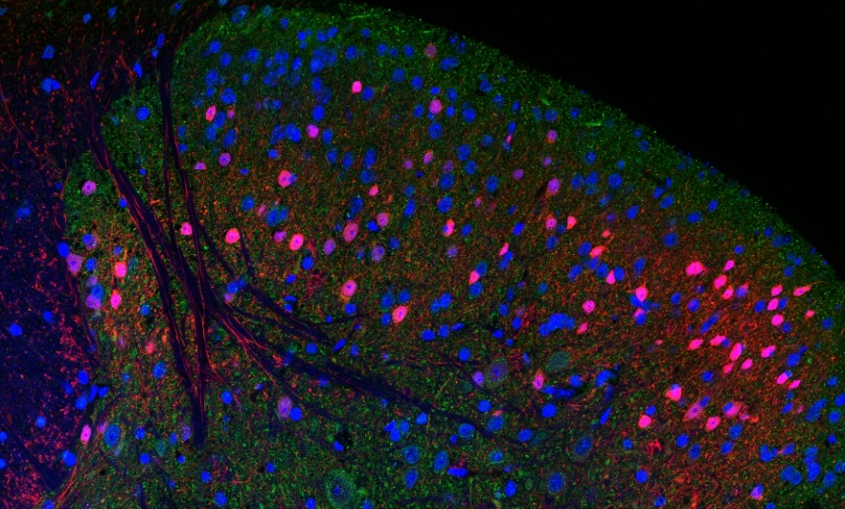
Histochemical Analysis of CB1 Expression in CCK Positive Neurons in the Spinal Cord and Trigeminal nucleus
Julian Brown, Arturo Andrade, PhD.
University of New Hampshire
Background
Methodology (Continued)
Figure 5: 40x Tile scan of the Trigeminal Nucleus Top left: Alexa 488 signal indicating CB1 receptor expression. Top Right: TdTomato signal indicating CCK(+) cells. Bottom Left: TO-PRO-3 od DNA indicating all cell bodies. Bottom Right: Composite Image
The Spinal Cord and Trigeminal Nucleus:
In the spinal dorsal horns, nociceptive inputs enter the central nervous system where they can be processed and transmitted to the brain (Figure 1)
Nociceptive inputs from above the neck enter the trigeminal nucleus where they are initially processed and sent to the brain (Figure 2)
Figure 3: Schematic of Cre-LoxP recombination to create a mouse line which expresses tdTomato in CCK(+) cells
Figure 1 (Left): Nissl stain of the brain stem, highlighting the trigeminal nucleus
Figure 2 (Right): Nissl Stain of the mouse spinal cord, highlighting the dorsal horn (Allen Mouse Brain atlas)
Cholecystokinin (CCK)
Antagonizes opioid mediated functions including analgesia
Linked to morphine tolerance
Anxiogenic effects in both human and animal models
Induces panic attacks in patients with panic disorders
Cannabinoids
Cannabinoids and endocannabinoids modulate neurotransmission presynaptically through the Cannabinoid Receptor 1 (CB1)
Cannabinoids and endocannabinoids have potent analgesic on multiple types of pain including neuropathic pain
Interactions of CCK and CB1 receptor
Colocalization of the CCK and CB1 receptor has been shown in forebrain areas and hippocampus (Marsicano & Lutz, 1999)
CB1 inhibits anxiogenic effect of CCK (Kurrikoff, Inno, Matsui, & Vasar, 2008)
No studies found have examined interactions of CB1 and CCK in the spinal cord or trigeminal nucleus.
Stained sections were mounted and imaged with confocal microscopy
Images were using ImageJ to quantify rates of Alexa 488 signaling and compare between CCK (+) and CCK (-) cells
Figure 6: Plot of Alexa 488 Signals per cell in the Trigeminal Nucleus
Figure 4: Schematic of indirect immunohistochemical assay. Primary antibodies bind to the CB1 receptor, then fluorescently labelled secondary antibodies bind to the primary antibody.
Conclusions
The data from quantitative image analysis does not show a significantly elevated level of CB1 signal expression in CCK (+) cells in the trigeminal nucleus or spinal cord. This does not indicate an involvement of the two pathways in the noted areas
results
Acknowledgments
CB1 Expression was shown to be present in CCK (+) cells in the dorsal horns of the spinal cord and in the trigeminal nucleus
Based on quantitative image analysis data, CB1 expression was not elevated in CCK (+) cells in the spinal cord or trigeminal nucleus
Funded by Hamel Center for Undergraduate Research and the Research Experience and Apprenticeship Program
Special thanks to Maxwell Blazon for your mentorship and support
objectives
Determine whether CB1 expression is enriched in CCK expressing neurons in the dorsal horn of the spinal cord
Determine whether CB1 expression is elevated in CCK expressing neurons in the sensory trigeminal nucleus
References
Figure 5: 40x Tile scan of the spinal dorsal horn Top left: Alexa 488 signal indicating CB1 receptor expression. Top Right: TdTomato signal indicating CCK(+) cells. Bottom Left: TO-PRO-3 od DNA indicating all cell bodies. Bottom Right: Composite Image
Dourish, C. T., O’neill, M. F., Coughlan, J., Kitchener, S. J., Hawley, D., & Iversen, S. D. (1990). The selective CCK-B receptor antagonist L-365,260 enhances morphine analgesia and prevents morphine tolerance in the rat. European Journal of Pharmacology, 176(1), 35–44.
Elphick, M. R., & Egertova, M. (2001). The neurobiology and evolution of cannabinoid signalling. Philosophical Transactions of the Royal Society of London B: Biological Sciences, 356(1407), 381–408.
Faris, P. L., Komisaruk, B. R., Watkins, L. R., & Mayer, D. J. (1983). Evidence for the neuropeptide cholecystokinin as an antagonist of opiate analgesia. Science, 219(4582), 310–312.
Kurrikoff, K., Inno, J., Matsui, T., & Vasar, E. (2008). Stress‐induced analgesia in mice: evidence for interaction between endocannabinoids and cholecystokinin. European Journal of Neuroscience, 27(8), 2147–2155.
Marsicano, G., & Lutz, B. (1999). Expression of the cannabinoid receptor CB1 in distinct neuronal subpopulations in the adult mouse forebrain. European Journal of Neuroscience, 11(12), 4213–4225.
Noble, F., Derrien, M., & Roques, B. P. (1993). Modulation of opioid antinociception by CCK at the supraspinal level: evidence of regulatory mechanisms between CCK and enkephalin systems in the control of pain. British Journal of Pharmacology, 109(4), 1064–1070.
Nógrádi, A., & Vrbová, G. (2006). Anatomy and physiology of the spinal cord. In Transplantation of Neural Tissue into the Spinal Cord (pp. 1–23). Springer.
Sanudo-Pena, M. C., Strangman, N. M., Mackie, K., Walker, J. M., & Tsou, K. (1999). CB1 receptor localization in rat spinal cord and roots, dorsal root ganglion, and peripheral nerve. Zhongguo Yao Li
methodology
CCK expression was shown using a transgenic mouse model with the Cre-loxP system. A mouse line containing a loxP flanked stop sequence preceding a gene encoding the fluorescent protein tdTomato was bred with a line containing the gene for Cre recombinase under the control of a CCK promoter. The resulting line expressed tdTomato in cells that expressed CCK (Figure 3)
Spinal cord tissue was fixed and sliced into 100 μm sections
Sections were first incubated in a rabbit primary antibody targeting the CB1 receptor, then in an anti-rabbit antibody tagged with the fluorescent protein Alexa 488 (Figure 4)
Sections were then stained with the nucleic acid marker TO-PRO-3 to identify all cell bodies
Figure 6: Plot of Alexa 488 Signals per cell in the Spinal Dorsal Horn

