Slide 1

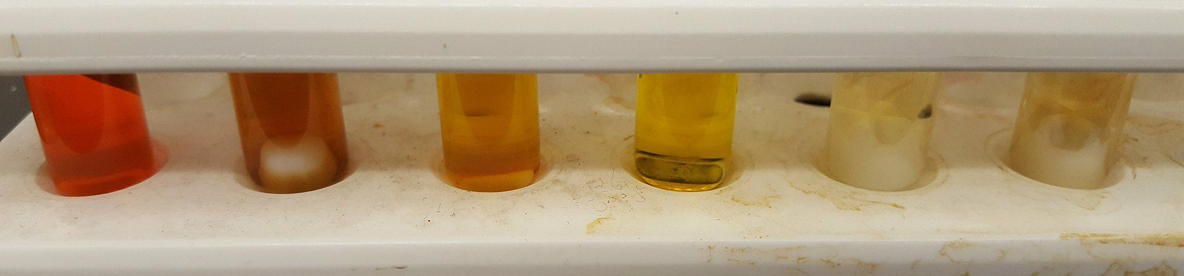
B
Synthesis and Photocatalysis with Cobaloxime Derivative
Christopher J. LaSalle, Zane Relethford, Luke Fulton, Roy Planalp, and Christine Caputo.
Department of Chemistry, University of New Hampshire
Introduction
Table 1: Photocatalysis trials 1-6
Optimization is required to determine if the CDs require purification or alternate functionality to increase the energy gap between the CD LUMO and the metal LUMO. This study also proved that the novel catalyst is capable of hydrogen evolution. The production was lower by a magnitude of 10. It is likely that this trial experienced similar issues as the other trials. Solubility also presented another problem, where a precipitate was noted, Figure 4: Vial 4.
Fossil fuel production has been optimized, however it is still a limited and destructive resource. Solar radiation offers a sustainable fuel option, with the only problem of storage. Photovoltaics were the first attempt at utilizing solar radiation as fuel. Another researched area is photocatalytic processes, due to their ability to utilize the high specific energy of diatom bonds. Diatomic hydrogen is often selected due to the minimal environmental effects caused by combustion where only water and the energy stored in the bond are released. This process requires and electron donor, photosensitizer, catalyst, and a proton source to convert H⁺ into H₂.^{[1]}
Trial | Photosensitizer | Amount | Catalyst | Amount | Electron Donor | Amount
1 | Na₂EY | 2.25x10⁻⁵ mol | (1) | 5.65x10⁻⁶ mol | TEOA | 5.30x10⁻⁵ mol
2 | CD | 5.50 mg
3 | BP NP | 200 µL
4 | Na₂EY | 2.25x10⁻⁵ mol | (2) | 3.08x10⁻⁶ mol
5 | CD | 5.50 mg
6 | BP NP | 200 µL
Results and Discussion
The synthesis of [CoCl(dmg)₂py] (1) yielded 2.2998 g of a light brown powder which was analyzed by ¹H NMR, Figure 1. The synthesis of [CoBr₂ (dopy-dam)] yielded a dark brown / black solid. When removed from the vacuum, the solid clumped together. It was suspended in water and collected as a light brown fine powder, 1.3435 g. The NMR prior to suspension is overlaid with the final product NMR, Figure 2. Both spectra are inconclusive due to the effect paramagnetic complexes can have on ¹H NMR spectroscopy.
E° (V)
e⁻
LUMO
e⁻
Figure 4: Photocatalytic trials 1-6.
e⁻
Future Work
Figure 1:
Photocatalysis
mechanism
LUMO
The two complexes can be resynthesized and tested again to determine if purity was a factor in the photocatalysis trials. UV-Vis and IR spectroscopy might also afford an alternate characterization technique. Past this, the trials can be optimized by changing the amount of photosensitizer, metal complex, and electron donor present in the solution. This process will allow for the determination of the best conditions for H₂ evolution. With the process optimized, a kinetic study can be conducted to determine the rate of H₂ production as a function of the components present.
0 V
2H⁺
2H⁺
H₂
H₂
0.82 V
TEOA
e⁻
HOMO
TEOA⁺
h⁺
e⁻
h⁺
Metal catalyst
HOMO
Figure 2: (Right): ¹H NMR CoCl(dmg)₂py (1)
Figure 3 (Below): ¹H NMR CoBr₂ (dopy-dam) (2). Prior to suspension (red), post suspension (blue).
Photosensitizer
This research utilizes a homogenous solution to produce H₂. The solution is exposed to UV radiation and H₂ is formed. This production varies based on each component, and work conducted within Dr. Caputo’s group has allowed for the comparison between two photosensitizers with the commonly used, Eosin Y (Na₂EY). The metal complex utilized can also be varied. In this experiment two cobaloxime derivatives were used, one cited in literature and a novel complex.
Conclusion
The photocatalysis trials displayed success in H₂ evolution. Both the literature and novel catalyst functioned to varied degrees and can be optimized in the future to increase their production. Although the black phosphorous nanoparticles did not yield any data to indicate their photosensitizing ability, the carbon dots did show evidence of moderate success. Despite the low H₂ production, CDs are still a great area to explore do to their easily modified surface chemistry and physical properties. This experiment was just the beginning of research into homogenous photocatalysis as a means to synthesize H₂ for alternate fuels.
Experimental Design
In the literature chloro(pyridine)bis(dimethylglyoximato)cobalt(III), [CoCl(dmg)₂py] (1), is synthesized according to Scheme 1.^{[2]} A novel complex, [CoBr₂(dopy-dam)] (2), utilizes a clam shell ligand rather than two aniline ligands according to Berben’s research, Scheme 2.^{[3]} These complexes were then added to photocatalysis tubes according to Trials 1-6 with the carbon dots (CD) and black phosphorous nanoparticles (BP NP) provided by the Caputo group.
Acknowledgements
Despite the difficulties in characterizing the metal complexes, the photocatalysis trial were conducted and hydrogen evolution occurred in Trial 1, 2 and 4. These were proven by GC analysis of the headspace in the airtight vials, Table 2. The standard, utilizing the literature cobaloxime derivative with the well known photosensitizer, Eosin Y, produced the highest amount of hydrogen. This complex also produced hydrogen with CDs, to a much lower extent.
I would like to thank Dr. Christine Caputo, Dr. Roy Planalp, Zane Relethford, Luke Fulton and the entire Berda group for their shared knowledge and continued support through this project. I am also appreciative of the instruments provided by the University of New Hampshire Instrumentation Center and the gas chromatograph provided by Dr. Li.
Scheme 1: Left Scheme 2: Below
Table 2: GC data analysis
References
Trial | H₂ area | % H₂ | H₂ (mol) | Catalyst (mol) | TON
1 | 37.454 | 44.605 | 1.110x10⁻⁴ | 5.648x10⁻⁶ | 19.732
2 | 0.581 | 0.686 | 1.715x10⁻⁶ | 5.648x10⁻⁶ | 0.304
4 | 1.752 | 2.081 | 5.200x10⁻⁶ | 3.080x10⁻⁶ | 1.688
Lakadamyali, F.; Reisner, E. Chemical Communications 2011, 47(6), 1695.
W. L. Jolly, Inorganic Syntheses, Ed. McGraw-Hill: New York, 1968, 11, 61-70.
Berben, L. A.; Peters, J. C. Chem. Commun.2010, 46(3), 398–400.

