Slide 1
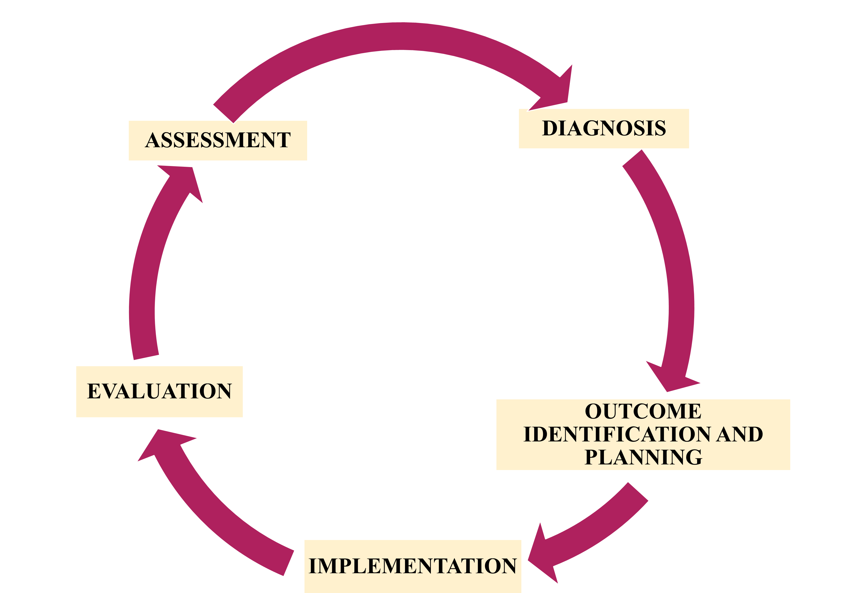
PICO: DOES USING CERNER EHR COMPARED TO THE FORMER MCKESSON SYSTEM INCREASE INTEGRATED PLAN OF CARE (IPOC) DOCUMENTATION COMPLIANACE FOR POSTPARTUM PATIENTS, AS EVIDENCED BY INITIATION OF AN IPOC WITHIN 24 HOURS OF ADMISSION AND IPOC PROGRESS EACH SHIFT.
Debora Pimentel
NURS968, DEPARTMENT OF NURSING, UNIVERSITY OF NEW HAMPSHIRE
BACKGROUND
OREM’S SELF-CARE THEORY
Appraisal Method
Resistance to changing Electronic Health Records
Staff apprehension about new charting standards → time-consuming and redundant
Poor documentation compliance charting IPOCs
IPOCs are preformatted nursing care plans that are suggested by the EHR based on patient data to be ‘Accepted’ or ‘Rejected.’ Nurse must check if goals are ‘in progress’ or ‘met.’
IPOCs:
  Evidence-based care
  Prioritizes conditions related to hospital admission and length of stay
  Guides nurses and clinicians to identify high-risk patients or possible adverse events
  Emphasizes elements of care to address for a timely and safe transition of care
  Identification of nursing interventions, desired outcomes or goals determined in collaboration with patients & families
IPOC compliance is a requirement for DNV hospital accreditation.
DNV 2018 survey → 12/18 records audited were found to have missing diagnoses in care plan.
THEORY OF SELF-CARE
Self-care requisites are actions that are required to maintain human functioning and development that lead to self-care agency.
SELF-CARE DEFICIT THEORY
Nursing is required when an individual has a limited capacity for continuous effective self care.
Orem’s 5 methods of helping include:
  Acting for and doing for others, guiding, supporting, providing environment to promote personal development to meet future needs & teaching others
THEORY OF NURSING SYSTEMS
How the patient’s self-care needs are met through the nurse, the patient, or both.
OREM’S THEORY AND THE NUSING PROCESS
The Nursing Process is used to assess self-care deficits and determine the role of the nurse or patient to meet the self-care demands.
ARTICLE | LEVEL OF EVIDENCE | PROS/ CONS
Lavin, M. A., Harper, E., & Barr, N. (2015). | VII | QI focused Experiential-reflective reasoning model based on expert opinions & recommendations Not robust evidence
Elliott, L., Weil, J., Dykstra, E., Calinski, R., Schurman, J., Conn, L. (2018). | VI | PDSA QI Model Chart audits showed 98% compliance. Small staff sample size: 19 CNAs, 30 RNs
O'Brien, A., Weaver, C., Settergren, T., Hook, M. L., & Ivory, C. H. (2015). | VII | Expert opinions/ recommendations by informatics leaders from practice, academia, and the vendor community Does not follow a model or framework
Kiliç, M., & Erci̇, B. (2017). | III | Pre-test post-test quasi-experimental model Total 80 participants Data from 5 visits No suggestions for future research.
Camara de Moura, Muniz Braga, Santana Domingos, Rodrigues, Lopes Correia & Assunção Oliveira, (2014). | VI | Studied comorbidities in relation to Orem’s theory and nursing process Suggested future research: longer follow-up with participants and a larger sample size.
NURSING PROCESS
METHODS OF DATA COLLECTION
DATA SUMMARY
PRACTICE IMPLICATIONS
DATABASES
CINAHL
SEARCH TERMS AND PHRASES
“Nursing documentation improvement”
“Plan of care” and “Documentation”
“Charting” and “Compliance”
“Electronic Health Record” and “Nursing”
“Orem” and “Nursing diagnoses”
Voice nursing concerns; improve basic informatics education; review and advance nursing sensitive EHR technology; increase collaboration between health IT and nursing standards
Nurse leaders and informaticists must participate in development, design and implementation of EHRs to ensure accurate integration of nurse workflows, EBP, and interdisciplinary consideration
Systematic nursing diagnoses and model-based care approach to diagnosing problems produces strong results compared to ordinary nursing care, based on Orem’s model.
Orem’s theory should serve as a framework when implementing the nursing process to support the scientific basis for nursing care plans to target disease prevention and health promotion.
Nurses report screenshots and tip sheets helpful in transition to new EHR
> Eight-month adjustment period helpful to increase success when improving and increasing adherence to documentation standards
Audits and education improve staff ability to maneuver through the EHR effectively while increasing the standardization of documentation.
Improved charting compliance leads to decreased findings in hospital accreditation surveys
Charting and implementing IPOCS leads to EBP, and interdisciplinary teamwork to support patient-centered care and improved quality outcomes.
SEARCH CRITERIA
Limited articles to “Full text” with publication dates from 2013 to 2018, written in English.

