Slide 1

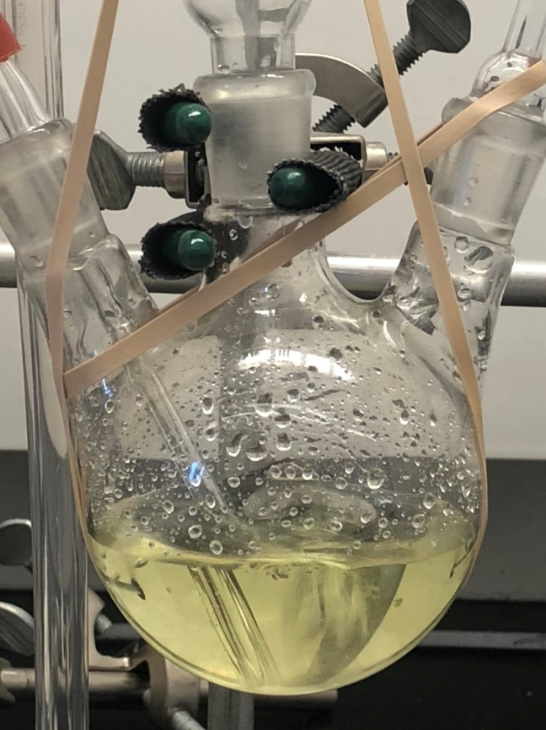
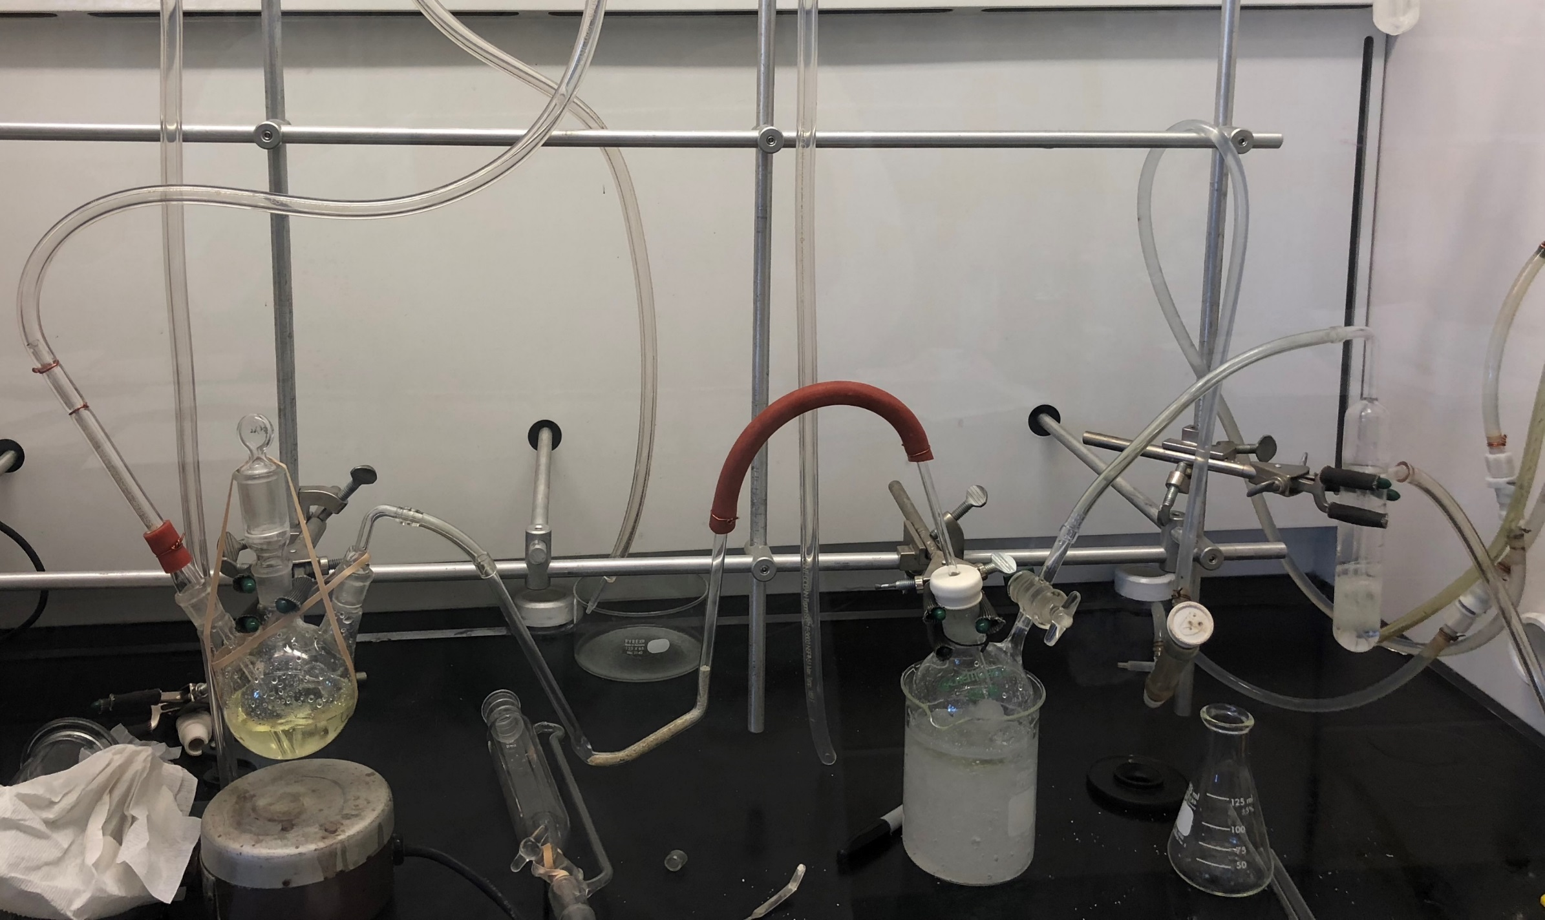
Investigation of Chlorine dioxide Vibrational Energy Level by UV-Vis Spectroscopy
Zekun Li, Luke A. Fulton, Roy Planalp
Zl10@wildcats.unh.edu. Department of Chemistry, University of New Hampshire, Durham, NH 03824
Introduction
Data and Interpretation
Chlorine dioxide is a strong oxidant that is used as disinfectant in water treatment and pulp bleaching, both of which are useful to ecosystem and manufacturing.¹ The structure of chlorine dioxide indicated it possess very different chemical properties with elemental chlorine. Chlorine atom covalently bond with two oxygen atom. Due to the odd number of valence electron, one unpaired electron is shared among all atoms in the radical and the structure is stabilized by resonance. ClO2 has a bent molecular geometry and belong to C2v symmetry according to group theory. In this work, chlorine dioxide was prepared and its absorption spectrum was obtained and analyzed. Photo dissociation was observed through optical measurement.
When molecule is exposed to a light source, it may be excited from ground state to its excited energy states. In order to excite a molecule, the wavelength of light source of certain energy has to be identical to the energy difference between molecule ground and excited states. UV-vis spectroscopy was used to measure the absorbance of molecule. Excitation of molecule depends on the wavelength range of the light source. The selected range of interest belong to visible region of light, which means vibrational and rotational excited energy levels were measured. Vibrational and rotational modes of molecule can be characterized by UV-Vis spectroscopy.² Figure 1. is the UV-Vis spectrum for chlorine dioxide prepared in the experiment. Different Vibrational modes were label on the graph for each peaks. Furthermore, thermal and photo decomposition of chlorine dioxide add complicity to the absorption spectrum.³
Figure 2.Chlorine dioxide molecule can be stabilized by its resonance structures
Future Work
Methods and Materials
Due to the receiver flask was exposed to light during the reaction. Photo decomposition caused decreased yield of product, which the absorbance of peaks are lower than desired, and byproducts may also affects the spectrum. A new reaction is needed and darker environment is preferred for the new reaction. Ramen spectroscopy of chlorine dioxide should also be measured.²
Chlorine dioxide was prepared in a closed system and the reaction was protected by nitrogen gas. The reaction was performed in the apparatus shown below. In this reaction sodium persulfate reacts with sodium chlorite. Gas phase products were filtered and dissolved in receiver flask. The aqueous chlorine dioxide was then extracted by diethyl ether and its UV-Vis spectrum was obtained.²
Conclusions
Chlorine dioxide aqueous solution
The UV-Vis spectrum of chlorine dioxide molecule was obtained. The spectrum indicated vibrational transitions of chlorine dioxide ground state to excited states. This information is useful for interpreting the structure of the molecule. Comparing to literature spectra, the differences are caused by the insufficient yield of product, decomposition of product and potential interference from decomposition reaction byproducts.
2Na₂S₂O₈+2H₂O→4NaHSO₄+O₂ (1)
4NaHSO₄+5NaClO₂→4ClO₂+2H₂O+4Na₂SO₄ (2)
Reactions for preparing chlorine dioxide
Figure 1. Absorption spectrum of ClO2. The peaks are broadened due to different vibrational modes. This is the result of coupling of symmetric stretch and bend, and coupling of asymmetric stretch and symmetric stretch.
Reference
2ClO₂→ Cl₂+2O₂ (3)
Derby, R. I.; Hutchinson, W. S. Chlorine(IV) Oxide Inorganic Syntheses. Inorganic Syntheses. 1953 IV: 152–158. doi:10.1002/9780470132357.ch51. ISBN 978-0-470-13235-7.
Sutton C .S ,Cleland E, W, Hammer I. N . Introducing Students to a Synthetic and Spectroscopic Study of the Free Radical Chlorine Dioxide. J. Chem. Educ., 2017, 94 (4), pp 515–520
Cosson H, Ernst R, W; hotodecomposition of Chlorine Dioxide and Sodium Chlorite in Aqueous Solution by Irradiation with Ultraviolet Light. Ind. Eng. Chem. Res., 1994, 33 (6), pp 1468–1475
Thermal decomposition of ClO2
2ClO₂+H₂O→ O₂+ClO₃⁻+Cl⁻+2H⁺ (4)
Photo dissociation of ClO2

