Slide 1

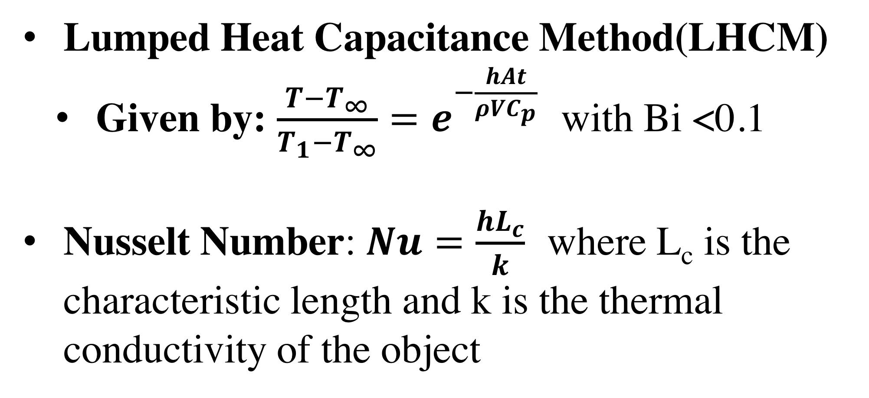
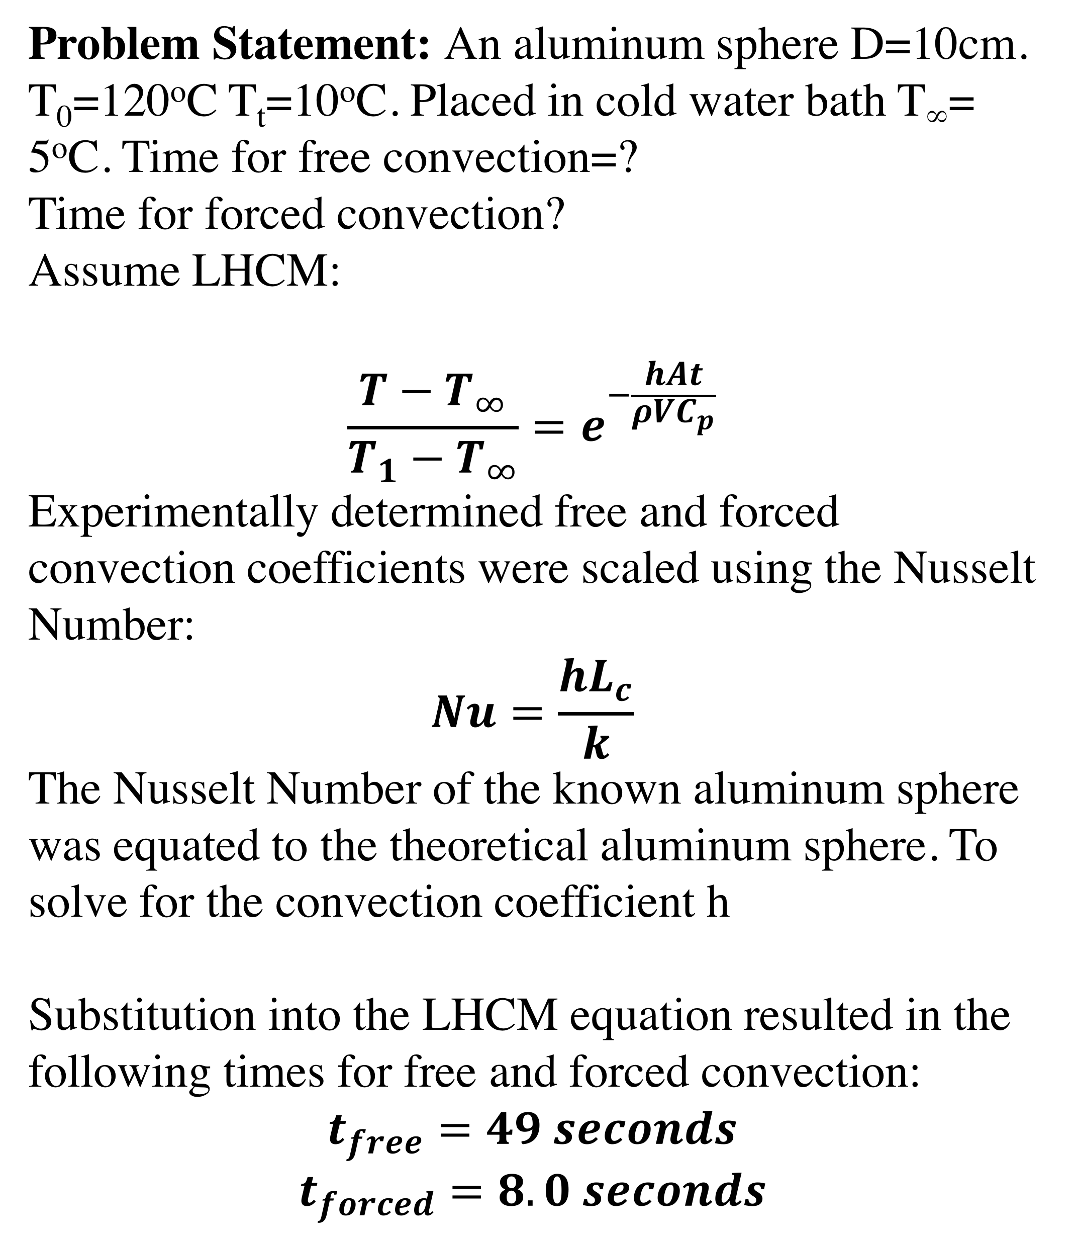
Transient Convection
Kayla Lawlor, Caitlin Considine, & Liam Corless
Department of Chemical Engineering, University of New Hampshire
Introduction
Results
Design Problem
Explore free and forced convection methods
Determine h (heat transfer coefficient) for each object
Observe the effect of material properties on cooling time and h
Determine effect of geometry on h
Problem Statement: An aluminum sphere D=10cm. T₀=120ºC T_{t}=10ºC. Placed in cold water bath T∞= 5ºC. Time for free convection=?
Time for forced convection?
Assume LHCM:
$$\frac{T−T_{∞}}{T_{1}−T_{∞}}{=e}^{−\frac{hAt}{ρVC_{p}}}$$
Experimentally determined free and forced convection coefficients were scaled using the Nusselt Number:
$$Nu=\frac{hL_{c}}{k}$$
The Nusselt Number of the known aluminum sphere was equated to the theoretical aluminum sphere. To solve for the convection coefficient h
Substitution into the LHCM equation resulted in the following times for free and forced convection:
$$t_{free}=49 seconds$$
$$t_{forced}=8.0 seconds$$
Assumptions and Equations
Lumped Heat Capacitance Method(LHCM)
  Given by: $\frac{T−T_{∞}}{T_{1}−T_{∞}}{=e}^{−\frac{hAt}{ρVC_{p}}}$ with Bi <0.1
Nusselt Number:$Nu=\frac{hL_{c}}{k}$ where L_{c} is the characteristic length and k is the thermal conductivity of the object
Figure 1: Calculated h values for free and forced convection of each object. Error bars represent 90% confidence interval.
Methods
In all cases, the aluminum has a higher heat transfer coefficient than the corresponding brass object.
Forced convection had significantly higher heat transfer coefficient values than free convection, as expected.
The sphere had the highest heat transfer coefficient for both free and forced convection.
Brass/Aluminum objects
ice
Acknowledgements
UNH Department of Chemical Engineering
Pre-heat
bath
Hot Bath
~100∘C
Cold Bath
~1-3∘C
Discussion
References
.
h values for forced convection higher -> faster cooling time
Brass showed longer cooling times -> more dense
Aluminum lower h values -> faster cooling time
Larger geometries larger h -> larger area/volume
C. J. Geankoplis, Transport Processes and Separation Process Principles, Fourth ed., Upper Sadle River: Pearson Education Inc., 2003.
Data
Computer

Slide 2

This poster template provided courtesy of
UNH ESRC Poster Printing Services
Trust us to make your poster look GREAT!
Website: http://posters.unh.edu
Poster Guide: http://goo.gl/1E7TJY
DELETE THIS SLIDE BEFORE PRINTING

