Slide 1

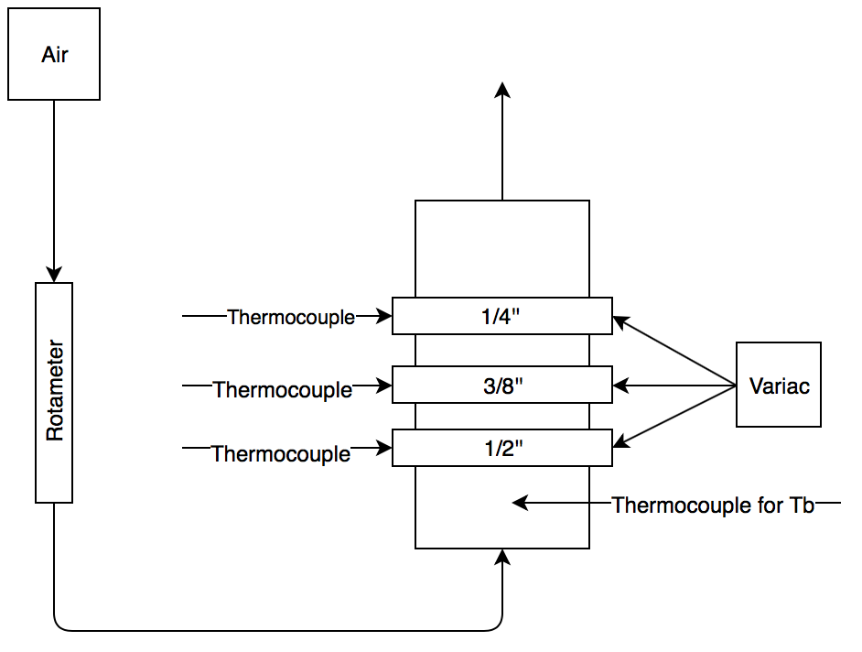
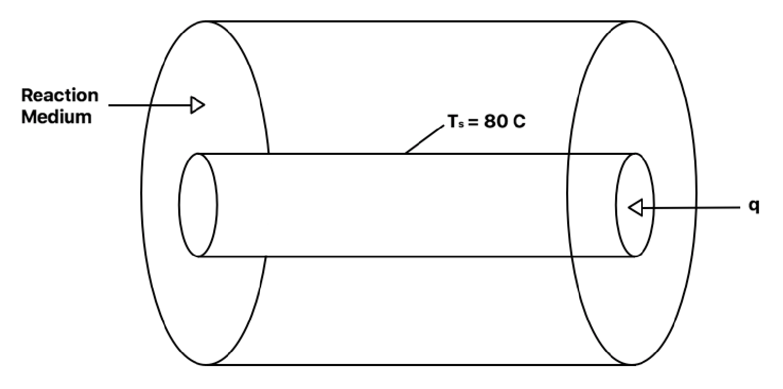
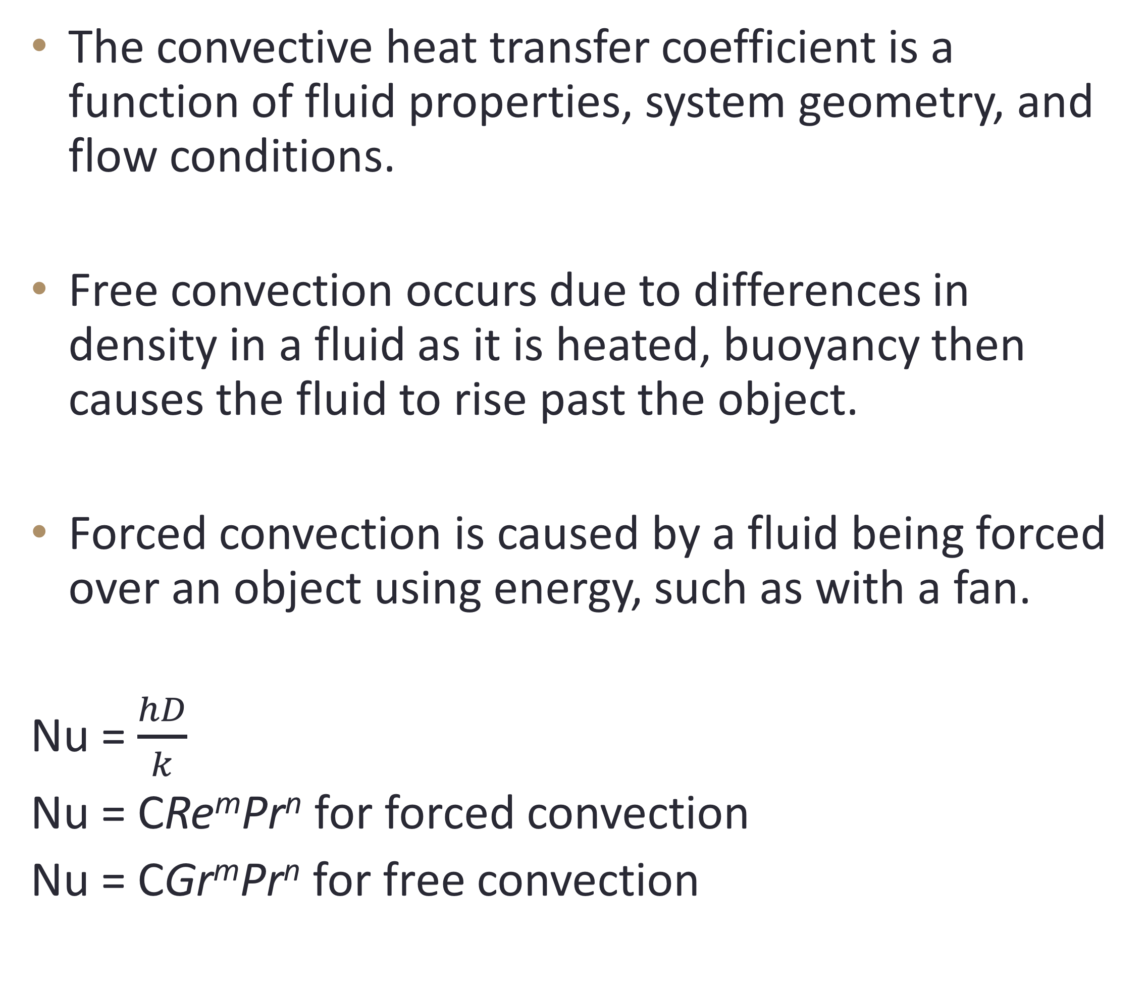
Convection from Horizontal Cylinders
Evan Redfearn and Scott Batchelder, Chemical Engineering, University of New Hampshire
background
Results
Discussion
The convective heat transfer coefficient is a function of fluid properties, system geometry, and flow conditions.
Free convection occurs due to differences in density in a fluid as it is heated, buoyancy then causes the fluid to rise past the object.
Forced convection is caused by a fluid being forced over an object using energy, such as with a fan.
Nu = $\frac{hD}{k}$
Nu = CRe^{m}Pr^{n} for forced convection
Nu = CGr^{m}Pr^{n} for free convection
Accepted convective heat transfer coefficients for air = 10-100 W/m*K
Experimental values = 20 – 180 W/m*K
For forced convection h_{large} >h_{small} >h_{medium}
For free convection h_{meduim} >h_{small} >h_{large}
Figure 1. The heat transfer coefficient increased as Reynolds Number increased for forced convection
Figure 2. The heat transfer coefficient increased as Grashof Number increased for free convection
Nu range: 4-40 | M | C
Accepted Value Forced Convection | 0.385 | 0.911
Calculated: Forced Convection Free Convection | 0.626 0.377 | 4.97 0.403
95% Confidence Forced Convection Free Convection | 0.059 - 1.19 0.297 - 0.475 | 1.34 – 18.45 0.192 – 0.457
Methods
The surface temperature and bulk fluid temperatures were recorded to find h.
Two potentials were used for free convection and three air flow rates were used for forced convection
Figure 3. ln(Nu) did not fit linearly with ln(Re).
Figure 4. ln(Nu) showed a linear fit with ln(Gr).
conclusions
Design Problem
h increased for increased air velocity for forced convection
h increased as Grashof number increased for free convection
Connections between pipe diameter and convective heat transfer coefficients were inconclusive, h increased with increased diameter for free convection.
Pipe diameter required to dissipate 100 J/min in a 0.5m³ container for free and forced convection at 25 m/s.
q = hA(T_{s} – T_{inf})
Assuming length element length of 0.1524 inches
D for free convection = 0.004 m
D for forced convection = 1.56 x 10⁻⁵ m
References
Geankoplis, Christie J. Transport Processes and Seperation Process Principles. Fourth Edition. Prentice Hall, 2003.

Slide 2
This poster template provided courtesy of
UNH ESRC Poster Printing Services
Trust us to make your poster look GREAT!
Website: http://posters.unh.edu
Poster Guide: http://goo.gl/1E7TJY
DELETE THIS SLIDE BEFORE PRINTING

