Slide 1

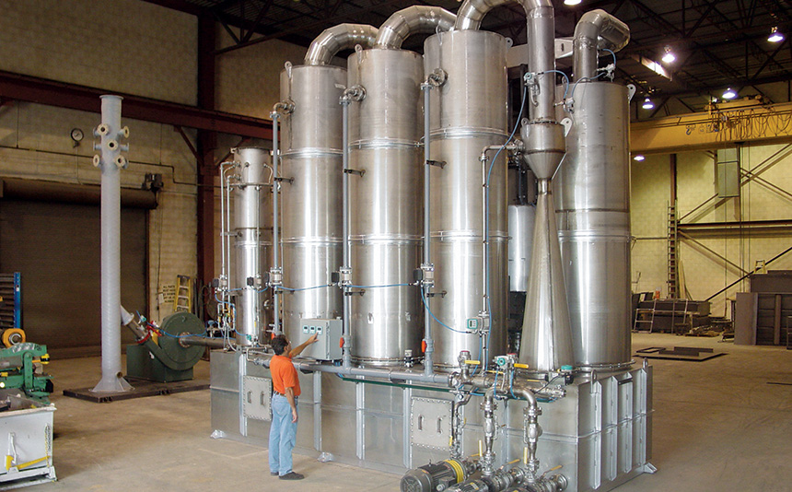
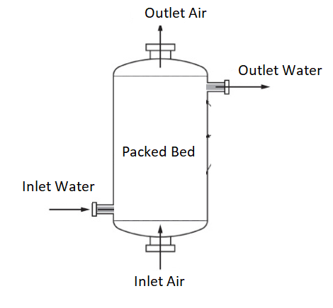
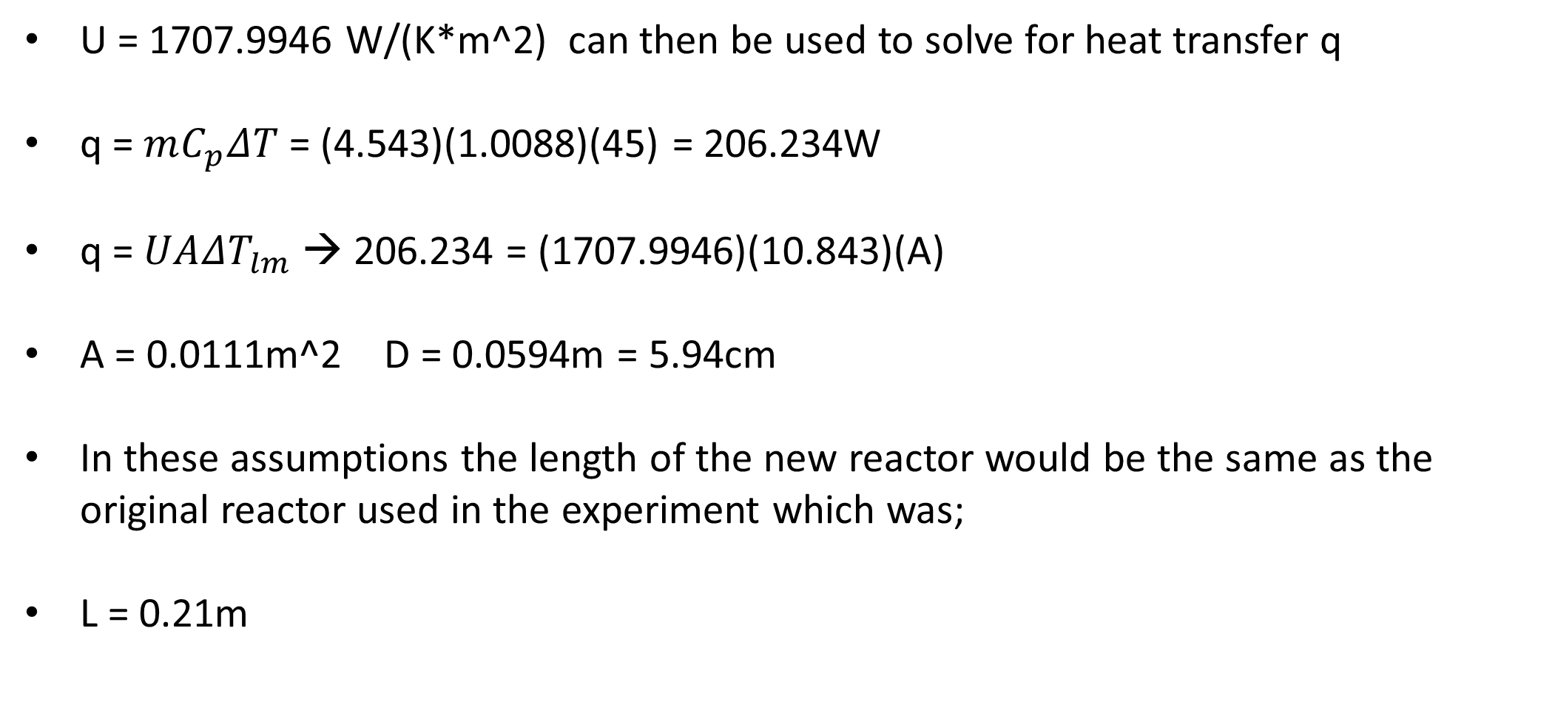
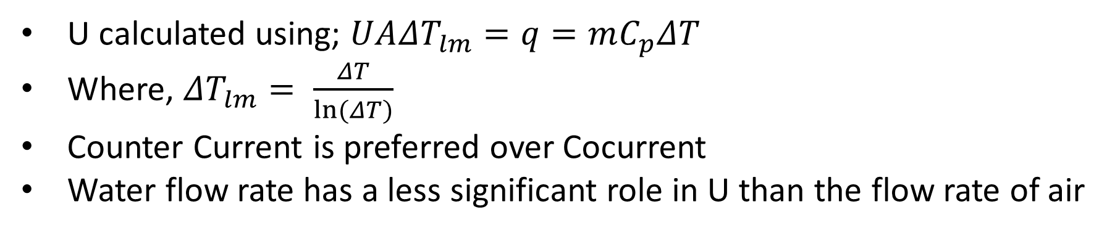
Effects of Co-current and Counter Current Flow on Heat Exchange in Packed Bed Reactors
Garrett St. Laurent, Janice Mugisha, Thomas Carter
Department of Chemical Engineering, University of New Hampshire
INTRODUCTION
Results
Design Problem Cont.
Packed Bed Reactors are extremely useful in many chemical processes such as separation processes, stripping, distillation and catalytic reactors.
They are primarily used when heating or cooling a system
This experiment focused primarily on that of heat transfer to an air stream from a water jacket.
Catalyst or Carbon Particles are the most commonly used beds
Heat transfer within the reactor is affected by flow rate and area
Effects of Counter and Cocurrent Flow on Heat Transfer Coefficient
U = 1707.9946 W/(K*m^2) can then be used to solve for heat transfer q
q = $mC_{p}ΔT$ = (4.543)(1.0088)(45) = 206.234W
q = $UA{ΔT}_{lm}$ → 206.234 = (1707.9946)(10.843)(A)
A = 0.0111m^2 D = 0.0594m = 5.94cm
In these assumptions the length of the new reactor would be the same as the original reactor used in the experiment which was;
L = 0.21m
Figure 1: Overall Heat Transfer Coefficient versus Flow Rate of Air for Counter and Cocurrent Flows
(Light Blue Cocurrent/Orange Countercurrent)
Figure 2: Overall Heat Transfer Coefficient versus Flow Rate of Air for Counter and Cocurrent Flows
(Green Cocurrent/Dark Blue Countercurrent)
Effects of Water Flow rate on Overall Heat Transfer Coefficient
conclusions
methods
The overall heat transfer coefficient increases as air flow rates increases, though there seems to be minimal effect on the heat transfer coefficient based on the water flow rate. This effect appears to increase, however as the air flow rates increase. This correlation also appears to affect the co-current versus counter current difference, though much less than it does for the water flow effect. Counter current flow appears to generally have a higher heat transfer coefficients than co-current. As one might expect, the higher water flow rate does also have the higher heat transfer coefficient. Using this information, an answer to the design problem was found.
Main Objectives: Find Overall Heat Transfer Coefficient, determine the effects of water and air flow rates, and use the results to find a solution to the design problem
The experiment was conducted in a down-scaled pre-designed packed bed
Thermal couples were strategically positioned around the reactor to record temperature changes at inlets and outlets for five different air flow rates and 2 different water flow rates.
The flow diagram shown below is for co-current flow. For counter current flow, the water streams would be flipped, but the air streams were kept as in at the bottom and out at the top.
Figure 3: Overall Heat Transfer Coefficient versus Flow Rate of Air at different Water Flow Rates (Dark blue; 0.015, Orange; 0.0068 water flow rate.
Figure 4: Overall Heat Transfer Coefficient versus Flow Rate of Air at different Water Flow Rates (Green; 0.015, Light Blue; 0.0068 water flow rate.
U calculated using; $UA{ΔT}_{lm}=q=mC_{p}ΔT$
Where, ${ΔT}_{lm}= \frac{ΔT}{ln(ΔT)}$
Counter Current is preferred over Cocurrent
Water flow rate has a less significant role in U than the flow rate of air
Design Problem
Sources
If a gas leaves a reactor at 75°C is to be cooled with a water-cooled jacket. The flow rate of the gas is 100 SCFM and it leaves the bed at 30°C. Specify the length and diameter of the packed column, assuming the gas has the properties of air.
Assuming a water flow rate of 0.016L/s, as in the highest U calculated from the data. The value of U for the problem
U = 0.2847(6000) – 0.2054
U = 1707.9946
Foley, A. (2014, August 15). What Is a Packed Bed Reactor? Retrieved April 29, 2018, from https://www.comsol.com/blogs/packed-bed-reactor/
Geankoplis, Christie J. Transport Processes and Separation Process Principles (Includes Unit Operations) Fourth Edition. Prentice Hall, 2003.
Pashian, Gary. Packed Bed Scrubbers Applications & Engineering https://www.monroeenvironmental.com/ (accessed Apr 30, 2018).

Slide 2
This poster template provided courtesy of
UNH ESRC Poster Printing Services
Trust us to make your poster look GREAT!
Website: http://posters.unh.edu
Poster Guide: http://goo.gl/1E7TJY
DELETE THIS SLIDE BEFORE PRINTING

