Slide 1


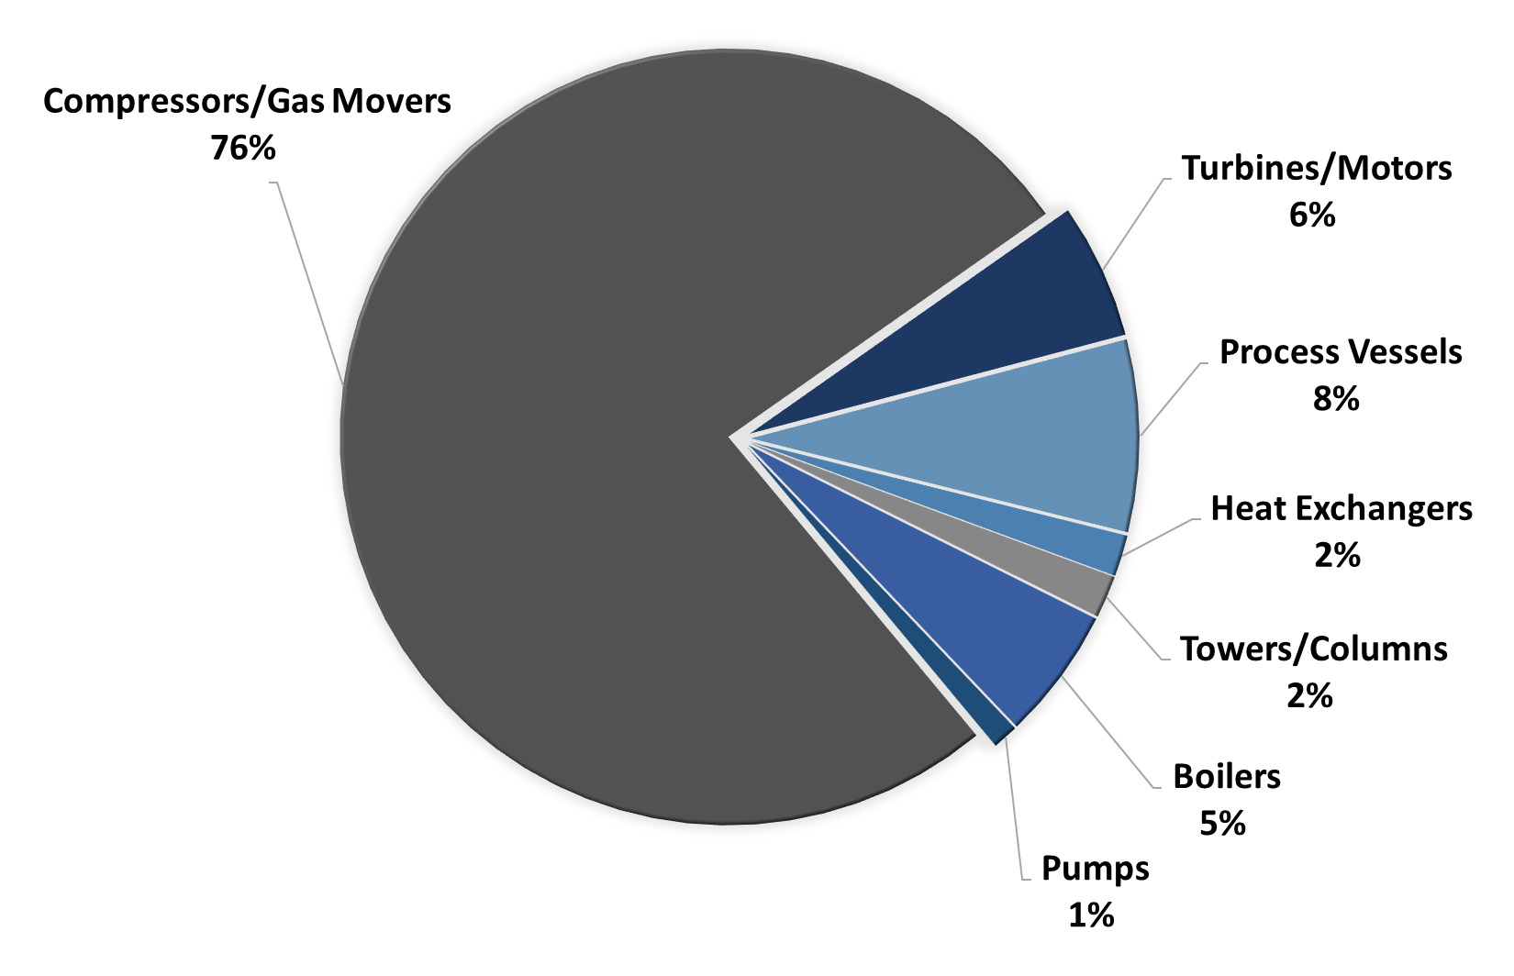
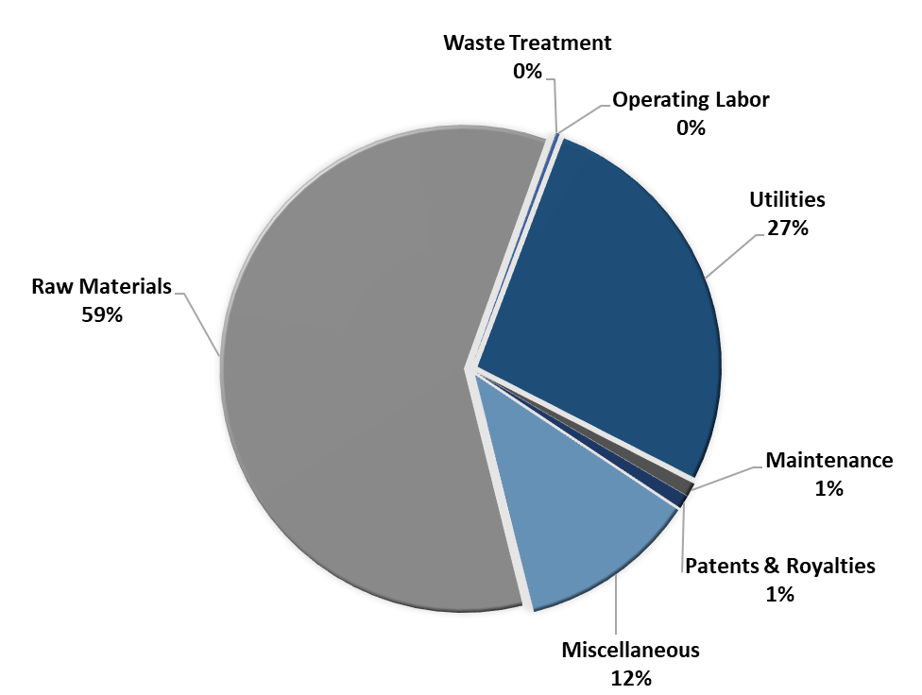
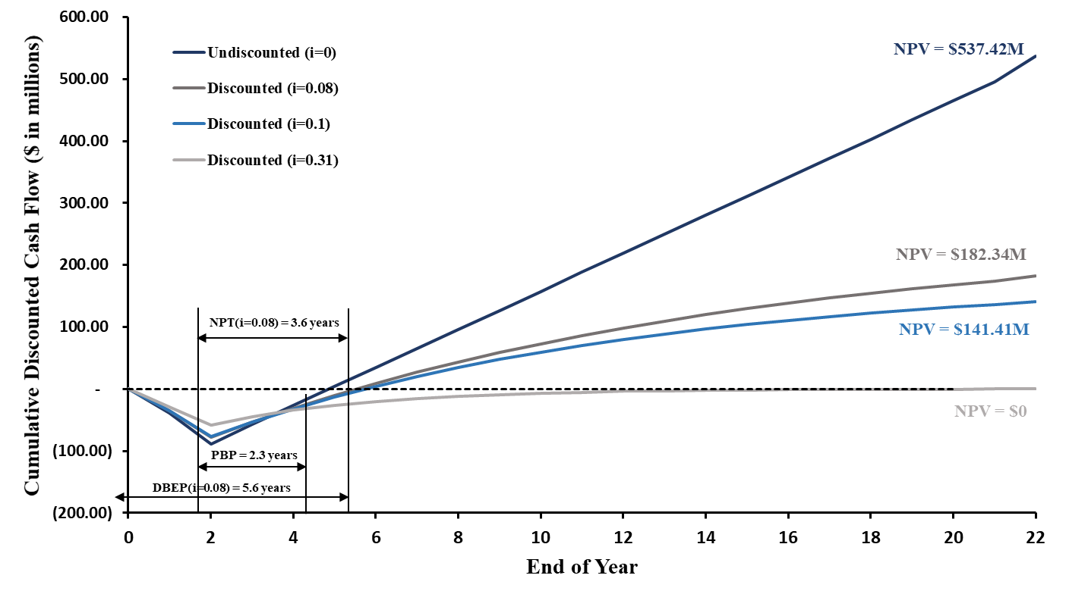
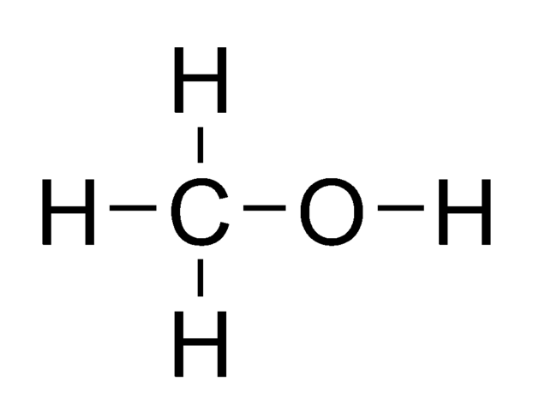
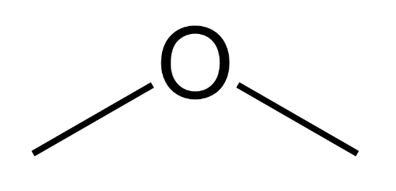
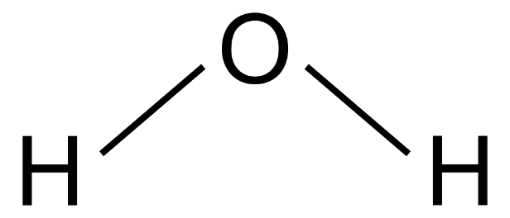
Production of Dimethyl Ether for Transportation
DME: Take It or Leaf It
Sara Duclos, Patrick McGee, Joseph McGrath, Jason Mills
Department of Chemical Engineering, University of New Hampshire
Background
Process Flow Diagram & Material Balances
Economic Analysis
Objectives
Design grass-roots plant that produces 250,000 gal/day of ISO DME Fuel Plant Gate Standard dimethyl ether
Location
Lake Charles, LA
Critical to Quality Variables
ISO DME Fuel Plant Gate Standards
Lubricant mass ~ 950 ppm
Design Criteria
Environmental/Safety Concerns
Complexity/Intellectual Property
γ-Al₂O₃ catalyst bed used
Total Capital Cost | Annual Expense | Selling Price | Annual Profit
$56.6M | $506.3M | $6.28 USD/gallon | $23.04M
Capital Cost Summary
Annual Expenses
2
γ-Al₂O₃
+
100% Material Balance
NPV (i=0.08) | DCFRR | DBEP
$182.34M | 31% | 5.6 years
Safety Evaluation
Inherent Safe Design
Initial HAZOP (R-110)
Designed Reliefs
Conclusions
Minimize
Moderate
Simplify
Substitute
References
Net Annual Profit is $23.04M with an after-tax rate of return of 39%
Designed controls and reliefs for an inherently safe design
Recommend MEA scrubbing of flue gas for CO₂ capture
Recommend investigating divided wall column for separation product
Recommend this project proceed to next stages of design
American Institute of Chemical Engineers, "2018 Student Design Competition," AIChE, 2018.
Acknowledgments
      We thank the UNH Chemical Engineering Department and Dr. Christopher McLarnon for providing support and guidance. We would also like to thank the Kingsbury library for providing a location for this project to be completed.
Reliefs for Process Vessels
P&ID for Reactor R-110

