Slide 1

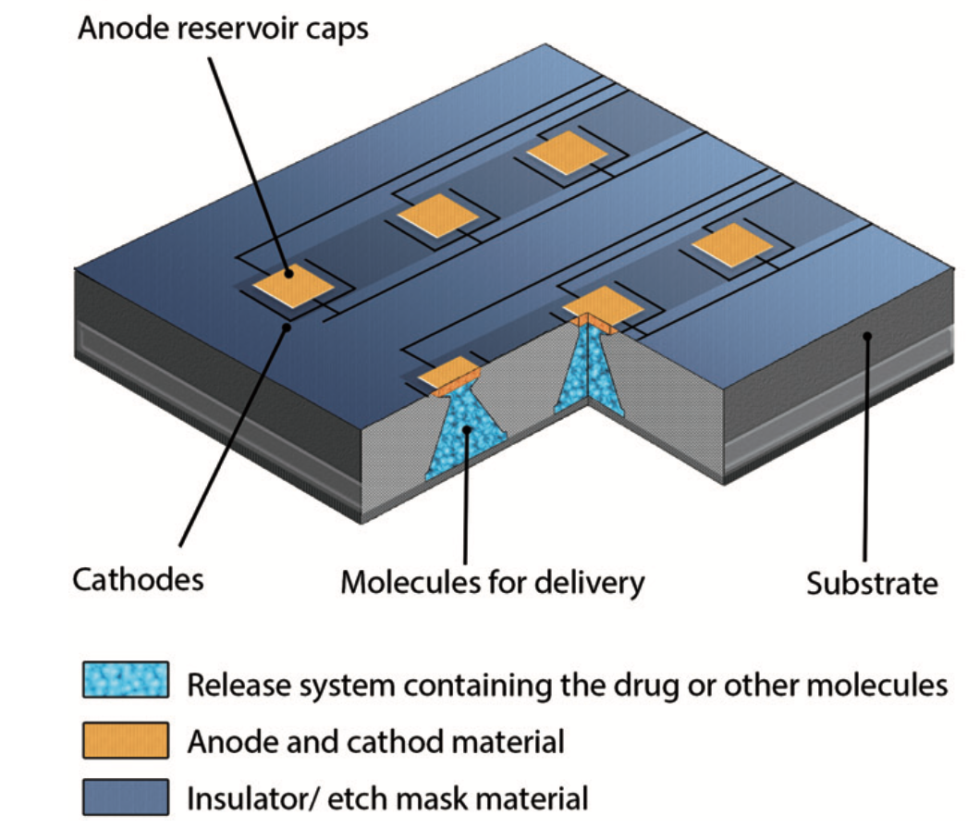
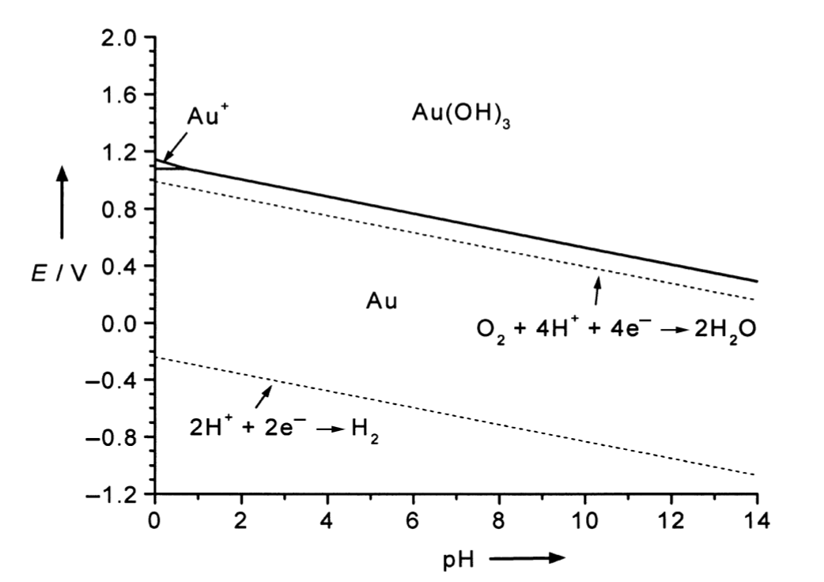
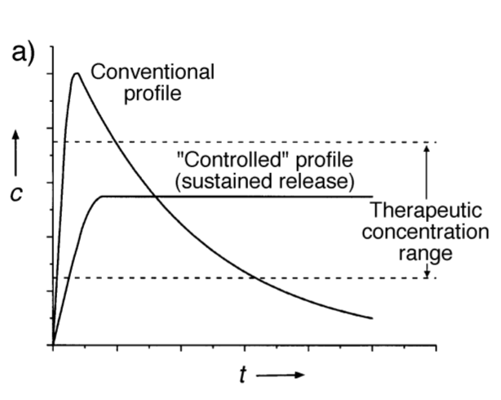
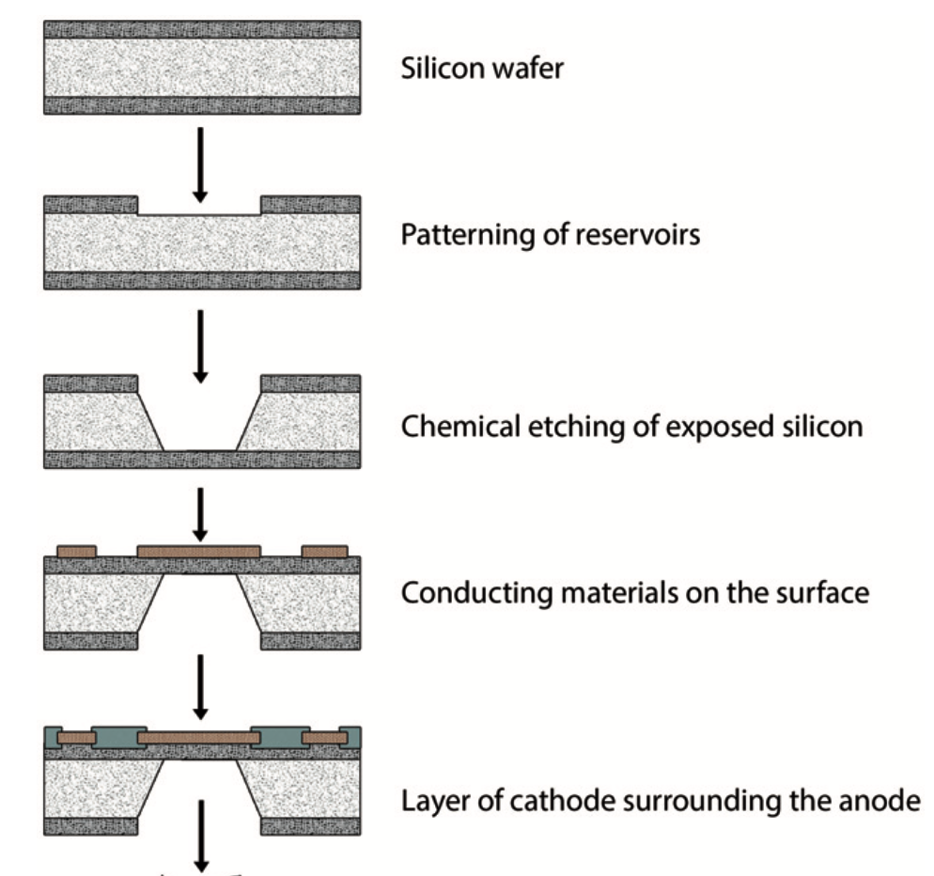
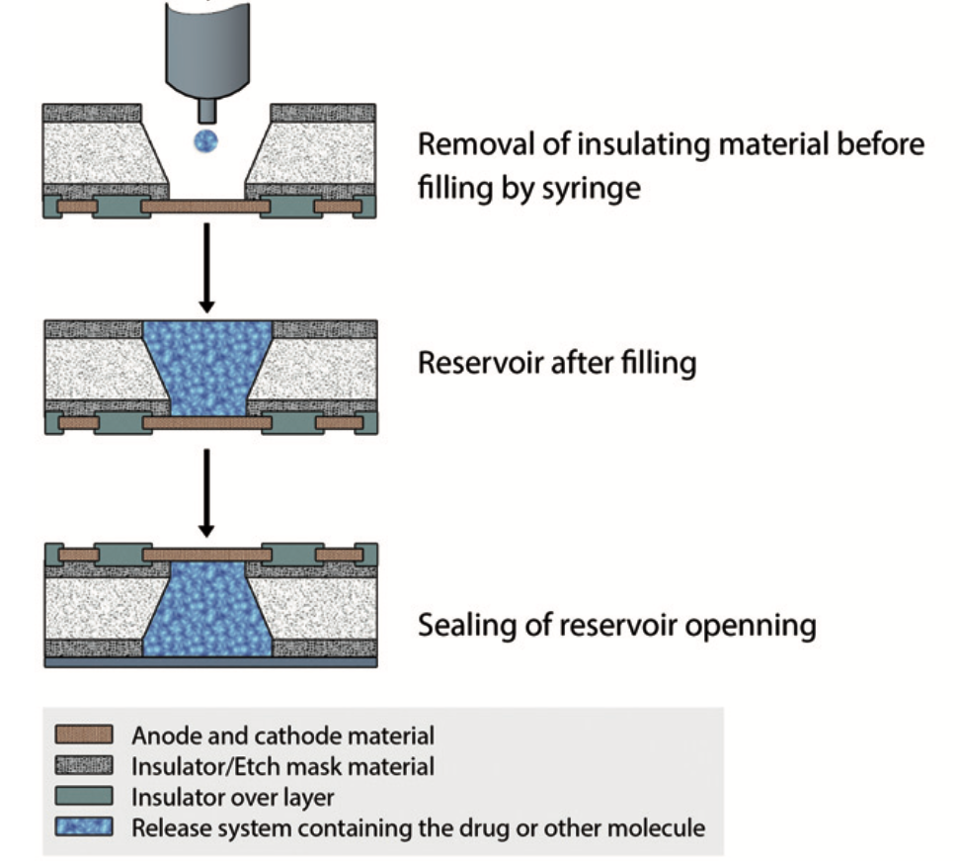
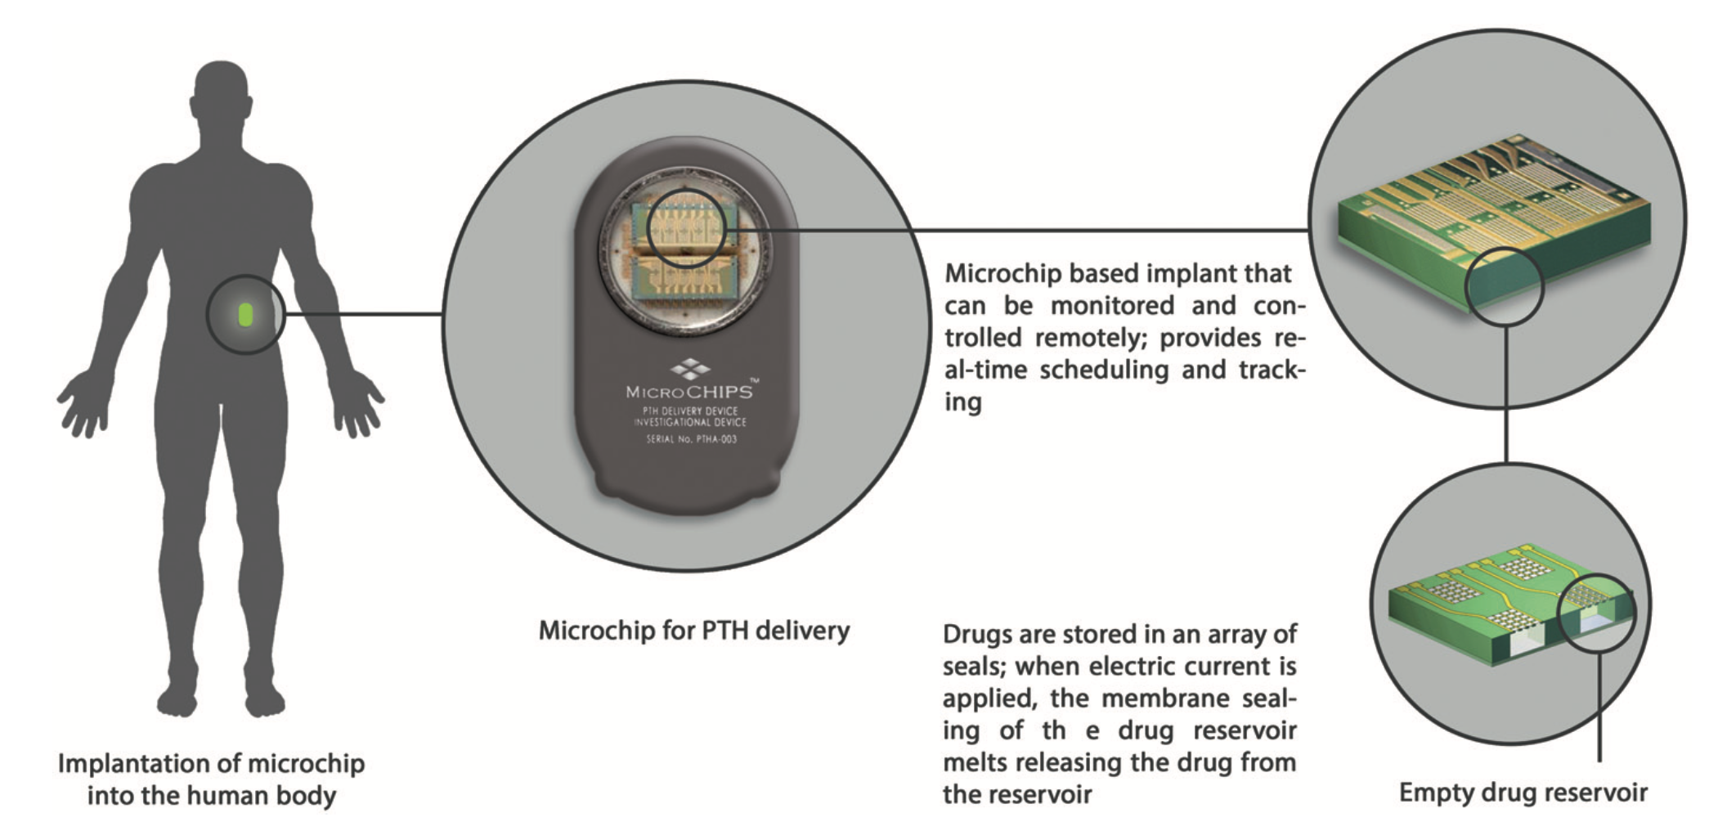
Using Microchips as Managed Drug Release Devices
Catherine M. Buckley, Professor Greenslade and Professor Johnson, University of New Hampshire.
Introduction
Production and Use of Microchip
Material Membrane
Technological and medical advances are happening rapidly. Managed delivery devices are used to release a set amount of chemical to people with applications in the cosmetic industry, food industry, but the focus here will be therapeutics. As medical advances occur, the creation of managed drug release devices provide new treatments. The conventional drug-delivery systems , like pulsatile and sustained, have limitations, like comfort and time spent being administered. To combat the limitations, microfabrication technology has been used to store chemicals on microchip devices, which release small, specific amounts of a compound over long periods of time. With the advancement in microchips as drug-delivery devices, it is easier to administer pharmaceuticals and provide different treatment options leading to improvements in long-term treatment plans for patients.
Figure 4- The graph that shows that gold is immune to corrosion between the dotted lines, and thermodynamically stable solid with varying potential and pH
Gold is immune to corrosion, it does not react with other compounds
It stays clean, and if there is oxidation it is a very thin layer
Stays stable when there is no potential applied
Figure 2- Silicon microchip with reservoirs that contain the compound to be release with the anode to keep it sealed, and the cathode that also serves as the conductive material
Conventional Drug Release
Conclusions and Future Work
Figure 5- Being able to implant the microchip into a person for managed drug release
Figure 1- concentration vs. time of conventional and managed drug release devices within the therapeutic range
Tablets/injections cause a rapid increase in concentration of the compound in the body, followed by a steady decrease. The compound is spending minimum time in the therapeutic range.
Sustained release is a continuous release of the compound into the body. The compound remains in the therapeutic range the entire duration.
Pulsatile release administers the drug in pulses at specific doses at certain intervals. This release closely imitates the way the body releases other natural compounds, like insulin and hormones.
Acknowledgements
Figure 3- The process of making the chip on a silicon wafer, with microfabrication technology
The author would like to thank the scientists responsible for this research, University of New Hampshire, as well as Dr. Erik Berda, all other Berda group members, and fellow Chemistry majors
Etched into the silicon wafer are 34 reservoirs, 50 μm each
The silicon wafer is 17 mm x 17 mm, but has the potential of being larger and smaller, as small as 2mm
There are three cathodes for the 34 reservoirs, each are gold
It has the ability of storing liquid, solid, and gel compounds
Sealed with a water-proof material
When an electrical potential is applied will dissolve the material membrane
References
Santini, J.T Jr.; Richards, A.C.; Scheidt, R.; Cima, M.J.; Langer, R. Microchips as Controlled Drug-Delivery Devices. Angewandte Chemie 2017, 39(14), 2396-2407.
Sutradhar, K.B.; Sumi, C.D. Implantable Microchip: the Futuristic Controlled Drug Delivery System. Taylor & Francis Online 2014, 23(1), 1-11.

