Slide 1
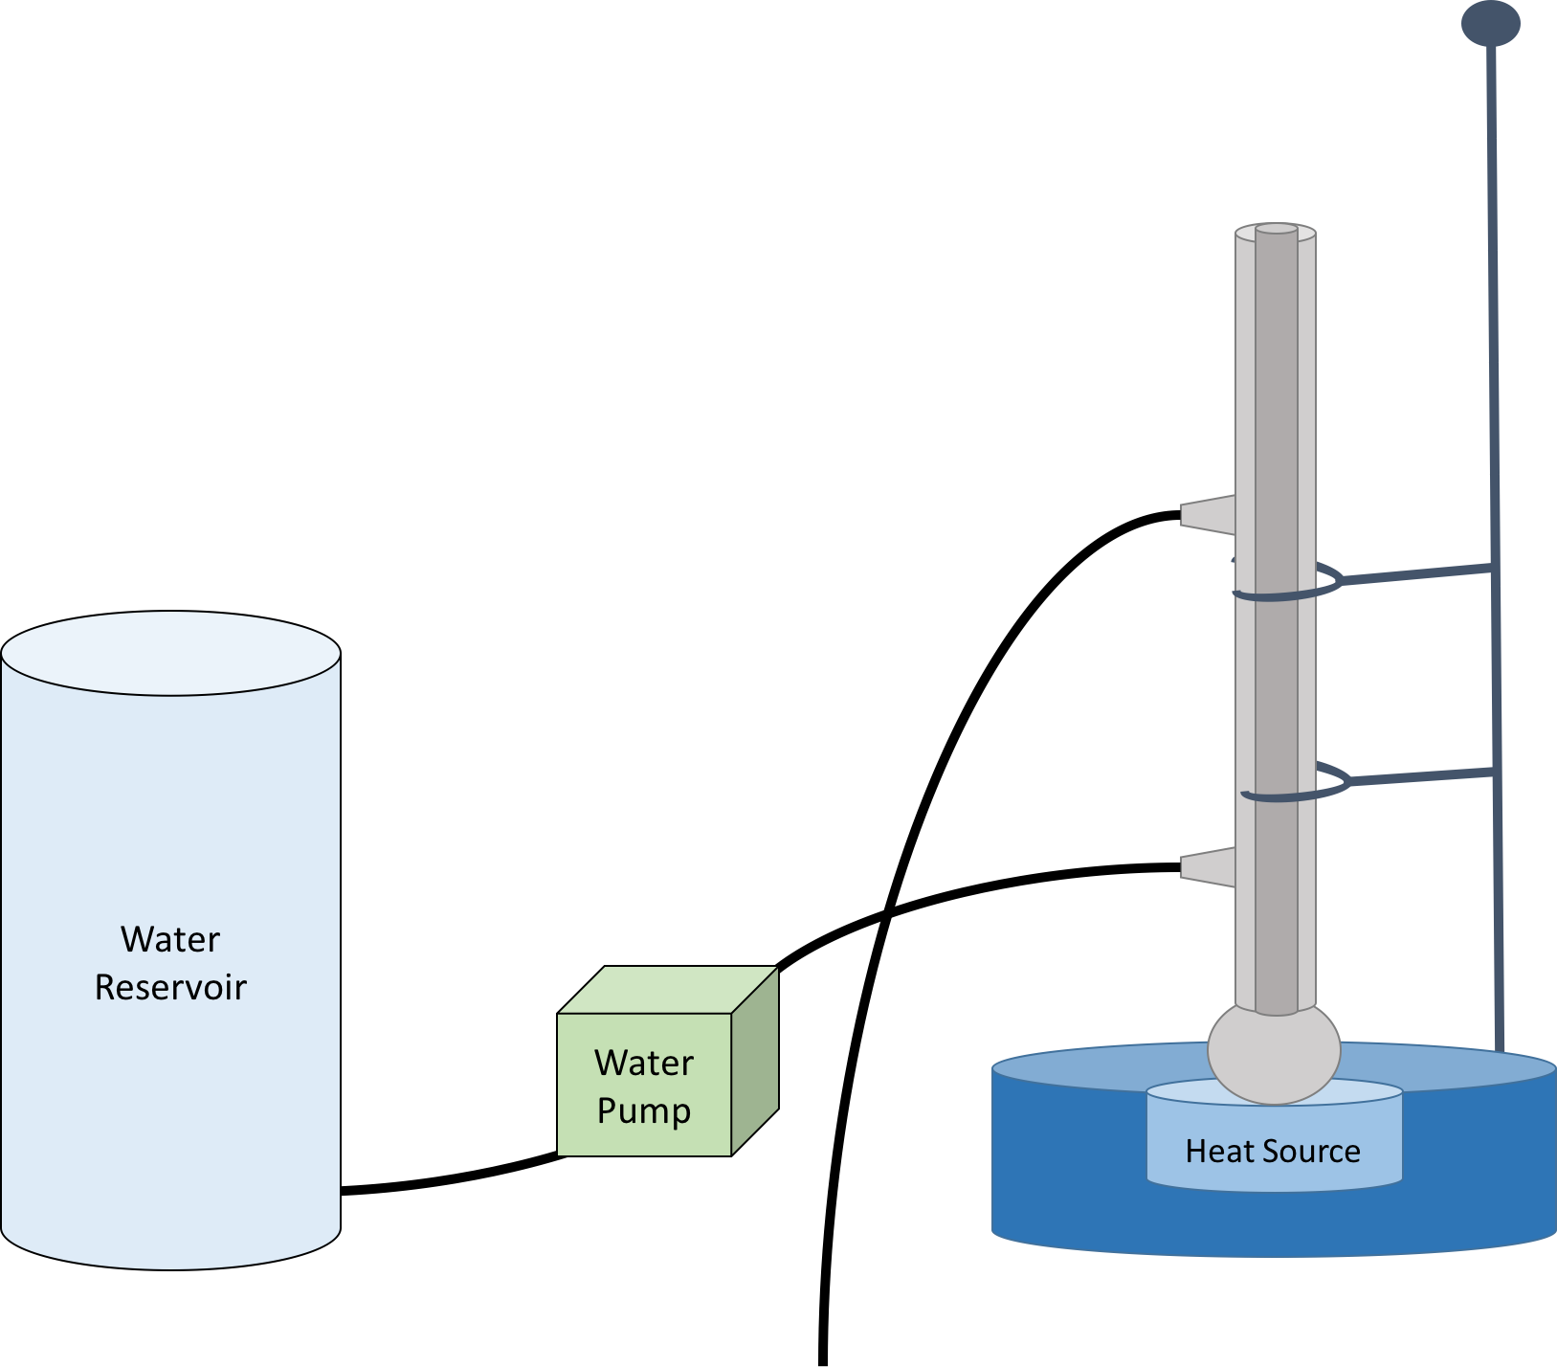
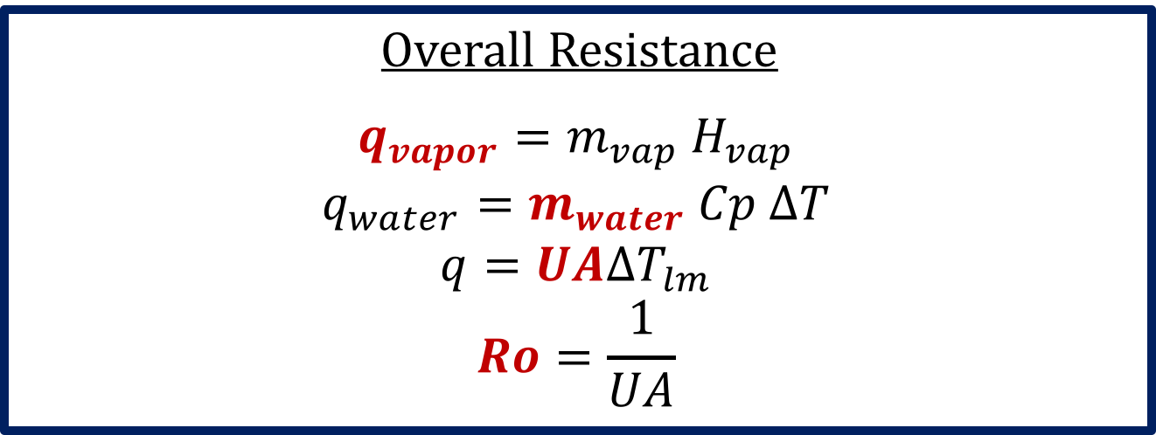
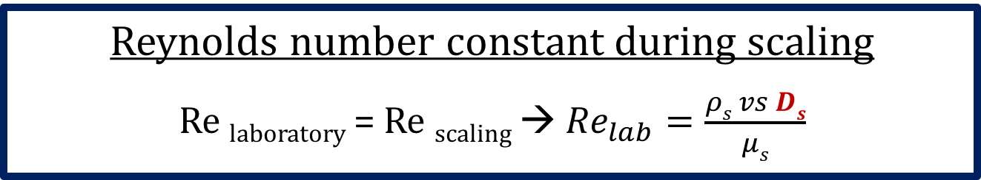
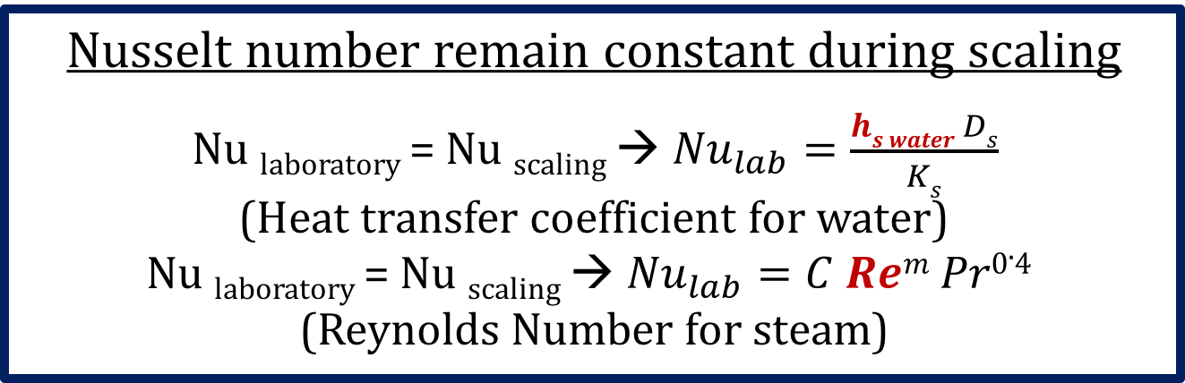


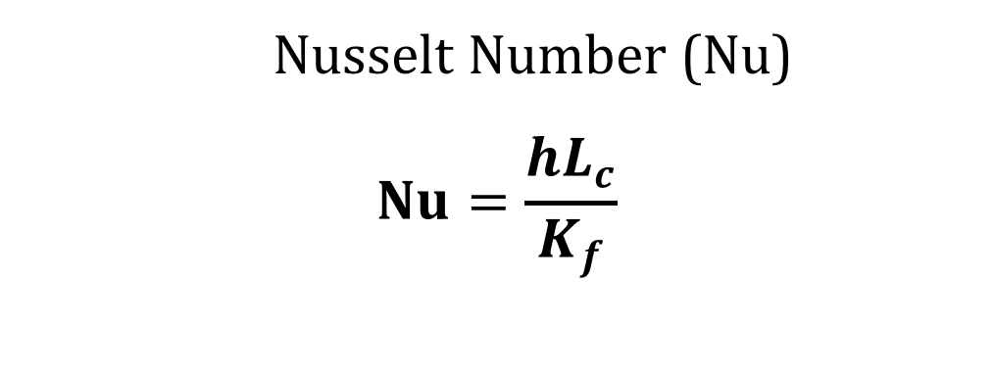
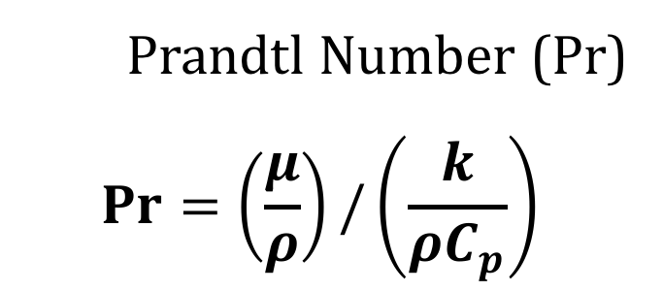
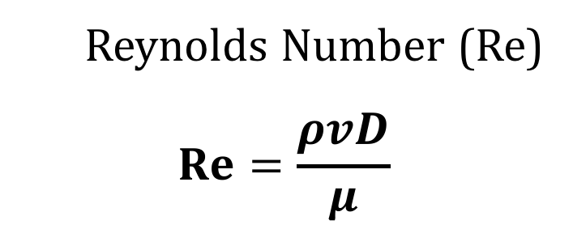
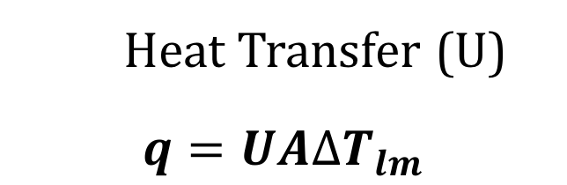
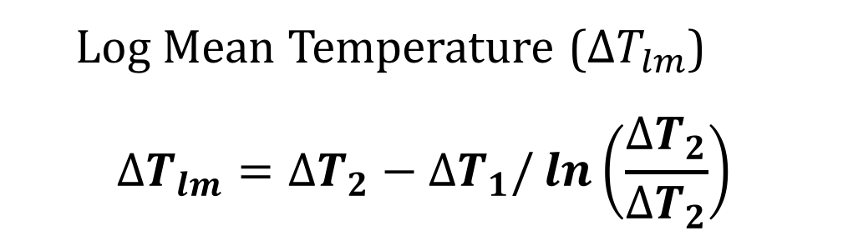
Heat Exchange in Condensing Systems
Caroline Houston, Brandon Blaesing, Thomas Lalouche, Tirthadeep Das
Chemical Engineering, University of New Hampshire, Durham, NH 03824
Introduction
Overall Heat Transfer Coefficient (U)
Design Problem
Background
Heat Exchange is important in many industrial processes
Overall heat transfer coefficient indicates effectiveness of heat transfer
Types of Condensation:
Film-type Condensation Drop-wise Condensation
Purpose
Study overall heat transfer coefficients in condensing systems
Effects of cold and hot stream flow rates and flow pattern
Determine correlations
Solve design problem
Assumptions:
Cylindrical shape
Counter Current
Same materials as laboratory scale
No fouling
Resistance from conduction is negligible compared to convection resistance
Scaling:
Type and Dimensions:
Counter current, Cylinder
Exit temperature: 45℃
Diameter:
Inner: 0.08m
Outer: 0.09m
Length: 75.2m
Cooled Wall
Vapor
Cooled Wall
Vapor
Liquid Film
Liquid Droplets
Overall Resistance
$$q_{vapor}=m_{vap} H_{vap}$$
$$q_{water}=m_{water} Cp ∆T$$
$$q=UA∆T_{lm}$$
$$Ro=\frac{1}{UA}$$
Reynolds number constant during scaling
Re _{laboratory} = Re _{scaling} → ${Re}_{lab}=\frac{ρs vs Ds}{μs}$
Dimensionless Numbers
Nusselt number remain constant during scaling
Nu _{laboratory} = Nu _{scaling} → ${Nu}_{lab}=\frac{hs water Ds}{Ks}$
(Heat transfer coefficient for water)
Nu _{laboratory} = Nu _{scaling} → ${Nu}_{lab}=C Rem Pr0.4$
(Reynolds Number for steam)
Reynolds Number (Re)
$$Re=\frac{ρvD}{μ}$$
Nusselt Number (Nu)
$$Nu=\frac{hL_{c}}{K_{f}}$$
Prandtl Number (Pr)
$$Pr=\left(\frac{μ}{ρ}\right)/\left(\frac{k}{ρC_{p}}\right)$$
Methods & Analysis
Heat Transfer Coefficient
$$h_{s water}=\left(\frac{K_{f}}{D_{s}}\right)C {Re}^{m} {Pr}^{0.4}$$
Assumptions
Film-type condensation
No sub-cooling of water after condensation
Constant heat source
Overall Heat Transfer Coefficient
$$\frac{1}{U_{scaled}}=\frac{1}{h_{s steam}}+\frac{1}{h_{s water}}$$
Condensation
Water
45 ℃
Water
600SFCM, 15℃
Apparatus
Flow: Co-current, Counter current
Inner Diameter: 0.014mm
Outer Diameter: 0.018mm
Steam
1 atm
Steam
1 atm
Conclusions
Ri
Effect of Heat Source:
Higher source temperature, decrease in overall heat transfer coefficient
Flow pattern constant
Effect of Flow Rate:
Inlet water flow rate increase, overall heat transfer coefficient increase
Flow pattern, heat source constant
0.0038kg/s – different trend
Effect of Flow pattern:
Higher overall heat transfer coefficient for counter current compared to co-current
Heat source constant
Discussion:
Film of condensation – effect overall heat transfer coefficient
Increase steam flow rate, increase condensed water amount – effect overall heat transfer coefficient
Sources of Error:
Inaccurate measurements
Heat source fluctuated
Fouling
Film condensation
Future Work:
Higher steam flow rates
Observe overall heat transfer coefficient
Effects of fouling
Horizontal cylinder
Ro
References
[1] S. Subramanian, http://ljournal.ru/wp-content/uploads/2017/03/a-2017-023.pdf, Thermal Analysis of a Steady Heat Exchanger, 2017
[2] P. Sabharwall, V. Utgikar, and F. Gunnerson, “Effect of Mass Flow Rate on the Convective Heat Transfer Coefficient: Analysis for Constant Velocity and Constant Area Case,” Nuclear Technology, vol. 166, no. 2, pp. 197–200, 2009
[3] C. J. Geankoplis, Transport Processes and Separation Process Principles, 4th ed. Pearson.
[4] “Engineering ToolBox,” Engineering ToolBox. [Online]. Available: https://www.engineeringtoolbox.com/. [Accessed: 30-Apr-2018].
Vertical Heat Exchangers
Acknowledgments
Log Mean Temperature ($∆T_{lm}$)
$$∆T_{lm}=∆T_{2}−∆T_{1}/\ln\left(\frac{∆T_{2}}{∆T_{2}}\right)$$
Heat Transfer (U)
$$q=UA∆T_{lm}$$
Dr. Adam St. Jean, Department of Chemical Engineering, for advising
Department of Chemical Engineering, for funding

