Slide 1

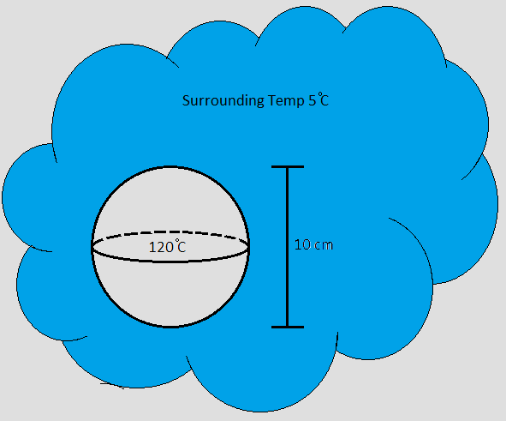

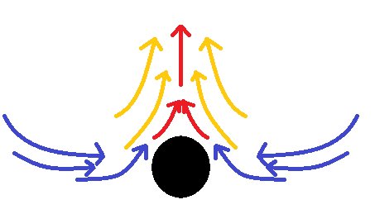
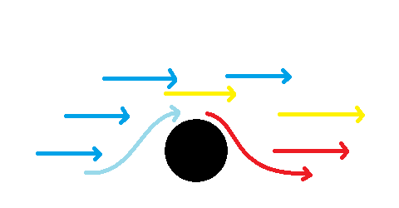

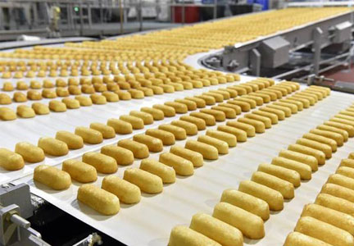
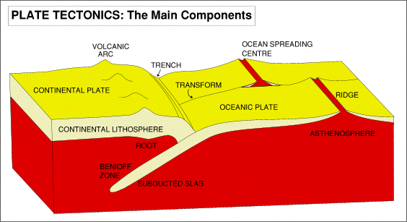



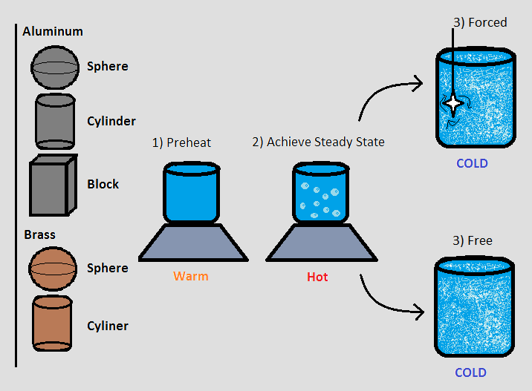
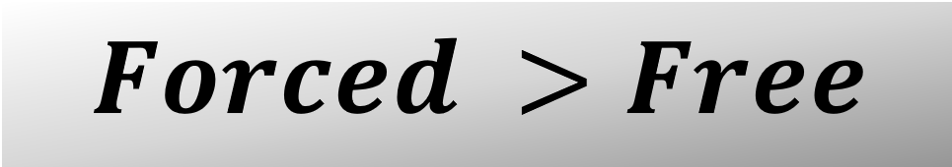
Object Geometry and Material Influence on Forced and Free Transient Convection
Jarret Askin, Lucas Hefler, Alex Rioux, Dean Yost
Department of Chemical Engineering, Kingsbury Hall, Durham, NH USA
Background
Results
Discussion
What is Transient Convection?
Treatments
Design Problem
Transient (adjective): transitioning, lasting for only a short time
Aluminum
Time to Equilibrate?
100%
Convection (noun): transfer of heat due to fluid motion
Al
Geometry | Dimensions | Time to Equilibrate Free Convection | Time to Equilibrate Forced Convection
Sphere | Diameter: 36.64 mm | 186 sec | 96 sec
Cylinder | Diameter: 50.81 Height: 152.93 mm | 735 sec | 142 sec
Block | Length 152.12mm Height: 50.90 mm Width: 25.52 mm | 372 sec | 122 sec
A)Free Convection
B)Forced Convection
Free Vs Forced
Brass
$$Nu=\frac{h_{l}D_{l}}{k}=\frac{h_{s}D_{s}}{k}$$
Assuming Nusselt Constant
𝑁𝑢=(ℎ_𝑙 𝐷_𝑙)/𝑘=(ℎ_𝑠 𝐷_𝑠)/𝑘
Assuming Nusselt Constant
$$h_{s}=\frac{h_{l}D_{l}}{D_{s}}$$
Determine the scale convection coefficient
ℎ_𝑠=(ℎ_𝑙 𝐷_𝑙)/𝐷_𝑠
Determine the scale convection coefficient
$$Bi=\frac{hLc}{k}$$
Confirming Biot Number below 0.1
𝐵𝑖=ℎ𝐿𝑐/𝑘
Confirming Biot Number below 0.1
$$\frac{T−T_{∞}}{T_{i}−T_{∞}}=e^{\frac{−t}{τ}}$$
Biot Number allows use of LHCM
(𝑇−𝑇_∞)/(𝑇_𝑖−𝑇_∞ )=𝑒^((−𝑡)/𝜏)
Biot Number allows use of LHCM
$$τ=\frac{ρVC}{hA}=\frac{ρCLc}{h}$$
Determine tau
𝜏=𝜌𝑉𝐶/ℎ𝐴=𝜌𝐶𝐿𝑐/ℎ
Determine tau
$$t=−\ln\left(\frac{T−T_{∞}}{T_{i}−T_{∞}}\right)∗τ$$
Use tau and LHCM to determine t
𝑡=−ln⁡((𝑇−𝑇_∞)/(𝑇_𝑖−𝑇_∞ ))∗𝜏
Use tau and LHCM to determine t
15-40%
Internal forces
External forces
Cu
Geometry | Dimensions | Time to Equilibrate Free Convection | Time to Equilibrate Forced Convection
Sphere | Diameter: 50.56 mm | 395 sec | 108 sec
Cylinder | Diameter: 50.86mm Height: 152.58mm | 845 sec | 171 sec
Free Convection
Forced Convection
60-85%
Zn
Real World Applications
Type of Convection | Nu | h_{s} | B_{i} | τ | t
Free | 0.0832 | 175 | 0.0139 | 237 | 743
Forced | 0.2328 | 489 | 0.0388 | 84.8 | 266
Everday Necessities
Commercial Manufacturing
Planetary
Scale
Results
Determining Coefficient:
Conclusion
Baking/Cooking
Air Conditioning
Quenching Metal
Start Up/Shut Down
Tectonic plates
Weather Systems
Materials and Set Up
≈
≈
Water Pots on Hot Plates
Plastic Tub with ice
Agitator at 100 RPM
Convection Coefficient:
References
-H.C. Perkins and G. Leppert, “Forced Convection Heat Transfer From a Uniformly Heated Cylinder,” The American Society of Mechanical Engineers: Journal of Heat Transfer, Vol. 84, 1961, pp. 257-261.
-L. Stradley, “Perfect Fried Eggs Recipe, Whats Cooking America,” What's Cooking America, 25-May-2017. [Online]. Available: https://whatscookingamerica.net/Eggs/FriedEgg.htm. [Accessed: 01-May-2018].
-“Metropoulos: Hostess highly profitable, set to expand,” Food Business News RSS. [Online]. Available: https://www.foodbusinessnews.net/articles/8273-metropoulos-hostess-highly-profitable-set-to-expand. [Accessed: 01-May-2018].
-Plate Tectonics: Geological Aspects. [Online]. Available: https://www.le.ac.uk/gl/art/gl209/. [Accessed: 01-May-2018].
-C.J. Geankoplis, Transport Processes and Separation Process Principles (Includes Unit Operations). Prentice Hall, 2007
“Brass Board Game for iOS and Android,” Brass mobile. [Online]. Available: http://www.brassgame.com/. [Accessed: 01-May-2018].

