Slide 1

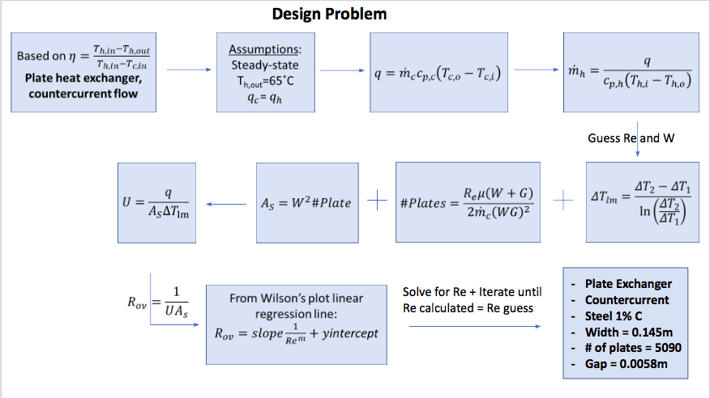
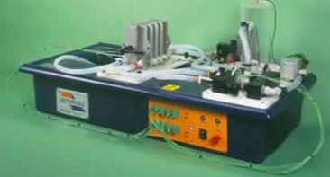
Comparison of Heat Exchangers
Genevieve Frigon, Samuel Rodda, Gabrielle Voltaire-Polche gf1019@wildcats.unh.edu, ssr2000@wildcats.unh.edu, ggv1000@wildcats.unh.edu
Department of Chemical Engineering, University of New Hampshire
Introduction
Results
Design Problem
Heat exchangers heat/cool a system by removing heat
Vary flow rate and pattern to determine the heat transfer coefficient of water
Determine efficiency of counter/cocurrent flow on steady state temperature difference
Overall Heat Transfer Coefficients
Specify the type, configuration, and size of a H.E. needed to heat a 3 kg/s stream of reactant fluid from 20 °C to 50°C. Assume the reactant fluid has properties similar to water.
Cocurrent flow
Countercurrent Flow
Goals
Overall Heat Transfer Coefficient ↑ Flow Rate ↑ U_{o}(cocurrent): Plate > Tubular > S&T
U_{o}(countercurrent): Plate > S&T > Tubular
Using the LMTD method to determine
      Cooling water flow rate effect on the Overall Heat Transfer Coefficient (U_{o})
      Flow pattern effect on U_{o}
Wilson Plot Analysis used to determine the average convection coefficients for hot and cold water streams
Collect relevant data to use for solving the design problem
Cold Stream Heat Transfer Coefficients
Conclusion
Cocurrent flow
Countercurrent Flow
As V↑, U_{o} and η ↑
Cocurrent flow, U_{o} : S&T < Tubular < Plate
Countercurrent flow, U_{o} : Tubular < S&T < Plate
Cocurrent flow, h_{cold}: S&T < Tubular < Plate
Countercurrent flow h_{hot}: S&T < Tubular < Plate
The Plate HE with countercurrent flow = highest U_{o} and η -> chosen for the design problem
h_{cold} ↑ Flow Rate ↑
Methods
Exchanger Type | Countercurrent (W/m²K ) | Cocurrent (W/m²K )
Shell & Tube | 1644 | 2287
Tubular | 3967 | 10861
Plate | 3898 | 3959
DI water (40°C) is circulated by a gear pump with cold water (10°C) from the house mains
Thermocouples read the inlet/outlet feeds temperatures to determine steady state
References
Flow Type vs. Exchanger Type
Heat Transfer Coefficient (hot)
Geankoplis, C. (2003). Transport processes and separation process principles. Upper Saddle River, NJ: Prentice Hall Professional Technical Reference.
J. Fernández-Seara, F. J. Uhía, J. Sieres, and A. Campo, “A general review of the Wilson plot method and its modifications to determine convection coefficients in heat exchange devices,” Applied Thermal Engineering, vol. 27, no. 17-18, pp. 2745–2757, 2007.
Korzenszky, P.; Kurjak, Z.; Geczi, G. ARMFIELD HT31 Tubular Heat Exchanger in the Education. Hungarian Agricultural Engineering.
R. H. Perry and D. W. Green, Perrys chemical engineers handbook. New York: McGraw-Hill, 1997.
T. L. Bergman, D. P. Dewit, A. S. Lavine, and F. P. Incropera, Fundamentals of heat and mass transfer. New Jersey: John Wiley & Sons, 2011.
https://www.che.iitb.ac.in/courses/uglab/cl333n335/ht310-plate.pdf [Accessed 1 May 2018].
Discoverarmfield.com. (2018). [online] Available at: http://discoverarmfield.com/media/transfer/doc/ht30xc.pdf [Accessed 1 May 2018].
HT30XC Heat Exchanger Unit
h_{hot}: Cocurrent > Countercurrent
Tubular > Plate > Shell & Tube
*

