Slide 1
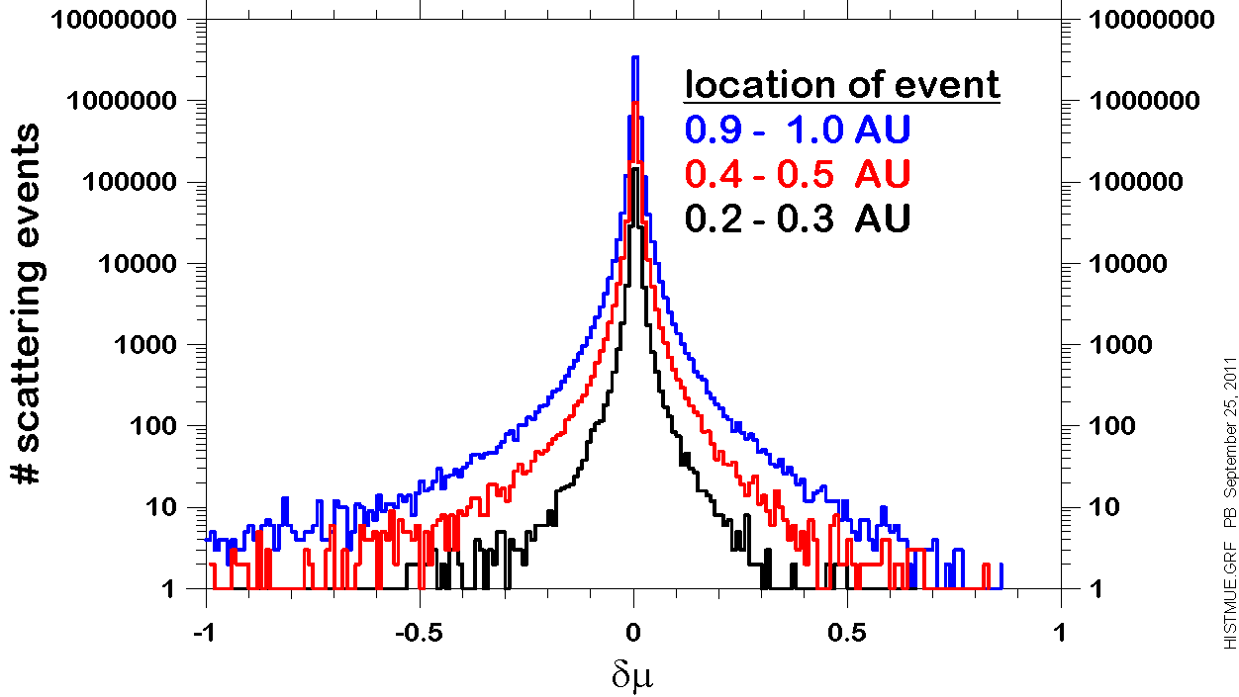
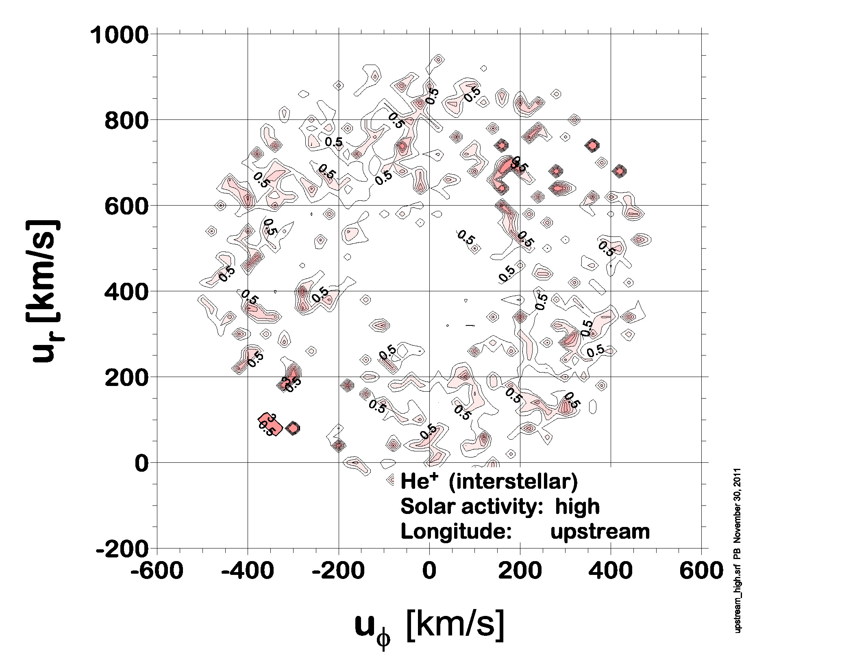
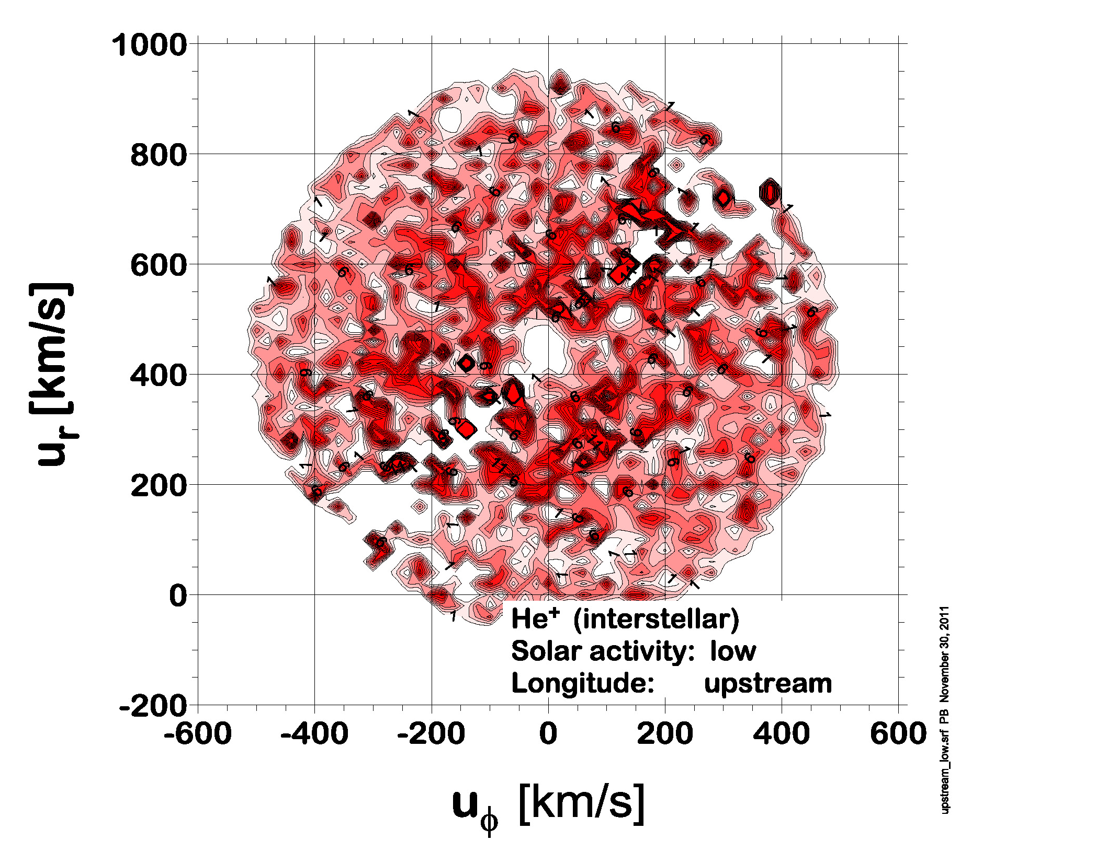
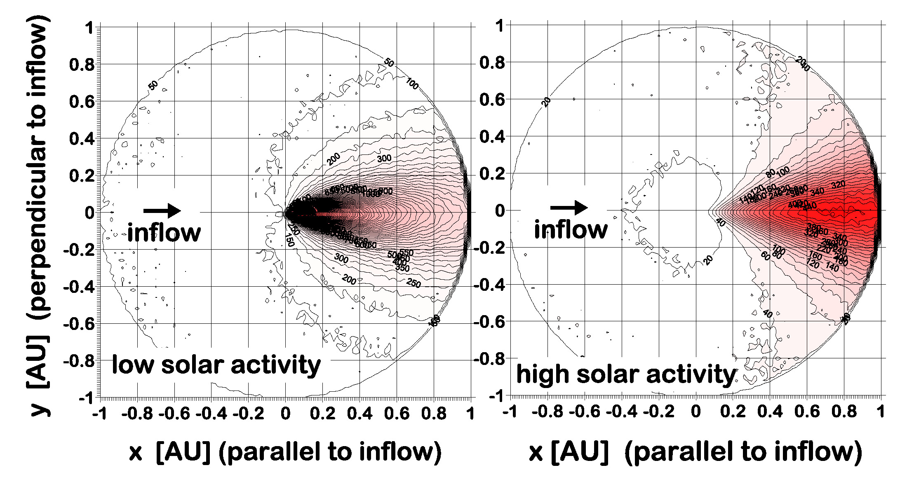
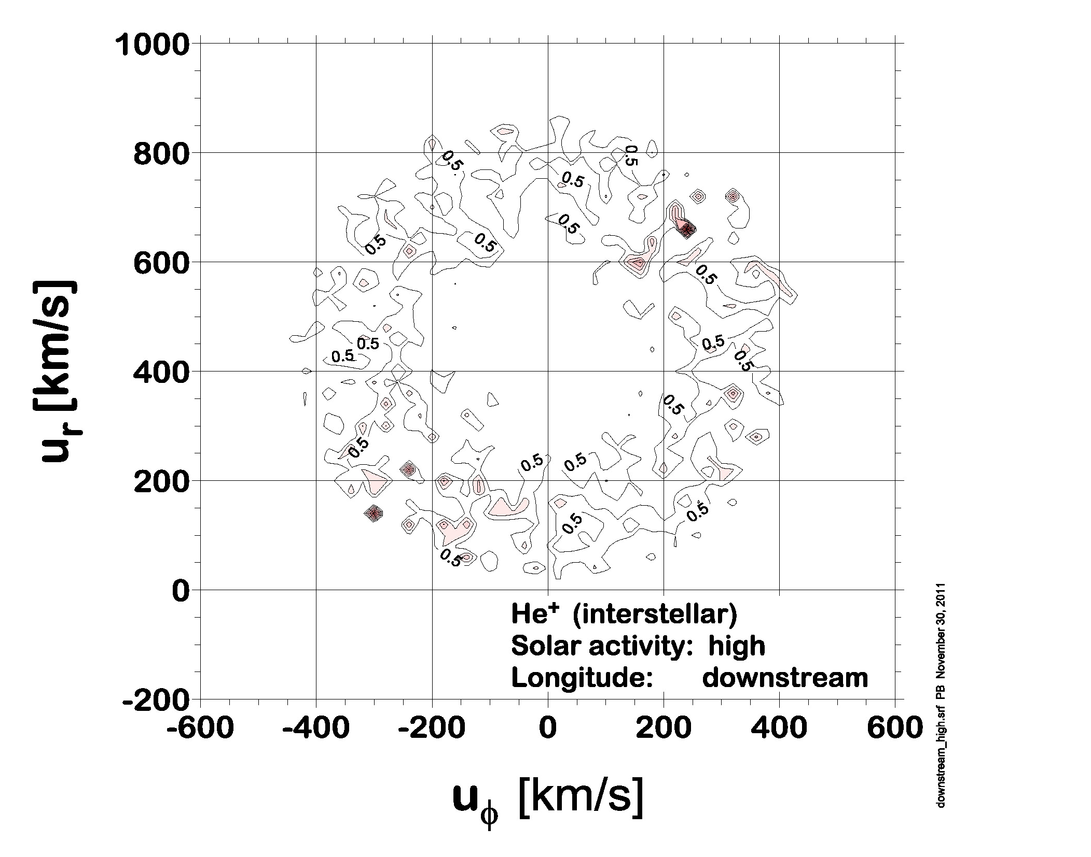
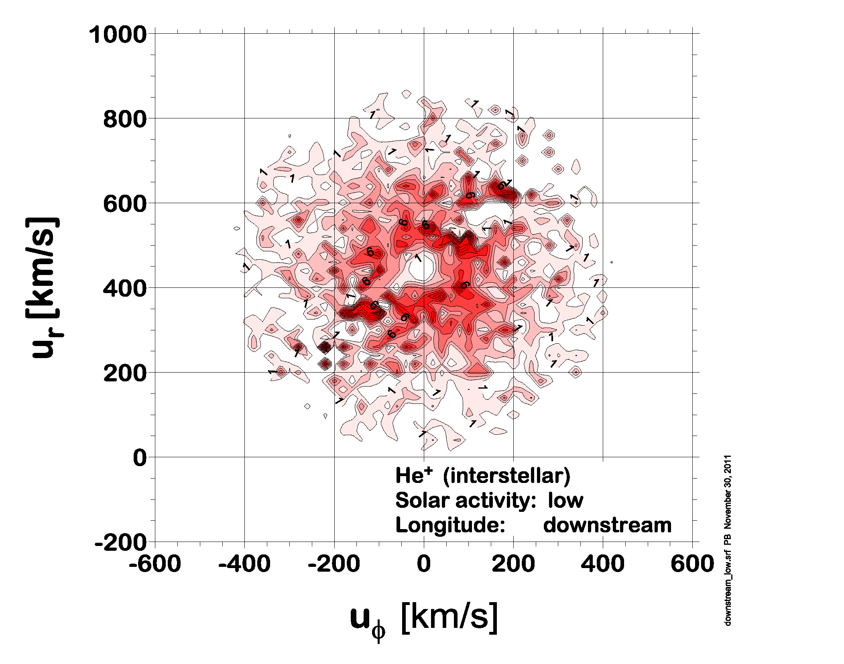
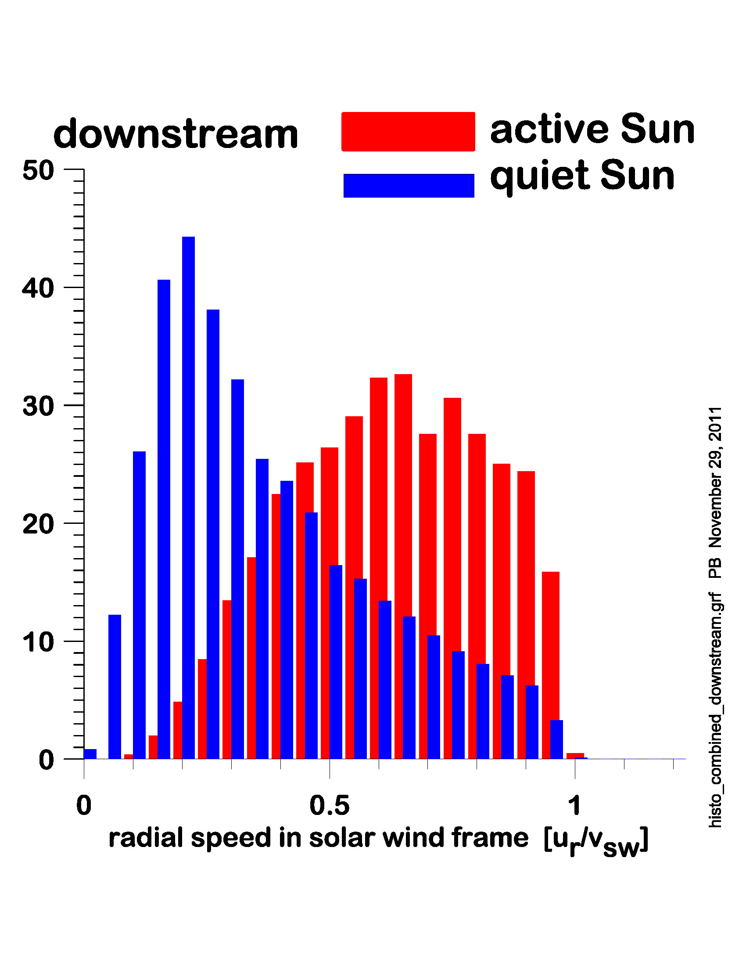
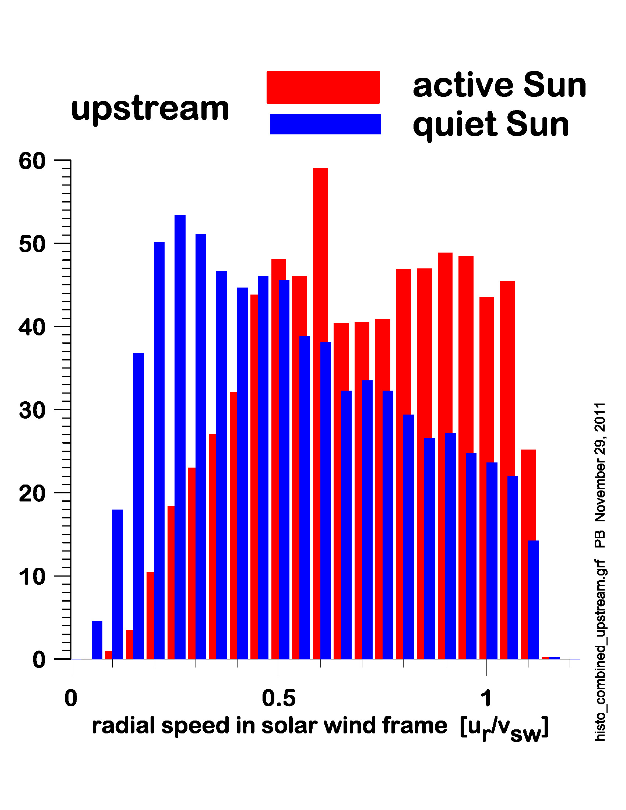
Monte-Carlo Simulation of Pickup Ion Velocity Distributions in the Inner Heliosphere SH23B-1955
Peter Bochsler, Philip A. Isenberg, and Eberhard Möbius
Space Science Center and Department of Physics
University of New Hampshire
Durham NH
Motivation
Various spacecraft have been collecting data on velocity distributions of inner-source pickup ions and of pickup ions from interstellar origin. The mechanisms which produce these distributions are still not completely understood.
We are establishing a Monte Carlo Program to investigate the role of pitch-angle scattering in isotropizing velocity distributions of pickup ions.
Procedures
Background: Homogeneous radially expanding solar wind with constant expansion velocity of 439 km/s (1 keV/nuc) . Radial component of magnetic field decreasing with B_{r} ∝ 1/r² , B_{φ} following the prescription of an expanding Parker spiral
Particle injection: “Interstellar” neutral ⁴He is injected from a rectangular boundary of 200 x 200 AU² located 200 AU away from the Sun. The main flow direction lies within the ecliptic plane. Flow speed at infinity: 26 km/s, temperature at infinity: 8500 K. For the generation of pickup ions only neutrals which cross the ecliptic plane at distances < 1 AU are considered. When a neutral particle crosses the ecliptic, the probability of ionization within a narrow range of heliographic latitudes is calculated. This probability is kept as a weight for investigating particle statistics at 1AU. We have considered two scenarios: One representing “Quiet Sun” (ν_{ion}= 5.9 x 10⁻⁸ s⁻¹) and one for “Active Sun” (ν_{ion}= 2.0 x 10⁻⁷ s⁻¹). The distribution of production rates in the ecliptic is shown in Figure 1.
Figure 1: Spatial and temporal variability of He⁺ pickup ion generation within the ecliptic and within the orbit of the Earth. The contour lines illustrate regions of equal production rates for periods of low solar activity (left) and high activity (right). Whereas pickup ions are produced at all heliographic longitudes in periods of low activity, the production is strongly concentrated in the focusing cone in the downwind region during periods of high solar activity. These differences have an impact on the resulting velocity distributions at 1AU.
Transport of pickup ions: Freshly injected particles begin to gyrate and move along magnetic field lines according to their initial speed in the frame of the expanding solar wind.
Scattering mechanism: In our Monte Carlo scheme we do not use the Diffusion approximation. Instead, we consider the transport and evolution of the distributions during the outward motion as an interplay between scattering events and motion on a free path along a magnetic field line. On the free path the magnetic moment of a particle is conserved. For the choice of random free paths between scattering events we use a power law with an index -3. The shortest (and most frequent) free paths were 10⁻⁶ AU = 150 km. The largest path between scattering events was 0.5 AU.
Scattering events are treated as random walk on a sphere, characterized by two random numbers. One parameter, again taken from a power law with index -3, is the step size (in degrees). The maximum step size is 180º , the shortest (and most frequent) step size is 0.5º . The second random parameter is the direction of a step. The change of the direction of the random walk is taken from a uniform distribution of numbers between 0 and 360º. The cosine of the polar angle of the location of the particle corresponds to the value μ, and random walk on a sphere is equivalent to diffusion with a diffusion law D(1- μ²). On average, the smallest changes in latitude occur, when the particle is moving in polar regions. The procedure needs no special prescription for walk across a pole. After each scattering event, v|| is set to a new value according to δμ=δv||/v. Figure 2 shows histograms of changes of δμ of a set of particles undergone at different heliocentric distances. Since newly ionized particles travel more frequently in radial direction at short heliocentric distances, they experience less frequently strong changes in μ than particles travelling at larger distances.
Figure 2: Histograms of changes in μ undergone by pickup ions at different radial distances from the Sun.
Once particles reach 1 AU we investigate their radial velocity distributions as measured in the solar wind frame. As expected, we find different features at different heliographic longitudes and for different phases of solar activity. Figure 3 shows that pickup ions from interstellar neutral helium, which are registered in the upstream direction of the inflowing interstellar gas, can reach speeds in the solar wind frame in excess of the solar wind speed. This is because they start with larger injection speeds relative to the solar wind ( Möbius et al. GRL 26, 1999, 3181ff)
Figure 3: Histograms of velocity distributions of pickup ions from interstellar helium in the downstream focussing cone (left) and in the upstream region (right) as found at
1 AU. Velocities are given in the solar wind frame and in units of the solar wind speed v_{sw} . The distributions under conditions of quiet solar activity are in blue and in red for periods of high solar activity.
Figure 3 also shows that during periods of high solar activity, interstellar neutral He atoms cannot penetrate close to the Sun; correspondingly the fraction of strongly cooled pickup particles at 1 AU is strongly reduced . We find similar pattern of velocity distributions for Inner Source pickup ions (to be reported later), however, their distributions are generally somewhat wider due to our assumption on injection speed, which is taken to be equal to the Kepler velocity of the parent dust particles.
Figure 4 illustrates cuts of velocity distributions taken in the ecliptic plane. The velocities are given in the rest frame of the Sun. The adopted intensity of pitch-angle scattering suffices to isotropize the distributions. However, we find a large cavity in the center of the distributions during periods of high solar activity. Again, this is due to the shorter penetration depth of neutral helium and the small fraction of strongly cooled particles. Comparing the upstream and downstream distributions one also notices that upstream distributions are generally more strongly energized than downstream distributions. A narrow gap, parallel to the direction of the interplanetary magnetic field near 1 AU is best visible during periods of low solar activity. We ascribe this gap to the lack of phase space in “polar regions” with μ close to +1 or -1. In any case, one has to keep in mind that the distributions are highly idealized since we assume a spherically symmetrically expanding solar wind with constant solar wind speed.
Figure 4: Velocity distributions at 1 AU in the rest frame of the Sun. Left panels for period of high solar activity, right panels for low solar activity. Top panels: Distributions observed upstream in the flow of the interstellar gas, bottom panels: Distributions in the downstream region.
Conclusion
For simple setups our Monte Carlo models succeeds to reproduce some similarity of pickup ion velocity distributions at different heliographic longitudes and under different conditions of solar activity with real observations. The model also works for Inner Source pickup ions, and distributions originating under different injection conditions. An in-depth comparison of these simulations with observations from spacecraft should reveal whether our characterization of the pitch-angle process is sufficiently realistic.
Acknowledgements:
We acknowledge helpful discussions with J. R. Jokipii, H. Kucharek, N. Schwadron, A. Chen, and with T. Leonard.
This work is supported by NASA SR&T Grant NNX09AW32G

