Slide 1

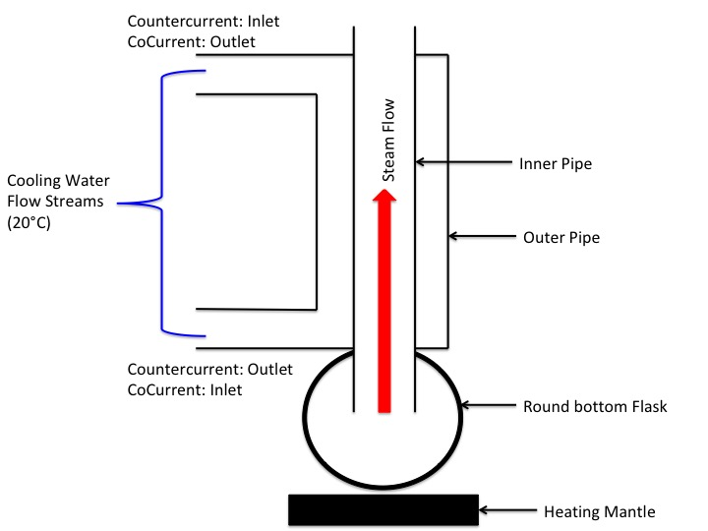
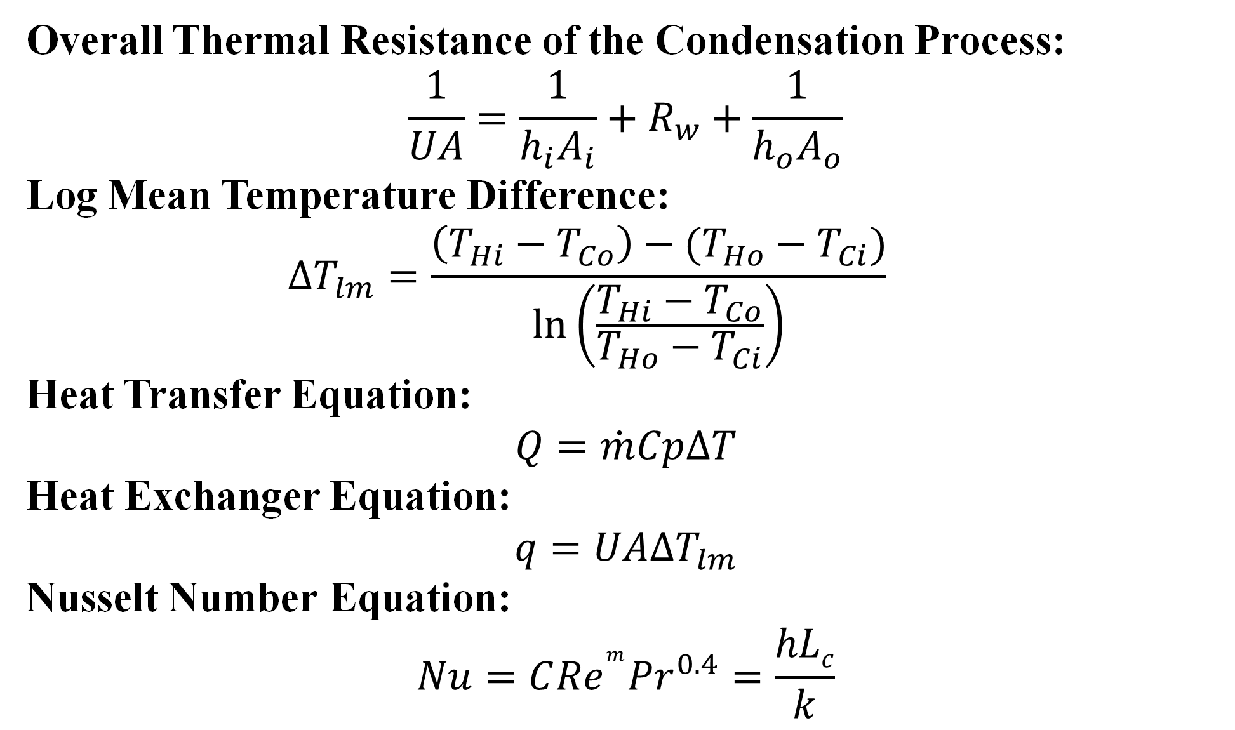
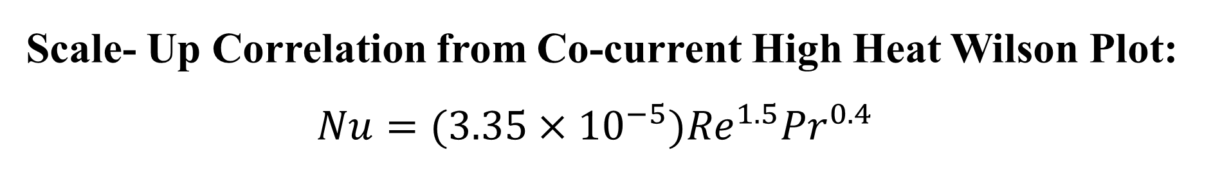
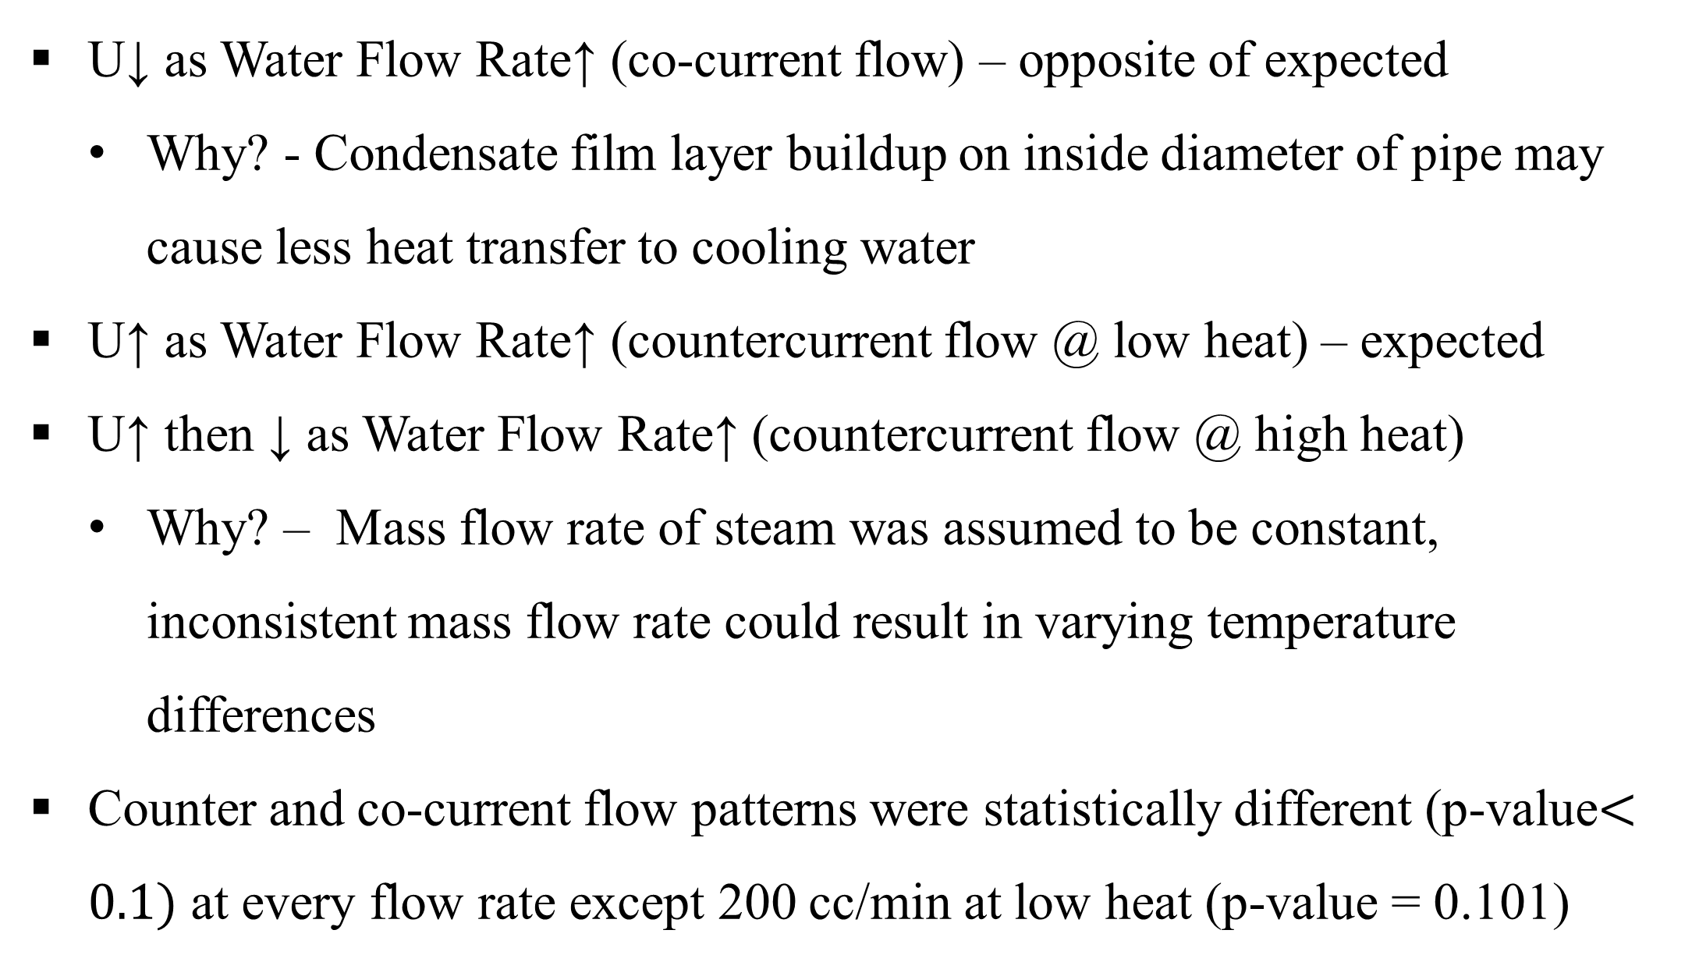

Heat Exchange in Condensing Systems
Nimesh Bhattarai, Thomas Gende, and Kristen Loose
University of New Hampshire Department of Chemical Engineering
Summary
Results and Discussion
Conclusion
The objective of this experiment was to determine the effect that changing the water flow rate, hot stream flow rate, and flow pattern has on the overall heat transfer coefficient in a double pipe heat exchanger condensing system. A correlation was developed using the data collected to scale up the system.
186%
Countercurrent flow is more efficient than co-current flow
  Larger overall U and smaller length of condenser
  Increasing the cold stream flow rate decreased the overall U for co-current flow
  For the design problem, the Wilson plot for the most effective flow pattern couldn’t be used because it was negative
Future Work
  Repeat experiment with horizontally positioned condenser tilted below 90° so most of the condensate will drain
  Test more cold and hot stream flow rates to decrease variability
63%
58%
108%
179%
Introduction
71%
Overall Thermal Resistance of the Condensation Process:
$$\frac{1}{UA}=\frac{1}{h_{i}A_{i}}+R_{w}+\frac{1}{h_{o}A_{o}}$$
Log Mean Temperature Difference:
  $$∆T_{lm}=\frac{\left(T_{Hi}−T_{Co}\right)−(T_{Ho}−T_{Ci})}{ln\left(\frac{T_{Hi}−T_{Co}}{T_{Ho}−T_{Ci}}\right)}$$
Heat Transfer Equation:
$$Q=\dot{m}Cp∆T$$
Heat Exchanger Equation:
$$q=UA∆T_{lm}$$
Nusselt Number Equation:
$$Nu=C{Re}^{m}{Pr}^{0.4}=\frac{hLc}{k}$$
Figure 2: The overall heat transfer coefficient was greater for countercurrent flow than for co-current flow.
Design Problem
U↓ as Water Flow Rate↑ (co-current flow) – opposite of expected
  Why? - Condensate film layer buildup on inside diameter of pipe may cause less heat transfer to cooling water
U↑ as Water Flow Rate↑ (countercurrent flow @ low heat) – expected
U↑ then ↓ as Water Flow Rate↑ (countercurrent flow @ high heat)
  Why? – Mass flow rate of steam was assumed to be constant, inconsistent mass flow rate could result in varying temperature differences
Counter and co-current flow patterns were statistically different (p-value$<0.1)$ at every flow rate except 200 cc/min at low heat (p-value = 0.101)
Problem Statement
Steam from a pilot-scale power generating turbine to be condensed in a small scale condensing unit
Steam initially at 100°C and 1 atm with flow rate of 600 SCFM
Cold stream inlet: 15 °C; cooling stream cannot boil
Solution
Parameters:
1. Re_{water}(lab) = Re_{water} (design)
2. Outlet Water Temperature = 30°C
Methods
12.7m
0.5m
Figure 5: Cross-Section of Scale-Up Condenser
Using parameter 1, Re=286.12, ${\dot{V}}_{water}=0.0002\frac{{ m}^{3}}{sec}, D_{water}$= $1 m$
Using parameter 1, Re=286.12, 𝑉 ̇_𝑤𝑎𝑡𝑒𝑟=0.0002 〖 m〗^3/𝑠𝑒𝑐, 𝐷_𝑤𝑎𝑡𝑒𝑟= 1 𝑚
$h_{i}$ was calculated using Nu equation and C and m values derived from Wilson Plot
$h_{i}$ = 0.068 W/($m^{2}$K)
ℎ_𝑖 was calculated using Nu equation and C and m values derived from Wilson Plot
ℎ_𝑖 = 0.068 W/(𝑚^2K)
Re_{steam} was calculated using Nu relation with tabulated C and m values
$${Nu}_{H2O}={Nu}_{steam}$$
$${Re}_{steam}=1311$$
Re_{steam} was calculated using Nu relation with tabulated C and m values
〖𝑁𝑢〗_𝐻2𝑂=〖𝑁𝑢〗_𝑠𝑡𝑒𝑎𝑚
〖𝑅𝑒〗_𝑠𝑡𝑒𝑎𝑚=1311
Steam flow diameter was found using Re equation
D = 12.7 m
$$Q=\dot{m}Cp\left(T_{2}−T_{1}\right)$$
where $T_{1}$= 15°C and $T_{2}$ = 30°C
$Q$ =12549 J
∆$T_{lm}$ = 77.26 °C
𝑄=𝑚 ̇𝐶𝑝(𝑇_2−𝑇_1 )
where 𝑇_1= 15°C and 𝑇_2 = 30°C
𝑄 =12549 J
∆𝑇_𝑙𝑚 = 77.26 °C
$h_{0}$ was calculated using Nu relation
$$Nu\left(water\right)=Nu\left(steam\right)$$
$h_{0}$ = 0.016 W/($m^{2}$K)
ℎ_0 was calculated using Nu relation
𝑁𝑢(𝑤𝑎𝑡𝑒𝑟)=𝑁𝑢(𝑠𝑡𝑒𝑎𝑚)
ℎ_0 = 0.016 W/(𝑚^2K)
$$\frac{1}{UA}=\frac{1}{h_{i}A_{i}}+R_{w}+\frac{1}{h_{o}A_{o}}$$
Assuming A_{o} = A_{i} , $Rw$ is negligible
U = 0.013 W/($m^{2}$K)
1/𝑈𝐴=1/(ℎ_𝑖 𝐴_𝑖 )+𝑅_𝑤+1/(ℎ_𝑜 𝐴_𝑜 )
Assuming A_{o} = A_{i} , 𝑅𝑤 is negligible
U = 0.013 W/(𝑚^2K)
Surface area (A) of the heat exchanger was calculated using
Q = UA ∆$T_{lm}$
A = 12470 $m^{2}$
Surface area (A) of the heat exchanger was calculated using
Q = UA ∆𝑇_𝑙𝑚
A = 12470 𝑚^2
L was calculated
A = 2$πrL$
L = 290.7 m
L was calculated
A = 2𝜋𝑟𝐿
L = 290.7 m
Figure 3: Wilson Plot Analysis for Co-Current Flow
(Low) $y=102±32x+0.45±0.03$with $R2=0.6$
(High) $y=107±41x+0.4±0.04$with $R2=0.5$
Figure 1: Condensing System Apparatus
Scale- Up Correlation from Co-current High Heat Wilson Plot:
  $$Nu=(3.35×{10}^{−5}){Re}^{1.5}{Pr}^{0.4}$$
Set Up Countercurrent Flow Condenser
Collected All Countercurrent Flow Data
Set Up Cocurrent Flow Condenser
Collected All Cocurrent Flow Data
Wilson Plot for countercurrent flow could not be used to find a scale-up correlation because it had a negative slope
References
Data collected at water flow rates ranging from 100-300 cc/min, heat settings high and low, steady state, 1 atm, and 25 ℃
  Inlet /Outlet Temperatures of Cooling Water Flow Streams
  Length of Condenser (Height where Internal Condenser Temp = Water Outlet Temp)
C. J. Geankoplis, Transport Processes and Separation Process Principles, Upper Saddle River, NJ: Pearson Education , 2003.
Ferna´ndez-Seara, J., & Uhı´a, F. J. (2007). A general review of the Wilson plot method and its modifications. Science Direct.
Acknowledgments
Figure 4: Wilson Plot Analysis for Countercurrent Flow
UNH Chemical Engineering Department for the cost of printing
Professor St. Jean for answering questions corresponding to data collection and analysis

