Slide 1

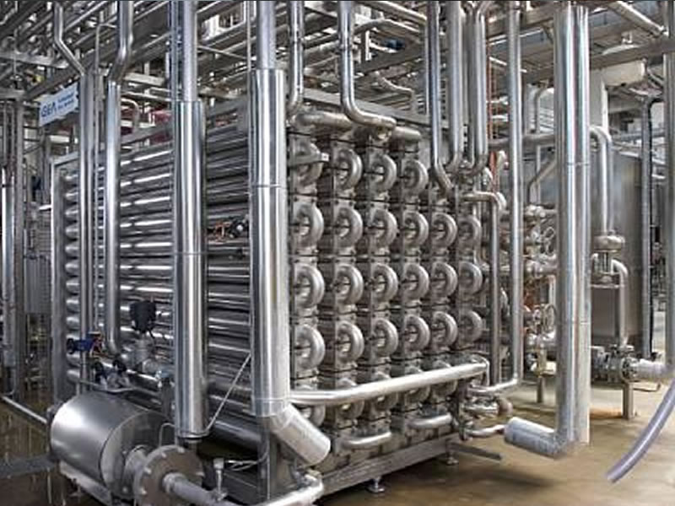
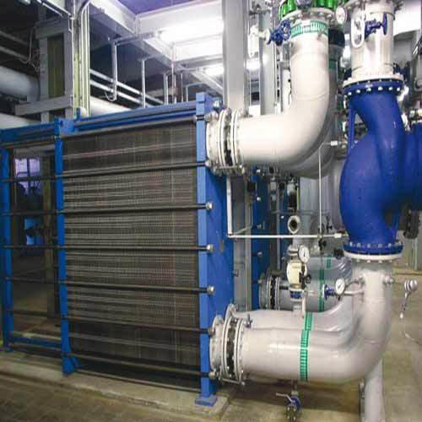
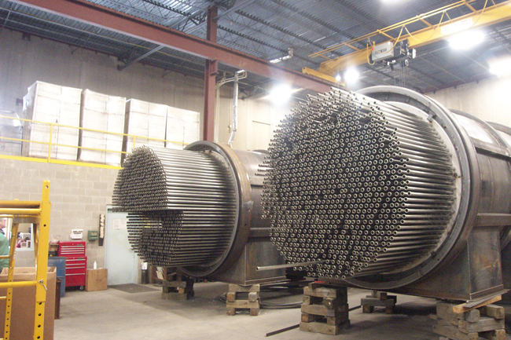
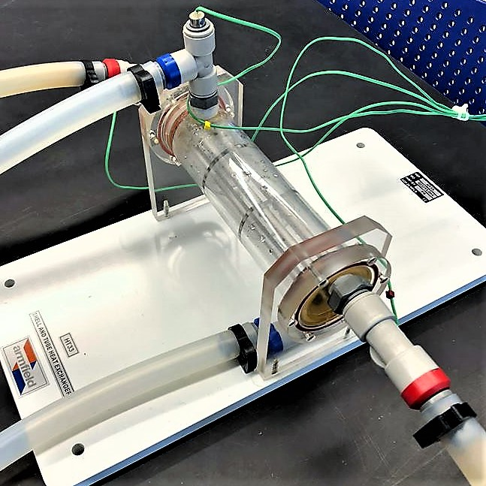
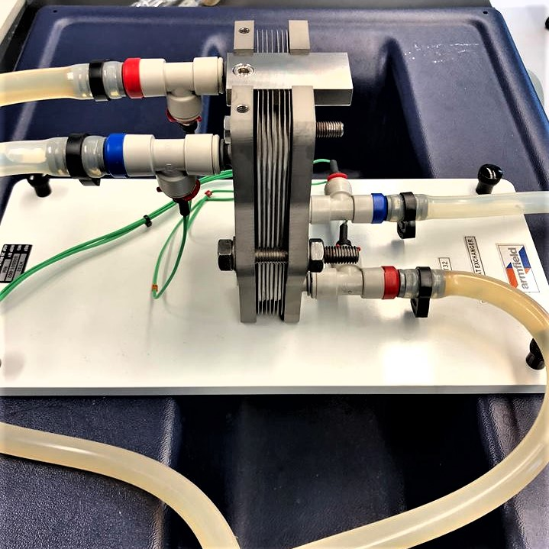
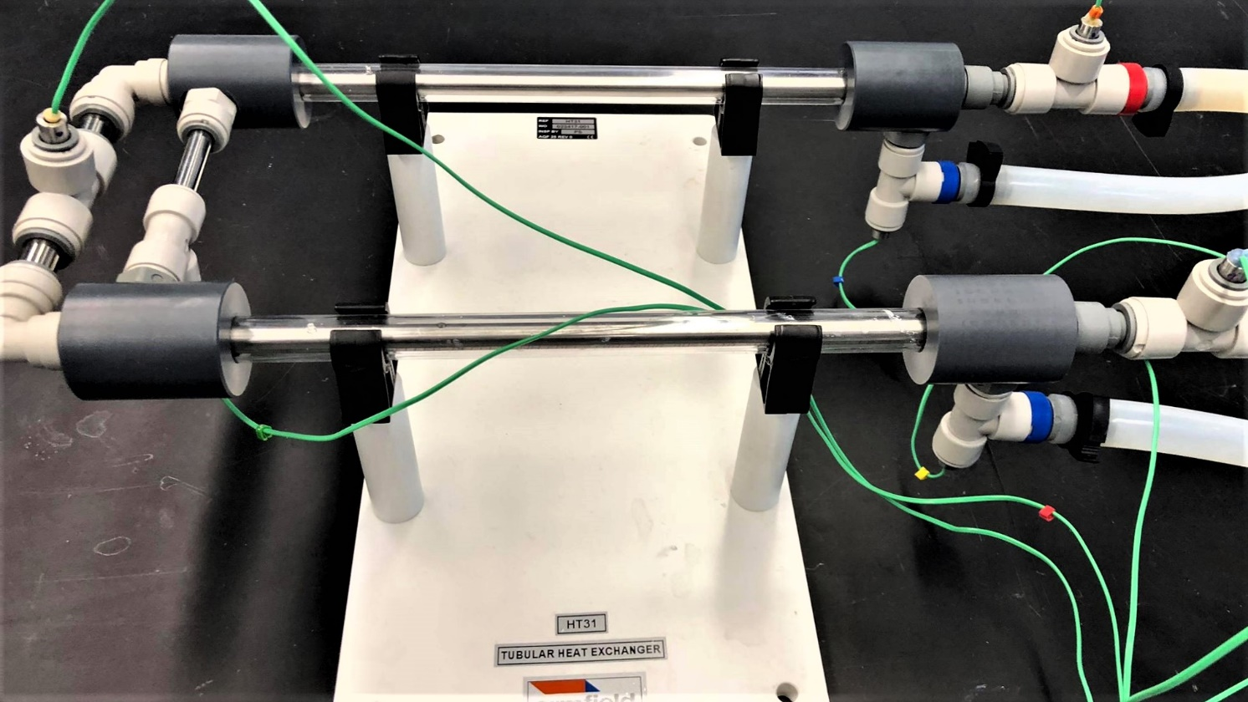
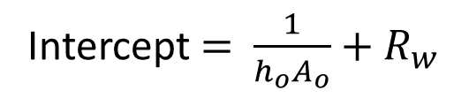
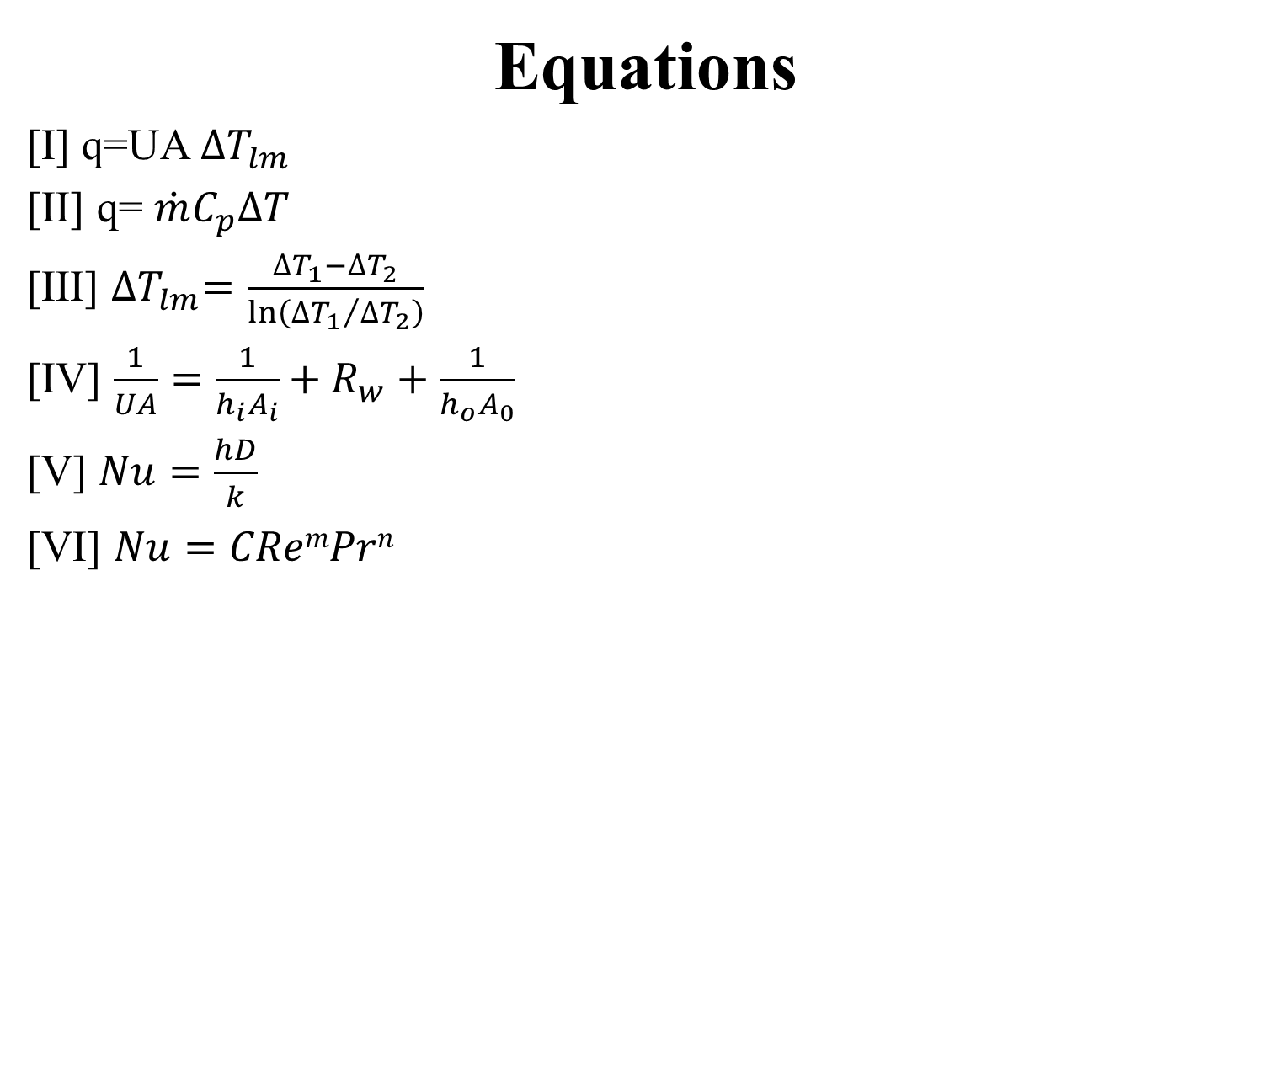
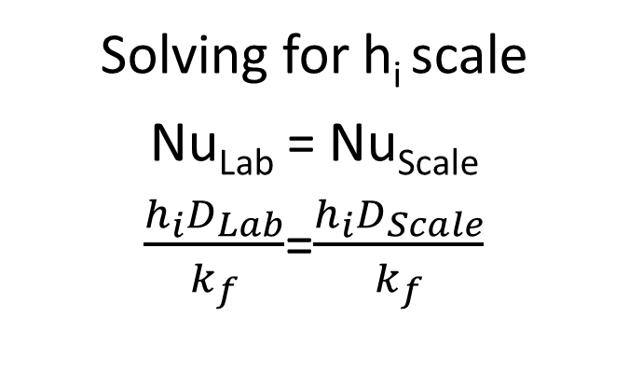
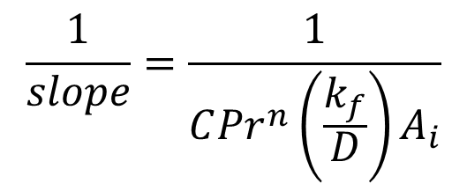
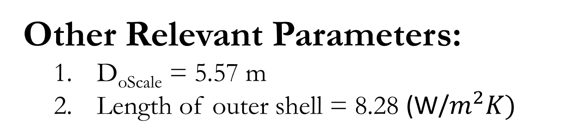
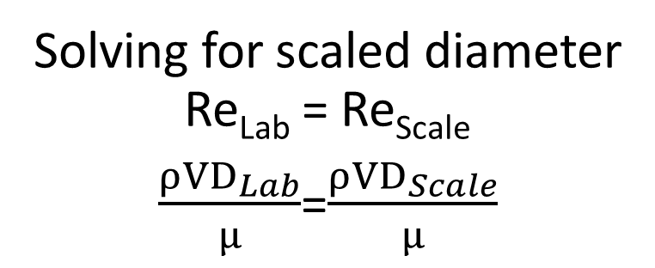
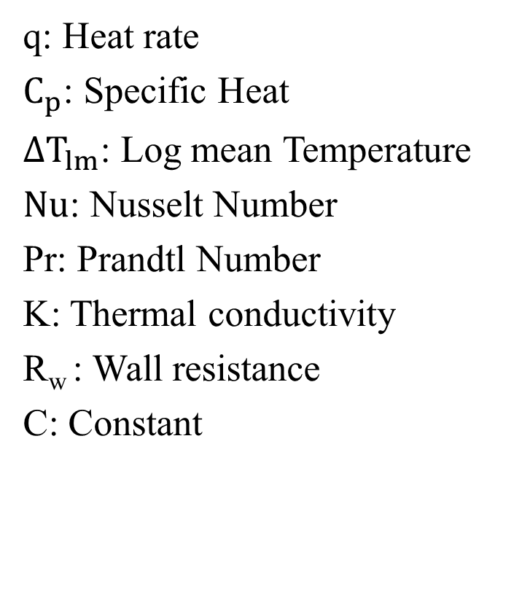
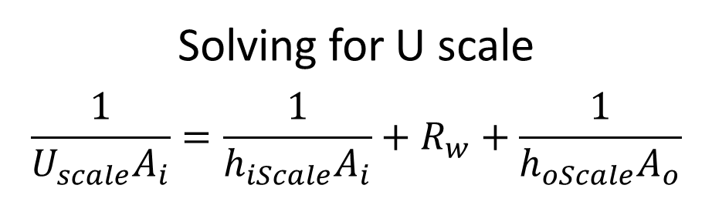
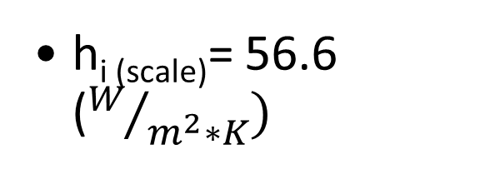
Comparison of Heat Exchanger Types
Ibrahim Al-Musawi, Sabrina Marnoto, Ibrahim Muhic
Dr. Adam St. Jean
Department of Chemical Engineering, University of New Hampshire
Introduction
Calculations
Design Problem
Heat exchangers: used to transfer heat [1]
Each heat exchanger type has varied pros and cons[2]
Cost determined by material, efficiency, and size [3]
Equations
[I] q=UA ${∆T}_{lm}$
[II] q= $\dot{m}C_{p}∆T$
[III] ${∆T}_{lm}=\frac{{∆T}_{1}−{∆T}_{2}}{\ln\left({{∆T}_{1}}/{{∆T}_{2}}\right)}$
[IV] $\frac{1}{UA}=\frac{1}{h_{i}A_{i}}+R_{w}+\frac{1}{h_{o}A_{0}}$
[V] $Nu=\frac{hD}{k}$
[VI] $Nu=CRemPrn$
Wilson Plot Analysis
Problem:
Liquid Reactor
Stream Heated from 20°C to 50°C entering at 3 kg/s
Hot Water Stream 80 °C
q: Heat rate
$C_{p}$: Specific Heat
${∆T}_{lm}$: Log mean Temperature
$Nu$: Nusselt Number
Pr: Prandtl Number
K: Thermal conductivity
R_{w} : Wall resistance
C: Constant
Intercept $=$ $\frac{1}{h_{o}A_{o}}+R_{w}$
$$\frac{1}{slope}=\frac{1}{C{Pr}^{n}\left(\frac{k_{f}}{D}\right)A_{i}}$$
Assumptions:
Similar to water
Flow rate of hot in = 3.5 kg/s
Constant Cp values
Arbitrary velocity of 2 m/s
m=0.8
http://www.heatexchangerasia.co/tubular-heat-exchanger.html
https://www.indiamart.com/proddetail/industrial-plate-heat-exchanger-4109995912.html
http://www.pre-heat.com/industrial-shell-tube-heat-exchanger.html
Results
Specifications:
Shell and Tube Heat Exchanger
Co-current Flow
Objectives
Compare different types of heat exchangers
Investigate effect of flow pattern on rate of convective heat transfer coefficient (h_{i})
Determine effect of cooling water flow rate on overall heat transfer coefficient (U)
Tubular
Plate
Shell and Tube
*= p-value>0.1
*= p-value>0.1
Hot
T_{in} = 80 °C
m = 3 kg/s
*
Cold
T_{in} = 20 °C
Cold
T_{out} = 50 °C
Methods
Hot
T_{out} = 54.3 °C
Measuring inlet and outlet cold and hot fluid temperatures
Hot inlet kept at constant temperature of 40ºC and 2 L/min
Varying flow rate of cold inlet (L/min): 3, 2, 1, 0.5
Co-current vs countercurrent flow
Co-current
Counter current
Shell and tube
Plate
Solving for scaled diameter
Re_{Lab} = Re_{Scale}
$\frac{ρVD_{Lab}}{μ}$=$\frac{ρVD_{Scale}}{μ}$
  D_{s}=.371m
Solving for h_{i} scale
Nu_{Lab} = Nu_{Scale}
$\frac{h_{i}D_{Lab}}{k_{f}}$=$\frac{h_{i}D_{Scale}}{k_{f}}$
  h_{i (scale)}= 56.6 ($W/{m^{2}∗K})$
Tubular
% difference in h_{i} between shell and tube and tubular significantly as flow rate for co-current
Overall 50-55% difference in h_{i} between shell and tube and tubular exchangers
  U=15.2 W/m² K
Solving for U scale
$$\frac{1}{U_{scale}A_{i}}=\frac{1}{h_{iScale}A_{i}}+R_{w}+\frac{1}{h_{oScale}A_{o}}$$
Conclusions
Future Work
$$πD^{2}=\frac{q}{Ux∆T_{lm}}$$
𝜋𝐷^2=𝑞/(𝑈𝑥∆𝑇_𝑙𝑚 )
Overall length = 331.1 m
Number of tubes= 15
Length of individual tube = 8.28 m
in h_{i} with Reynolds number
Counter and co-current flow significantly different
Shell and Tube has highest h_{i} for co-current
Tubular has highest h_{i} for counter current
The % difference for co-current with in flow rate
Test other types of heat exchangers
  Regenerative and Adiabatic Wheel
Investigate different types of fluids
Determine effect of baffles
Investigate the affect of fouling on h_{i}
Other Relevant Parameters:
D_{oScale} = 5.57 m
Length of outer shell = 8.28 (W/$m^{2}K)$
References
Acknowledgements
C. J. Geankoplis, Transport Processes and Separation Process Principles, Upper Saddle River, NJ: Pearson Education, Inc, 2003.4
J. E. Edwards, "Design and Rating Shell and Tube," J. E. Edwards of P & I Design Ltd, Teesside, UK, 2008.
R. K. Shah and D. P. Sekulic, Fundamentals of Heat Exchanger Design, Hoboken, New Jersey: John Wiley & Sons, 2003.
R. Mukherjee, "Effectively Design Shell-and-Tube Heat Exchangers," Chemical Engineering Progress, 1998.
We would like to acknowledge the Department of Chemical Engineering at the University of New Hampshire for providing resources to enable this project. We would also like to acknowledge Dr. Adam St. Jean, Darcy Fournier, and Zhen Tian for their support.
Notes:
80.7% to 11.4% difference between shell and tube and tubular

