Slide 1

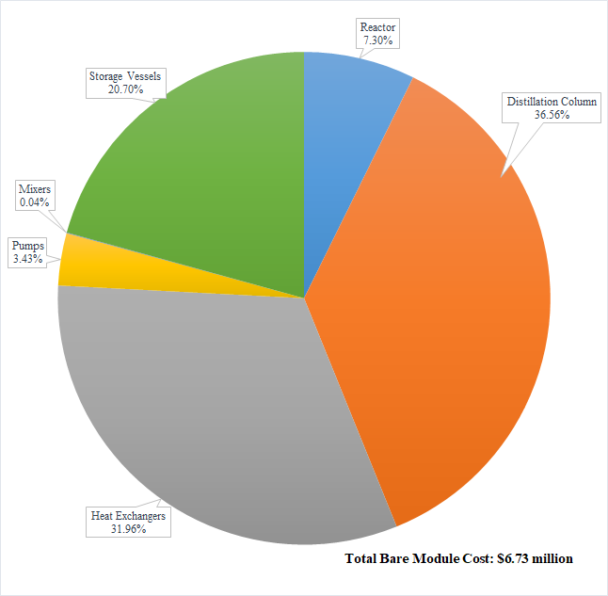
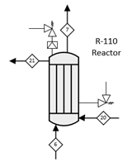
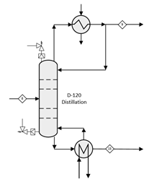
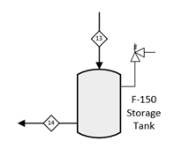
Production of Dimethyl Ether from Methanol
ROLO Engineers
Serge Boucher, MaKenzie Marshall, Jia Mo, Joseph Verro
Chemical Engineering, University of New Hampshire, Durham, NH 03824
Introduction
Economic Analysis
Market:
Transportation Fuel [1]
The global demand for dimethyl ether (DME) is continuously increasing and will grow to USD 11.72 billion by 2023 [2]
Product:
ISO DME Fuel Plant gate Standard (ASTM D7901.144734) [1]
Critical to quality variables:
Composition of 98.5 wt% minimum
Reaction:
Gas phase
Gamma Alumina Catalyst
35 barg and 325 ℃
Single pass conversion: 85%
Overall conversion: 99.99%
Capacity:
250,000 gallons per day at 100% [1]
125,000 gallons per day at 50%
Location:
Lake Charles, LA [1]
Market price: $2.28/gal
Net annual profit: $1.97 Million
After tax rate of return: 33%
DBEP: 6 Years
PBP: 3.2 Years
Grass Roots Costs: $7.67 million
Total Capital Investment: $9.06 million
Plant is under construction for 2 years and operates for 20 years [1]
Process Flow Diagram
Safety Evaluation
Inherent Safe Design
A continuous process was used
Pipes are insulated to reduce the risk of burns
Pipes and equipment are labeled
Relief valves are designed
Initial HAZOP Report completed
Relief Valves
R-110
D-120/130
F-150 A/B/C
Conclusions
DME market is growing due to demand for more environmentally friendly fuels.
Proposed process: Pressurized, high temperature, gas-phase reaction over Gamma Alumina catalyst.
Net annual profit: $1.97 Million
After tax annual rate of return: 33%
Proper safety considerations were made to ensure smooth operation
This plant is a GO!
Acknowledgements
Thank you to the chemical engineering staff, our families and friends for their help and support through the four years at UNH
 | MW | Stream 1 | Stream 2 | Stream 3 | Stream 4 | Stream 5 | Stream 6 | Stream 7 | Stream 8 | Stream 9 | Stream 10 | Stream 11 | Stream 12 | Stream 13 | Stream 14 | Stream 15 | Stream 16 | Stream 17 | Stream 18 | Stream 19 | Stream 20 | Stream 21 | Stream 22 | Stream 23 | Stream 24
Component | (kg/kmol)
CH₃OH | 32.04 | 36018.8 | 36018.8 | 42395.6 | 42395.6 | 42395.6 | 42395.6 | 6383.8 | 6383.8 | 0.6 | 0.6 | 0.6 | 0.6 | 0.6 | 0.6 | 6383.2 | 6376.8 | 6376.8 | 6.4 | 6.4
H₂O | 18.02 |  |  | 10.1 | 10.1 | 10.1 | 10.1 | 10133.6 | 10133.6 |  |  |  |  |  |  | 10133.6 | 10.1 | 10.1 | 10123.5 | 10123.5 | 2953 | 2953 | 2953
C₂H₆O | 46.07 |  |  | 2.59 | 2.59 | 2.59 | 2.59 | 25890.9 | 25890.9 | 25888.3 | 25888.3 | 25888.3 | 25888.3 | 25888.3 | 25888.3 | 2.6 | 2.6 | 2.6
Lubricant | NA |  |  |  |  |  |  |  |  |  |  |  | 23 | 23 | 23 |  |  |  |  |  |  |  |  | 23 | 23
Total (kg/hr) |  | 36018.8 | 36018.8 | 42408.3 | 42408.3 | 42408.3 | 42408.3 | 42408.3 | 42408.3 | 25888.9 | 25888.9 | 25888.9 | 25911.9 | 25911.9 | 25911.9 | 16519.4 | 6389.5 | 6389.5 | 10129.9 | 10129.9 | 2953.0 | 2953.0 | 2953.0 | 23.0 | 23.0
Temperature (◦C) |  | 25 | 27 | 58 | 118 | 194 | 320 | 325 | 130 | 102 | 35 | 35 | 35 | 35 | 35 | 212.7 | 192 | 192 | 244 | 160 | 98 | 320 | 98 | 25 | 25
Pressure (barg) |  | 1 | 38 | 38 | 37 | 36 | 35 | 35 | 34 | 34 | 33 | 17 | 17 | 17 | 17 | 35 | 35 | 38 | 36 | 35 | 3 | 2 | 1 | 1 | 17
Vapor Fraction |  | 0 | 0 | 0 | 0 | 0 | 1 | 1 | 0 | 0 | 0 | 0 | 0 | 0 | 0 | 0 | 0 | 0 | 0 | 0 | 0 | 1 | 0 | 0 | 0
References
[1] AIChE , "2018 Student Design Competition," AIChe, 2018.
[2] "Nasdaq GlobeNewswire," Crystal Market Research, 30 Nov 2017. [Online]. [Accessed April 2018].

