Slide 1

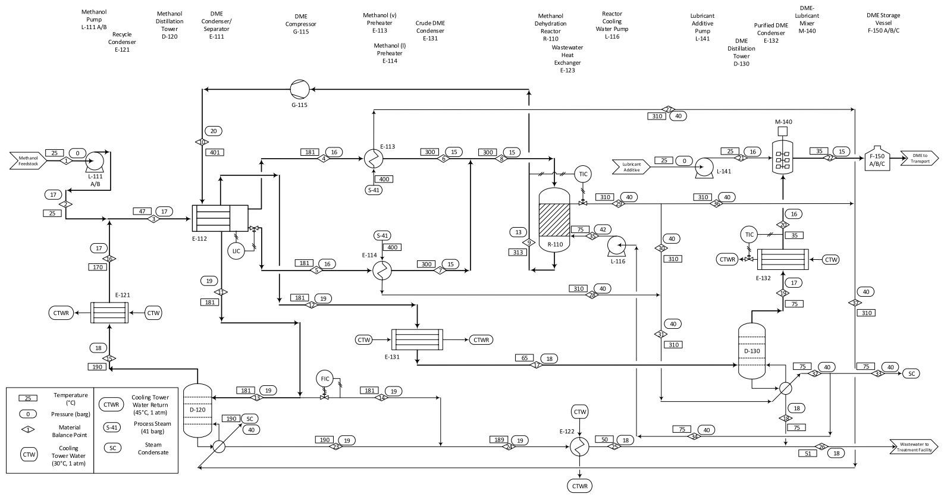
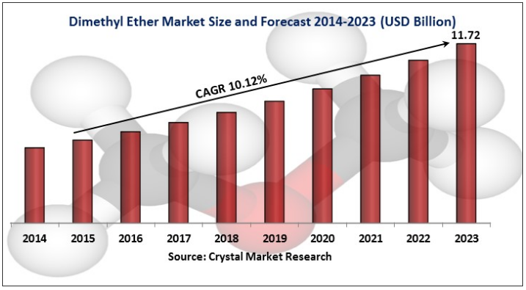
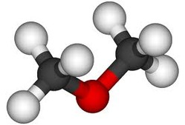
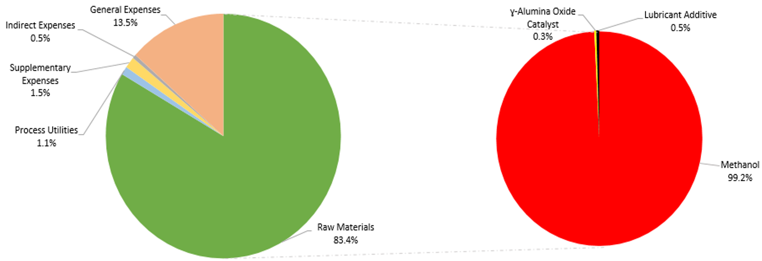
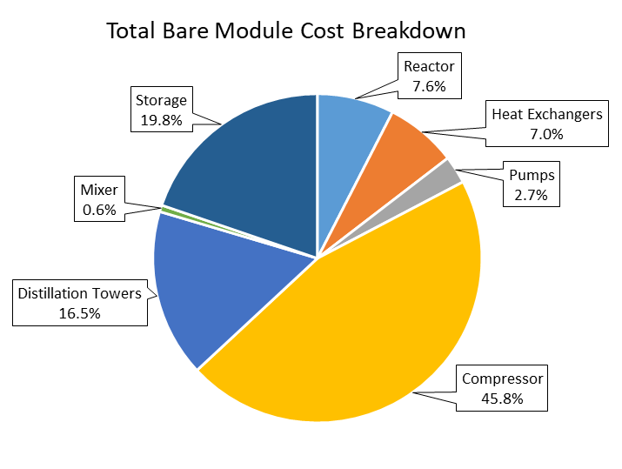
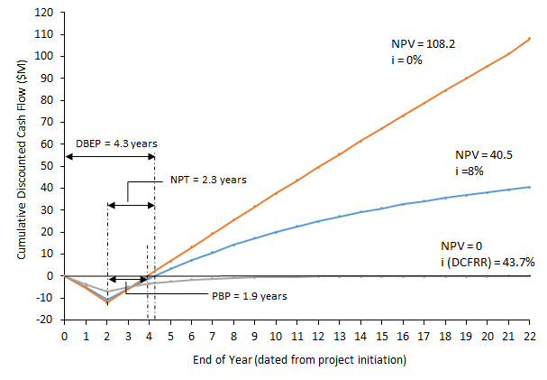
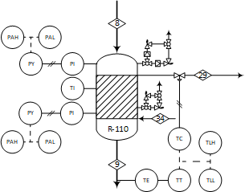
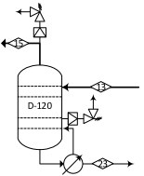

Design of a Continuous Process for the Production of Dimethyl Ether from Methanol
CALJ Consulting
Christian Quinn, Anthony Picone, Lorenzo Milani, and John Fernald
Department of Chemical Engineering, University of New Hampshire, Durham, NH 03824
Introduction
Process Flow Diagram and Material Balances
Quality Control
Objectives
Design a plant for the production
of dimethyl ether (DME) from a
methanol feedstock
Minimize carbon footprint
Produce 250,000 gal/day
Location
Lake Charles, Louisiana
Market
Growing demand for clean-burning fuels to reduce emissions
Major applications include: aerosol propellant, automotive fuel alternative, electrical power generation
Product
DME meets ASTM grade A- fuel standards (purity > 98.5 mass% DME)
Contains 900 ppm of lubricant additive
Intended for use as automotive transportation fuel
Critical-to-Quality Variables
Purity
Turbidity
Quantity
Cost
Objective
Assure a quality manufactured product
Meeting customer’s requirements
Product Specifications
Clear
Purity above 98.5%
Water content
Methanol content
Testing Methods
Turbidity test
Specific gravity test
Chromatography
Sampling of Final Product
DME samples from stream 20 would be tested every 4 hours
Other Sampling/Testing
The plant would be a part of the EPA compliance program
Figure 1. Past, Current and Forecast Dimethyl Ether Market Size (2014-2023) ^{[1]}.
$$2 CH_{3}OH → CH_{3}OH_{3}+H_{2}O$$
Safety
Economic Analysis
Major Assumptions
Inherent Safe Design
24/7 continuous process, 350 days per year
Kinetic energy, moving parts, and height differences were discredited for energy balance calculations
Ideal gas law with the inclusion of the compressibility factor was applied to all streams.
This design was conducted assuming steady state conditions
Jacketed water cooled reactor was chosen to ensure reactor safety
Major control loops were implemented for operation simplicity and operator safety
Initial HAZOP report completed for the main Reactor (R-110)
Relief valves were designed for all major pieces of equipment
Process Safety Management (PSM) practices will be strictly adhered to and developed
Conclusions
Figure 2. Breakdown of total annual expenses (left) as well as of raw materials for the DME production facility (right).
The final product purity of 99.9%
The total capital investment is 12.1 Million USD
The total annual expenses are 189.6 Million USD per year
At the interest rate of 8%, the NPV is 40.5 Million USD
The annual rate of return is 67.4%
The DCFRR is 43.7%
The process is safe
The process is profitable
Relief Valves and Controls
Figure 3. Breakdown of the total bare module cost for each type of equipment used in the DME plant.
Facts
DME selling price is $2.25/gal
Methanol price is $1.49/gal
2 years for construction
20 years of operation
Recommendations
Further engineering evolution of the process is recommended to optimize the process and maximize profit
A more detailed methanol market analysis is recommended
Because the process is profitable and safe, this project is a GO and it should move forward to a further detailed design
HAZOP Report
Rupture in R-110 jacket would reduce purity of DME
Less CW sent to R-110 than required might cause catalyst damage and reaction could runaway
Environmental Considerations
DME is classified as not dangerous for the environment ^{[2]}
No special treatment for CTWR
The first disposal option for CH₃OH is recycling, followed by incineration
Figure 4. Cash flow analysis for the continuous processing of dimethyl ether from methanol. NPV values are in Million USD.
References
[1] – CRYSTAL MARKET RESEARCH, “Dimethyl Ether Market”. Available at: https://www.crystalmarketresearch.com/report/dimethyl-ether-dme-market
[2] - CHEMOGAS, "Safety Data Sheet: Dimethyl Ether, based on regulation no. 1907/2006," [Online]. Available:http://www.chemogas.com/sites/default/files/pdfs.pdf.
Acknowledgement
  Dr. Christopher McLarnon, Department of Chemical Engineering, UNH
  Department of Chemical Engineering, UNH

