Slide 1

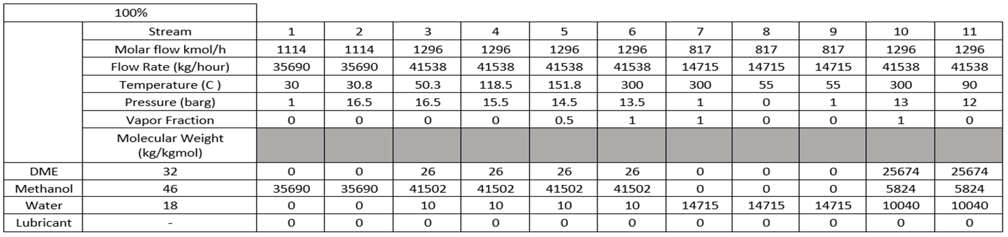
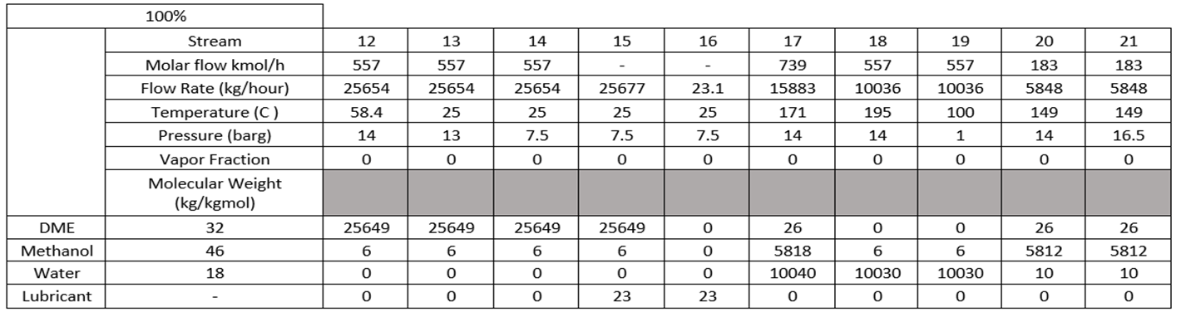
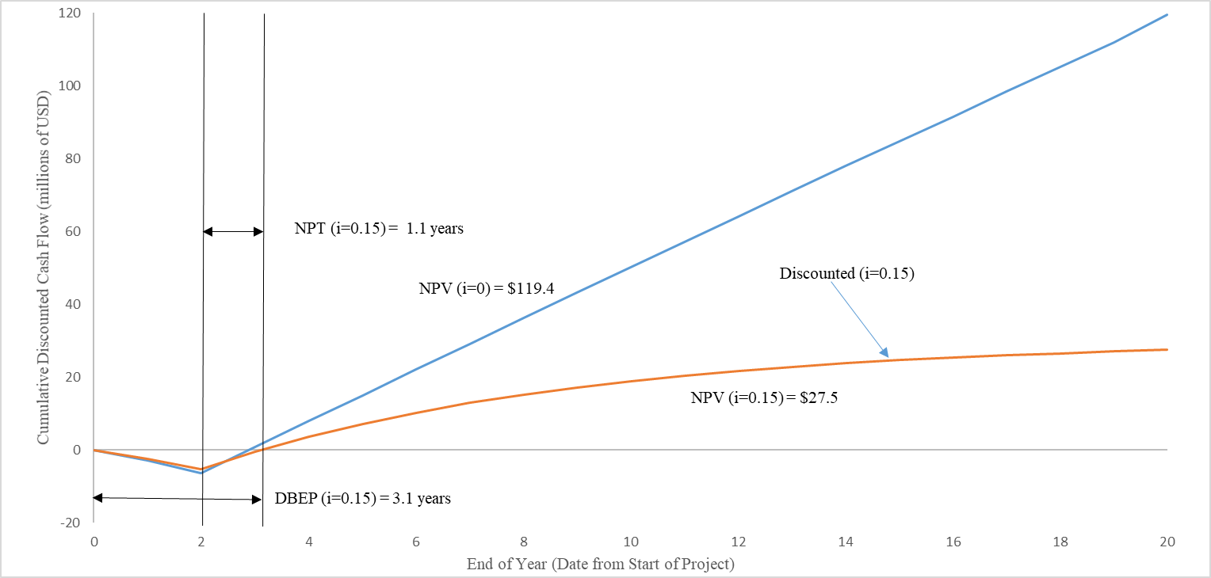
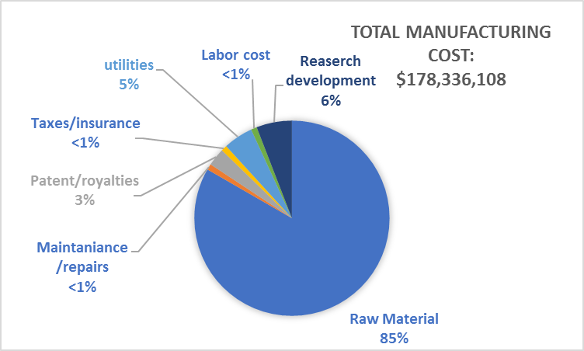
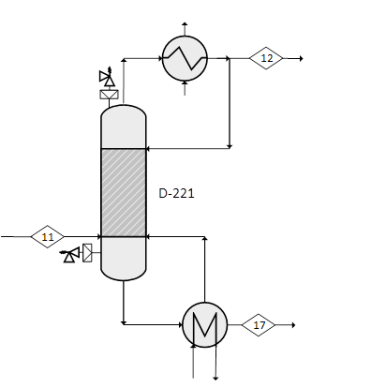
The Production of Dimethyl Methyl Ether Using Pure Methanol
Team 8: Ahmed Alzawar, Christopher Bales, Ryan Bingman, Andrew Knight
Department of Chemical Engineering, University of New Hampshire
Introduction
Process Flow Diagram
Market
Largest market for DME: Transportation and industrial fuels, Aerosol propellants
DME use for domestic applications is gradually growing
World Production: 5 million tons annually
Product
DME (99.97% pure)
Annual Capacity
100%: 91.25 million gallons
Plant
Lake Charles, Louisiana
2 years on construction
Operates 24hrs/day
363 days for 18 years
Safety Considerations
Minimize
Leaking
Storage Volume of Tanks
Substitute
Oil or Organic Solvents → Water
Packing → Mechanical Seals
Flanged pipes → Welded Pipes
Moderate
Pressure
Temperatures
Early Warning Detection System
Ambient Temperature of Storage Vessels
Pumps
Simplify
Temperature and Pressure Controls
Vessels Labeled
Safety Barricades
Economic Analysis
Conclusions
Cash Flow Profile
Manufacturing Costs
DME production should focus on transportation fuel market
224 million kg per year capacity
Net annual profit after taxes: $6,692,642
Safety and economic analysis suggest proceeding with construction of the plant
Acknowledgments
Total Bare Module Cost: $4,771,807
Grass Roots Capital: $5,572,483
Total Capital Investment: $6,408,355
Market Price: $ 0.99/kg
Net Annual Profit Before Tax: $10,296,372
After Tax Rate of Return: 157%
We would like to thank the Chemical Engineering Department of the University of New Hampshire and Professor McLarnon.
R-130: Pressure relief valves and rupture discs on reactor
D-221: Relief valves and rupture discs on distillation column

