Slide 1

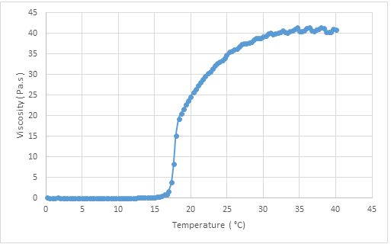
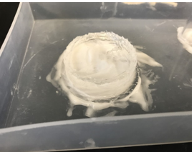
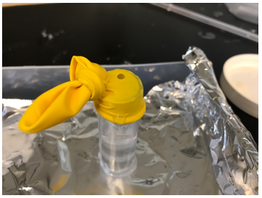
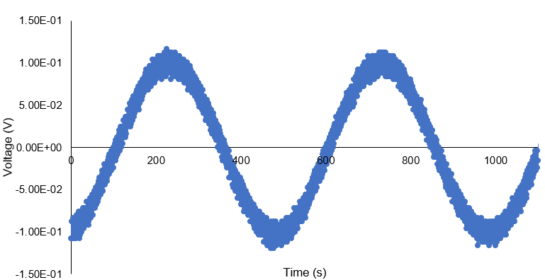
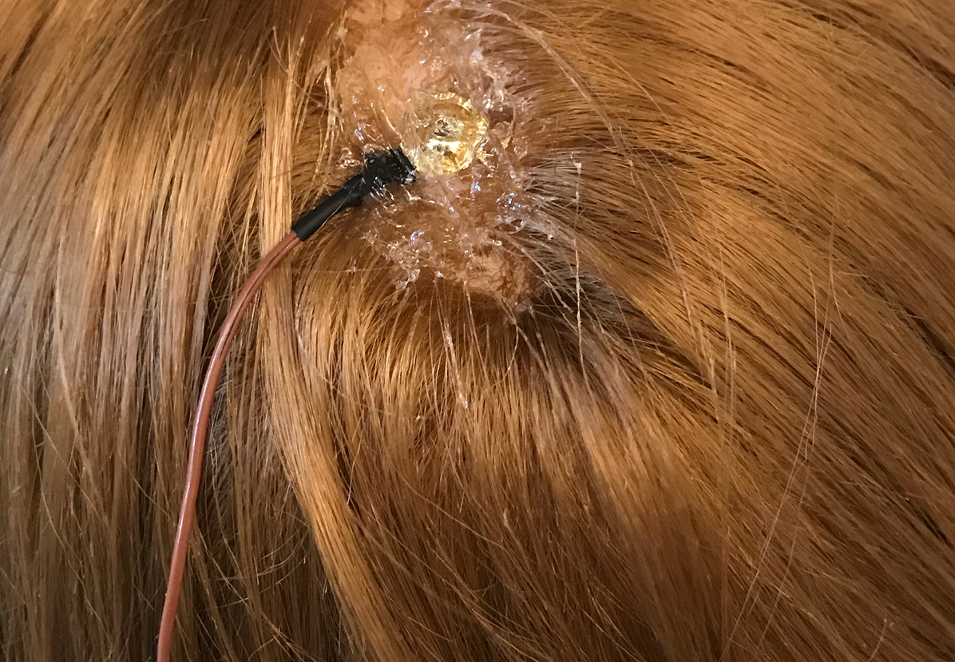
Securing Electrode Attachment during Electroencephalography with PF-127 Hydrogel
Bioengineering Class of 2018 - Daniel Courter, Kaixin Feng, Salimah Hussien, and Caroline Ladegard
Problem Description
Conceptual Journey of Hydrogel Product
Electrical Measurements
Provide strong gel adhesion and ease of application of an electrode to all hair types; specifically thick, natural hair for conducting an electroencephalogram (EEG) while minimizing signal distortion.
Viscosity increased with temperature
PF-127 hydrogel (25 wt%) transitioned from liquid to gel between 17ºC and 30°C
Stabilized as the temperature increased beyond 30ºC
Needle Electrode Data
Brittany
Dionne
PF-127 Hydrogel Production
Dissolved pluronic acid in DI water (25 wt%) via refrigeration (4°C)
Determined lower critical solution temperature at 25 wt% using room temperature water bath/hot water bath system
  LCST: 25°C
Heated solution with hair dryer
  Lower concentrations failed to gel
  Supported literature findings (Lee, et al., 2010)
Performed rheology testing with temperature ramp (0.2°C/sec)
Figure 1. Viscosity-temperature relation of PF-127 hydrogel (25 wt%) tested by rheometer, shear rate was fixed (20 s⁻¹) and viscosity were measured as the temperature increased from 0ºC to 40ºC.
 | Tensive | Ten20 | Spectra360 | PF-127
Amplitude (V) | 1332 | 1787 | 1289 | 1281
Frequency (Hz) | 108.4 | 77.1 | 91 | 60.2
 | Tensive | Ten20 | Spectra360 | PF-127
Amplitude (V) | 372 | 1215 | 1203 | 1440
Frequency (Hz) | 96.3 | 74 | 103.7 | 82.4
Design I: Hydrogel Injection Mold
Purpose
Secure electrode to scalp through all hair styles/types
Contain hydrogel & take advantage of thermo-responsiveness
Manage application and removal to accommodate patient
Procedure
Layer of Ten 20 conductive paste was applied on the bottom to prevent leakage; latex cap on top
Inner surface of vinyl tubing mold (D=5cm) was coated with petroleum jelly for
PF-127 (25 %w/w) hydrogel (21mL) was injected through balloon then heated
Gold Cup Electrode Data
Brittany
Dionne
Effectiveness: low
Poor adherence potentially caused by mold
Inconsistent seal at bottom
Difficult to apply
Latex can cause allergic reactions
Electrical Characterization
Experiments used conductive mesh wrapped in aluminum foil attached to a signal generator within head
Sinusoidal potential introduced
Output BNC harness had one wire grounded and the other attached to the electrode (needle or cup)
Oscilloscope measured signal amplitude and frequency recorded
Picture of autozeroed signal taken as .csv file and compiled in excel
Design II: Direct application of Hydrogel
 | Tensive | Ten20 | Spectra360 | PF-127
Amplitude (V) | 1113 | 739 | 610 | 608
Frequency (Hz) | 87 | 893 | 1113 | 2410
 | Tensive | Ten20 | Spectra360 | PF-127
Amplitude (V) | 950 | 1047 | 900 | 943
Frequency (Hz) | 1210 | 39 | 39 | 35
Purpose
Strongly secure electrode to scalp using PF-127 thermo-responsiveness
Provide convenient application
Compete on the market with collodion, a strong adhesive used in EEGs
Procedure
Applied hydrogel directly to head over gold cup electrode dipped in Ten 20 paste
Heated with hair dryer to increase temperature and rigidity
Effectiveness: moderate
Moderate electrode adherence
Significant signal distortion
Advantages over collodion on the market
  Less expensive
  Less toxic
  More convenient to apply
Summary
Electrode Data
  Needle had minimal signal distortion than gold cup electrode
  Ability to get clear signal directly relates to viscosity of gel and stick to the head of the cup electrode
  PF-127 was comparable to Ten 20 paste and Tensive adhesive gel
Direct application of PF-127 hydrogel with cup electrode
  Provided moderate electrode adherence
  Easy application
  Potential advantages over similar products on the market
References
Future Work
Electrode Application with Demonstration. https://www.youtube.com/watch?v=bFdTS-HeVmc&feature=youtu.be
Giofreddi, E. (2015). Pluronic F127 Hydrogel Characterization and Biofabrication in Cellularized Constructs for
Tissue Engineering Applications: The Second CIRP Conference on Biomanufacturing. Elsevier
Hanson Information Systems (2017). ABRET: Accredited EEG Laboratories. ABRET.org/lab/eeg
Lee, Y., Chung, H.J., Yeo, S., Ahn, C.-H., Lee, H., Messersmith, P.B., and Park, T.G. (2010).
Thermo sensitive, injectable, and tissue adhesive sol–gel transition hyaluronic acid/pluronic
composite hydrogels prepared from bio-inspired catechol-thiol reaction. Soft Matter 6, 977.
Semmlow, J. (2017). Circuits, Signals, and Systems (Academic Press).
Crosslink PF-127 hydrogel with hyaluronic acid to increase rigidity
Determine signal noise generated by cross-linked hydrogel
Improve gold cup electrode adhesion to point comparable to needle electrode
Develop custom mannequin head as better signal generation model
  Materials that better mimic skin conductivity
  Generated signal more similar to brain waves
Utilize programming tools to get more accurate data
Design controlled environment of mannequin head for quality signal
Work towards human testing after IRB approval
Acknowledgements
Dr. Carr, PhD, Professor and Chair of Chemical Engineering
Dr. Gupta, PhD, Professor of Chemical Engineering
Jim Abare and Darcy Fournier

