Slide 1



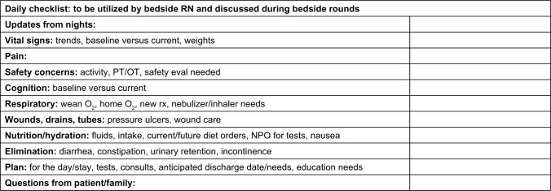
Interprofessional Collaborative Bedside Rounding: Improving Communication Across the Healthcare Team
Jaque Goudreault, University of New Hampshire, Senior Nursing Student
Problem
Current Evidence
Communication and collaboration between nurses and physicians has proved to be sub-optimal, with a hierarchical system that does not facilitate shared decision-making.
Ineffective communication between members of the healthcare team can effect the quality of patient care.
A lack of communication and collaboration leads to poor job satisfaction among nurses.
Purpose
A literature review was conducted to answer the PICO question: For nurse-physician communication, how does interprofessional collaborative bedside rounding, compared to traditional hierarchal physician rounding, impact the perception of shared-decision making and the quality of patient care?
Post-implementation showed perceptions of nurses and physicians:
100% agreed that there was an increase in understanding of the patients’ plan of care, perception of collaborative team work, personal job satisfaction, and patient safety (Gausvik et al, 2015).
92% believed it improved efficiency of care (Gausvik et al, 2015).
After implementation, there was a decrease in the number of pages to the physicians during the clinical day (Henkin et al, 2016).
To increase collaboration between members of the healthcare team in order to create an environment of effective shared decision-making and increase job satisfaction.
Clinical & Research Implications
Creating a culture of teamwork can increase staff job satisfaction and improve nurse retention rates.
Improving nurse-physician communication can improve efficiency and quality patient care.
Utilizing structured interprofessional bedside rounding increases mutual understanding and collaboration of the patient plan of care.
More definitive research should be conducted focusing on the impact of collaborative bedside rounding on patient safety, length of stay, and costs.
Practice Recommendations: Policy Change
Upon arrival to the unit, physicians will page the assigned nurse and members of the healthcare team will meet at the bedside.
If the assigned nurse is unable to attend, the clinical nurse leader will substitute and report to the assigned nurse.
Physicians will collaborate schedules so nurses caring for patients with different assigned physicians may be present for each round.
A structured daily checklist will be utilized to provide guidance of important topics to cover during rounds.
Acknowledgements
Stephanie Carpenter, RN

