Slide 1

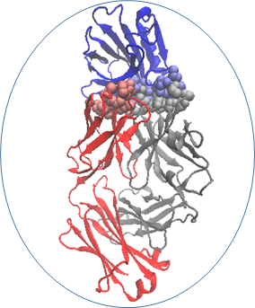
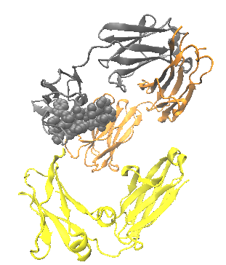
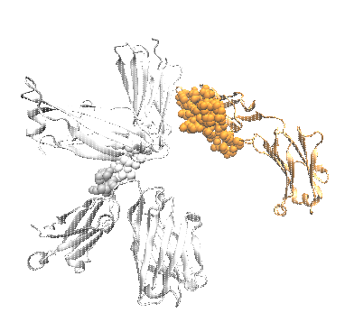

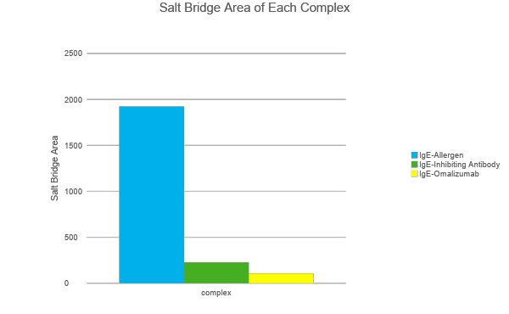

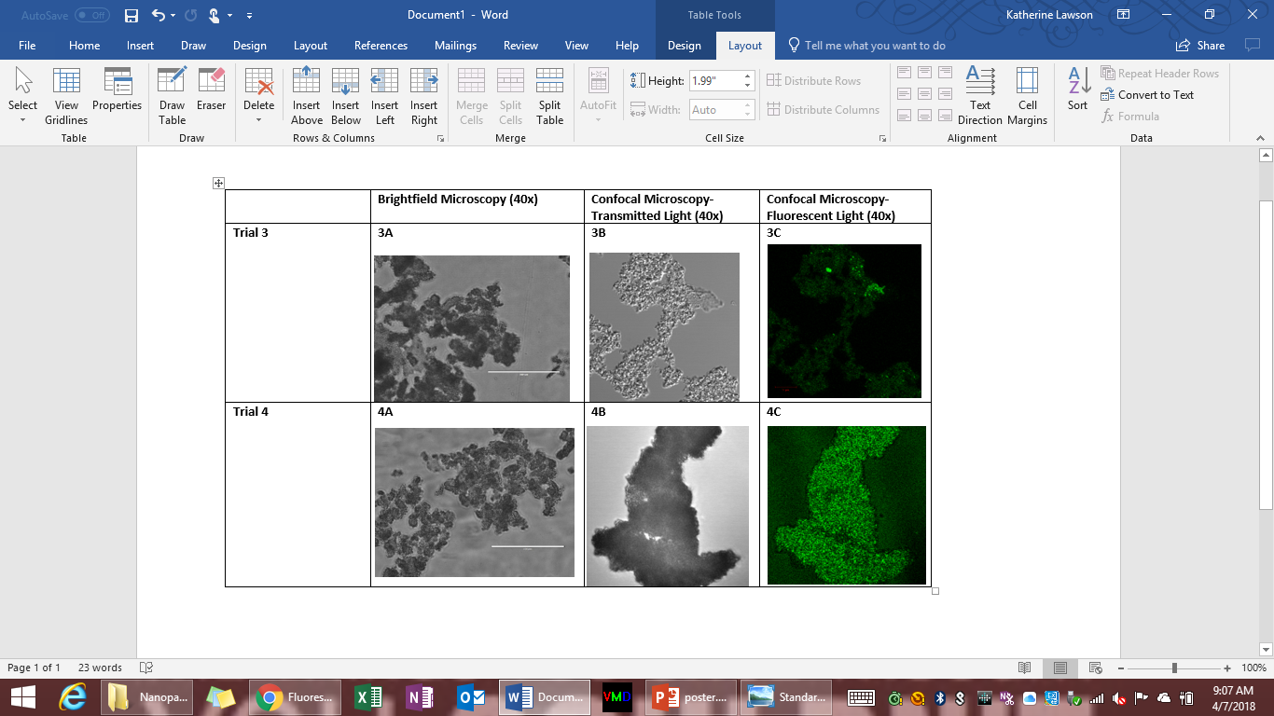
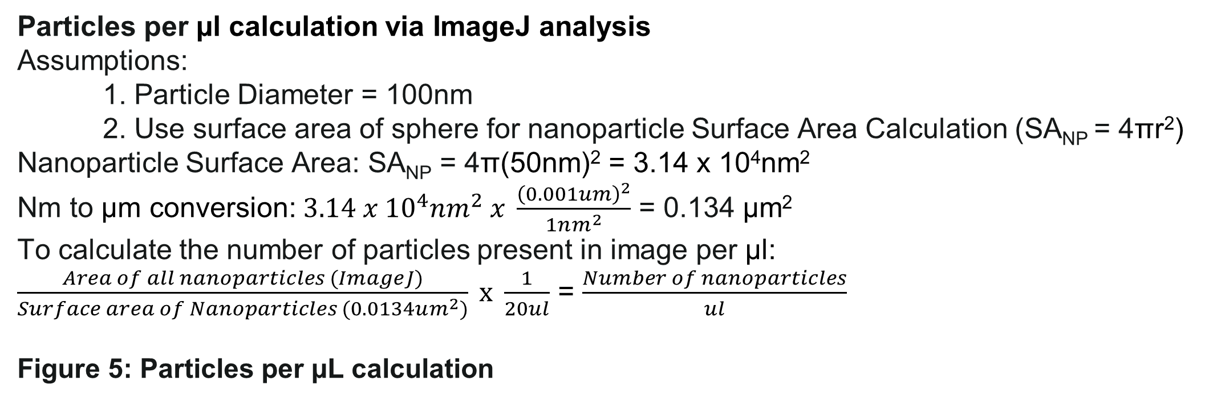
Lipophillic Nanoparticles as a Mechanism for Allergen Immunotherapy
Katherine E. Lawson, Alexandra K. Reade, and Tyler E. Weir | Dr. Carr | University of New Hampshire
Background
Results
Particles per µl calculation via ImageJ analysis
Assumptions:
1. Particle Diameter = 100nm
2. Use surface area of sphere for nanoparticle Surface Area Calculation (SA_{NP} = 4πr²)
Nanoparticle Surface Area: SA_{NP} = 4π(50nm)² = 3.14 x 10⁴nm²
Nm to µm conversion: $3.14 x {10}^{4}nm^{2} x \frac{{\left(0.001um\right)}^{2}}{1nm^{2}}$ = 0.134 µm²
To calculate the number of particles present in image per µl:
$\frac{Area of all nanoparticles (ImageJ)}{Surface area of Nanoparticles (0.0134um^{2})} x \frac{1}{20ul}$ = $\frac{Number of nanoparticles}{ul}$
Figure 5: Particles per µL calculation
Problem:
Allergic reactions are an immune system-mediated response to specific environmental allergen [1]. Mediated by the Th2 helper cells, this overstimulation of the immune system has two phases: first the CD4+ Th2 cells produce IgE antibodies, and then the IgE antibodies bind to mast cells to produce an allergic response when the allergen is recognized [1]. Over 15 million Americans suffer from allergic reactions, and there are currently only two treatments available: allergy desensitization and the therapeutic Omalizumab [2,1].
Project /Solution:
Our group sought to develop non-toxic and biodegradable IgE-inhibitory antibody-conjugated lipophilic nanoparticles, which could then be inserted into the bloodstream to act as a preventative measure against allergic reactions. These particles would then be marketed as intellectual property to larger companies in order to provide immunotherapy to patients.
Trial III Concentration: 8.76x10⁴ nanoparticles/µL.
Trial IV Concentration: 2.86x10⁴ nanoparticles/µL.
There are 4 times more nanoparticles per µL in Trial III than in Trial IV.
Figure 2: Visual Representation of IgE-Allergen Complex (Right), IgE-Inhibitor antibody Complex (Center) , and IgE-Omalizumab Complex (Left)
Salt Bridge Amino Acid Composition:
IgE only contains amino acids with basic or neutral side chains
1 protein chain from each adjuvant contributes neutral amino acids
Other adjuvant protein chain contains amino acids with acidic side chains
Salt bridge forms via interactions between acidic and basic side chains
Conclusion
Through Visual Molecular Dynamics (VMD) and Nanoscale Automated Molecular Dynamics (NAMD), the following was determined. The area of the IgE-allergen salt bridge is about 10 times greater than the area of the IgE-inhibitory antibody complex, and 20 times greater than the IgE-Omalizumab complex. Because salt bridges are hypothesized to stabilize protein structures, it would be reasonable to assume a smaller salt bridge would induce a more unstable and energetically-unfavorable complex [5]. Also, mast cell binding is greatly influenced by IgE stability, so a more unstable IgE complex would be less likely to bind to the mast cells [6]. This is most likely why Omalizumab is such an effective therapeutic, because the area of its salt bridge is five percent the area of the IgE-allergen salt bridge.
Out of the five product experiments, only trials III, IV and V successfully produced nanoparticles. The group attributed this to the protocol adjustments made after trial II synthesis. Most likely due to the lipophilic nature of the nanoparticles, nanoparticle aggregation increased with time. This issue was resolved by diluting (10-fold, 20-fold, 50-fold) the nanoparticle solutions in deionized water. The discrepancy in nanoparticle concentrations can be attributed to Trial III being an older and more aggregated sample. The autofluorescence of the nanoparticles under brightfield microscopy was most hypothesized to be due to the lipophilic coating. While there is no definitive proof that the group successfully produced a lipid-coated nanoparticle, Croce et al. wrote about how autofluorescence occurred when a biomolecule acted as a fluorophore [7]. Because the lipids are the only biomolecules present in the sample, it would be reasonable to assume they were the cause of autofluorescence.
Future directions for the group include determining the number of maleimide groups present on each nanoparticle for accurate adjuvant concentration, and running an ELISA assay to determine the concentration of adjuvant necessary to successfully inhibit IgE. The group also plans to determine what tests would be necessary to be in compliance with Food and Drug Administration (FDA) guidelines for therapeutic nanotechnology.
Mast
cell
Lipophilic
np
Figure 1: Model of anti-IgE binding to PEGylated nanoparticles, and then inhibiting IgE expressing B cells. Generated by PubMed Chemistry Drawing Tool. [3]
Methods
Figure 3: Area of the Amino Acid Salt Bridge for each IgE complex
Computational Analysis
Generic Buried Surface Area TCL script used to calculate salt bridge areas
Protein Databank Reference Files:
      2r56 (Recombinant IgE Fab fragment complexed with Bovine Beta-Lactoglobulin Allergen)
      5anm (IgE Fab complexed with neutralizing antibody [anti-IgE])
      5hys (IgE complexed with Omalizumab)
Nanoparticle Synthesis
The protocol for nanoparticle synthesis was adapted from the work of Dr. Darrell J. Irvine of MIT. To make the particles, PLGA, DOPC, DOPG, and mal-PEG2k-PE were dissolved in dichloromethane to form an organic phase. Deionized water was then dispersed into the organic phase via sonication at 15 amps for 1 minute and 30 amps for 6 minutes. The solution was then incubated at room temperature on a stir plate for 19 hours to evaporate DCM. The adaptations of the protocol incorporated anti-IgE and FITC-BSA as adjuvants. The materials were all increased by a 10-fold scale to ensure the correct amounts were measured and recorded. Due to the increase in resources, the organic phase was evaporated over a longer period.
Sources
Fujita, Hiroyuki, et al. “Mechanisms of Allergen-Specific Immunotherapy.” Clinical and Translational Allergy, BioMed Central, 5 Jan. 2012, www.ncbi.nlm.nih.gov/pmc/articles/PMC3395833/.
FARE. “Food Allergy Facts and Statistics for the U.S.” Food Allergy Research & Education, 2017, www.foodallergy.org/sites/default/files/migrated-files/file/Final-FARE-Food-Allergy-Facts-Statistics.pdf.
“Sulfhydryl-Reactive Crosslinker Chemistry.” Sulfhydryl-Reactive Crosslinker Chemistry | Thermo Fisher Scientific, Thermo Fischer Scientific, www.thermofisher.com/us/en/home/life-science/protein-biology/protein-biology-learning-center/protein-biology-resource-library/pierce-protein-methods/sulfhydryl-reactive-crosslinker-chemistry.html.
Bershteyn, Anna, et al. “Robust IgG Responses to Nanograms of Antigen Using a Biomimetic Lipid-Coated Particle Vaccine.” Journal of Controlled Release, Elsevier, 24 July 2011, www.sciencedirect.com/science/article/pii/S0168365911005347.
Bosshard, Hans Rudolf, et al. “Protein Stabilization by Salt Bridges: Concepts, Experimental Approaches and Clarification of Some Misunderstandings.” Journal of Molecular Recognition, Wiley-Blackwell, 28 Jan. 2004, onlinelibrary.wiley.com/doi/pdf/10.1002/jmr.657.
Kubo, S, et al. “Drastic up-Regulation of Fcepsilonri on Mast Cells Is Induced by IgE Binding through Stabilization and Accumulation of Fcepsilonri on the Cell Surface.” Journal of Immunology (Baltimore, Md. : 1950)., U.S. National Library of Medicine, 15 Sept. 2001, www.ncbi.nlm.nih.gov/pubmed/11544335.
Croce, A.C., and G. Bottiroli. “Autofluorescence Spectroscopy and Imaging: A Tool for Biomedical Research and Diagnosis.” European Journal of Histochemistry : EJH, PAGEPress Publications, Pavia, Italy, 22 Oct. 2014, www.ncbi.nlm.nih.gov/pmc/articles/PMC4289852/.
Figure 5: Microscopical analysis of Trial 3 and Trial 4 nanoparticle formation.
3A. 40x Brightfield Microscopy of Trial 3 nanoparticles; 3B. 40x Transmitted Confocal Microscopy of Trial 3 nanoparticles; 3C. 40x Fluorescent Confocal Microscopy of Trial 3 nanoparticles; 4A. 40x Brightfield Microscopy of Trial 4 nanoparticles; 4B. 40x Transmitted Confocal Microscopy of Trial 4 nanoparticles; 4C. 40x Fluorescent Confocal Microscopy of Trial 4 nanoparticles
Acknowledgements
The group would like to thank Dr. Russell Carr, Dr. Kyung Jae Jeong, and Dr. Harish Vashisth of the Chemical Engineering Department; Nancy Cherim and Mark Townley of the Instrumentation Center; and Dr. Xuan Mao Chen of the Biochemistry, Molecular and Cellular Biology Department for all their help with this project.
Notes:
This project contains three main objectives:
The first objective was to achieve computational simulation and analysis of the complexes that the IgE antibody is able to form and analyze how it impacts therapeutic approach. To accomplish this objective, the most stable conformation of the complex was modelled, the IgE-allergen complex was compared to the project simulation (IgE-anti-IgE) and current allergen therapeutic (IgE-Omalizumab), and the complex salt bridge area and amino acid composition was determined.
The second objective was the technical development of lipophillic PEGylated nanoparticles. This objective was met through procedure development and successful replication of nano- to micro- sized particles.
The third objective was the successful conjugation of adjuvant to lipophillic nanoparticles. This
Successful conjugation of goat Anti-IgE to lipophilic nanoparticles
Determination of concentration of adjuvant necessary to successfully inhibit IgE binding

