Slide 1

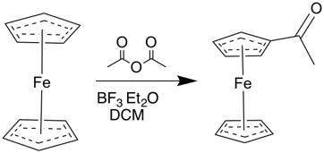
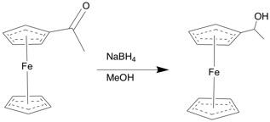
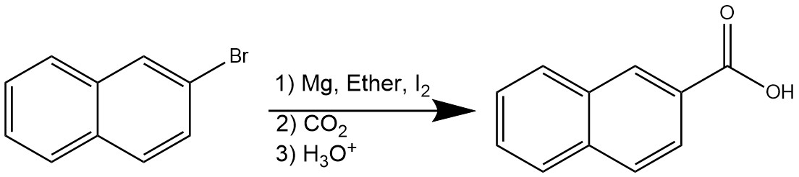
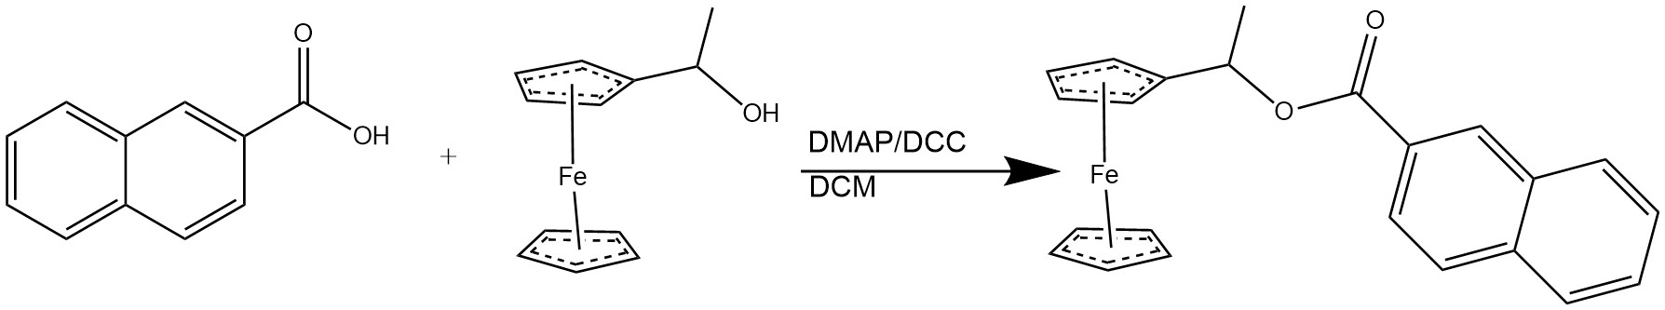
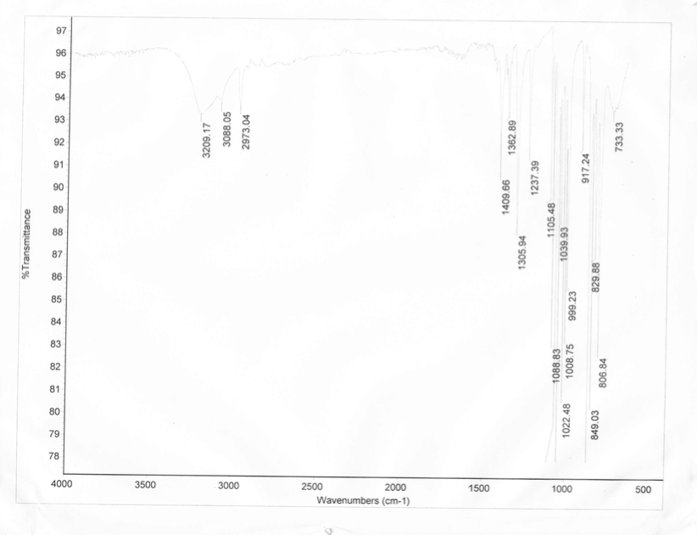
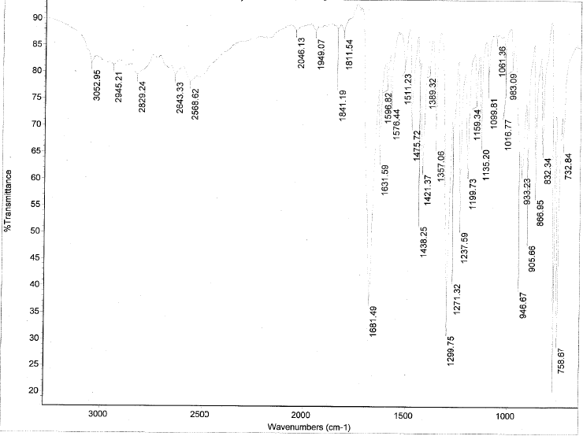
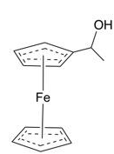
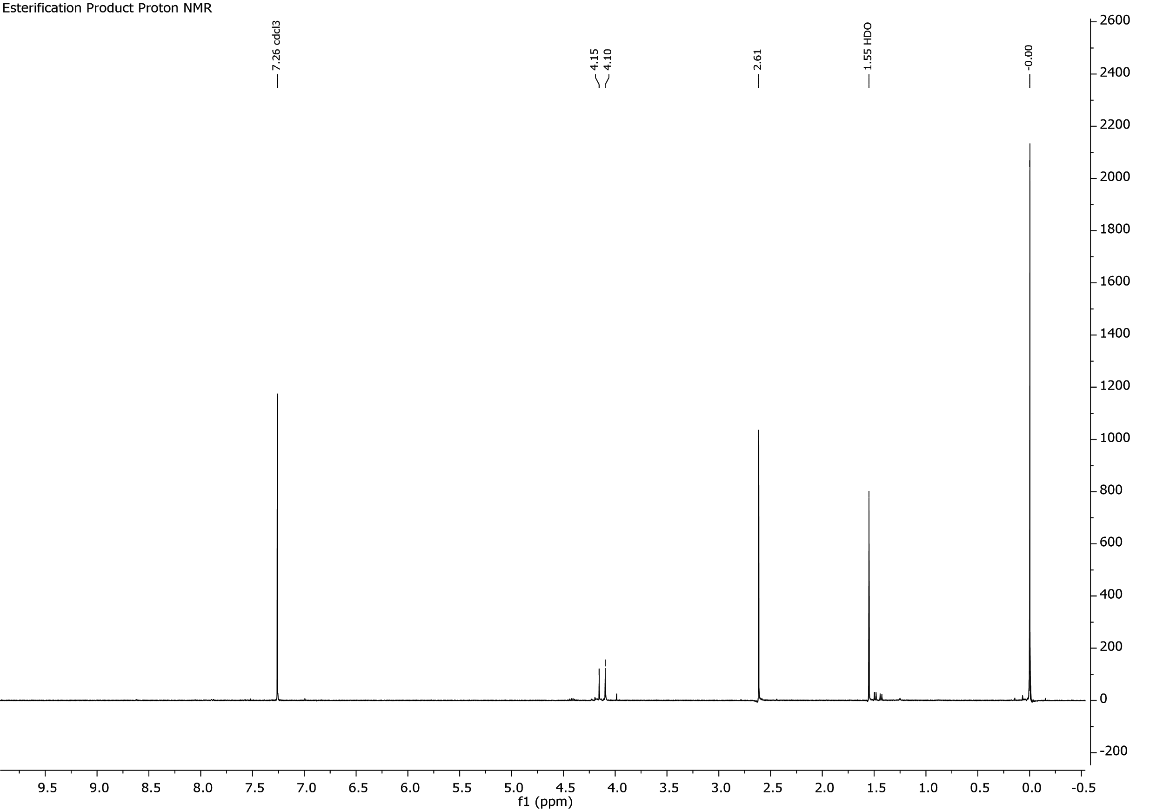
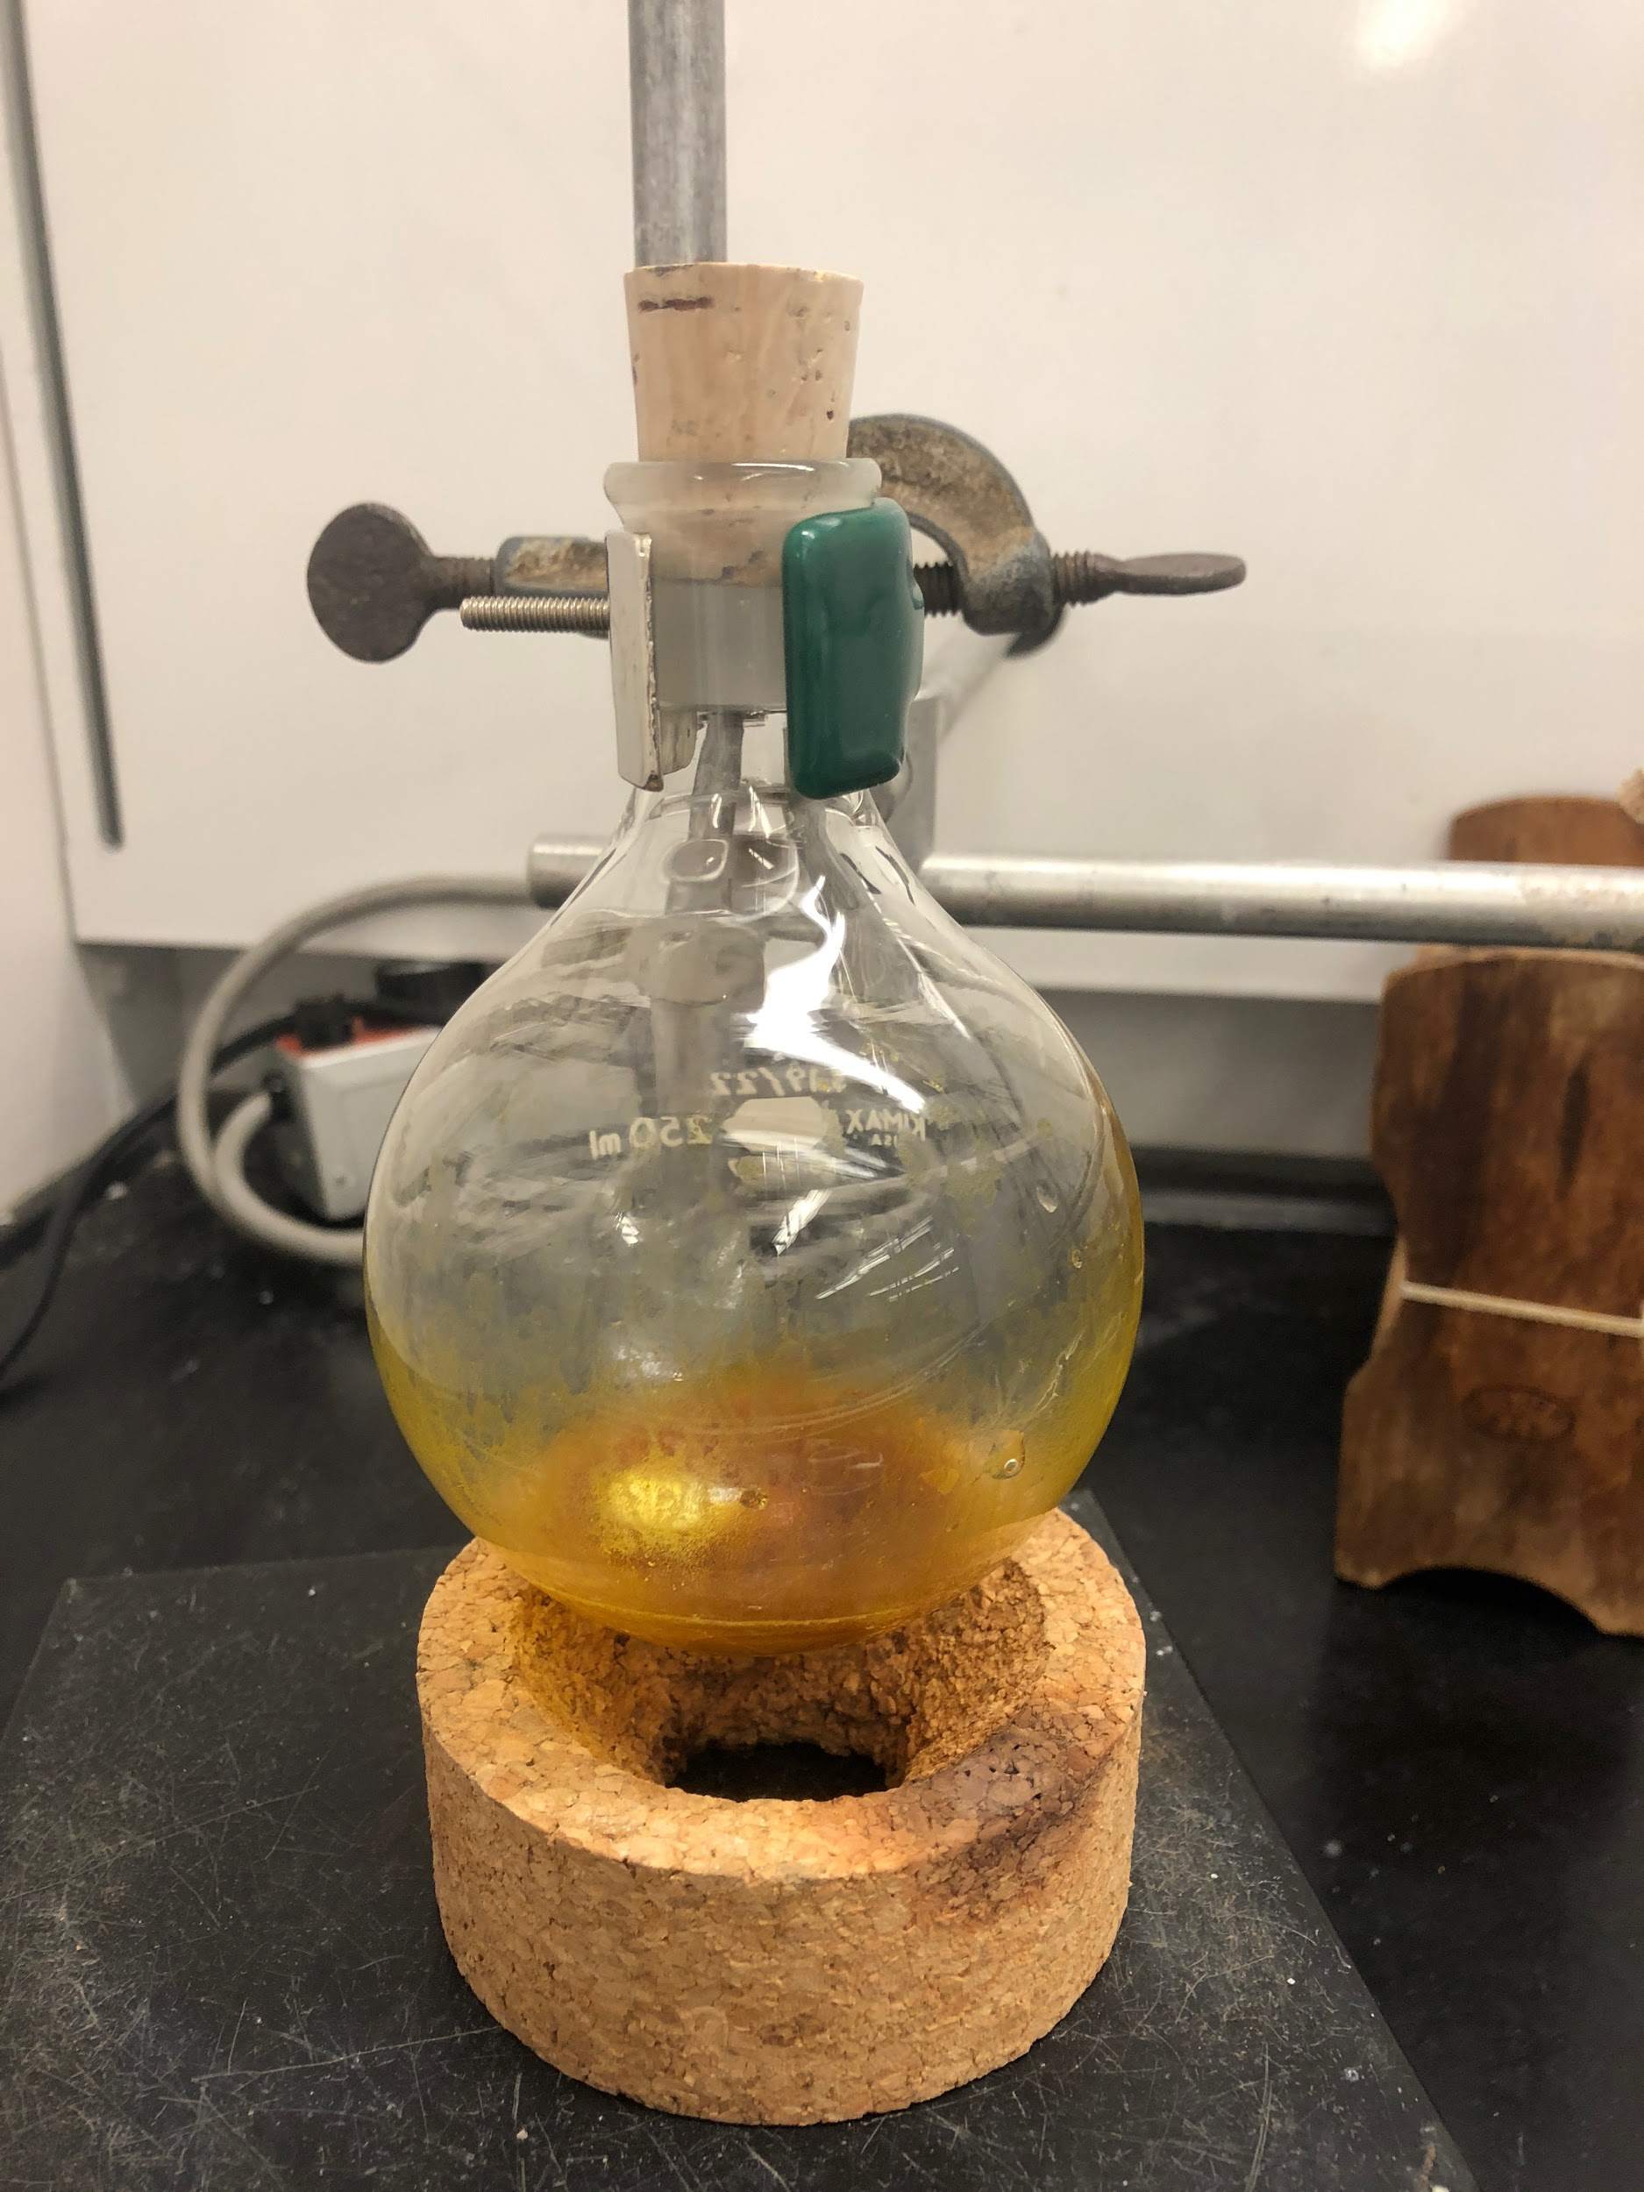
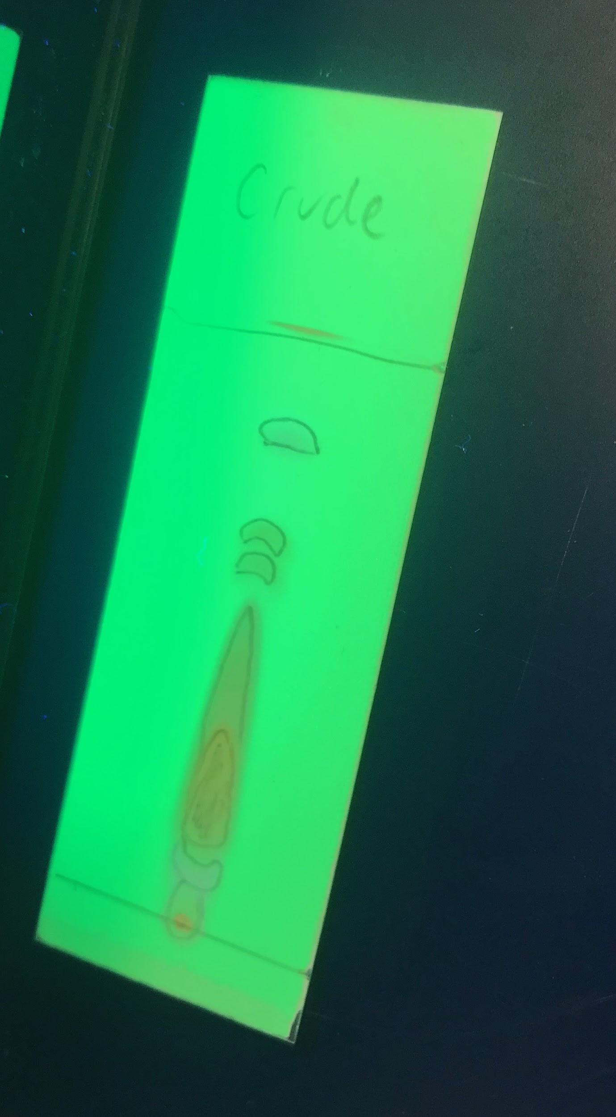

Synthesis of 1-(ferrocenyl)ethyl-2-naphthoate from 2-bromonaphthalene and ferrocene
Elizabeth M. Buford, Sierra C. Hoes, Ella V. Francis, Allyson M. O’Neil, Luke M. Maravelias, Tarun Anand and Erik B. Berda. Chemistry 550, Department of Chemistry, University of New Hampshire.
Abstract
Synthetic Plan
Discussion
  Unexpected challenges:
Lack of Grignard product due to trouble controlling temperature
Low yield on successful Grignard experiment
Subsequent small quantities
Availability of chemicals
  Solutions:
Grignard experiment was repeated
Esterification procedure was selected based on small quantities of reagents
Chemicals obtained through the Berda research group
Possible explanations for unsuccessful final experiment:
Low quantities of reagents meant yield would have to be high in order to obtain good, final product
Final product may have been thrown out with one of the column fractions
There is no prior published literature on the synthesis of 1-(ferrocenyl)ethyl-2-naphthoate. Reactions involving similar molecules were used as a basis for the multistep synthesis of this molecule. Some reactions including the acetylation of ferrocene and Grignard carboxylation had been completed by this group before. The key challenges presented by this project were working with the bulky naphthalene moiety in the Grignard carboxylation and deciding on the most suitable esterification procedure to obtain the final product. Although the final product was not made, it gave the group an opportunity to advance their lab skills through performing new procedures.
Reaction 1: Acetylation of ferrocene
Reaction 2: Reduction of acetylferrocene
32.5% yield
MP: 80-83℃
119.9% yield
MP: 77-79℃
Reaction 3: Grignard carboxylation
Goals
Synthesize 1-(ferrocenyl)ethyl-2-naphthoate from starting materials 2-bromonaphthalene and ferrocene
Determine the best esterification method based on the involved molecules
Accurately interpret the characterization data of the final product to determine its identity
3.8% yield
MP: 175-180℃
Reaction 4: Esterification
Methods
19.9% yield
Results
Ferrocene was acetylated using acetic anhydride with DCM as a solvent
  TLC plates were used to monitor the reaction
  The crude product was purified using column chromatography and a gradient of solvents with increasing polarity
  A melting point of the purified product was taken to confirm the product’s identity
The resulting acetylferrocene was reduced using sodium borohydride and methanol as a solvent
  The reaction was stirred for 24 hours at 60℃ in an oil bath
  An IR was taken to characterize the product
A Grignard reaction was used to synthesize 2-naphthoic acid from 2-bromonaphthalene
  Carbon dioxide in the form of dry ice was used to form the carboxylic acid
  An IR was taken to characterize the product
2-naphthoic acid and 1-(ferrocenyl)ethanol were reacted using a Steglich Esterification
  The crude product was purified through column chromatography using DCM as the solvent
  An ¹H NMR was taken to characterize the final product
Summary and Conclusions
OH bond
C-H bond
C=C-H bond
C-H
O-H stretch
1-(ferrocenyl)ethanol and 2-naphthoic acid were successfully made
The final product 1-(ferrocenyl)ethyl-2-naphthoate wasn’t synthesized
If attempted again, the carboxylic acid could be converted to an acid chloride before performing a base-catalyzed esterification
C-O bond
C=C
C=O
C-O
Figure 3: IR of 1-(ferrocenyl)ethanol
Figure 4: IR of 2-naphthoic acid
Acetylation of ferrocene was successful, evidenced by melting point
Reduction of acetylferrocene was also successful, evidenced by melting point and IR showing a clear OH peak
Carboxylation of 2-bromonaphthalene was a success, evidenced by melting point and IR showing OH and C=O peaks
Steglich esterification was unsuccessful, evidenced by NMR
Acknowledgements
Unknown solvent/impurity peak. Does not match solvents used or possible starting materials.
The authors of this paper would like to acknowledge Marie-Josiane Ohoueu, Elizabeth Bright and Erik Berda. Special thanks to the Berda research group for providing DCC and DMAP for the esterification. Thanks also goes to the University of New Hampshire for providing a laboratory and chemicals for research. Thanks to Sarah Joiner and Sue Small for guidance through the project.
Possible ferrocene peaks. Sample is too dilute for good sample intensity.
References
Berda, E. 2018. Acetylation of Ferrocene.
Berda, E. 2018. Grignard Synthesis.
Berda, E. 2018. Purification of Acetylferrocene by Column Chromatography.
Boulder, Colorado. http://cssp.chemspider.com/article.aspx?id=759
Mikhailova, T. and N. Marshall. 2014. Reduction and dehydration of acetylferrocene; vinylferrocene.
Neises, B. and W. Steglich. 1978. Angewandte Chemie International Edition in English, 17 (7): 522–524.
Figure 1: Steglich esterification reaction flask
Figure 2: TLC of final product
Figure 5: ¹H NMR of final product

Slide 2
References
Mikhailova, T. and N. Marshall. 2014. Reduction and dehydration of
acetylferrocene; vinylferrocene. Boulder, Colorado.
http://cssp.chemspider.com/article.aspx?id=759
Neises, B. and W. Steglich. 1978. Angewandte Chemie International Edition in
English, 17 (7): 522–524.
Berda, E. 2018. Acetylation of Ferrocene.
Berda, E. 2018. Purification of Acetylferrocene by Column Chromatography.
Berda, E. 2018. Grignard Synthesis.

