Slide 1


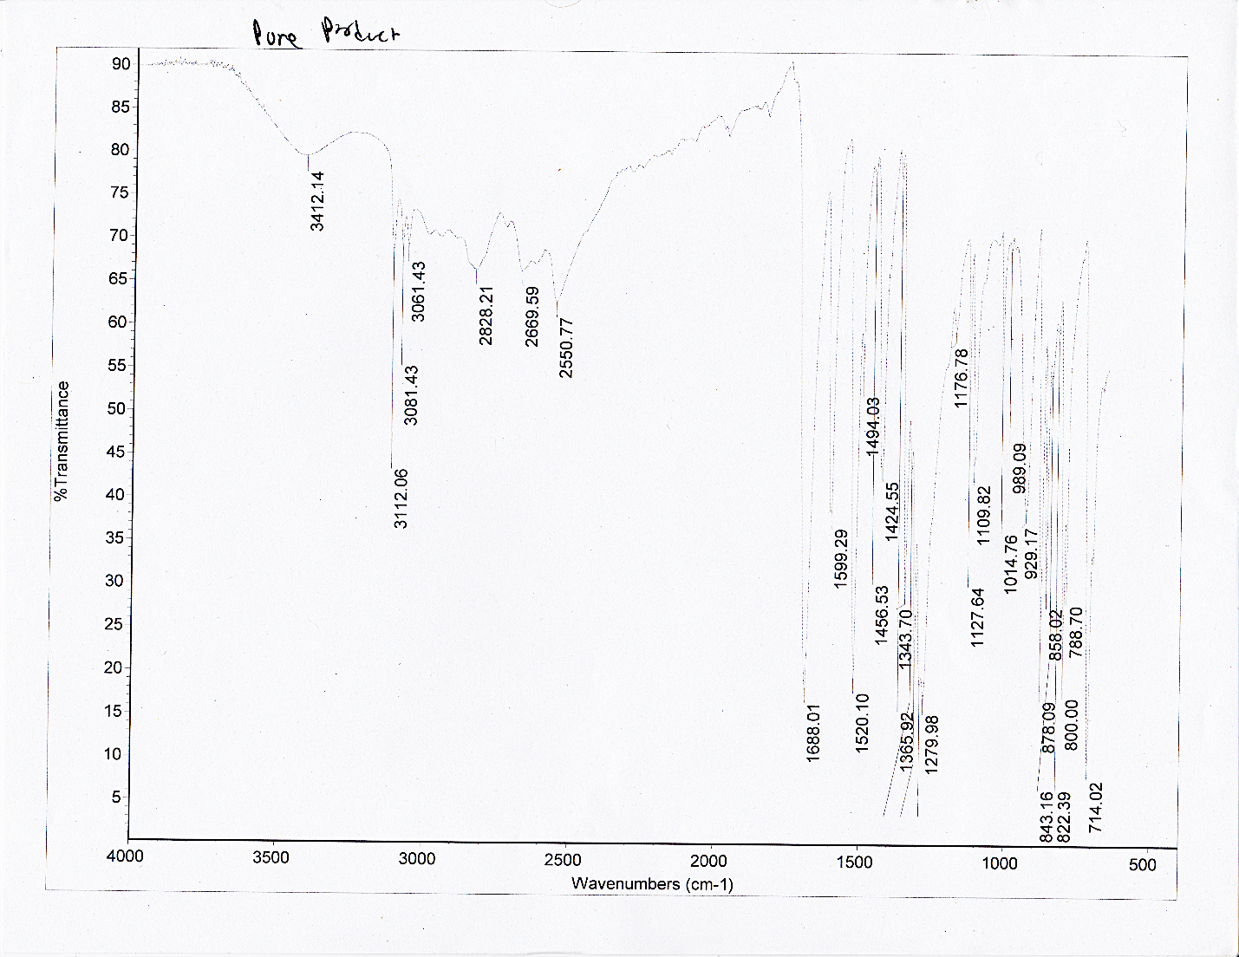
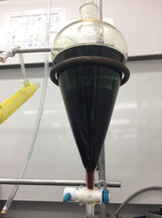
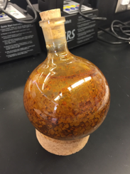
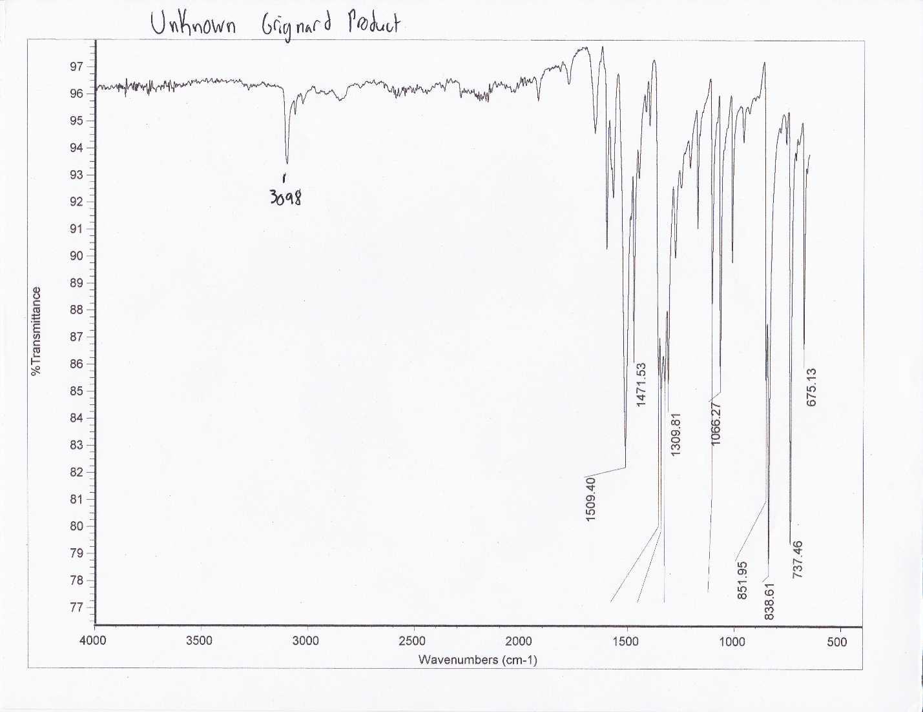
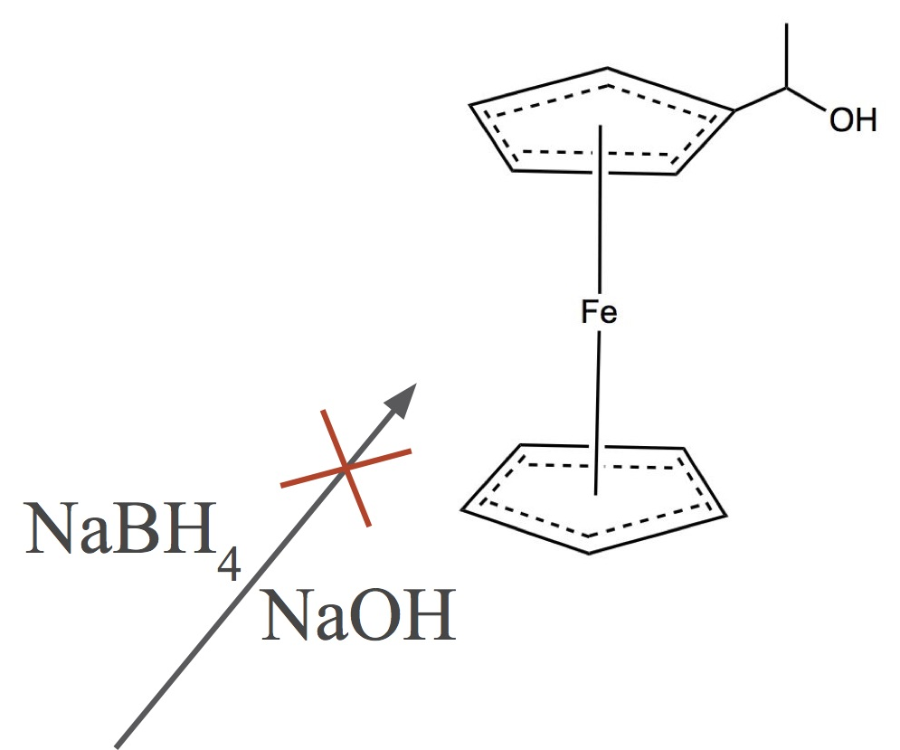
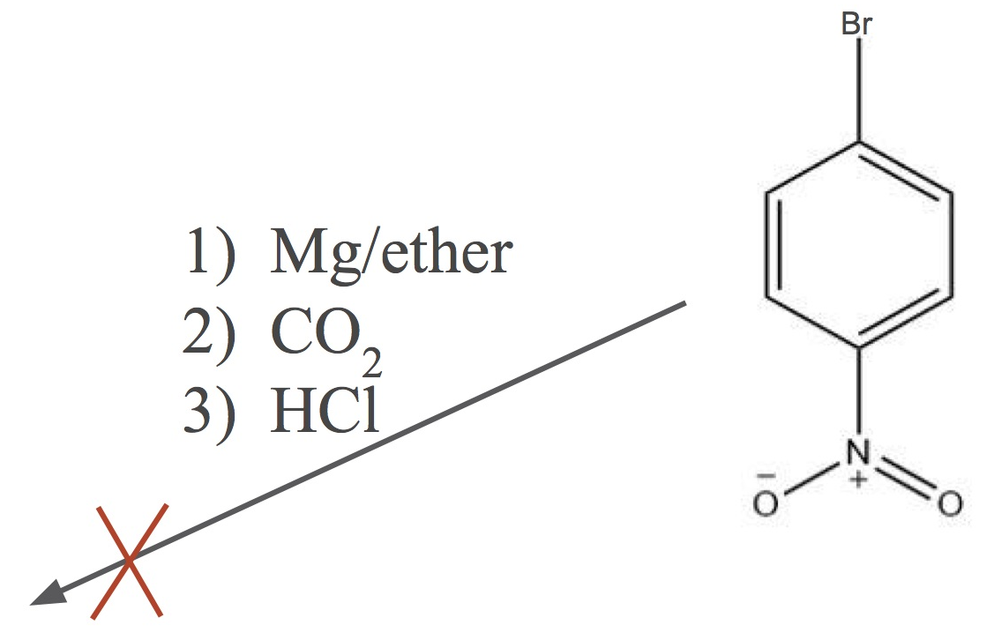
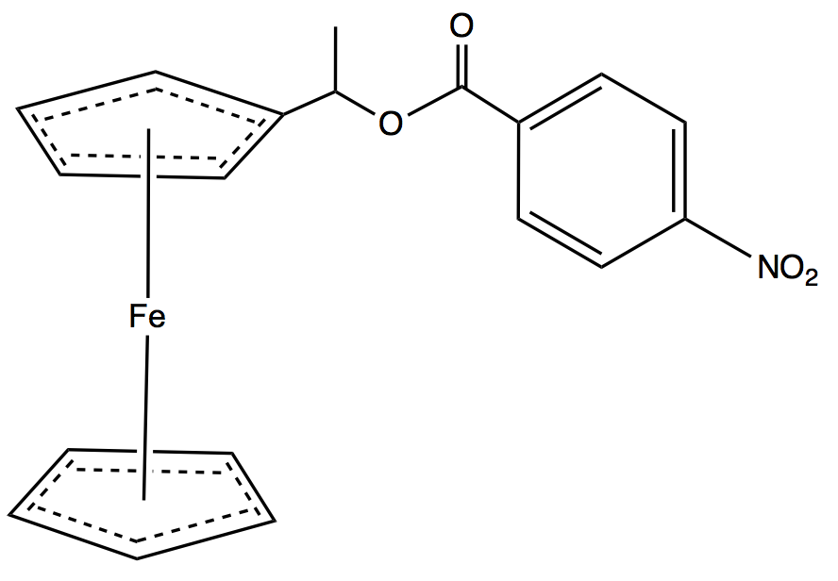
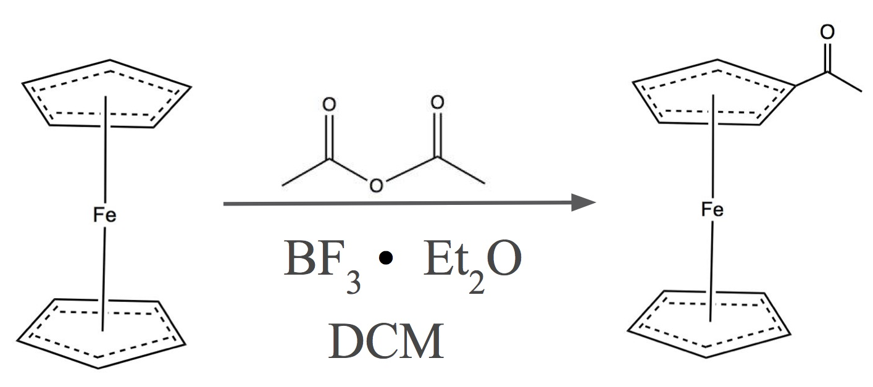
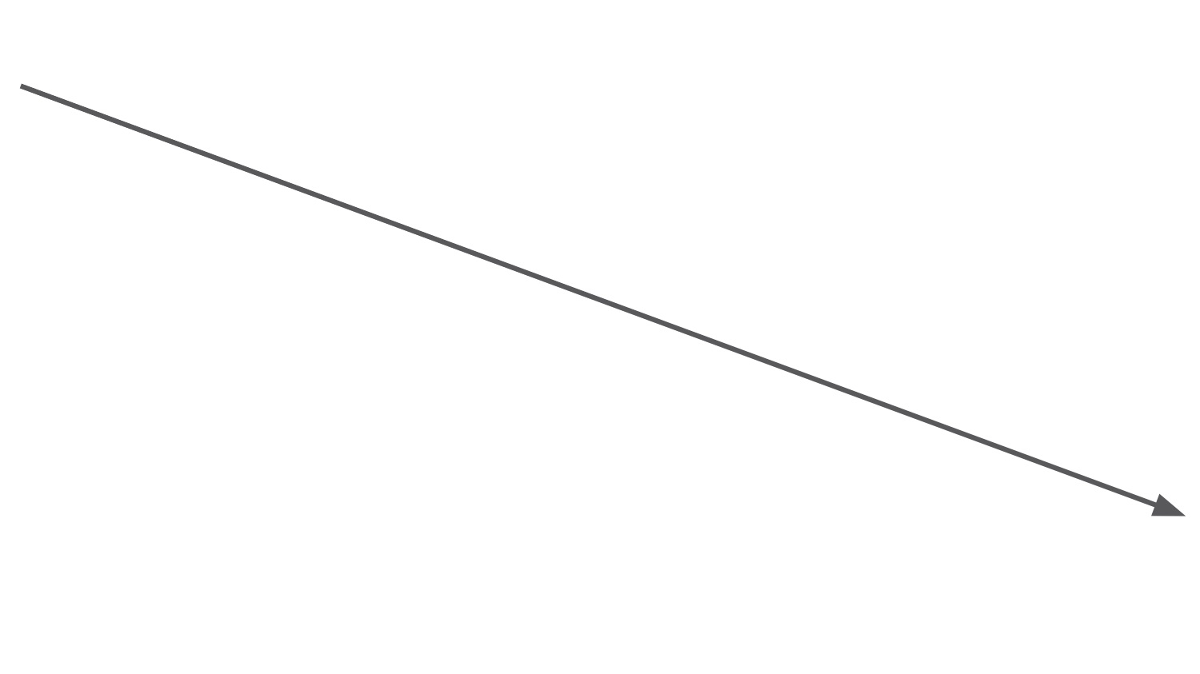
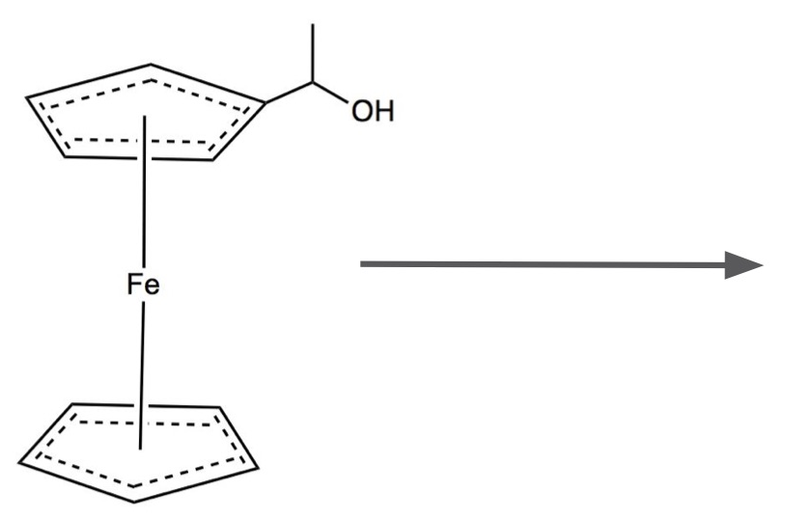
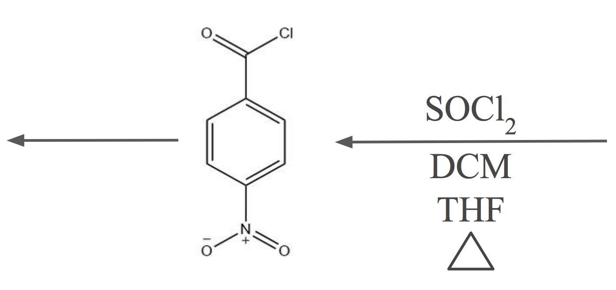
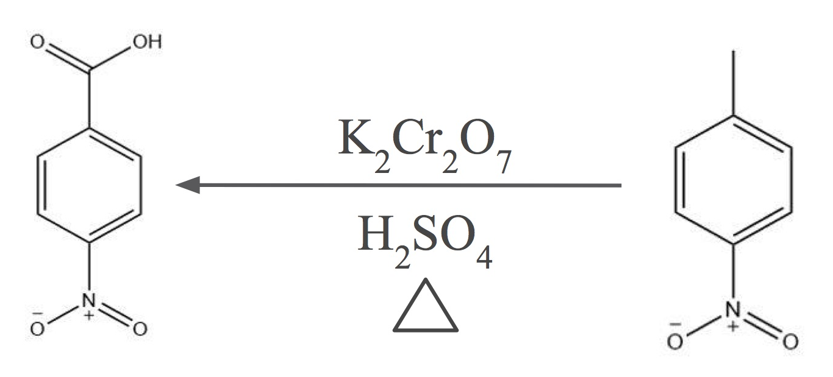
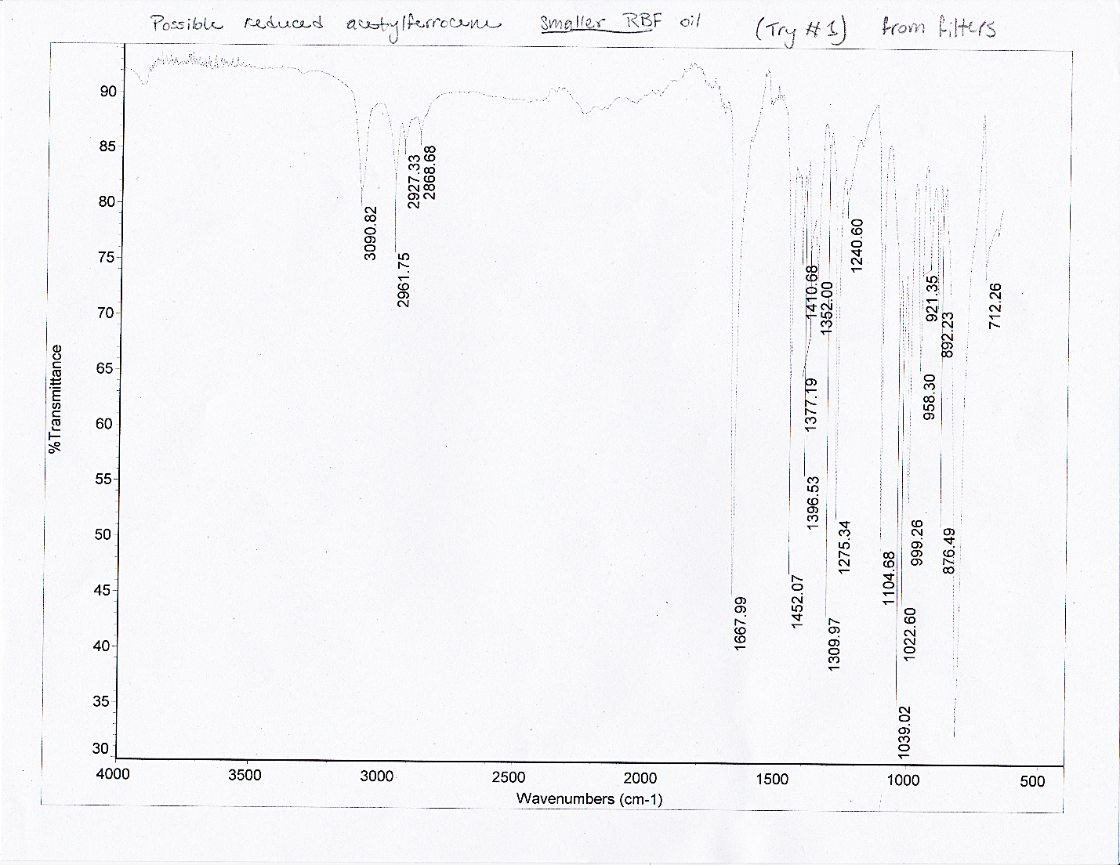
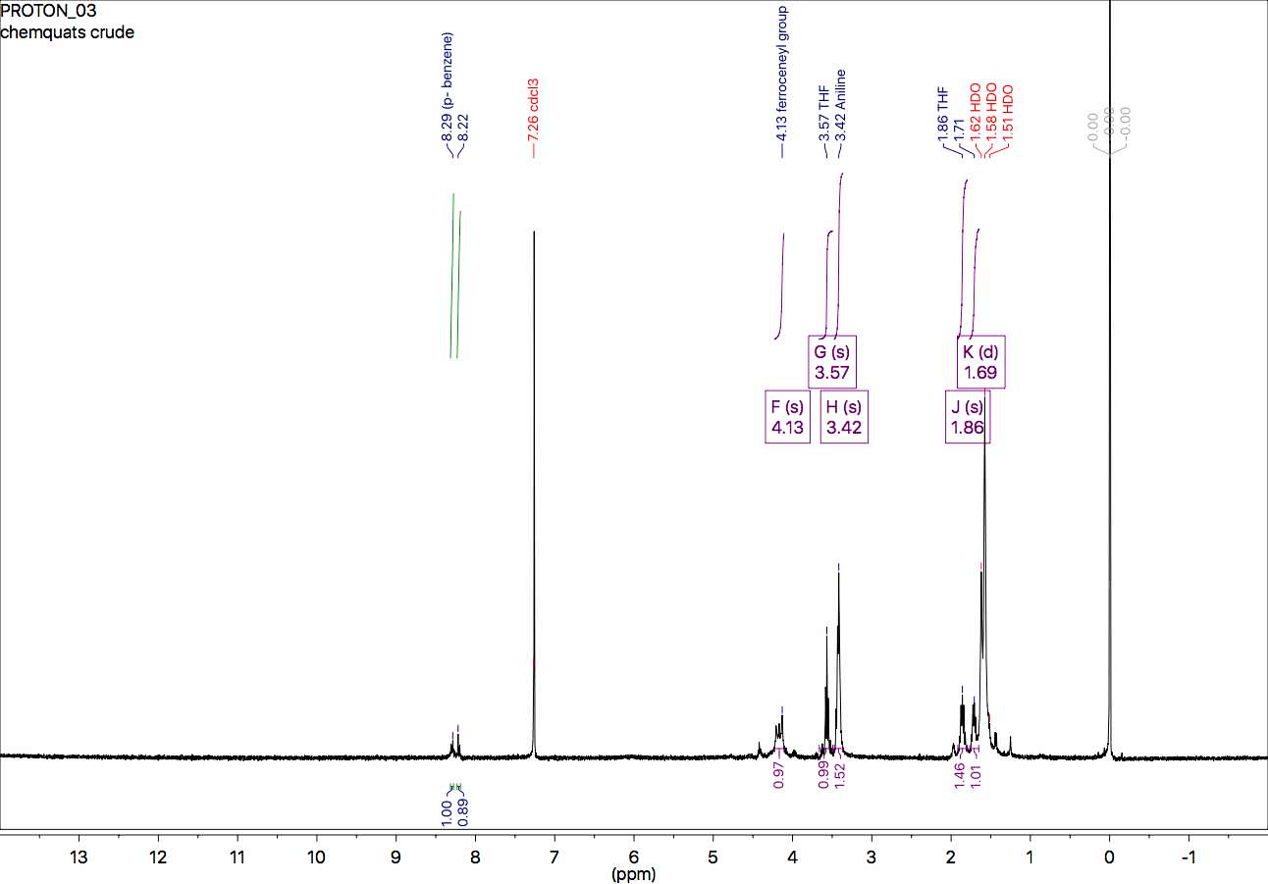
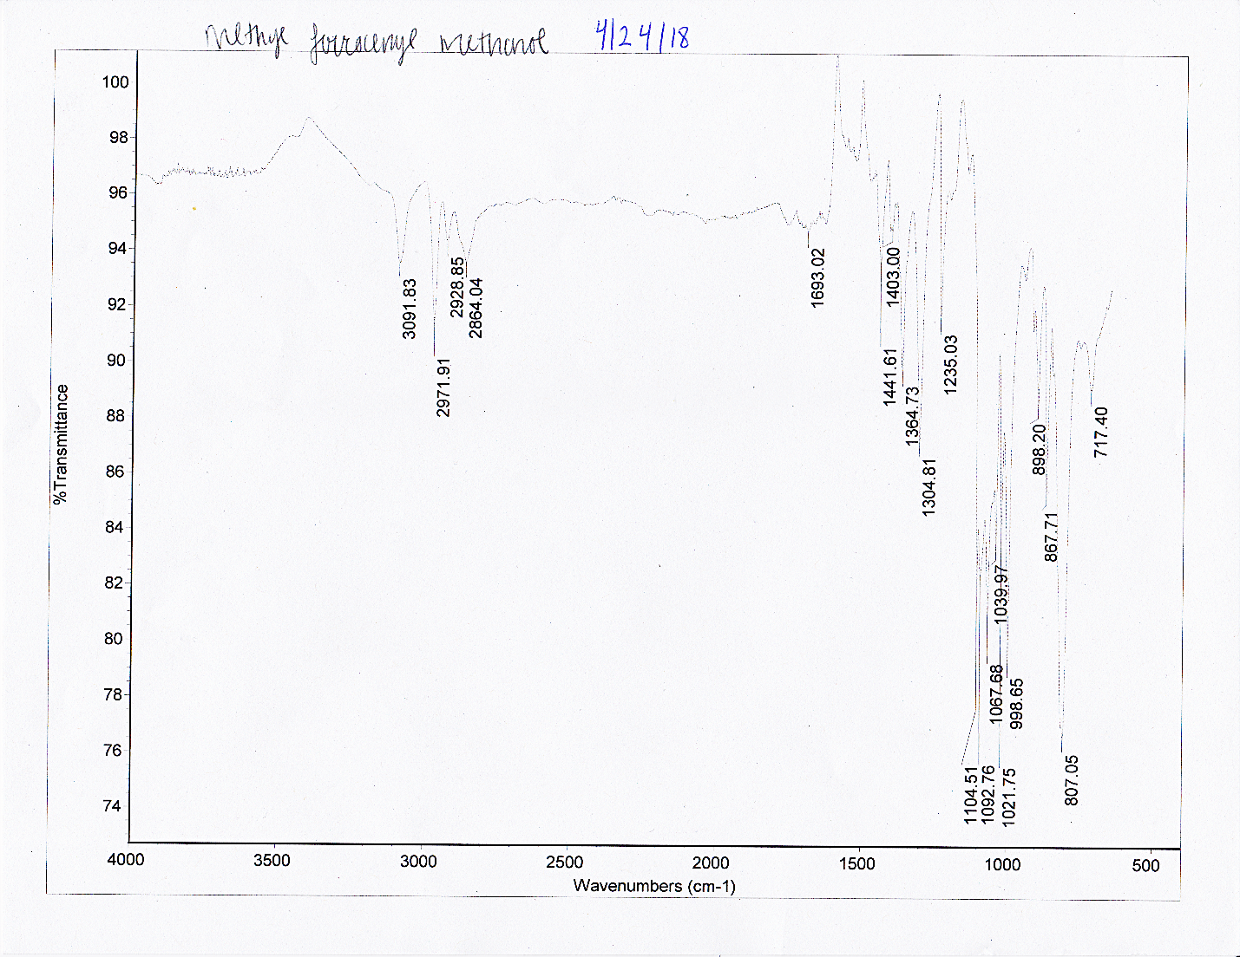

Chemquats: Synthesis of an Exotic Ester
Nicholas D. Heath, Brittany J. Coulstring, Alexander J. Thorpe, Nicholas M. Wakeman, Hannah E. Erskine, Jennifer E. Halloran, Graeme T. Lambert, M.J. Ohoueu, Liz Bright, and Erik B. Berda. Chemistry 550, Department of Chemistry, University of New Hampshire.
Introduction
Materials/Methods
Results: 4-Nitrobenzoyl Chloride Synthesis
The purpose of this project was to synthesize Ferrocene, [1-[(4-nitrobenzoyl) oxy]-ethyl] using p-nitrotoluene and ferrocene. Ferrocene was acetylated and reduced to form an alcohol. The p-nitrotoluene was oxidized, turned into an acid chloride, and used with the ferrocenyl alcohol in an esterification. This experiment utilized air sensitive techniques, rotary evaporation, liquid/liquid extraction, and column chromatography. The product and intermediates were characterized using ¹³C and ¹H NMR, IR, TLC, and melting point analysis. After analysis, the synthesis was determined to be unsuccessful.
Synthesis of α-methylferrocene methanol:
Acetic anhydride and BF₃ etherate were used to acetylate ferrocene in DCM and water
Under nitrogen, acetylferrocene was reduced to α-methylferrocene methanol using NaBH₄ in ethanol and NaOH
Synthesis of p-nitrobenzoyl chloride
p-nitrotoluene was refluxed with K₂Cr₂O₇ and H₂SO₄ to produce p-nitrobenzoic acid via side-chain oxidation
p-nitrobenzoic acid was converted to an acid chloride with SOCl₂
Synthesis of the benzoic acid starting with p-nitrotoluene (3.709g) yielded
p-nitrobenzoic acid (0.396g, 8.76%, MP: 238-239 °C)
Acid chloride synthesis using 2.477g p-nitrobenzoic acid (0.396g + 2.081g bought) yielded 0.376g p-nitrobenzoyl chloride (6.69% yield)
Figure 1: IR spectrum of
p-nitrobenzoic acid
Final synthesis: esterification
p-nitrobenzoyl chloride was mixed with α-methylferrocene methanol
Figure 2: IR spectrum of failed Grignard reaction product
Goal product
0.3759g of unknown substance
24.0% yield
5.001g, starting material
1.998g, 32.6% yield
0.951g bought
0.396g,
8.76% yield,
2.081g bought
3.709g, starting material
Figure 3: Scheme: Attempted synthesis of ferrocene, [1-[(4-nitrobenzoyl) oxy]-ethyl] by synthesis of a ferrocenyl alcohol and a nitrobenzoyl chloride
Results: α-Methylferrocene Methanol Synthesis
Final Product and Conclusions
Pitfalls
Acetylation of ferrocene (5.0g) produced 3.409g crude acetylferrocene and 1.998g (32.6% yield) after purification.
Reduction of acetylferrocene failed, with a 7.8% yield
0.951g α-methylferrocene methanol was bought to finish our synthesis.
Yield: 0.3759g of unknown substance
Cost: $6,124.05/gram if goal product was made
¹H NMR shows we likely did not make the goal final product
A ferrocenyl group and a p-benzene ring were identified, but functional groups were hard to distinguish
More product was needed to get a useful ¹³C NMR and more accurate ¹H NMR.
Some pitfalls were time constraints, an unsuccessful Grignard reaction to form p-nitrobenzoic acid, and two unsuccessful reductions of acetylferrocene.
References
Adams, R.; Jenkins, R. p-Nitrobenzoyl Chloride. Organic Syntheses. 1923, 3, 75
Hamilton, D. E. Reduction of Acetylferrocene with Lithium Aluminum Hydride and Resolution of the Enantiomers with a Chiral HPLC Column. Journal of Chemical Education. 1991, 68, A143-A144.
Kamm, O.; Matthews, A. O. p-Nitrobenzoic Acid. Organic Syntheses. 1941,1, 392. 1922, 2, 53.
Newirth, T.; Srouji, N. Acetylation of Ferrocene. J. Chem. Educ. 1995, 72, 454-456
Williamson, K.; Macroscale and Microscale Organic Experiments. Houghton Mifflin. 2003, 364-368
Figure 5: ¹H NMR spectrum of final product
Acknowledgements
We would like to acknowledge Professor Richard Johnson and the Department of Chemistry at the University of New Hampshire for their support.
Figure 4: IR Spectra from attempted 1st and 2nd reductions of acetylferrocene.
Notes:
After analysis of the H1NMR for the final product, it does not appear to represent the expected product. The major components were identified in the compound, but the variants were hard to distinguish. Both a ferrocenyl group and a p-benzene ring were identified, but the configuration of their exact functional groups and structure are undefined. The concentration was not high enough to get a useful carbon NMR and an IR spectrum was not taken due to time.

