Slide 1


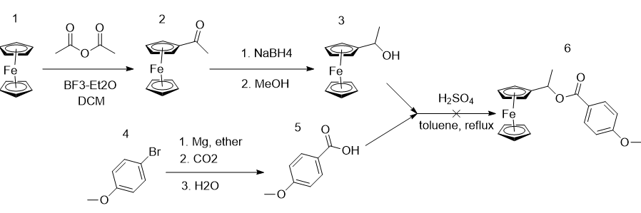
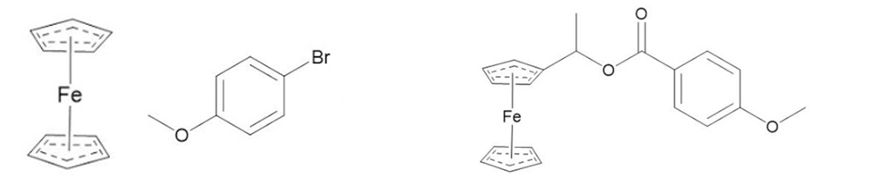
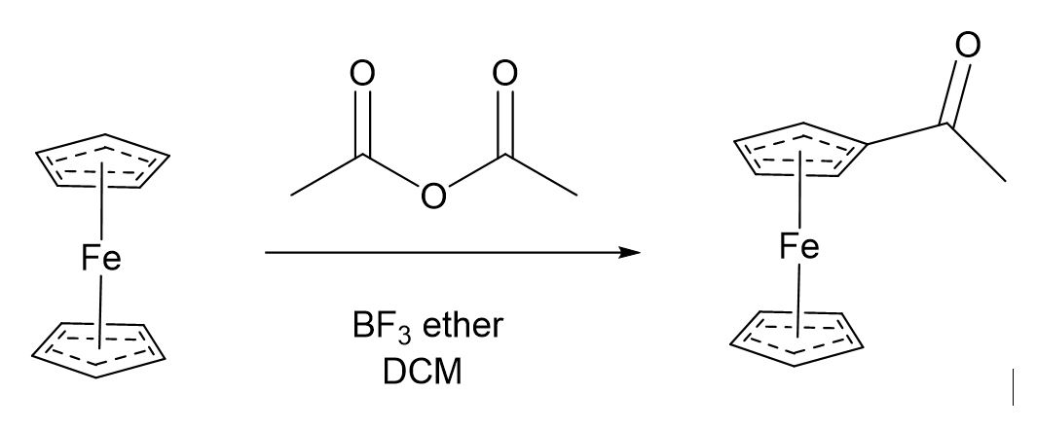
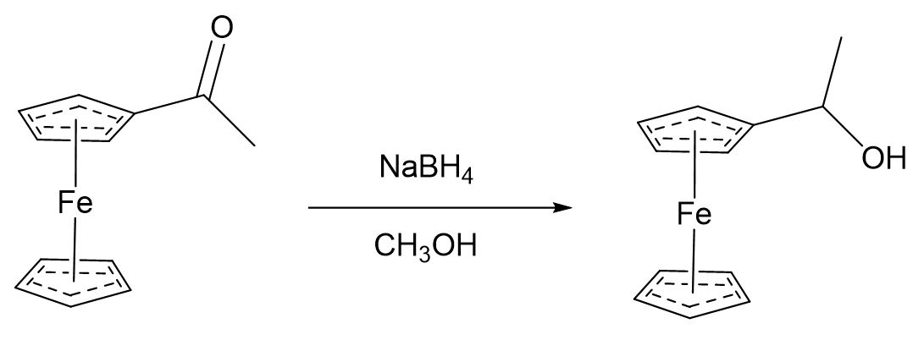
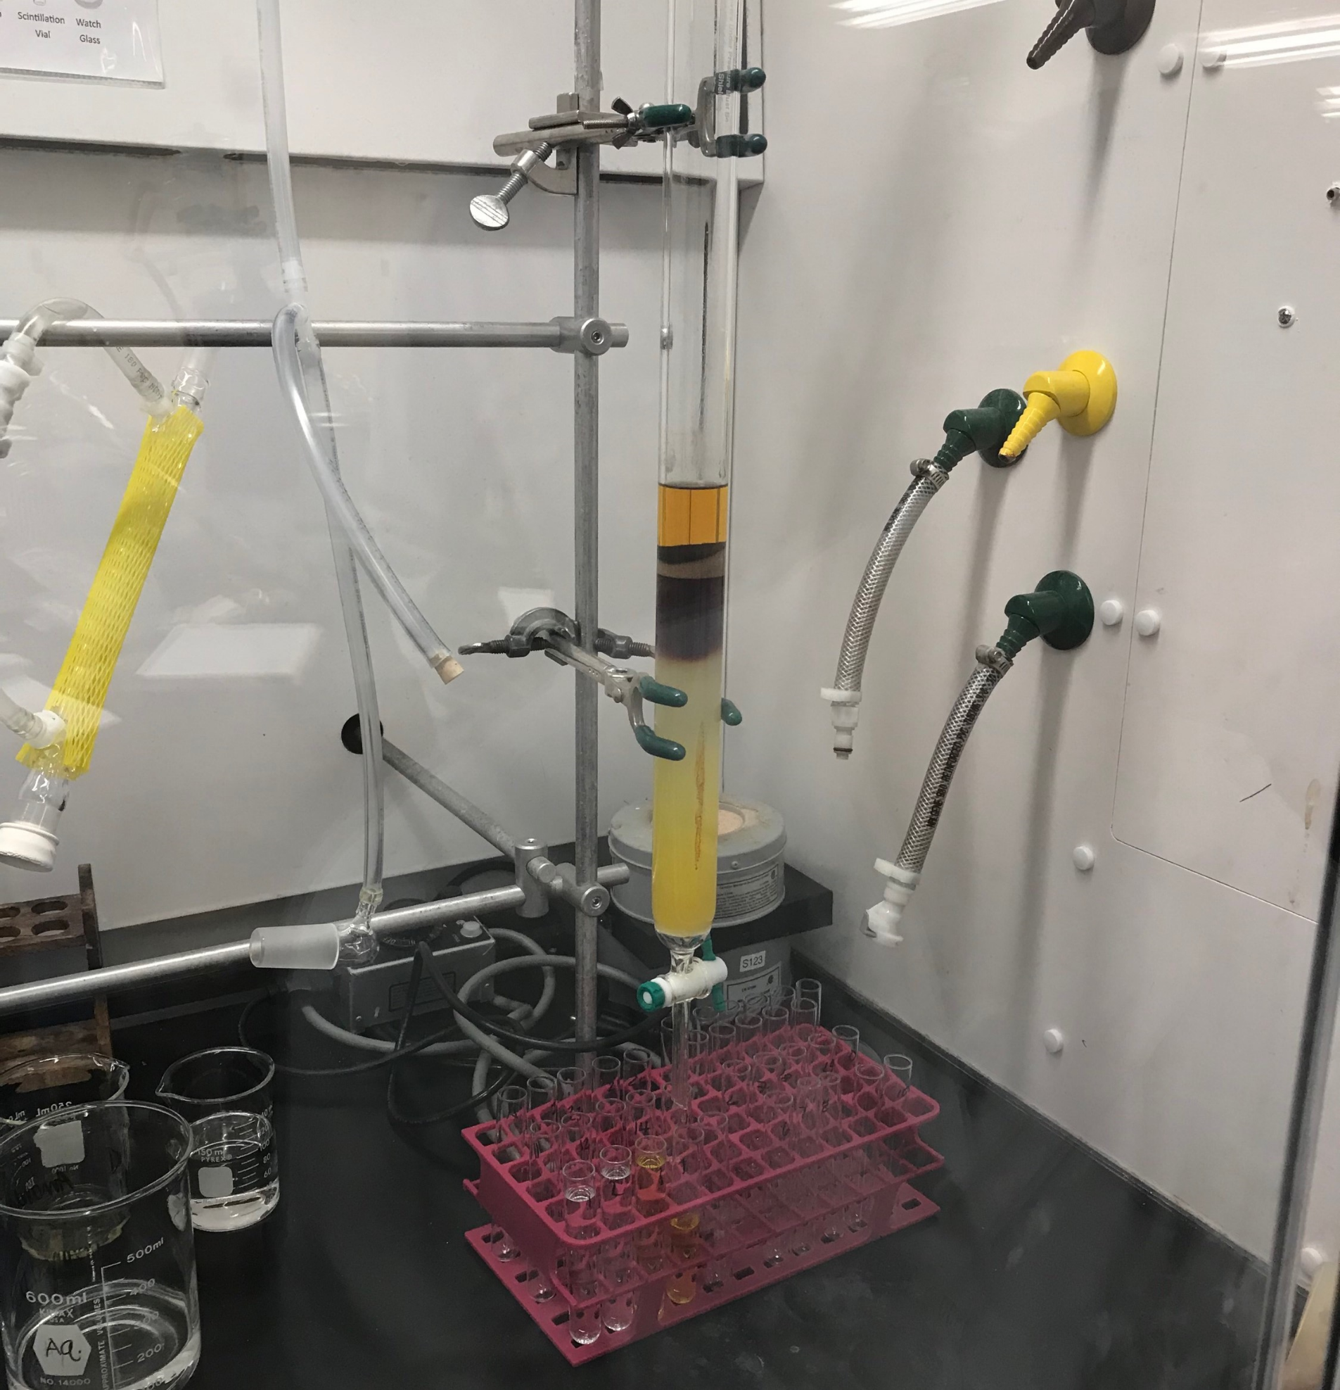
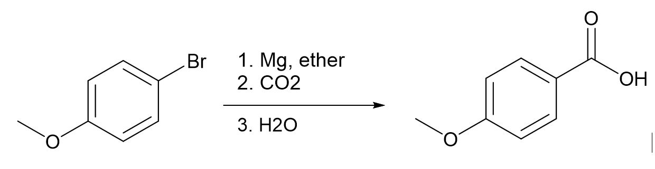
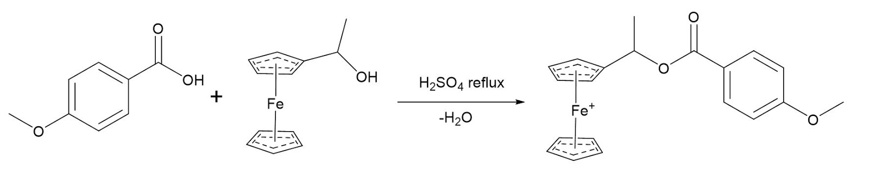

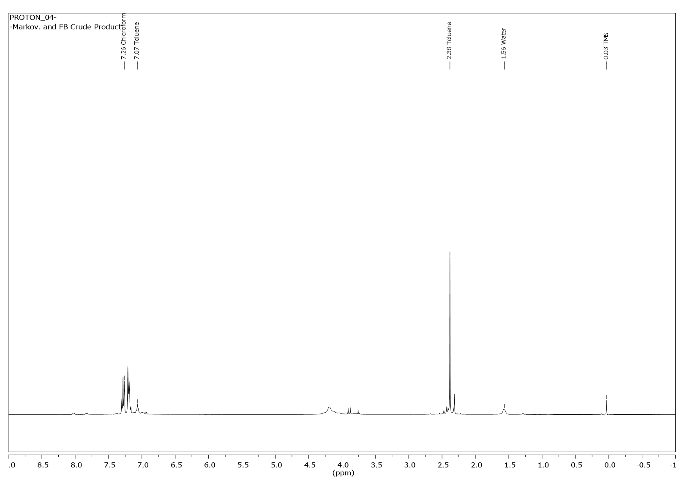
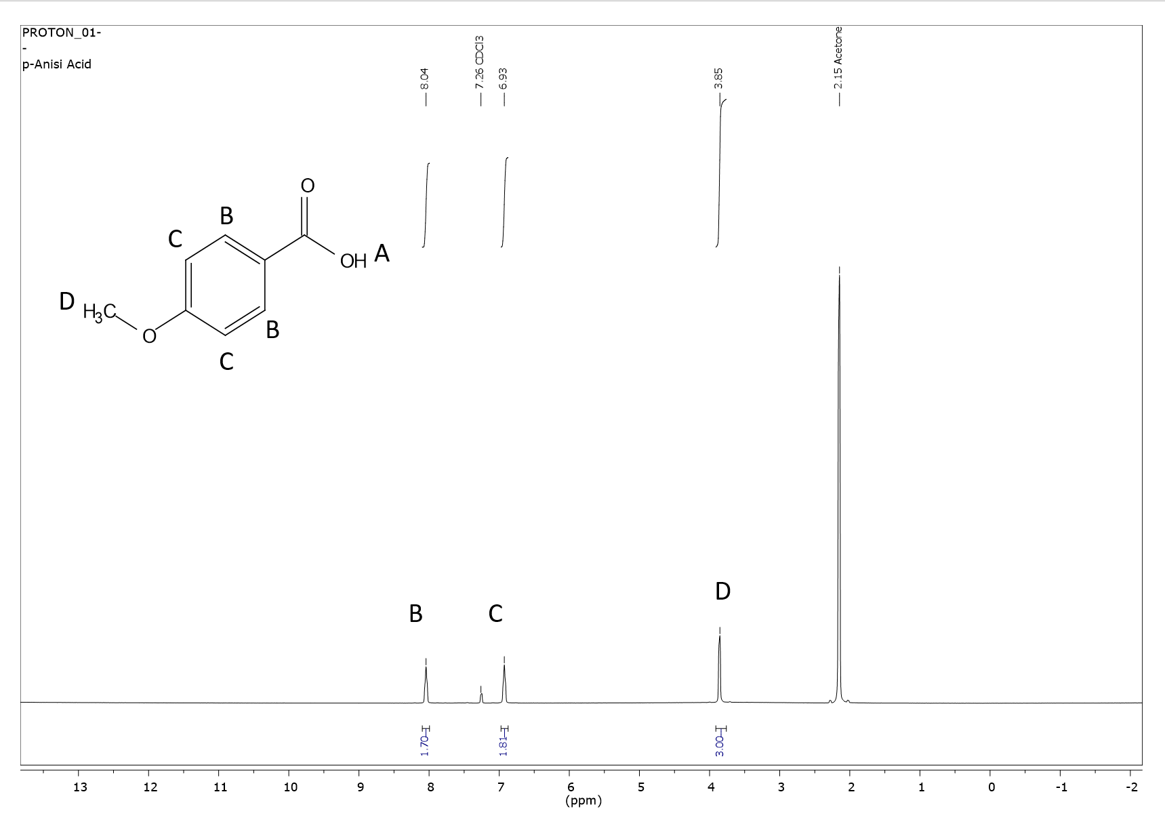
A Multistep Synthesis of Ferrocenyl Ethyl p-Ansinate
Benjamin J. Adams, Elizabeth R. Beaton, Amanda N. Gaudreault, Joseph D. Green, Benjamin E. Novotny, Trey E. Patno, and Erik B. Berda.
Chemistry 550, Department of Chemistry, University of New Hampshire.
Introduction
Results and Discussion
Future Work
Tasked with creating the molecule 1-ferrocenyl ethyl p-anisate, we used a multistep synthesis to put the pieces together from p-bromoanisole and ferrocene (Fig. 1). Our process used reactions such as Friedel’s Craft acetylation and a Grignard reaction to begin and create two intermediate products, acetylferrocene and anisic acid. Following this reduction of the acetylferrocene and two separate methods of esterification (either acid chloride or Fischer) were used in attempt to achieve our final product. Various IRs, melting points, and NMRs were taken of intermediate products to ensure the correct path was being followed.
Step 1
The yield of the first step of the synthesis (Fig. 3) can be increased with more caution, and better monitoring of reaction progress by thin layer chromatography. In Step 4, the Fischer Esterification can be run with 10% mol of acid catalyst. The acid-chloride may be fulfilled under better conditions to minimize contact with air.
Step 2
Step 4
Step 3
Summary/Conclusion
Figure 3. Synthesis route of Ferrocenyl Ethyl p-Ansinate
Although our final product was not isolated and purified, the steps leading up to the final esterification were successful. Through melting points and IR spectroscopy, the reagents for the esterification were identified as the compounds of interest. If a correct amount of catalytic H₂SO₄ was used, the final step of the procedure is theoretically sound. Acid catalyzed esterification in toluene using a Dean Stark apparatus is well backed by literature, and should work to form the desired ferrocenyl ethyl p-anisate.
Starting Material
Expected Product
Acetylation of Ferrocene:
The acetylferrocene product (1) was a red-orange solid, and was characterized by the Infrared Spectroscopy peak of 1659 cm⁻¹. Melting point met that of literature.
Figure 1: Show the starting materials p-bromoanisole (far left) and ferrocene (mid-left), as well as the expected product by the end of the synthesis, 1- ferrocenyl ethyl ansinate (right).
1
MP:82-86C
25%
2
MP: 78-79°C
47%
Methods for Isolation & Characterization
Reduction of Acetylferrocene:
A brighter orange product (2) was recovered and an IR illustrated an alcohol peak at 3205.74 cm⁻¹. From this test we were able to confirm that the acetylferrocene successfully reduced to it’s alcohol (1-ferrocenylethanol).
Column Chromatography and Recrystallization:
First idea to isolate acetylferrocene was column chromatography. Recrystallization with hexanes was more effective.
Acknowledgements
Team MATFB would like to thank Erik Berda, Marie-Josiane Ohoueu, Elizabeth Bright, and the UNH Chemistry Department for making this project possible.
3
MP: 180-182° C
63%
4
MP: Not collected
0%
Infrared Spectroscopy: Was used to determine the reduction of acetyl ferrocene by the identification at a weak broad peak at 3205 cm⁻¹.
Grignard:
The light orange crystals (3) had IR peaks at 2842, 2560, 1922 cm⁻¹. These peaks suggested that the p-anisic acid was the major product.
References
Final product:
The black sludge (4) had an IR spec showing a surprisingly intense peak right around 3000 cm⁻¹, indicating it was likely not our expected product. NMR showed the peaks for toluene, which was the solvent used in the reaction.
Mikhailova, T.; Marshall N., “Reduction and Dehydration of Acetylferrocene; Vinylferrocene”. Synthetic page 2014. 759.
MacLean, B.; Singer, R.; Stark, A. “1-Ethyl-3-methylimidazolium halogenoaluminate ionic liquids as solvents for Friedel–Crafts acylation reactions of ferrocene”. J. Chem Soc., Dalton Trans., 1999, 0, 63-66.
Martine, K., “Analogues of Fenarimol Are Potent Inhibitors of Trypanosoma cruzi and Are Efficacious in a Murine Model of Chagas Disease”. Journal of Medicinal Chemistry. 2012, 55, 9, 4189-4204.
De Nil, P.“Method for the synthesis of antimicrobial alkyl hydroxybenzoate esters using alcohol esterification and azeotropic distillation”. PCT Int. Appl. 1998.
Nuclear Magnetic Resonance: Used to identify Anisic Acid (Fig. 3).
Figure 4: ¹H-NMR of the final product of the esterification.
Total Cost of Project: $1602.65
Figure 2. ¹H-NMR of Anisic Acid – Product of Grignard Reaction

