Slide 1
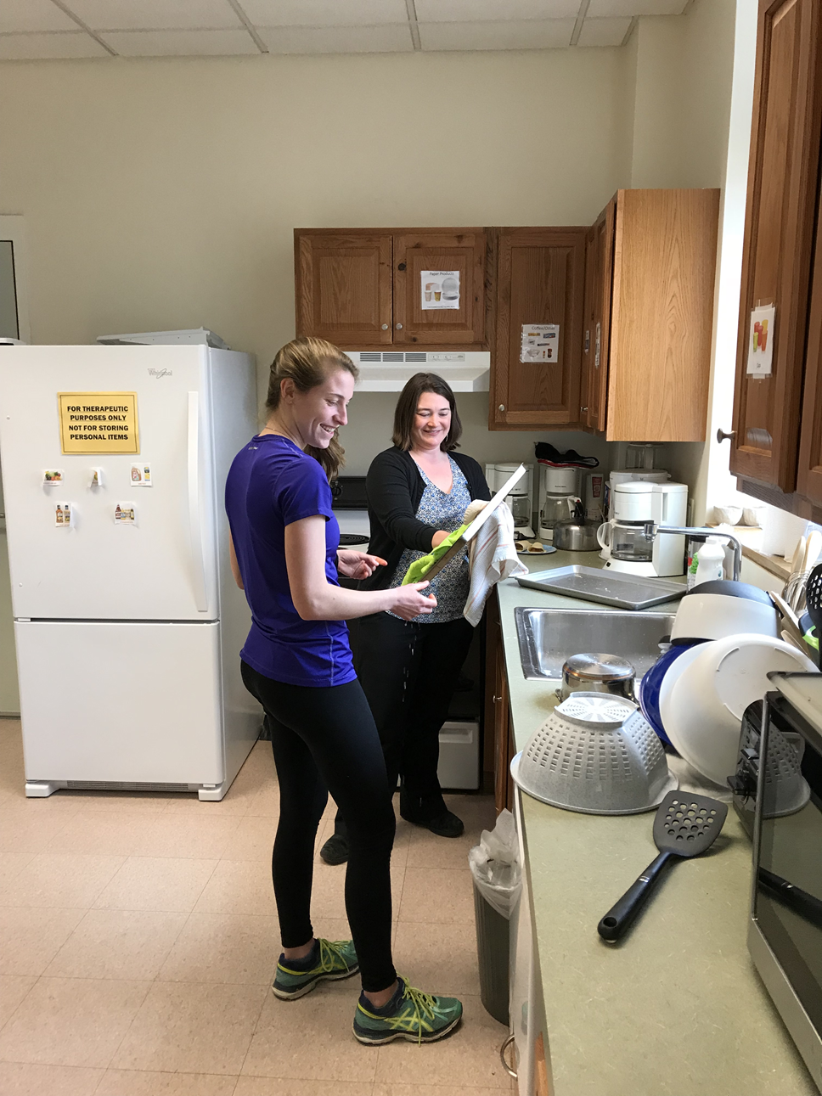
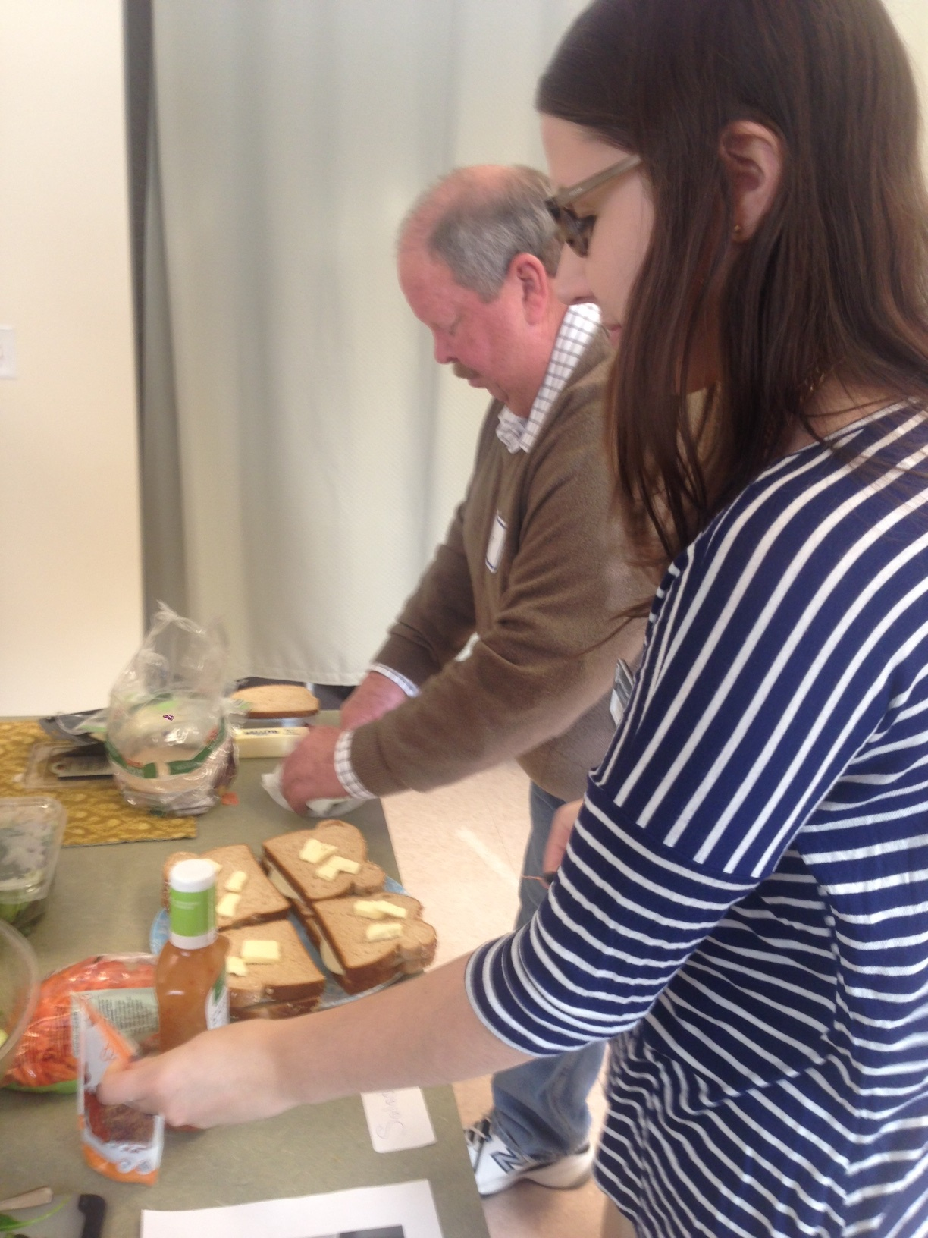
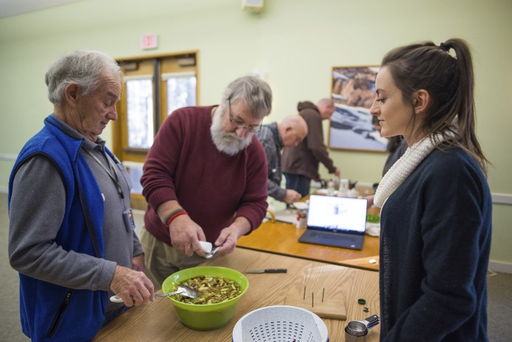
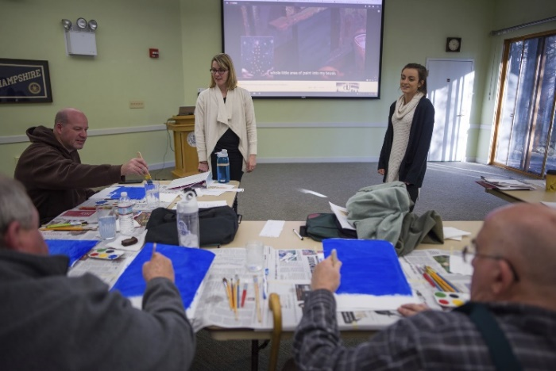
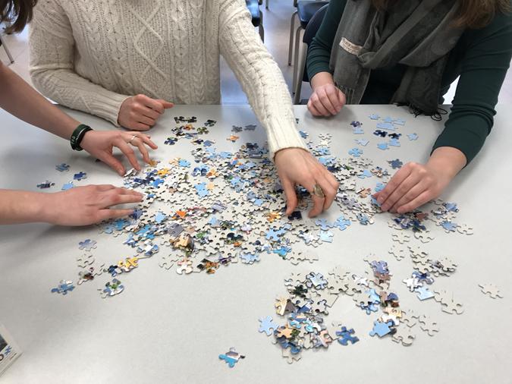
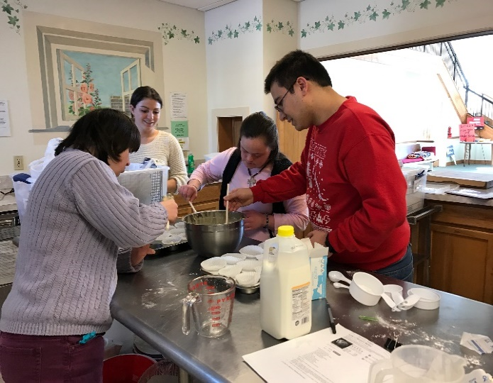
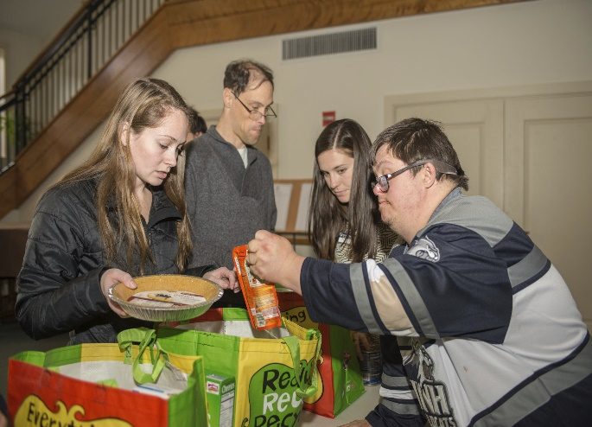
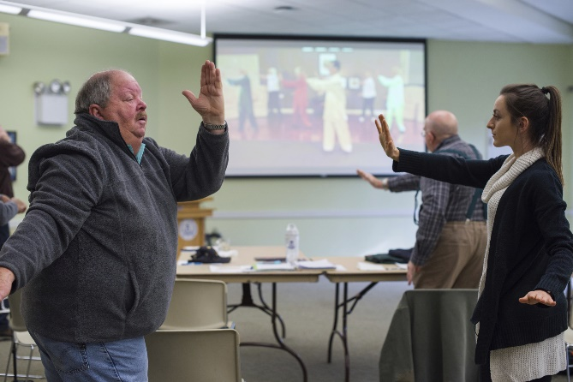
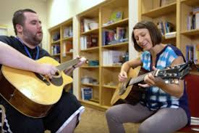
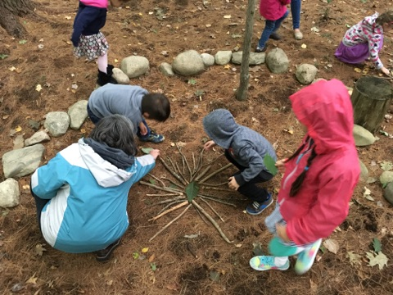
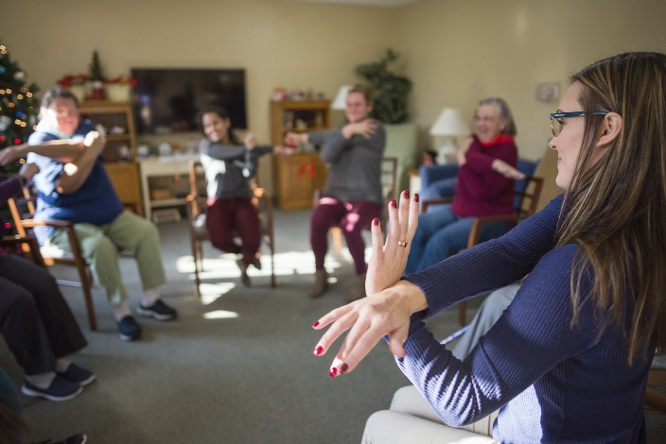

Applying a Public Health Model in OT Education to Develop Student-Led Programs Promoting the Health and Wellness of Various Populations within a Community
Alexa Trolley-Hanson MS OTR/L and John Wilcox, OTD, OTR/L, CAPS
University of New Hampshire
UNH MS in OT Program Goals:
Student promotion of health and wellness in various populations within the community
Service-Learning clinical experiences that increase student confidence and promote community health and wellness.
Curricular Design:
1st year students learn about health promotion, health prevention, and Frieden’s Health Impact Pyramid interactively through service learning collaborations with community stakeholders through multiple classes.
    Enabling Participation in Community Groups
    Occupational Therapy Psychosocial Evaluation and Intervention
    Occupational Therapy Evaluation and Intervention for Children
Adapted Health Impact Pyramid:
UNH Interdisciplinary Primary Care Behavioral Health Grant
ACOTE Mandated Level 2 Fieldwork Experiences
Intensive Interventions
Individual interventions focused on skill development addressing occupational performance due to a health issue.
Stroke Post-Rehabilitation Group
Southeastern New Hampshire Services Drug and Alcohol Program
Targeted Interventions
.
Process:
Student led group interventions in the community for challenged populations and people “at risk” for developing health issues.
Outcomes:
Development of health behaviors in group members
Increased student leadership, confidence, and professional skill acquisition
Increased sense of professional role
Interprofessional collaboration skills
Client/Caregiver communication skills
ID/DD Life Skills Group
ABI/TBI/PCS Groups
Child Development Groups
Universal Interventions
Senior Wellness
Broad population based intervention groups focused on patient activation and engagement in meaningful and necessary everyday activities to promote health and prevent illness.
380 Community Members Impacted Per Year:
“This assignment has provided me with an understanding of the important role of occupational therapists in mental health and specifically substance abuse populations…the opportunity to interview and explain the role of OT to patients in the midst of an intensive residential program was extremely informative and inspiring.”
“From this experience, I feel like I have learned so much. Having the opportunity to take what we are learning in class and applying it to real life situations has benefited my learning immensely.”
“Their journeys, motivation, and spirit has helped me remember why OT is such a special field to work in. They have allowed me to not only show them what I have to offer, but to learn from them and practice my group leading skills.”
“This assignment gave me the opportunity to learn how to look beyond the diagnosis and to understand that clients are people and they have human needs, life stories, and valuable information they can provide us.”
“I think by helping the members gain skills, socialize and engage in their communities helps the overall health of the community.”
“I had the opportunity to understand how I work as a leader while also making a difference in individual’s lives.”
“One member expressed to me at the last group that this was the reason he would wake up on Tuesdays, and this was the best part of his week.”
“It was amazing to be able to put my knowledge to use! I was surprised by all of the things I knew and I grew from each session, learning how to better myself for the next group.”
“This program itself, provides a sense of community for these members and I think the activities and relationships built throughout the experience.”
“They love the fact that there is a group so it can help them connect with others and not feel alone.”

