Slide 1

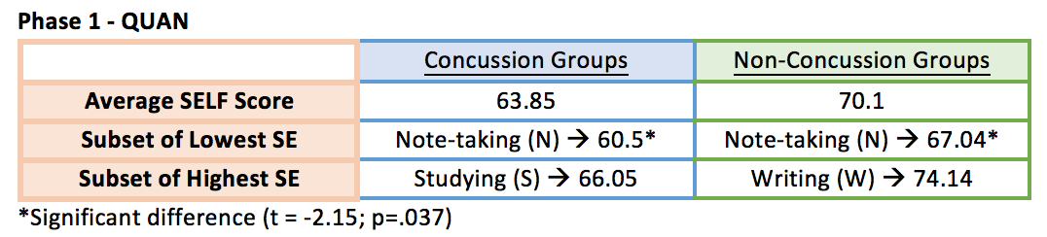
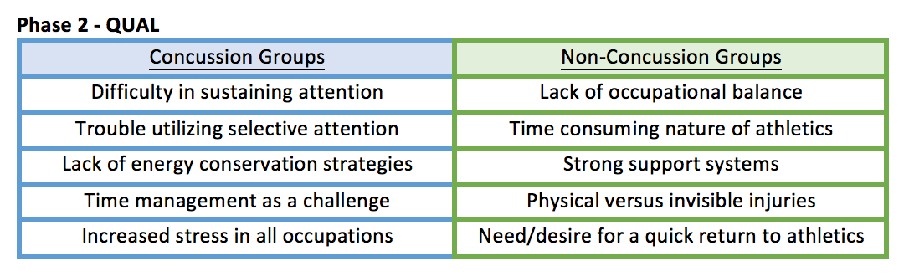
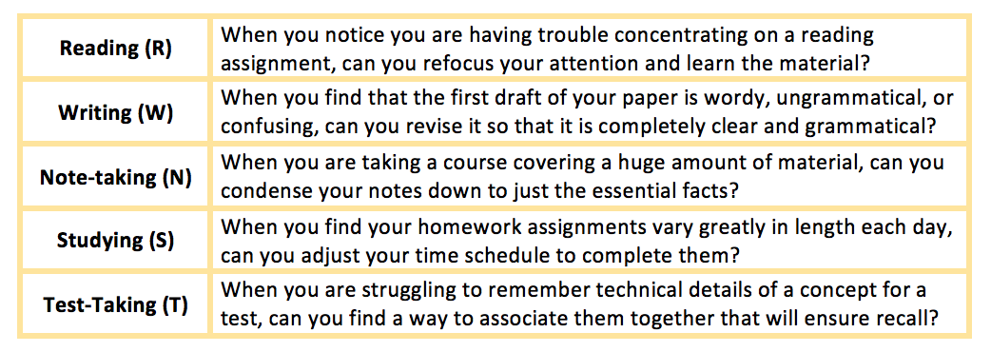
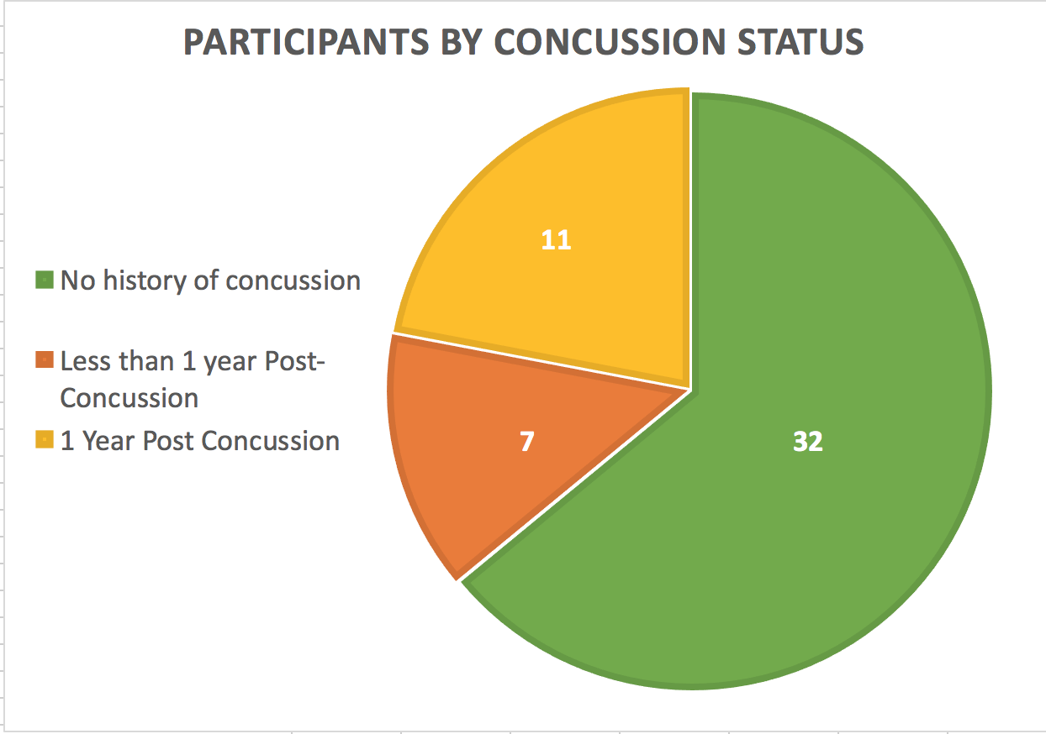
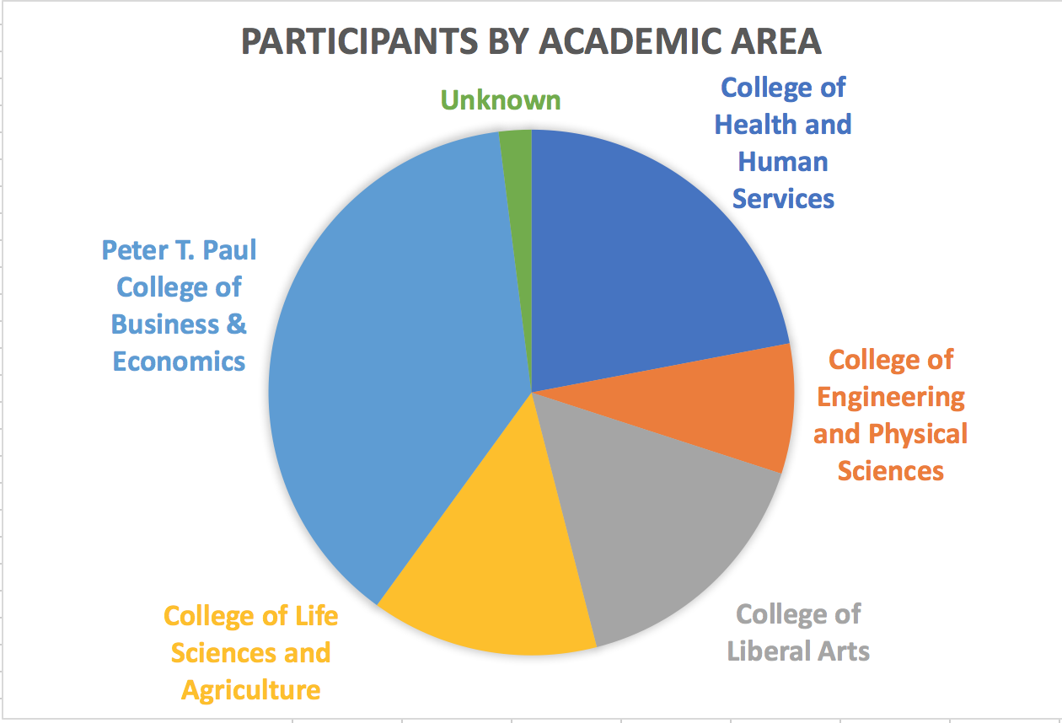
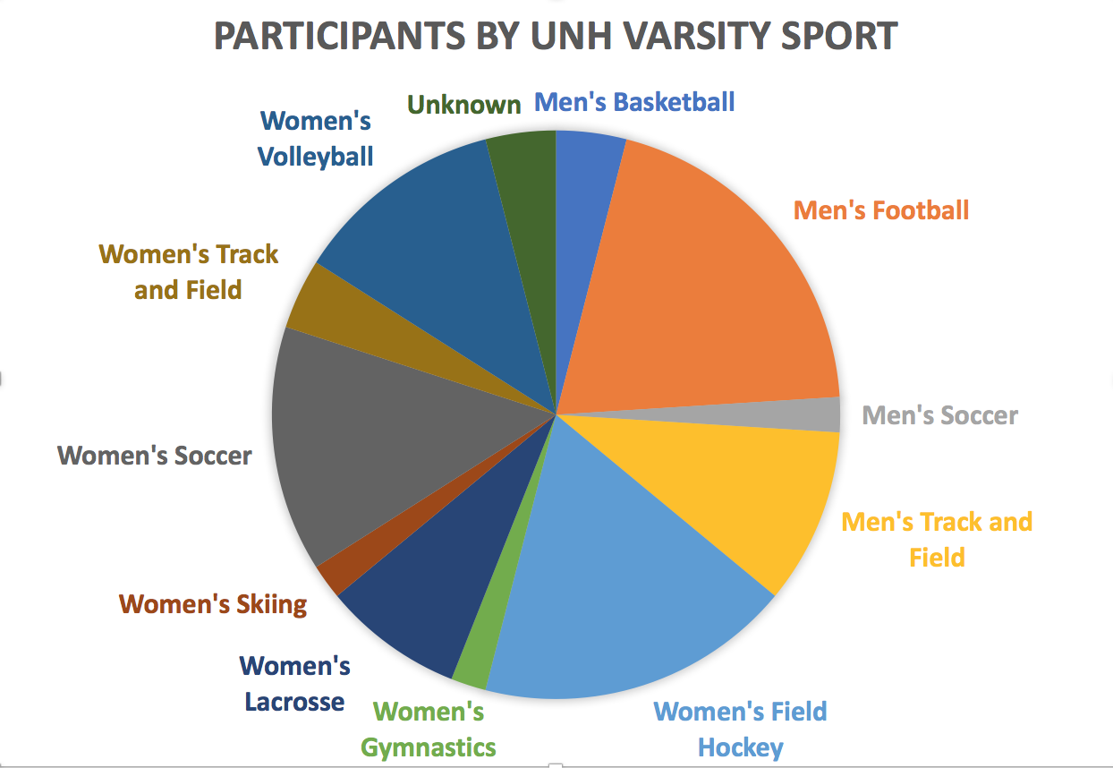
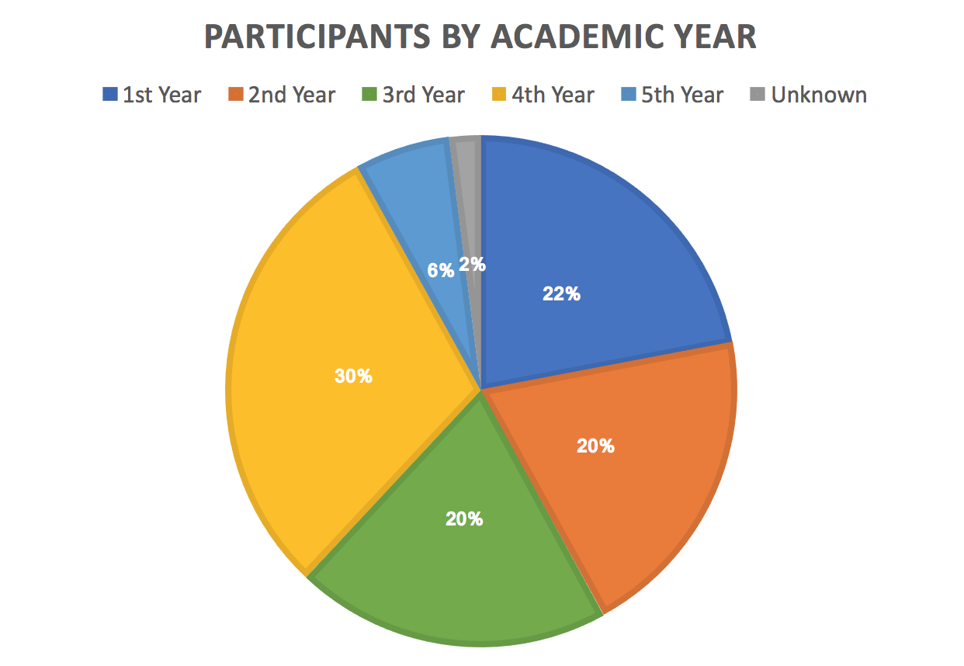
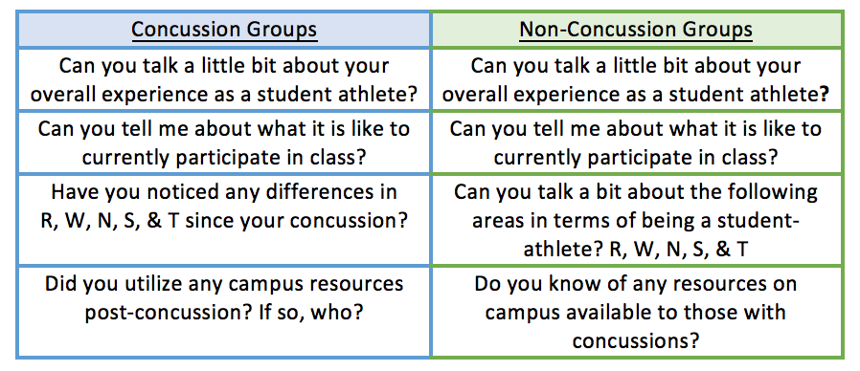
The Impact of Academic Self-Efficacy on the Occupation of Education
in College Athletes Who Experience Concussion
Samantha Colaw OTS & Gabrielle Petruccelli MS OTR/L
Background
Phase 1 - QUAN
Results
Concussions have been shown to impact occupational performance in work, education, leisure, social participation, and activities of daily living.
  (Brayton-Chung, Finch, & Keilty, 2016)
Research suggests a positive correlation between academic self-efficacy and one’s coping, positivity, growth, acceptance, and planning.
(Khan, 2013)
Recent studies have found that diagnosis threat and stigma may have a stronger impact on psychological and academic self-efficacy than on cognitive performance.
(Trontel, Hall, Ashendorf, & O’Connor, 2013)
50 participants completed a 20 minute Qualtrics survey, that included a variety of demographic, academic, and athletic information.
Participants also completed the standardized assessment Self-Efficacy for Learning Form (SELF)
Significant differences were found in academic self-efficacy in regards to note-taking between concussion and non-concussion groups.
Assessment Tool
Self-Efficacy for Learning Form (SELF)
(Zimmerman & Kitsantas, 2007)
57-item self-efficacy measure to assess reading, studying, test preparation, note-taking, and writing.
Individuals rank their confidence in being able to complete the task on a scale from 1-100% confidence.
Reliable and valid measure in concussion research, specifically among emerging return-to-learn protocols.
Sample SELF questions:
Major themes from in-depth interviews revealed:
  Similarities in the demands of the role of “student” and “athlete”.
  Differences specifically among experiencing physical versus invisible injuries and their corresponding recovery processes.
Research Aims
To understand the lived experience of a concussion as a student athlete.
To explore the student athlete’s perception of being a student in terms of reading, studying, test preparation, note-taking, and writing.
Conclusion
Participants
Student athletes with concussion experience lower academic-self efficacy, especially while performing complex tasks like note-taking.
A significant difference in note-taking aligns with previous literature regarding the relationship between concussions and executive function (specifically higher order thinking, multi-step actions, and problem solving).
Student athletes without concussion reported challenges in non-academic areas.
OTs working with student athletes with concussion should help implement a return to learning plan that includes strategies for note taking and addresses academic self-efficacy in the role of being a student.
Phase 2 -QUAL
11 participants completed in-depth interviews in homogeneous groups to discuss their experience at UNH, both as an athlete and a student.
Sample guiding
questions:
References
Brayton-Chung, A., Finch, N., Keilty, K., (2016), Action: the role of occupational therapy in concussion rehabilitation, OT Practice, 9-12.
Khan, M., (2013), Academic self-efficacy, coping, and academic performance in college, International Journal of Undergraduate
Research and Creative Activities, 5(4)
Trontel, H., Hall, S., Ashendorf, L., O’Connor, M., (2013), Impact of diagnosis threat on academic self-efficacy in mild traumatic brain
injury, Journal of Clinical and Experimental Neuropsychology
Acknowledgments
University of New Hampshire Hamel Center for Undergraduate Research

