Slide 1
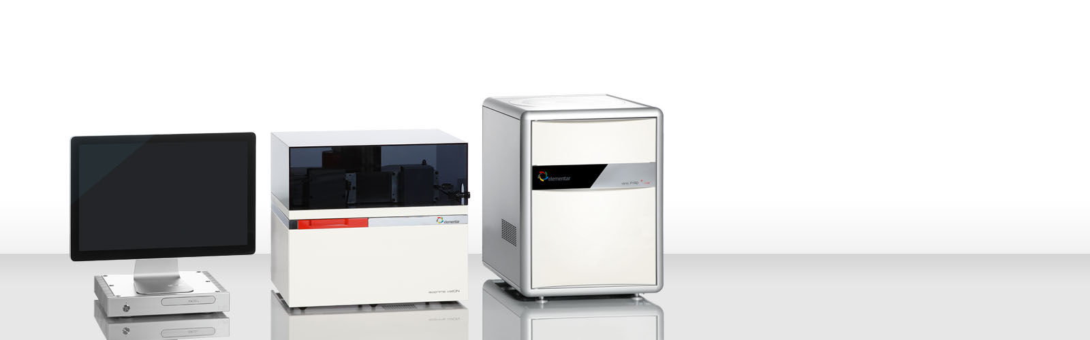
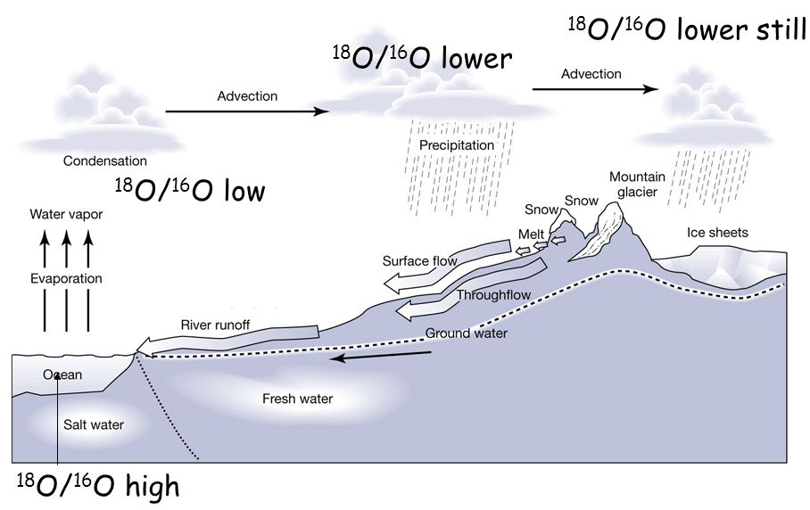
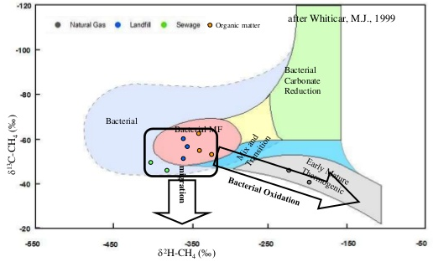


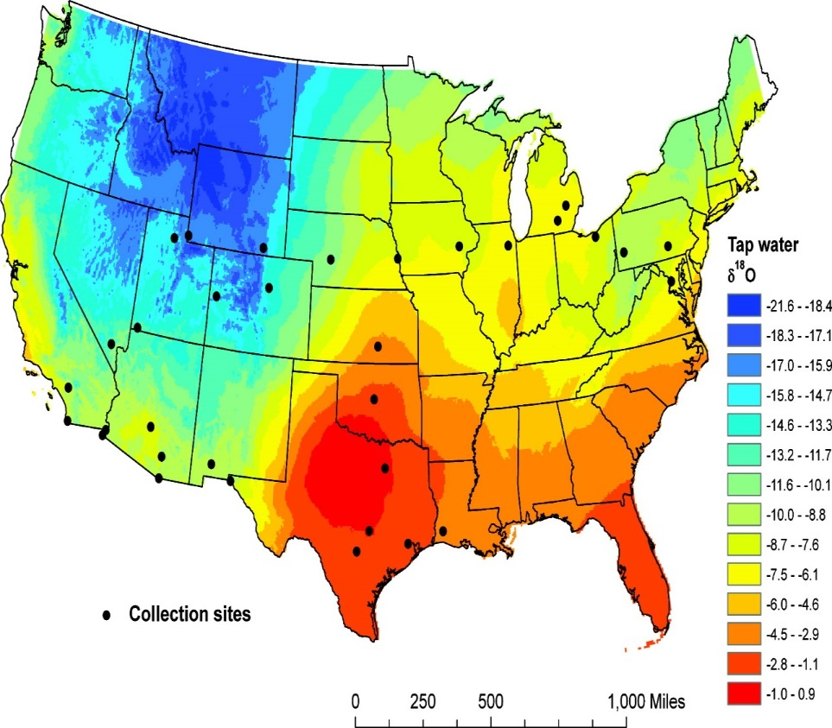
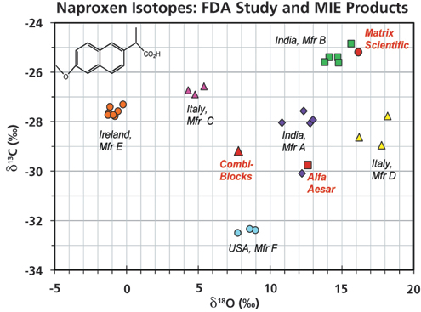
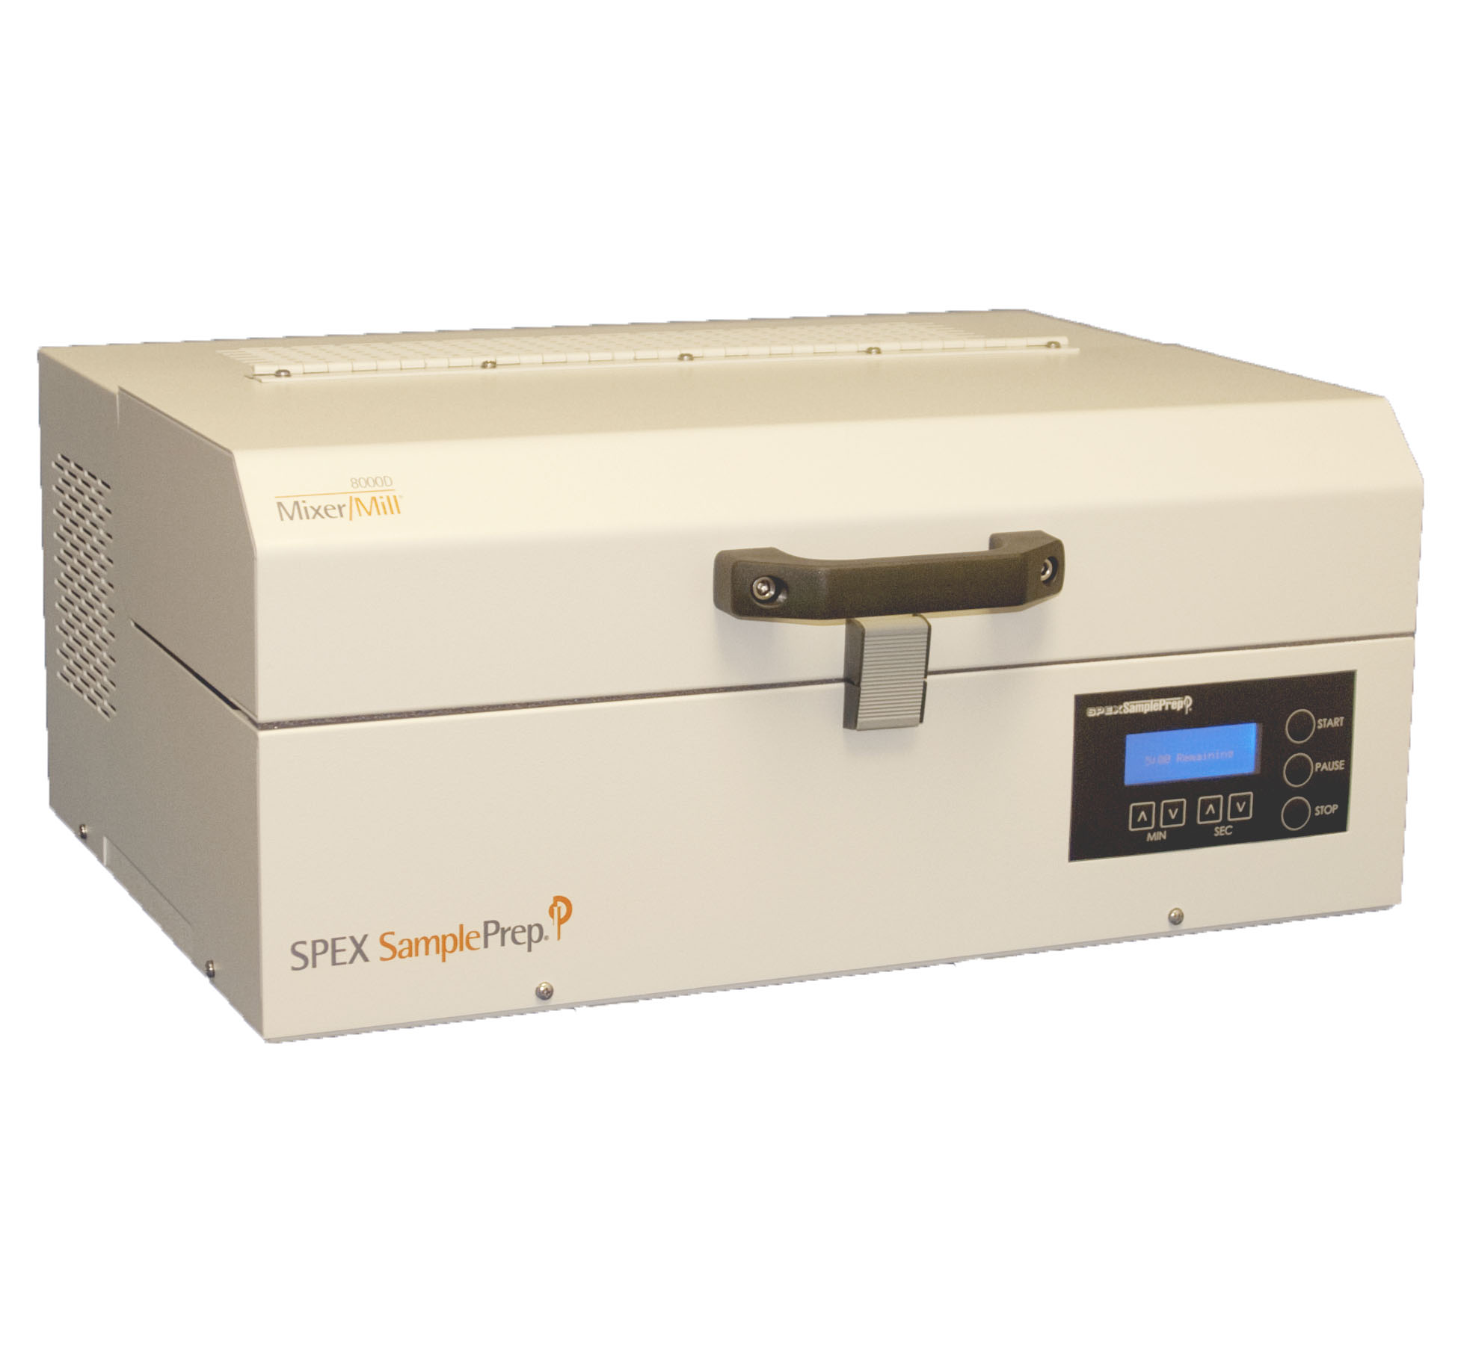
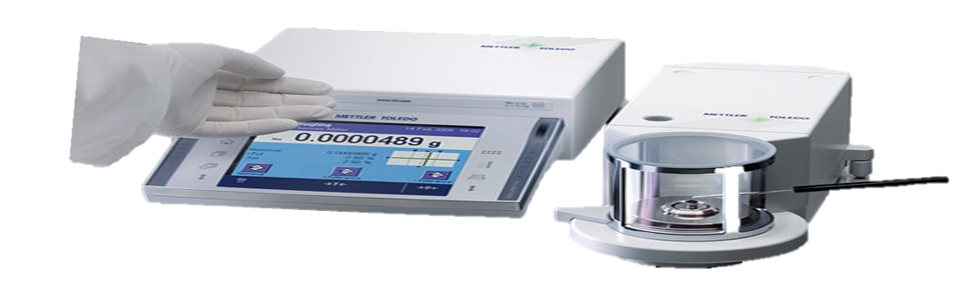
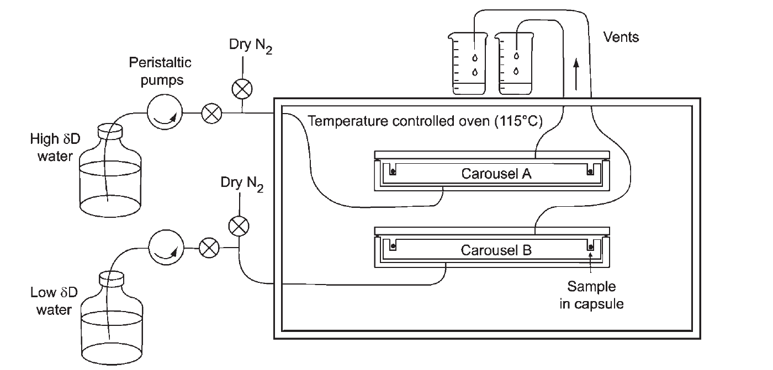
UNH Stable Isotope Lab – Why measure stable isotopes?
Andrew Ouimette
History of the lab
Instrumentation at UNH
Process Tracking
Started in 2004 with a Major Research Instrumentation (MRI) award from the National Science Foundation (NSF).
New MRI in 2015 Cost sharing and lab renovations funded by ESRC/EOS, Office of Research, COLSA, CEPS, Office of EH&S
Upgrade allows for elemental and isotope analysis of C, N, S, O, and H in a wide range of materials.
UNH’s stable isotope lab houses a new Elementar GeoVision consisting of a PyroCube elemental analyzer (EA) with Purge-Trap system, an IsoPrime 100 isotope ratio mass spectrometer (IRMS), two custom built sample equilibration and inlet systems as well as several sample preparation devices.
Tracking Hydrologic Cycles
Figure 4: Representation of the water cycle highlighting processes (evaporation, condensation) that alter oxygen and hydrogen stable isotope signatures.
Figure 2: Image of GeoVision elemental analyzer isotope ratio mass spectrometer for stable isotope analysis
Pathways of Methane Production
What are stable isotopes?
-120
-100
-80
Stable isotopes are:
Atoms of the same element that differ in their mass (see below)
Naturally occurring in all materials
Used either as 1) a fingerprinting tool or 2) to track processes
Can be isotopically labelled (manipulated) to enhance their use
δ¹³C-CH₄ (‰)
Figure 5: Pathways of methane (CH₄) production and the effect of each pathway the carbon and hydrogen isotopic signatures of CH₄.
-60
-40
-20
-350
-250
-150
-50
-550
-450
δ²H-CH₄ (‰)
Figure 1: Representation of the two most common isotopes of carbon (¹²C and ¹³C). All natural material contain different proportions of ¹²C and ¹³C. The unique isotope ratio (e.g. ¹³C:¹²C) of different materials allow stable isotope analysis to act both as a fingerprinting tool and a means to track a variety of processes that alter these isotope ratios.
Fingerprinting
Oxygen “Isomap”
Figure 6: Oxygen “isomap” showing oxygen isotopes in tap water across the US. These isomaps can be used in migration or forensic studies identify the source or location of humans, animals, or manufactured goods. (from Chesson L, et al. 2010)
¹²C
98.89%
¹³C
1.11%
UNH Stable Isotope Lab
Isotopes at UNH
Capabilities at UNH
Sourcing Pharmaceuticals
The need for stable isotope analysis has increased dramatically in recent years as a result of the increase in number and breadth of research disciplines that rely on stable isotope techniques, as well as the rapid technological improvements in stable isotope analysis. At UNH researchers from diverse disciplines use stable isotope analysis of different materials to study a broad range of topics including but not limited to:
Methane cycling in wetlands
Coastal nitrogen pollution
Marine methyl hydrate production
Archaeological analysis of cod fisheries
Quantification of carbon, nitrogen, and water cycles
The effects of forest management on small mammals
Microbial controls on soil carbon storage
Crop, weed, and soil management strategies
Climate change studies
Tracking supplemental feeding of deer populations
Linkages between dairy cow diet and greenhouse gas emissions
The role of wetlands and rivers on watershed hydrology and nutrient loading
Elemental analysis of CNSHO in solids and liquids (carbon, nitrogen, sulfur, hydrogen, oxygen)
Stable isotope analysis of CNSHO in solid samples and OH in liquid samples.
C, N, S, O, or H isotopes in compositionally complex samples and low mass samples using a new purge-trap system
C, N, S, O, or H isotope analysis on isotopically (experimentally) labeled samples
S isotope analysis in organic and inorganic samples using a custom-built system
Non-exchangeable H isotope analysis using custom built sample preparation system
Figure 7: Dual isotope plot of Naproxen carbon and oxygen isotopes highlighting the unique isotopic “fingerprint” of each manufacturer. (from Jasper et al. 2016)
Contact Information
The stable isotope lab is now part of the University Instrumentation Center (UIC). Inquires can be made through the UIC or directly to the lab director:
Andrew Ouimette
Andrew.Ouimette@unh.edu
(603) 953-5944
Figure 3: Image of preparation equipment available in the stable isotope laboratory – (from left to right) – ball mill, microbalance, hydrogen equilibration system.

