Slide 1
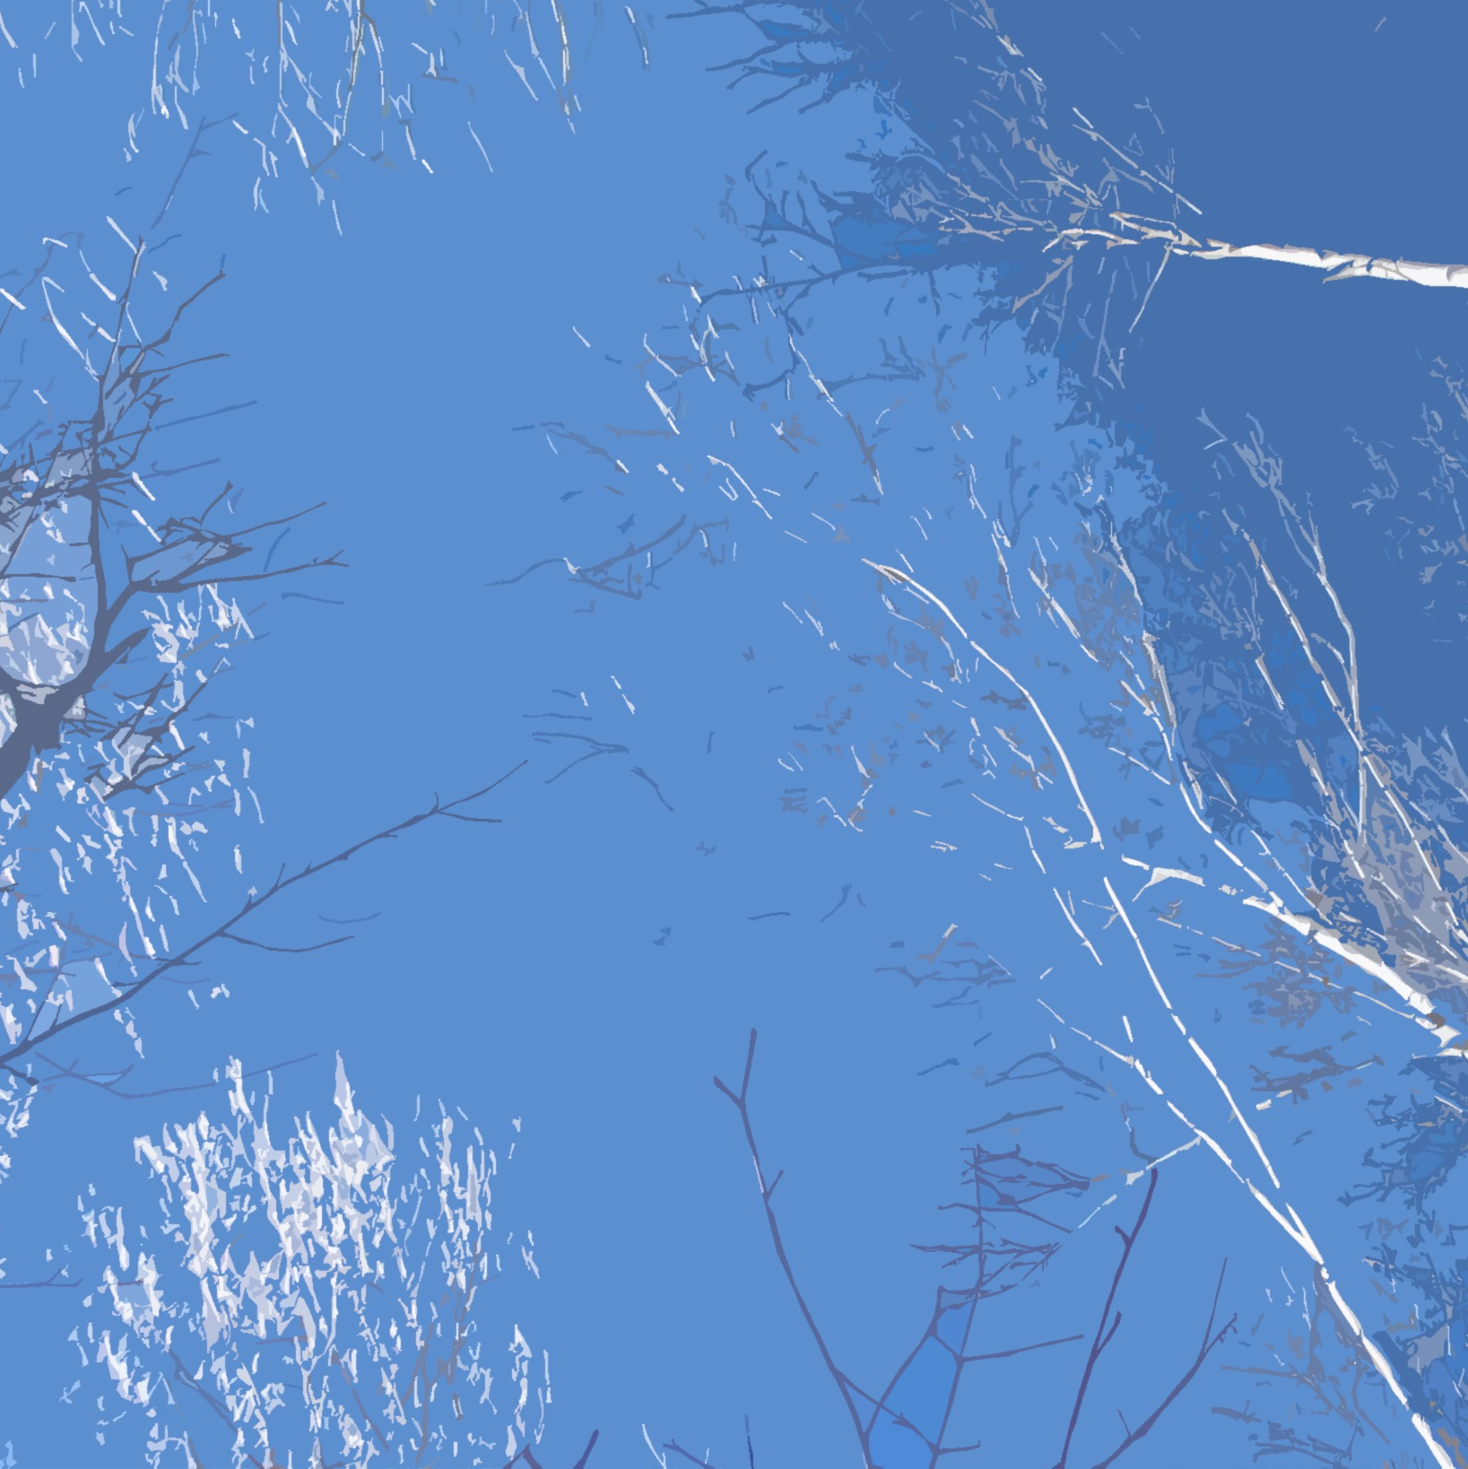
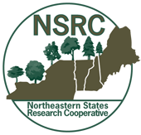
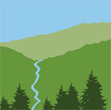
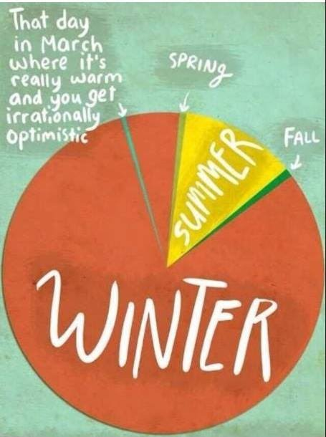
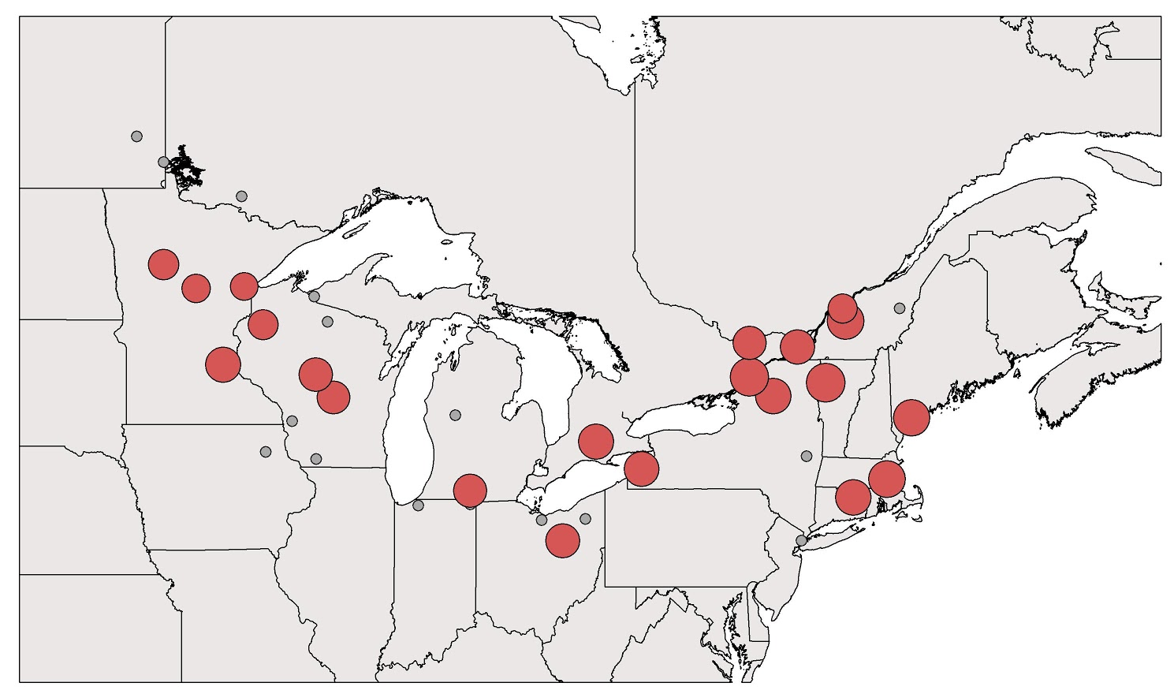
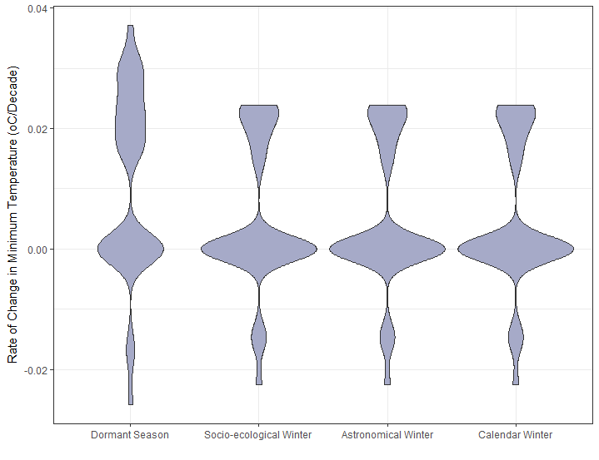
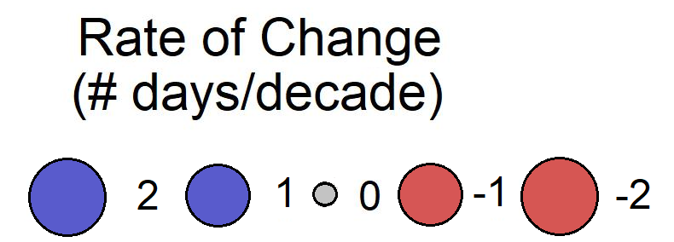
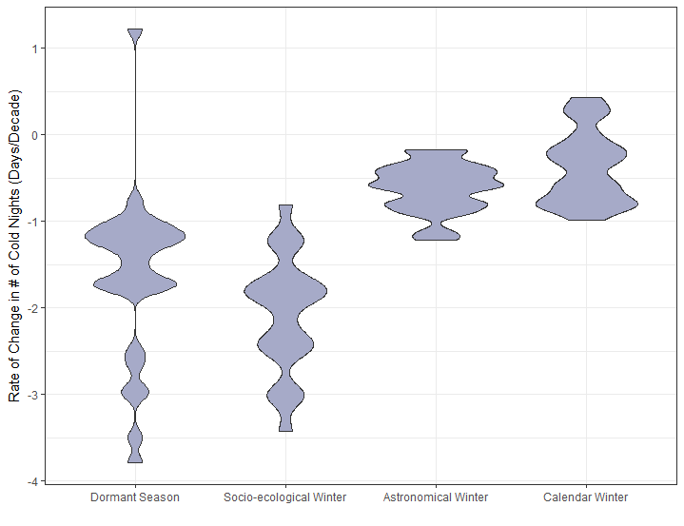
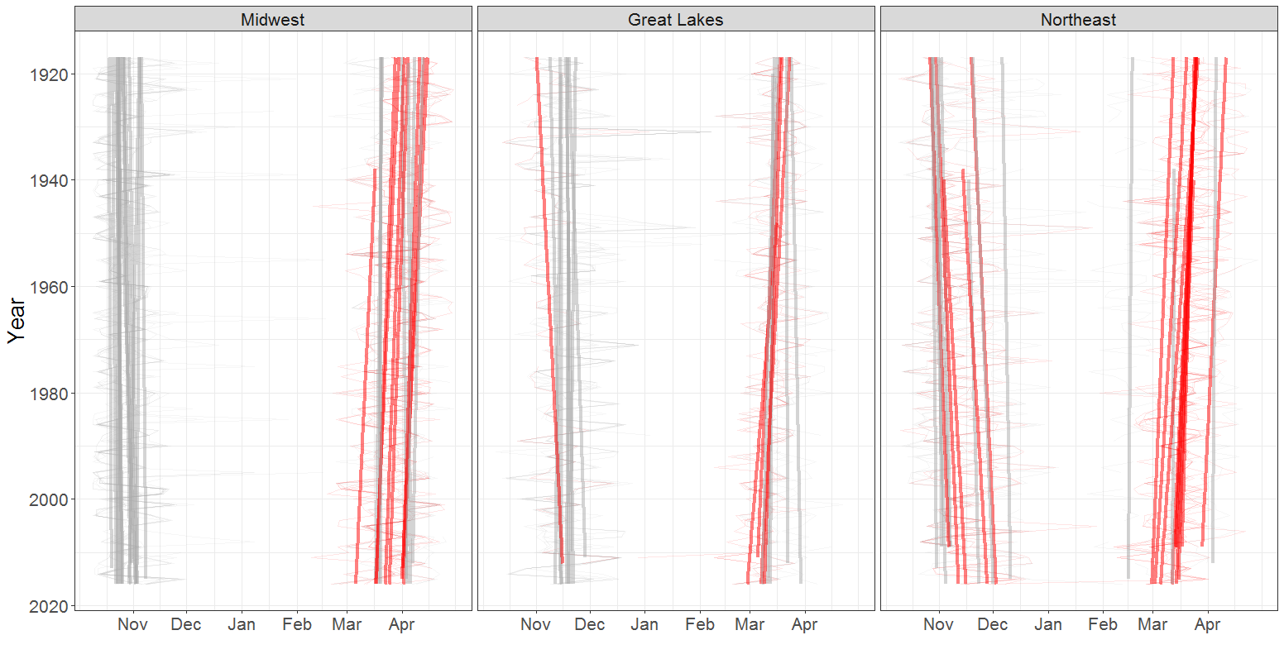
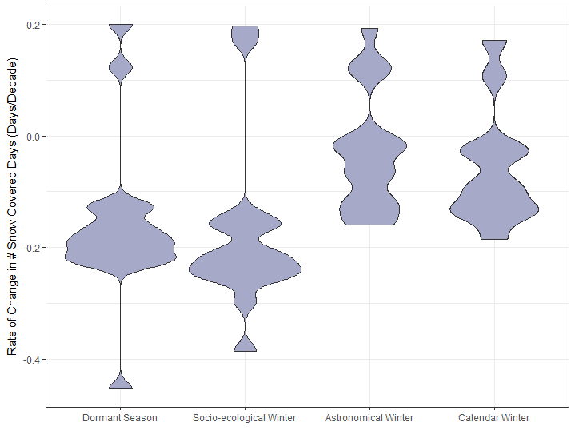
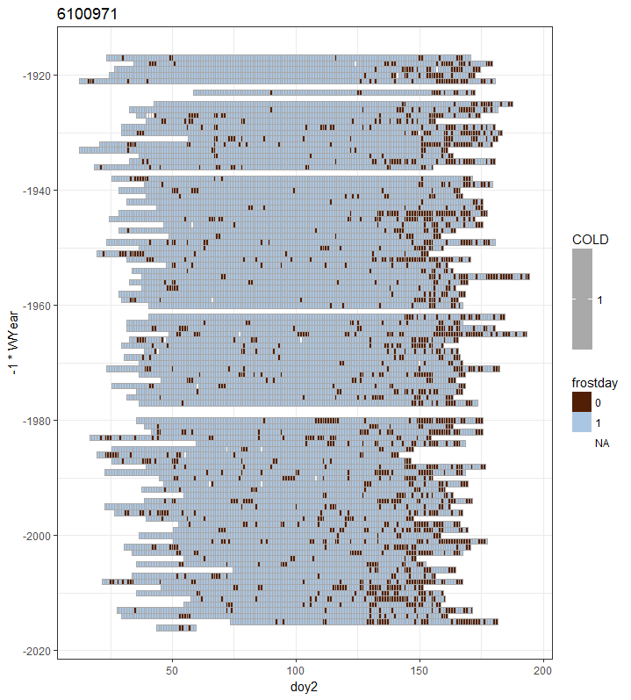
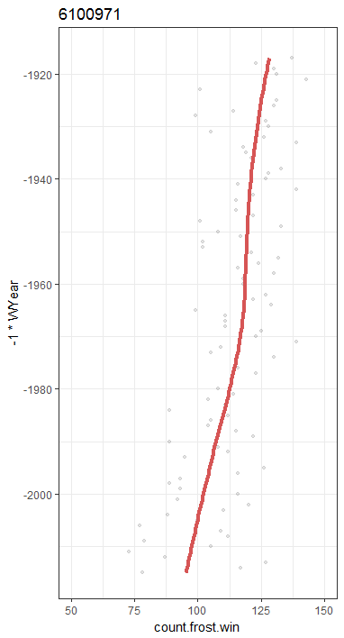
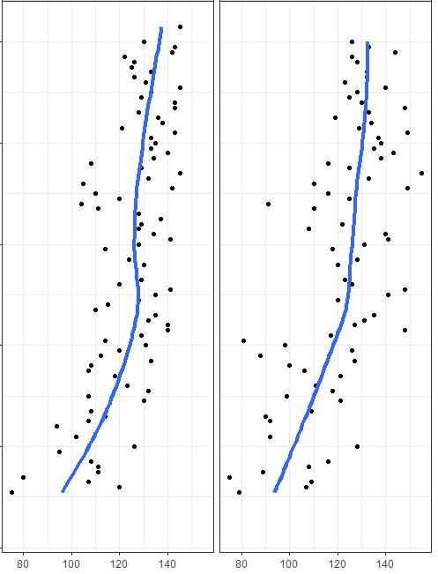
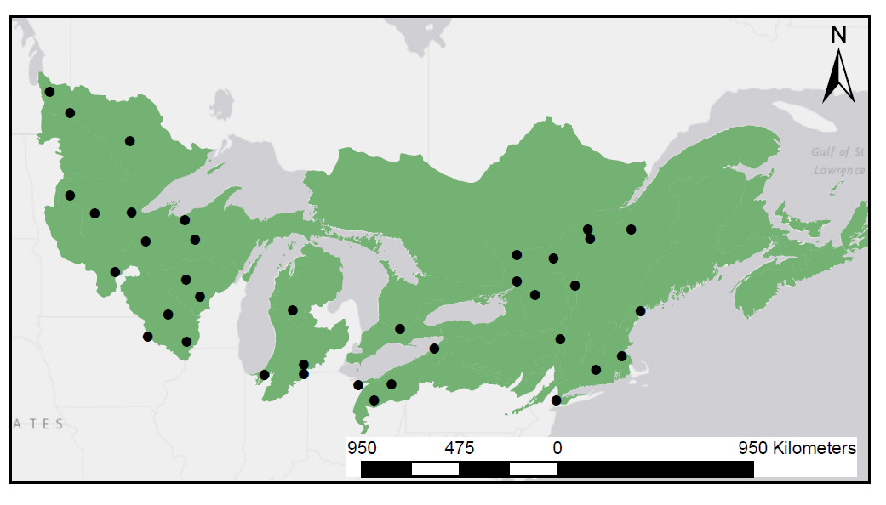
What is winter? A socio-ecological reckoning
Alexandra R. Contosta¹, Nora J. Casson², Sarah J. Nelson³ and Sarah Garlick⁴ ¹ Earth Systems Research Center, University of New Hampshire, Durham, NH 03824, USA; ² Department of Geography, University of Winnipeg, Winnipeg, MB, R3B 2E9, Canada; ³ School of Forest Resources, University of Maine, Orono, ME 04469; ⁴ Hubbard Brook Research Foundation, North Woodstock, NH 03824, USA
What is Winter? Some Reckonings
Astronomical: winter solstice to vernal equinox
Meteorological: three coldest months of year (DJF)
Cultural: All Hallows to Candlemas, ski season
Ecological: hibernal period of biological dormancy
All of the Above?
Traditional reckonings are out of sync with the socio-ecological experience of weather and do not capture how winter might vary with climate change. We propose a new reckoning that can better represent what it means to lose the cold and the snow.
We define a Socio-Ecological Winter as a period of sustained low temperatures below freezing and snow accumulation that together regulate ecological processes and their services, both during winter and the rest of the year.
Results and Discussion
Figure 3. Winter condition. The rate at which winter conditions are changing depends on the reckoning you choose. Violin plots show the distribution of rates of change in: A) average minimum temperature; B) number of cold (< 0ºC) nights; and C) number of snow covered days for each of four reckonings: dormant season (Nov. 1-May 31), as well as socio-ecological, astronomical and meteorological reckonings.
A
B
C
Figure 2. Timing and Duration. ‘Wedge plot’ showing onset and end of winter each year since 1916 for 37 stations in three geographic areas across the study region. Trend analysis shows that socio-ecological winters have become shorter, at a rate of up to 2 days per decade. This is largely due to an earlier spring onset, with many sites also showing trends toward a later end of fall.
Methods: We examined changes in socio-ecological winter timing and duration across the Northern Forest of the northeastern U.S. and eastern Canada (Figure 1) and examined how indicators of changing winter conditions vary among reckonings.
Figure 1. Location of stations within the Northern Forest region.
Data Sources
National Climatic Data of Environment Canada and USHCN with ≥ 100 years of records
Daily temperature (min and max), total precipitation, snow depth, snowfall
Indicators
Timing: start, end
Duration: number of days
Condition: average temperatures, snow cover
Trend Analysis: Mann Kendall and Sen slope
Implications
A key element is missing from past endeavors to define seasons: the idea that in many seasonally snow-covered areas, winter is a time when temperatures are largely below freezing and precipitation falls as snow, not rain.
Most studies rely on the concept of winter as either a fixed period (DJF) or as the coldest season, determining start and end dates based on air temperatures relative to historical baselines.
Our findings show that the conditions that define winter are changing, with implications for ecosystems and society that rely sustained temperatures below freezing and snow accumulation.
A
B
Day of Year
# of cold nights/year
# snow covered days/year
Night warmer than 0ºC
Night colder than 0ºC
Figure 4. Winter condition. Socio-ecological winters are becoming less continuous: A) timing and length of the socio-ecological winter (the period of sustained low temperatures, in blue) from 1917-2016 at an example site (near Montreal, QC, Canada), in which nights above 0°C within winter are shown in brown; B) The numbers of cold (< 0°C) nights and snow covered days per year within socio-ecological winter. Blue lines are fitted LOESS regressions demonstrating changes over time.
Acknowledgements
This project, “Winter Climate Change in the Northern Forest: Scientific Synthesis and Practical Solutions”, was funded by the Northeastern States Research Cooperative (NSRC), with support from the Hubbard Brook Research Foundation (HBRF). A team of over 30 scientists across the northeastern US and eastern Canada participated in this effort through the Winter Biogeochemistry Workgroup of the Northeastern Ecosystem Research Cooperative (NERC).
For more information, visit: changingwinters.wordpress.com

