Slide 1


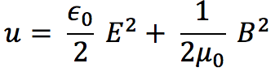
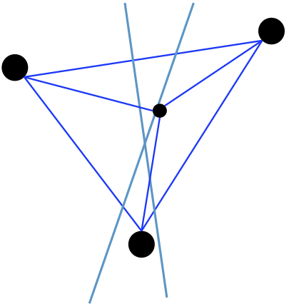



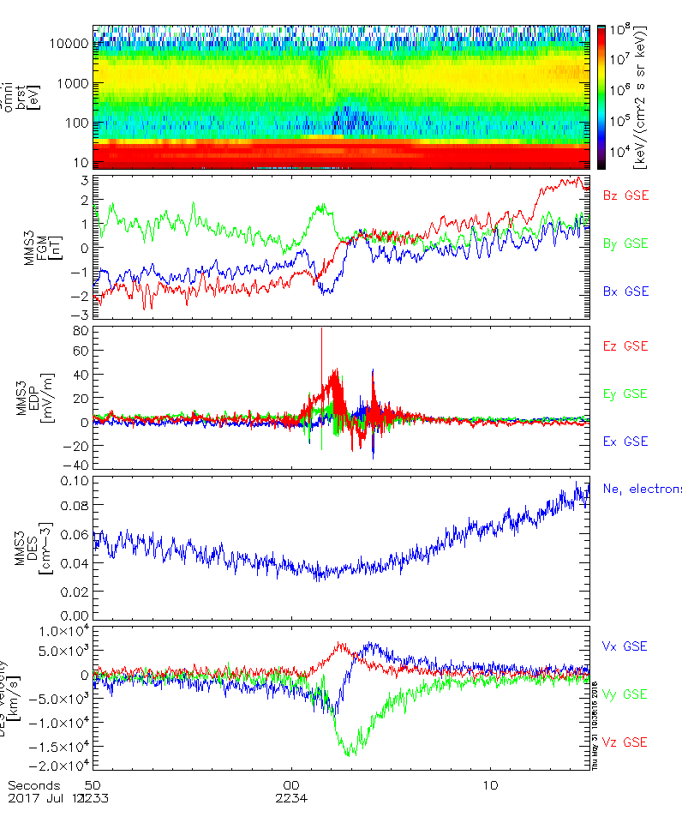

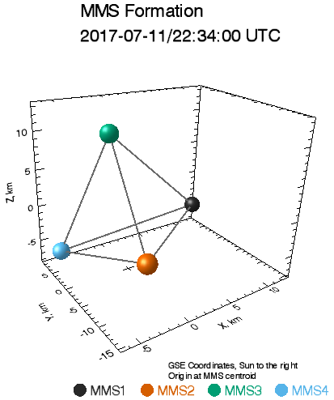

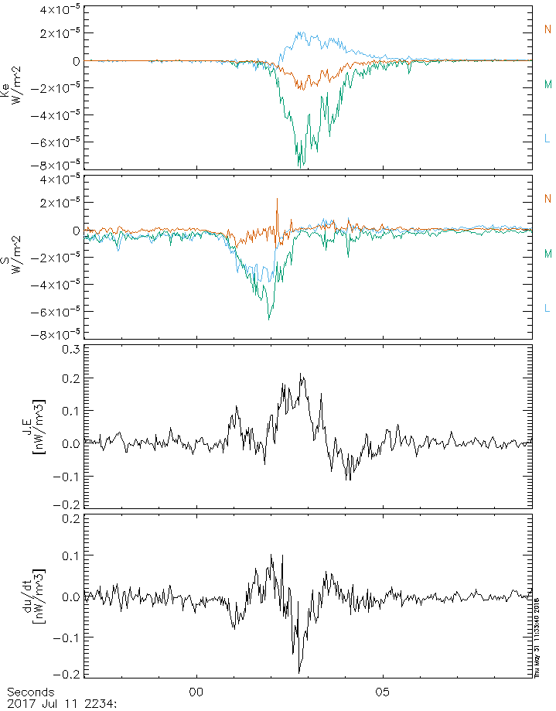
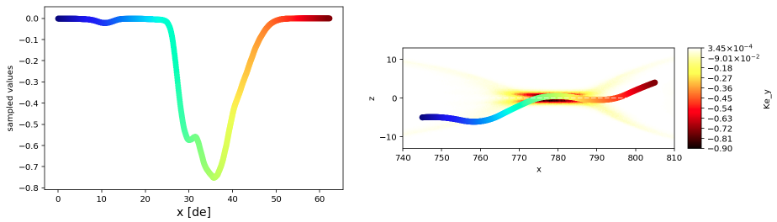
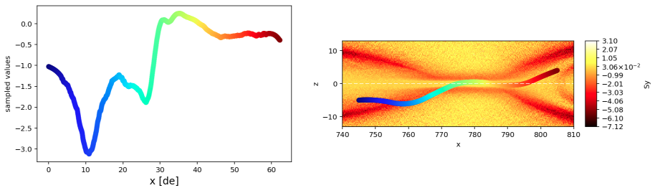
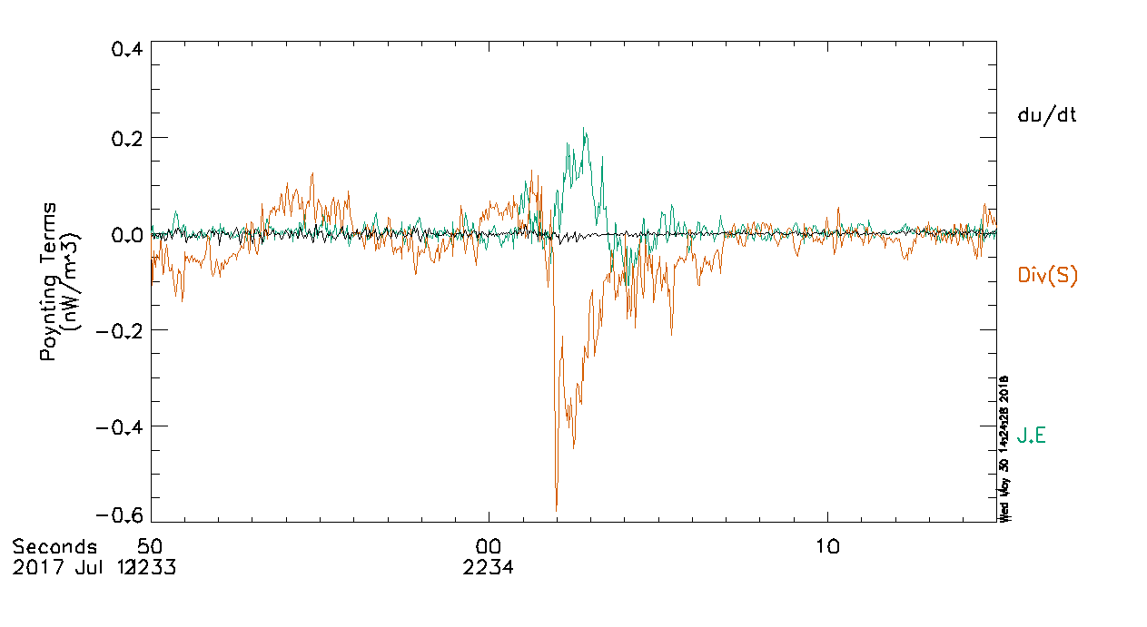

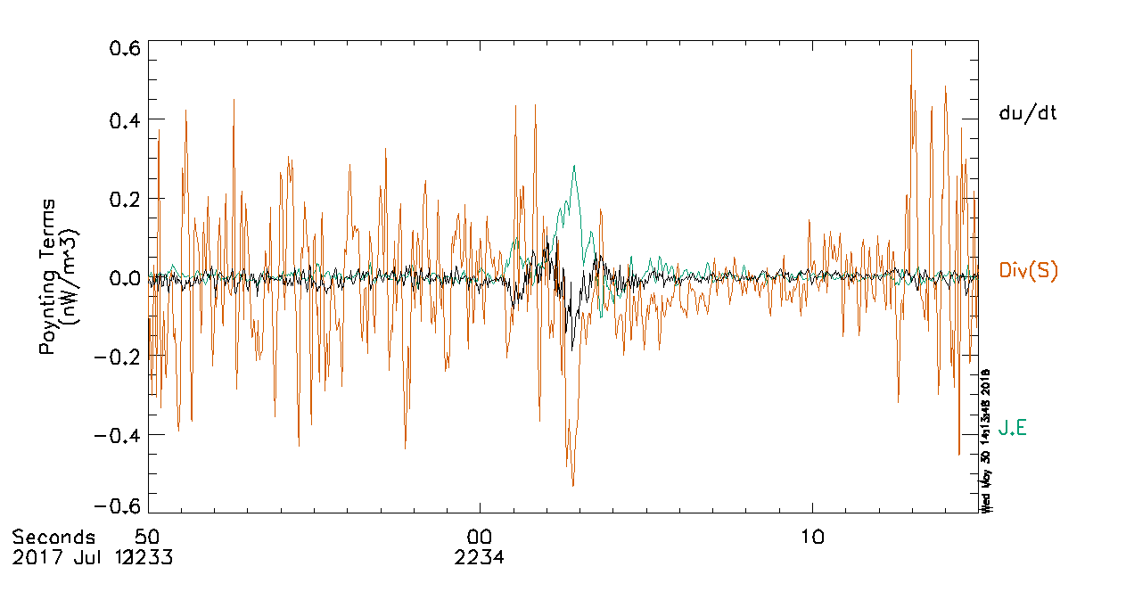
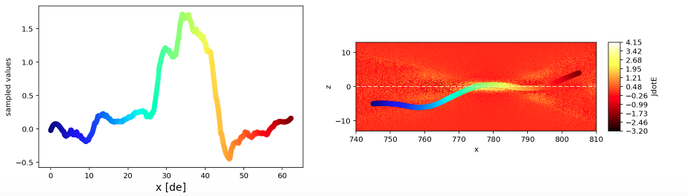
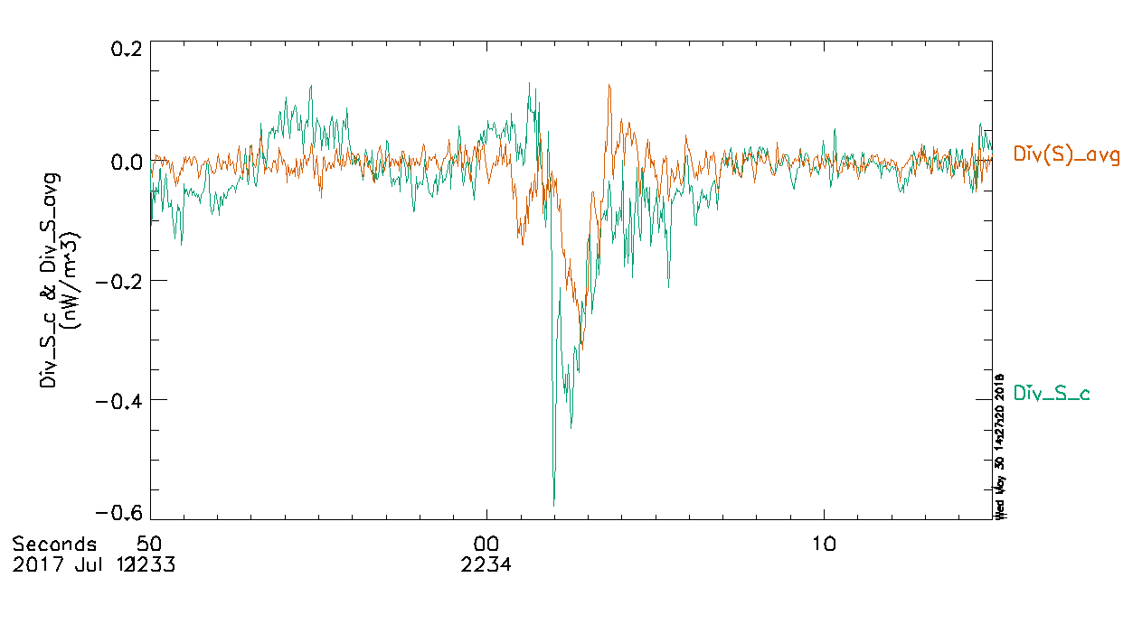

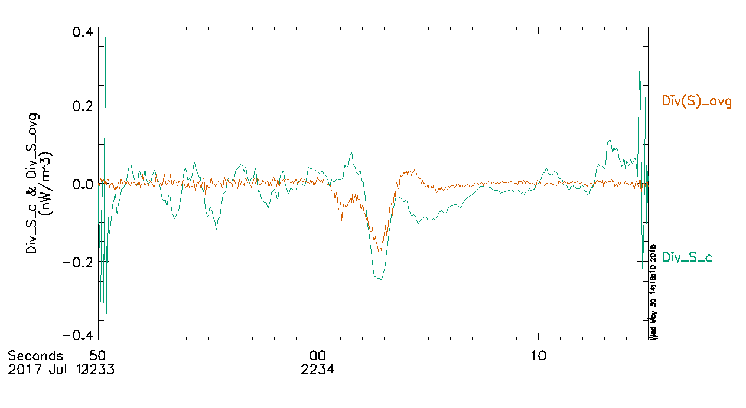
Poynting’s Theorem During a Magnetotail Electron Diffusion Region Encounter by MMS
D.S. Payne¹, M. Argall¹, R. Torbert¹
1) University of New Hampshire
Abstract
Poynting’s Theorem
Poynting’s theorem is a statement of the conservation of energy in the field of electrodynamics. Each of the three terms in Poynting’s theorem are evaluated and compared in multiple reference frames using high resolution MMS data from the EDR encounter on July 11th, 2017. These terms are also compared with Poynting flux and electron kinetic energy flux to identify three distinct regions of energy transfer between particles and fields in both the MMS data and a 2D PIC simulation. For this event, the terms in Poynting’s theorem do not balance perfectly, but the imbalance between them is well below an order of magnitude.
MMS 2
Three Considered Reference Frames
MMS frame
X-Line frame (s frame):
3. Electron frame:
MMS 4
MMS 1
Event Overview
Rate of change of u
Energy exchange between particles and fields
EM Energy flowing in/out of volume
MMS 3
Spacecraft Separation ~ 15 km
Small |B| indicates proximity to current sheet
Signatures of the EDR
  Reversals in B_{x} and B_{z}
  Large reversal in V_{ex}
  Large V_{ey} (out of plane)
Conservation of energy within a volume
All quantities taken as an average over the four spacecraft
Steady state → du/dt = 0
Ideally, all contributions should balance out
Energy Transfer in the EDR
Three Regions
Energy Buildup (blue)
  Increase in du/dt
  Decrease in J.E
  Increase in |S|
Energy Loss (red)
  Decrease in du/dt
  Increase in J.E
  Decrease in |S|
  Increase in |K_{e}|
Relaxation (green)
  Increase in du/dt to zero
  Decrease in J.E to zero
  Decrease in |K_{e}|
Frame Dependence of Poynting’s Theorem
K_{ey}
Comparison of Poynting’s Theorem Terms
MMS
X-Line
Electron
S_{y}
J•E
Comparison of Div(S)
Use Poynting’s Theorem to calculate Div(S) at each spacecraft and average the results (orange)
Use the reciprocal vector method for divergence (green)
Simulation Parameters
L_{x} × L_{z} = 80 × 20 d_{i} m_{i}/m_{e} = 400
T_{i}/T_{e} = 5 ω_{pe}/Ω_{ce} = 2
n_{b}/n₀ = 0.05 N_{total} =1.57e10
Conclusions
Poynting’s Theorem does not balance perfectly, but the imbalance is within a factor of 2
MMS and X-Line frames are nearly identical
Electron frame shows du/dt ~ -J.E, Div(S) very noisy
Comparison of Div(S) methods:
  Similar features from 22:34:02 – 04
  Features approximately equal in magnitude, but opposite sign from 22:34:00 - 02
MMS
X-Line
Electron (smoothed 0.1s)
Acknowledgements
FPI, EDP, and FGM teams for use of their data
We thank the successful MMS team for such wonderful data and NASA support via contract NNG04EB99C
Features in EDR broken into three regions with PIC simulation comparison
Email: dsp1007@wildcats.unh.edu

