Slide 1


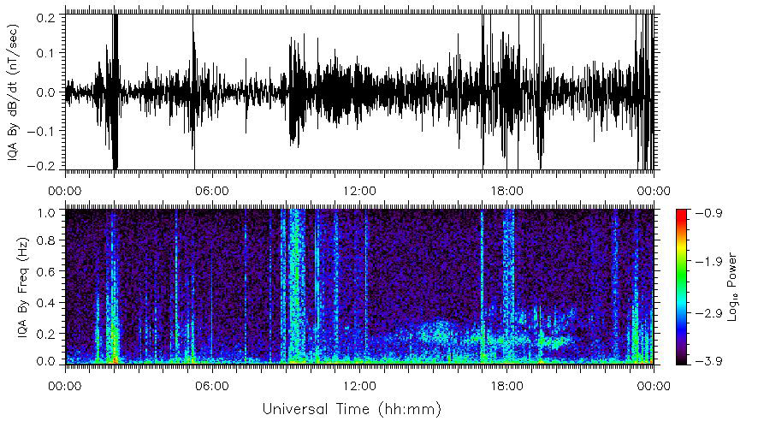
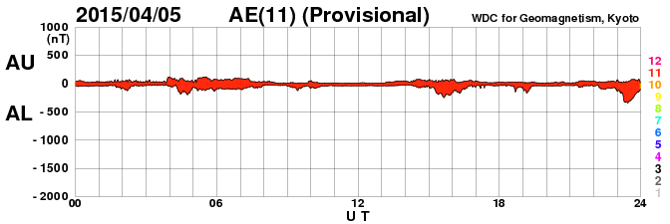
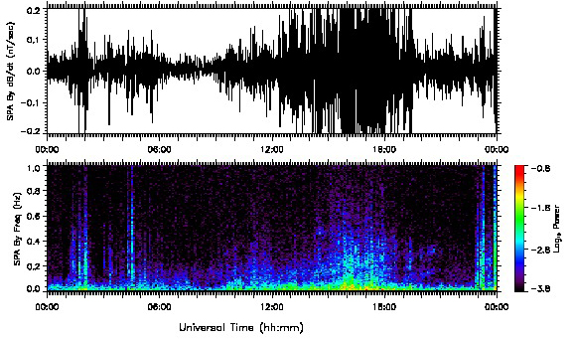
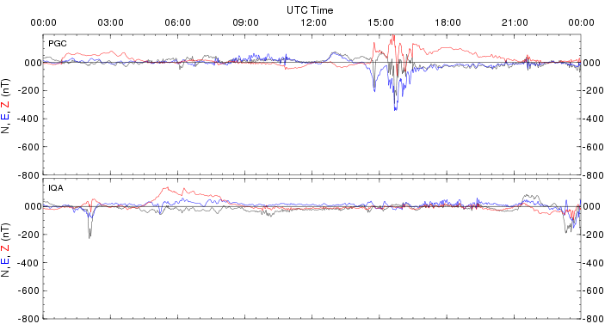
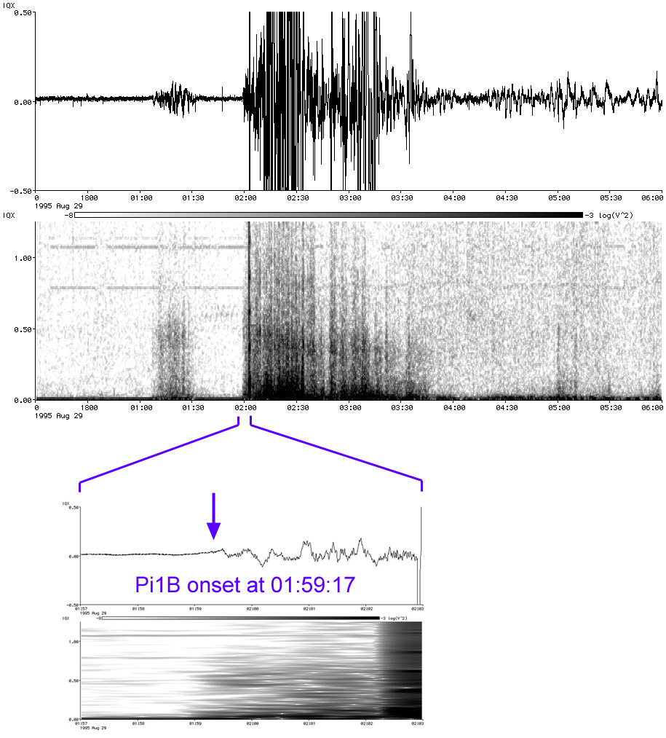
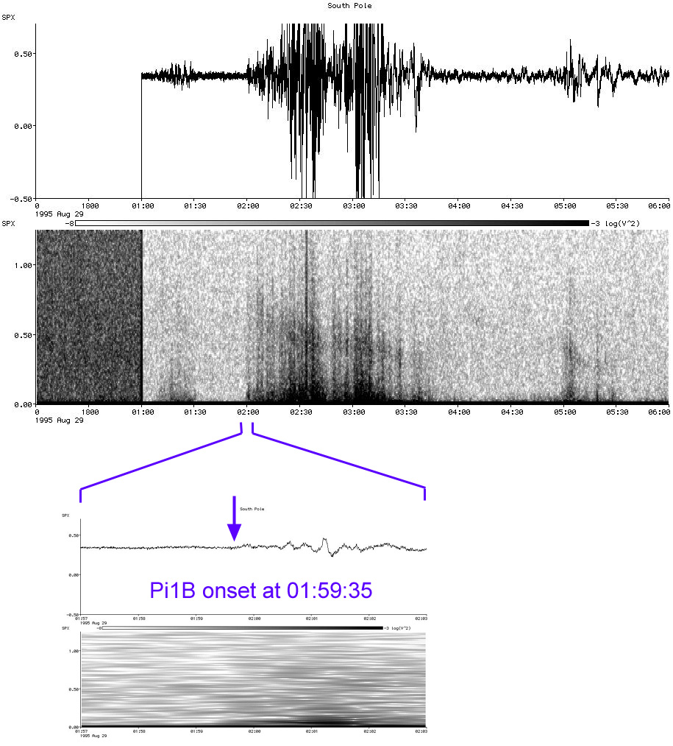
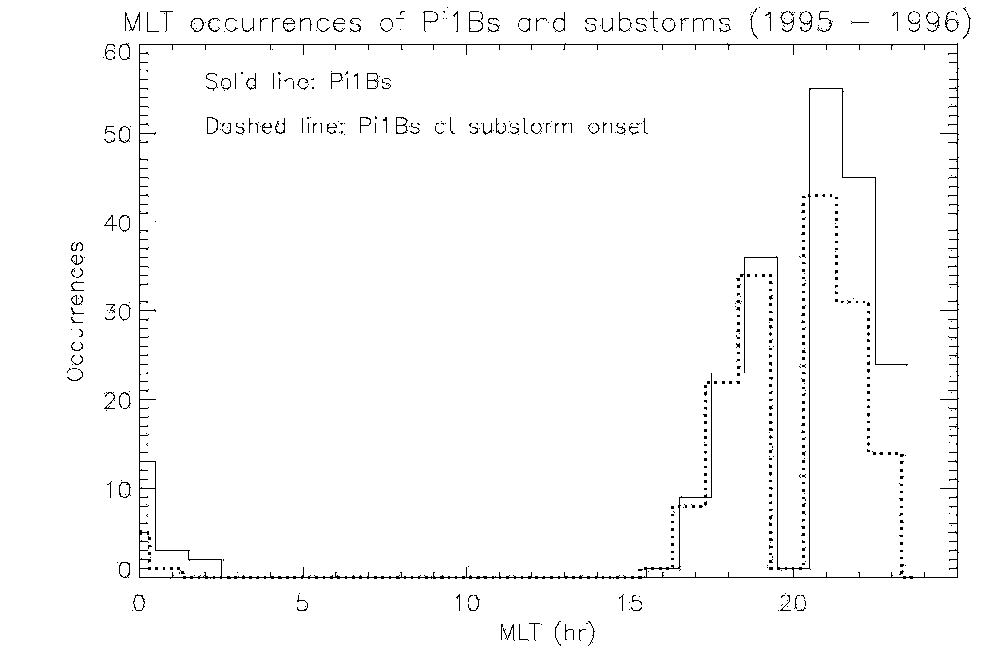
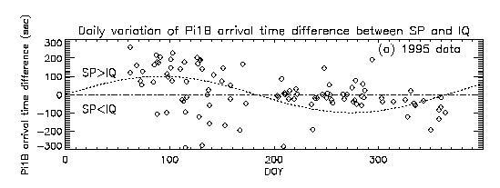
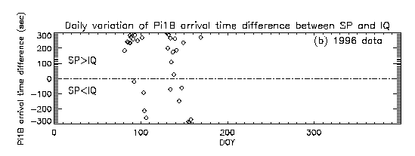
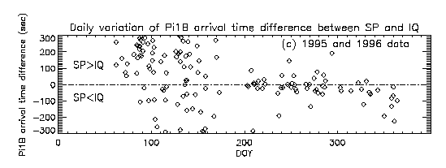
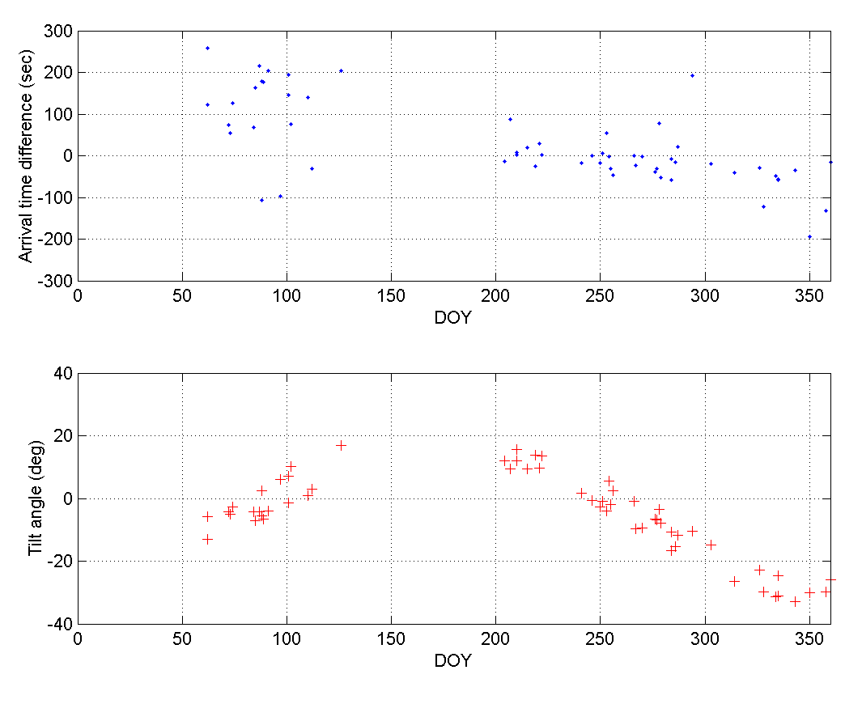
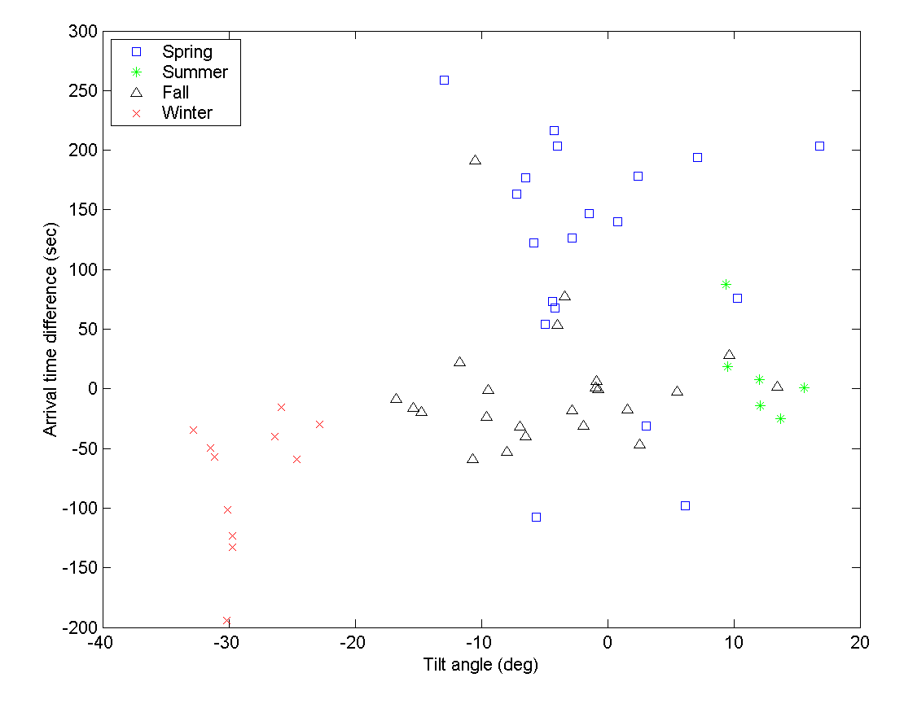
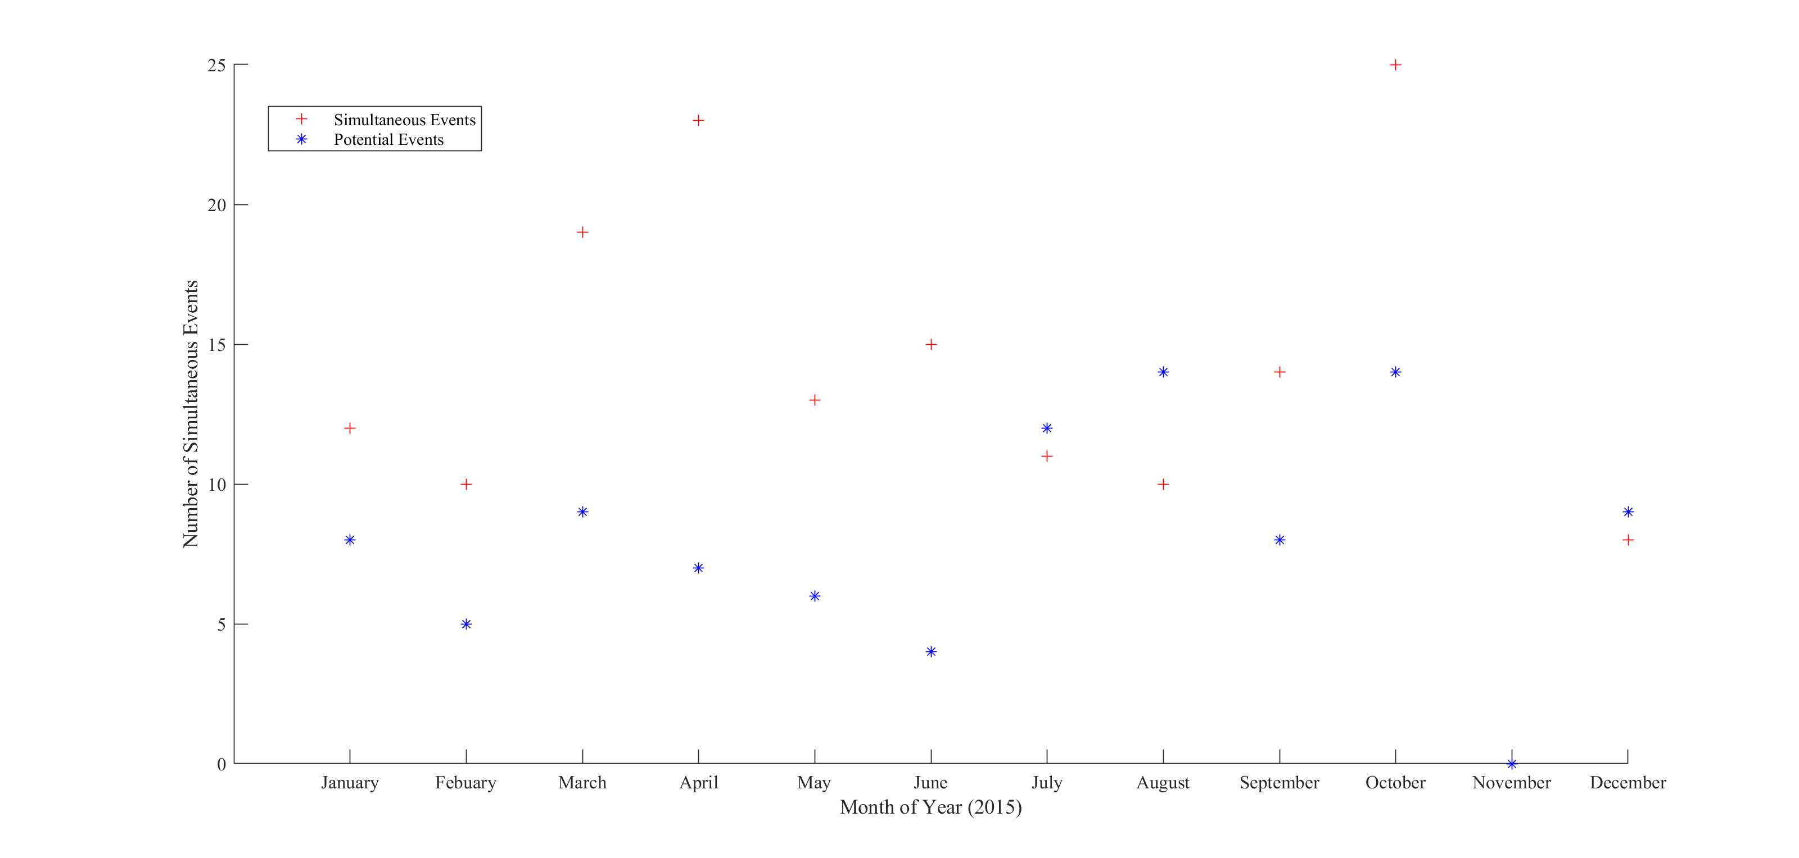
A Statistical Analysis of Interhemispheric Pi1B Seasonal Variations
Michelle Salzano¹, Marc R. Lessard¹, Hyomin Kim², Mark J. Engebretson³ , and Naomi Wight¹
¹ Space Science Center, University of New Hampshire, Durham, NH., USA.
² Center for Solar-Terrestrial Research, New Jersey Institute of Technology, Newark, NJ., USA.
³ Physics Dept., Augsburg College, Minneapolis, MN., USA
Abstract
Introduction
Pi1B at Substorm Onset
Pi1B magnetic pulsations are 1Hz broadband bursts with periods of between 1-40 seconds that are well-correlated with substorm onset. Lessard, et al. [2006] showed simultaneous observations of Pi1B pulsations in association with substorm onset on the ground and at geosynchronous orbit. Additional, they showed that Pi1B waves that are compressional at geosynchronous orbit must undergo a mode conversation to shear mode waves, and raised the question of whether this makes it possible to use ground-based arrival times to triangulate the source region of substorm onset in the magnetotail. The following study builds off of this question, and is additionally motivated by papers showing interhemispheric differences in substorm evolution [Papitashvili et al., 2002].Using ground-based 2015 data from South Pole (SPA) and Iqaluit (IQA) in conjunction with Kyoto University's Provisional AE index and SuperMAG magnetic field data, Pi1B waves associated with substorm onset are identified in both hemispheres. Onset time differences are compared between both stations over the course of the year to evaluate the seasonal dependence of these time differences. While the current study is still in progress, a preliminary study conducted in 2006 by Hyomin Kim suggested the presence of this seasonal dependence in Pi1B onset times in opposite hemispheres.
Pi1 pulsations are irregular ULF range (T=1~40 s) magnetic pulsations, which can be divided into two groups, Pi1B (broadband bursts) and PiC (narrowband, continuous typically for several tens of minutes). Pi1B and PiC are observed to occur near simultaneously between 2300-0200 LMT. [Heacock, 1967]
Various studies have shown that Pi1B pulsations are associated with substorm onset. Arnoldy et al. [1998] showed that these pulsations can be observed at geosynchronous orbit in conjunction with onset.
Lessard et al. [2006] looked at substorm-associated data from FAST, GOES 9, and a variety of ground-based stations. They observed shear mode waves in the data from FAST but observed compressional waves in the data from GOES 9. They concluded that there must be some mode conversation between the two regions, and hypothesized the following: compressional, fast-mode waves excited during substorm onset at geosynchronous orbit travel isotropically and slice through the magnetosphere unhindered; as they propagate, these waves become increasingly parallel to the background field and undergo a mode conversion to shear waves, which are guided by the magnetic field lines. This raised the question of whether or not onset times at ground-based stations could then be used to triangulate the source region of substorm onset.
Inspired by this question, a preliminary study of Pi1B onset times was conducted by Hyomin Kim in 2006. It showed that during the spring of 1995, ground signatures of Pi1B pulsations at South Pole tended to lead those at Iqaluit often by a minute or two, with a wide distribution in time differences. During the fall of 1995, however, events at Iqaluit tended to lead those at the South Pole, but with significantly smaller time differences and with less scatter than in the spring.
Figure 3 04 April 2015 AL index data from Kyoto University’s Provisional AE index. There is an obvious negative bay at 2300, which lines up with a Pi1B wave observed in the spectrogram data to the left.
Figure 1 04 April 2015 Spectrogram Data from IQA. Simultaenous Pi1B waves are observed at 0200, 0530, and 2300 UT.
Figure 4 04 April 2015 SuperMAG data showcasing the Z field at PGC and IQA. There is magnetic activity at 0200 and at 0530 that lines up with a Pi1B wave observed in the spectrogram data to the left.
Figure 2 04 April 2015 Spectrogram Data from SPA.
Results of the 2006 Preliminary Study
Iqaluit South Pole
Figure 7 Daily variations of Pi1B arrival time difference between South Pole Station (SP) and Iqaluit Station (IQ) obtained in (a) 1995; (b)1996, and (c) 1995-1996. If the waves arrive at SP first (SP>IQ), the difference is a positive number, and negative differences are shown for the opposite case (SP<IQ). It appears that the arrival times are clustered in the upper part (SP>IQ) during the spring season and in the lower part (SP<IQ) during the fall season. A sine curve is plotted in panel (a) to show that the typical arrival time differences in the spring are more scattered and larger than those in the fall.
Figure 6 MLT occurrence of Pi1Bs observed at the South Pole and Iqaluit, Nunavut, Canada simultaneously. Solid line represents all the Pi1Bs measured in this study; dashed line is for Pi1Bs that are confirmed to occur during substorm onsets observed by South Pole fluxgate magnetometer (75% of the total Pi1B events observed in this study).
Figure 5 Pi1B arrival time difference at Iqaluit Station (left) and its geomagnetic conjugate South Pole Station (right), identified visually during the preliminary study.
212 Pi1B events (obtained in 1995 and 1996) were included in a statistical study to compare substorm onset times at the South Pole and Iqaluit, Nunavut, Canada. 160 events were confirmed to occur during substorm onsets (Figure 7). These two stations are in opposite hemispheres but are nominally conjugate.
Pi1B Propagation vs Magnetospheric Geometry
Summary
•The compressional nature of the Pi1B waves at geosynchronous orbit suggests that they are fast-mode waves, capable of propagating isotropically. As the waves propagate earthward, they become increasingly parallel to the background field, eventually undergoing a mode conversion to shear mode waves. Lessard, et al. [2006, 2011]
•Under the condition that Pi1B is compressional wave and propagates isotropically, a very simple magnetospheric model, by which the wave travel distance is mostly affected by the tilt angle, might explain the travel time difference between the conjugate hemispheres.
PRELIMINARY STUDY:
212 Pi1B events were included in a statistical study to compare the arrival time differences at conjugate stations (the South Pole Station and Iqaluit Station, Nunavut, Canada, observed from 1995 to 1996). 160 out of 212 events were confirmed to occur during substorm onsets.
During the spring of 1995, events at the South Pole tended to lead those at Iqaluit often by a minute or two, with a wide distribution in time differences.
During the fall of 1995, events at Iqaluit tended to lead those at the South Pole, but with significantly smaller time differences and with less scatter than in the spring.
To study this seasonal dependence, the solar wind speed and the geometry of the magnetosphere such as tilt angle and clock angle were examined, which showed no clear tendency but tilt angle seemed to play a minor role in the arrival time differences.
CURRENT STUDY (IN PROGRESS):
The current study uses 2015 ground-based magnetic flux data from IQA and SPA, which remain good conjugates to eachother.
Because of the gray areas involved in identifying Pi1B waves, data from Kyoto University's AE index and SuperMAG magnetic field data is used to confirm a substorm-relationship.
An initial cut of the data has been performed. The next steps involve a third pass to catch any missed events, as well as beginning the onset-time analysis. Currently it is planned to do this visually.
Figure 9 Definition of tilt angle: the angle between SM and GSM.
Figure 8 Pi1B propagation time delays due to magnetospheric geometry.
The figure to the left shows the number of simultaneous events identified each month, as well as possible events that require some closer inspection.
An average of 14 simultaneous events a month were identified. This number is expected to rise with a third pass.
There is no SPA data for November 2015. This gap may be filled using AGO data in the future.
Pi1B waves were identified visually using spectrograms.
Figure 10 The plot of arrival time difference vs geomagnetic tilt angle shows the events observed in each season were clustered at particular tilt angles and arrival time differences, which might suggest the propagation of Pi1B is controlled by the geometry of the magnetosphere.
Figure 11 Seasonal variation of the arrival time differences and IMF tilt angles. The seasonal variations of Pi1B arrival time differences might be controlled by the geomagnetic tilt angle.
References
Arnoldy et al., Pi1 magnetic pulsations in space and at high latitudes on the ground, J. Geophys. Res., 103, 23,581, 1998.
Heacock, R. R., Two subtypes of Pi micropulsations, J. Geophys. Res., 72, 3905, 1967.
Kim et al., Seasonal Variations of Pi1B Propagation Asymmetries at Conjugate Hemispheres in Association with Substorm Onset, GEM Spring Meeting, 2006.
Lessard, M. R., E. J. Lund, H. M. Kim, M. J. Engebretson and K. Hayashi, Pi1B pulsations as a possible driver of Alfvénic aurora at substorm onset, J. Geophys. Res., doi: 10.1029/2010JA016355, 116, A6, 2011.
Lessard, M. R., E. J. Lund, S. L. Jones, R. L. Arnoldy, J. L. Posch, M. J. Engebretson and K. Hayashi, The Nature of Pi1B Pulsations as Inferred from Ground and Satellite Observations, Geophysical Research Letters, 33, L14108, doi:10.1029/2006GL026411, 2006.
Acknowledgement: This research was conducted under NSF grants ARC-0520475 and ANT-0233169.

