Slide 1
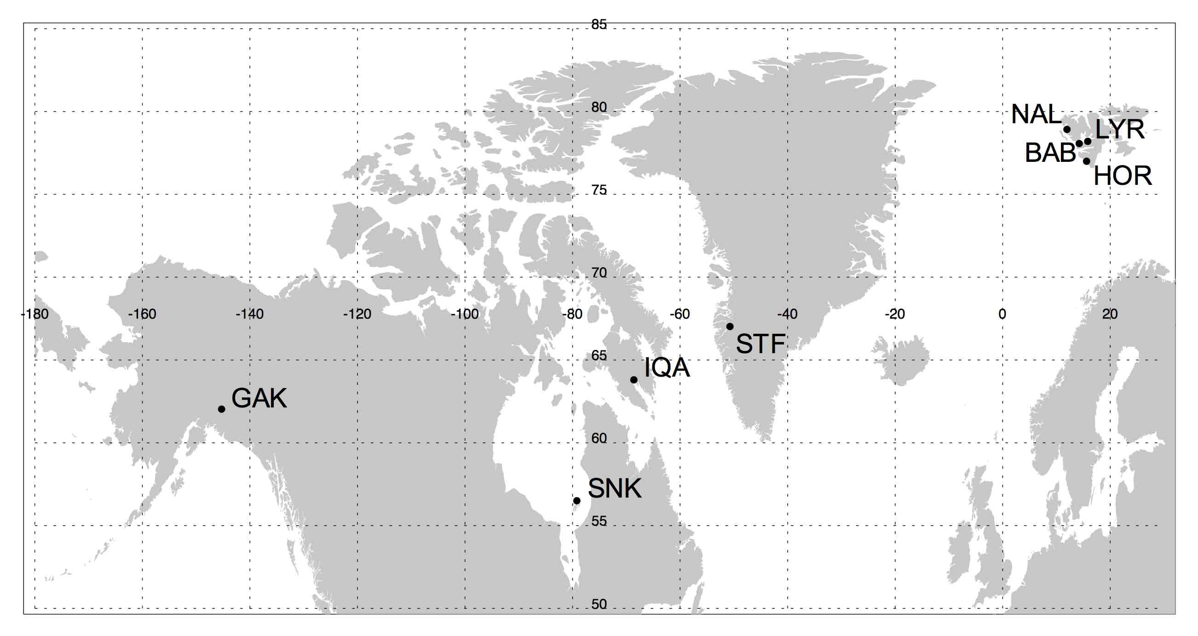
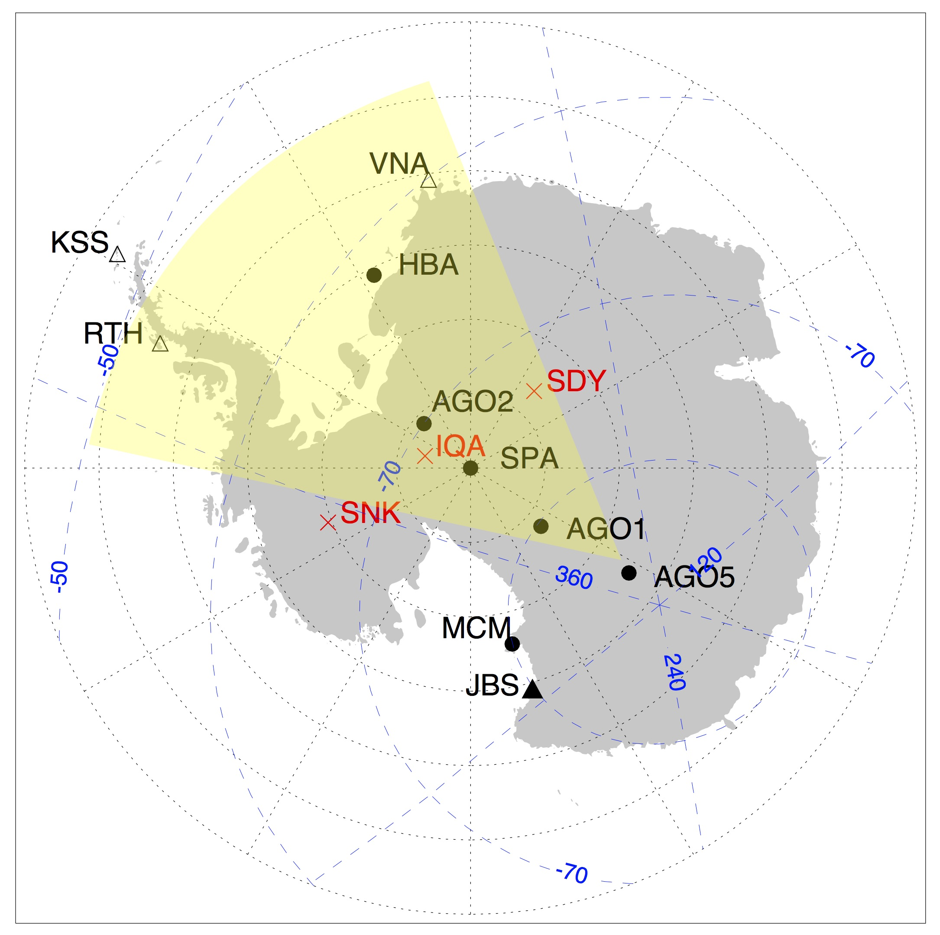
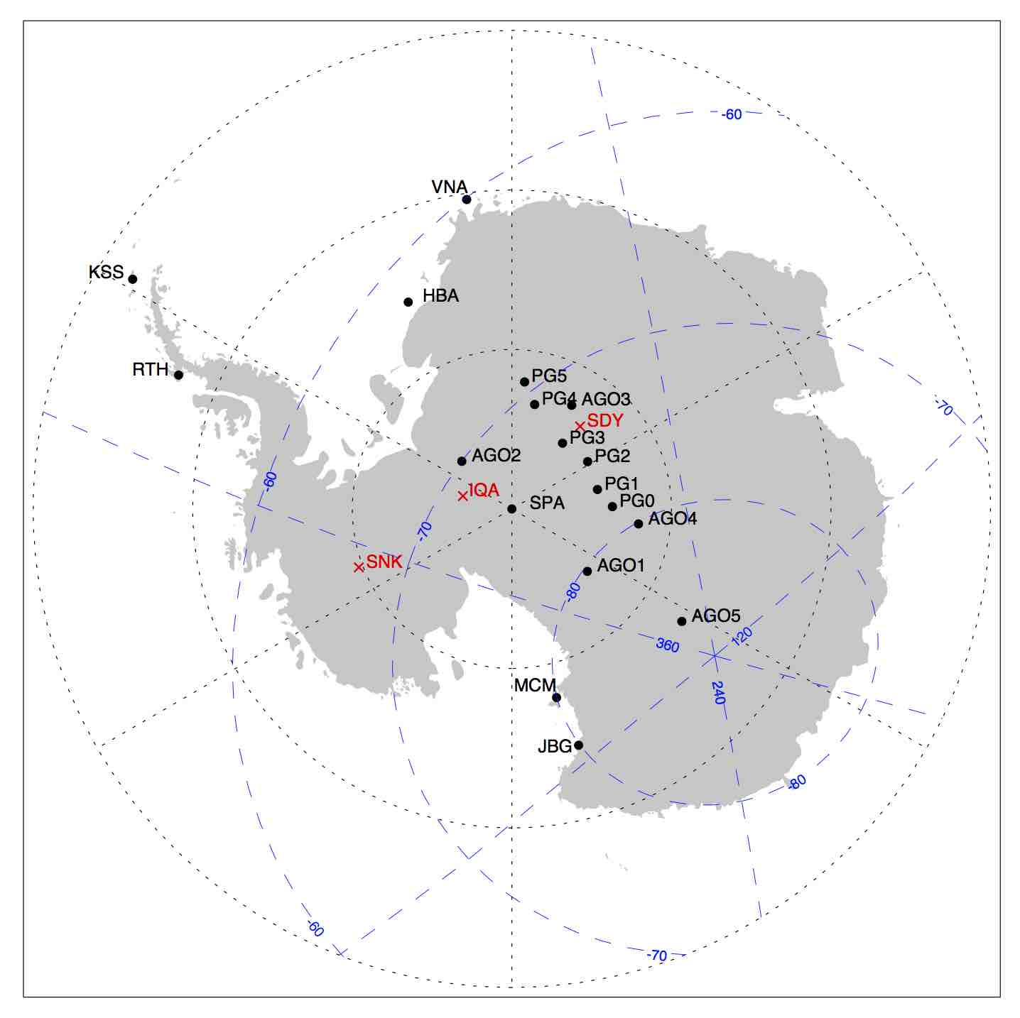
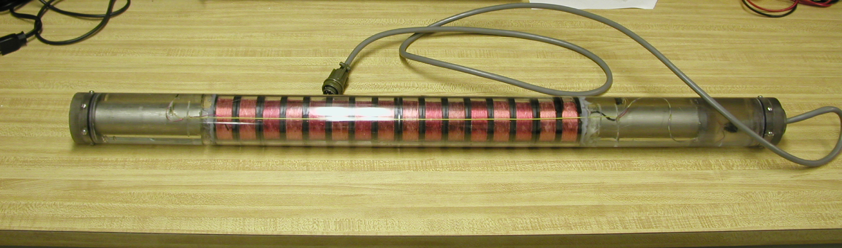
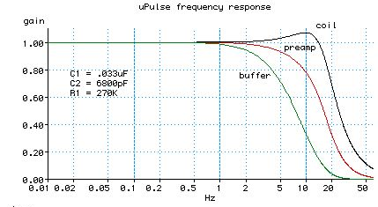
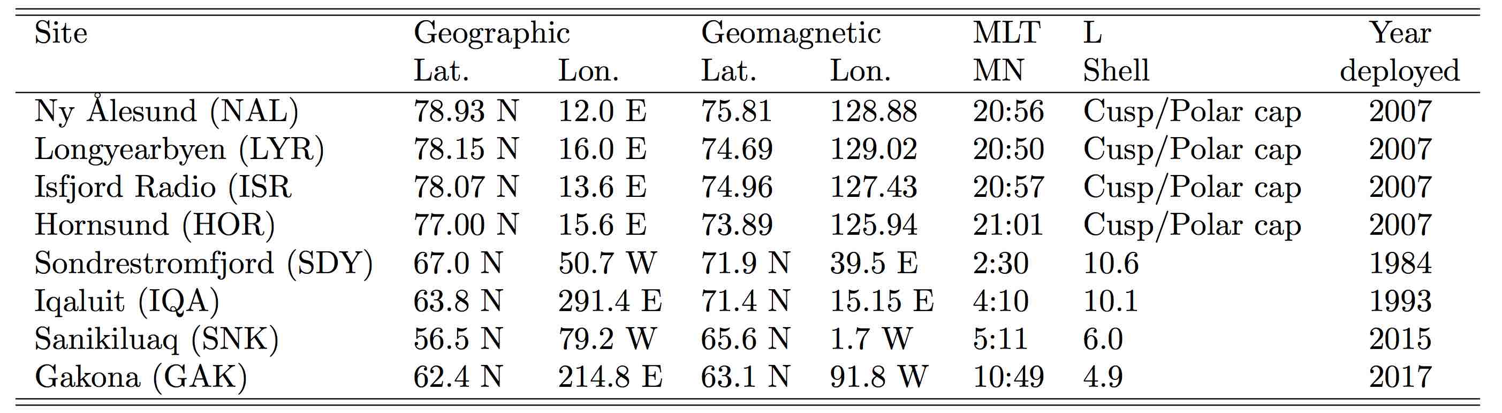
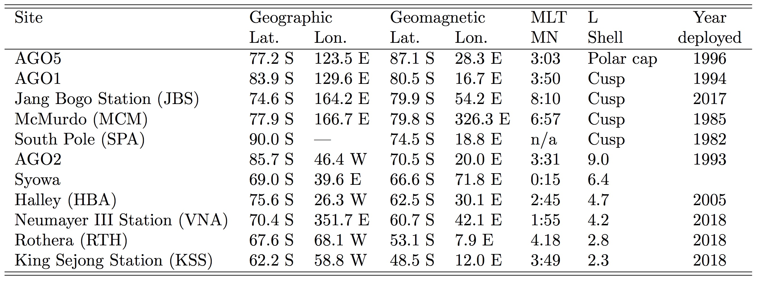
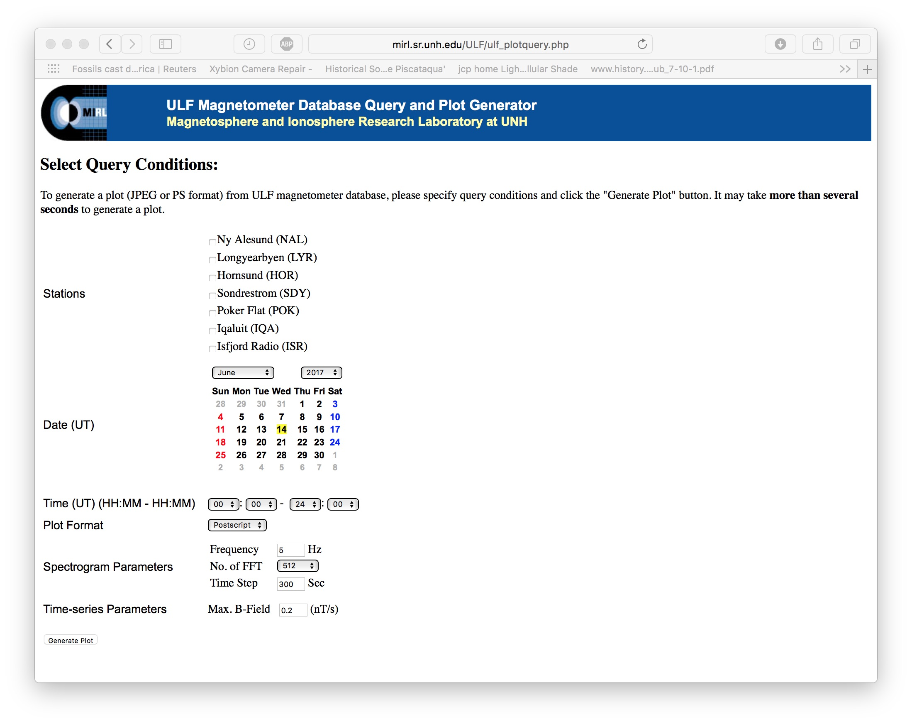
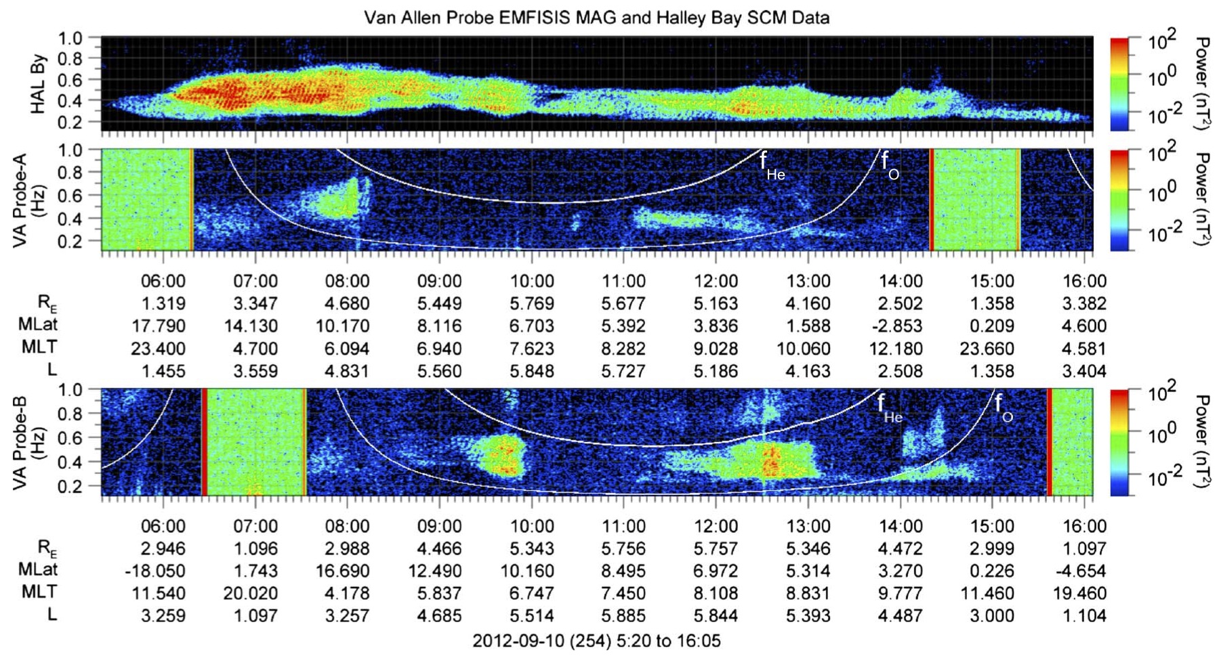
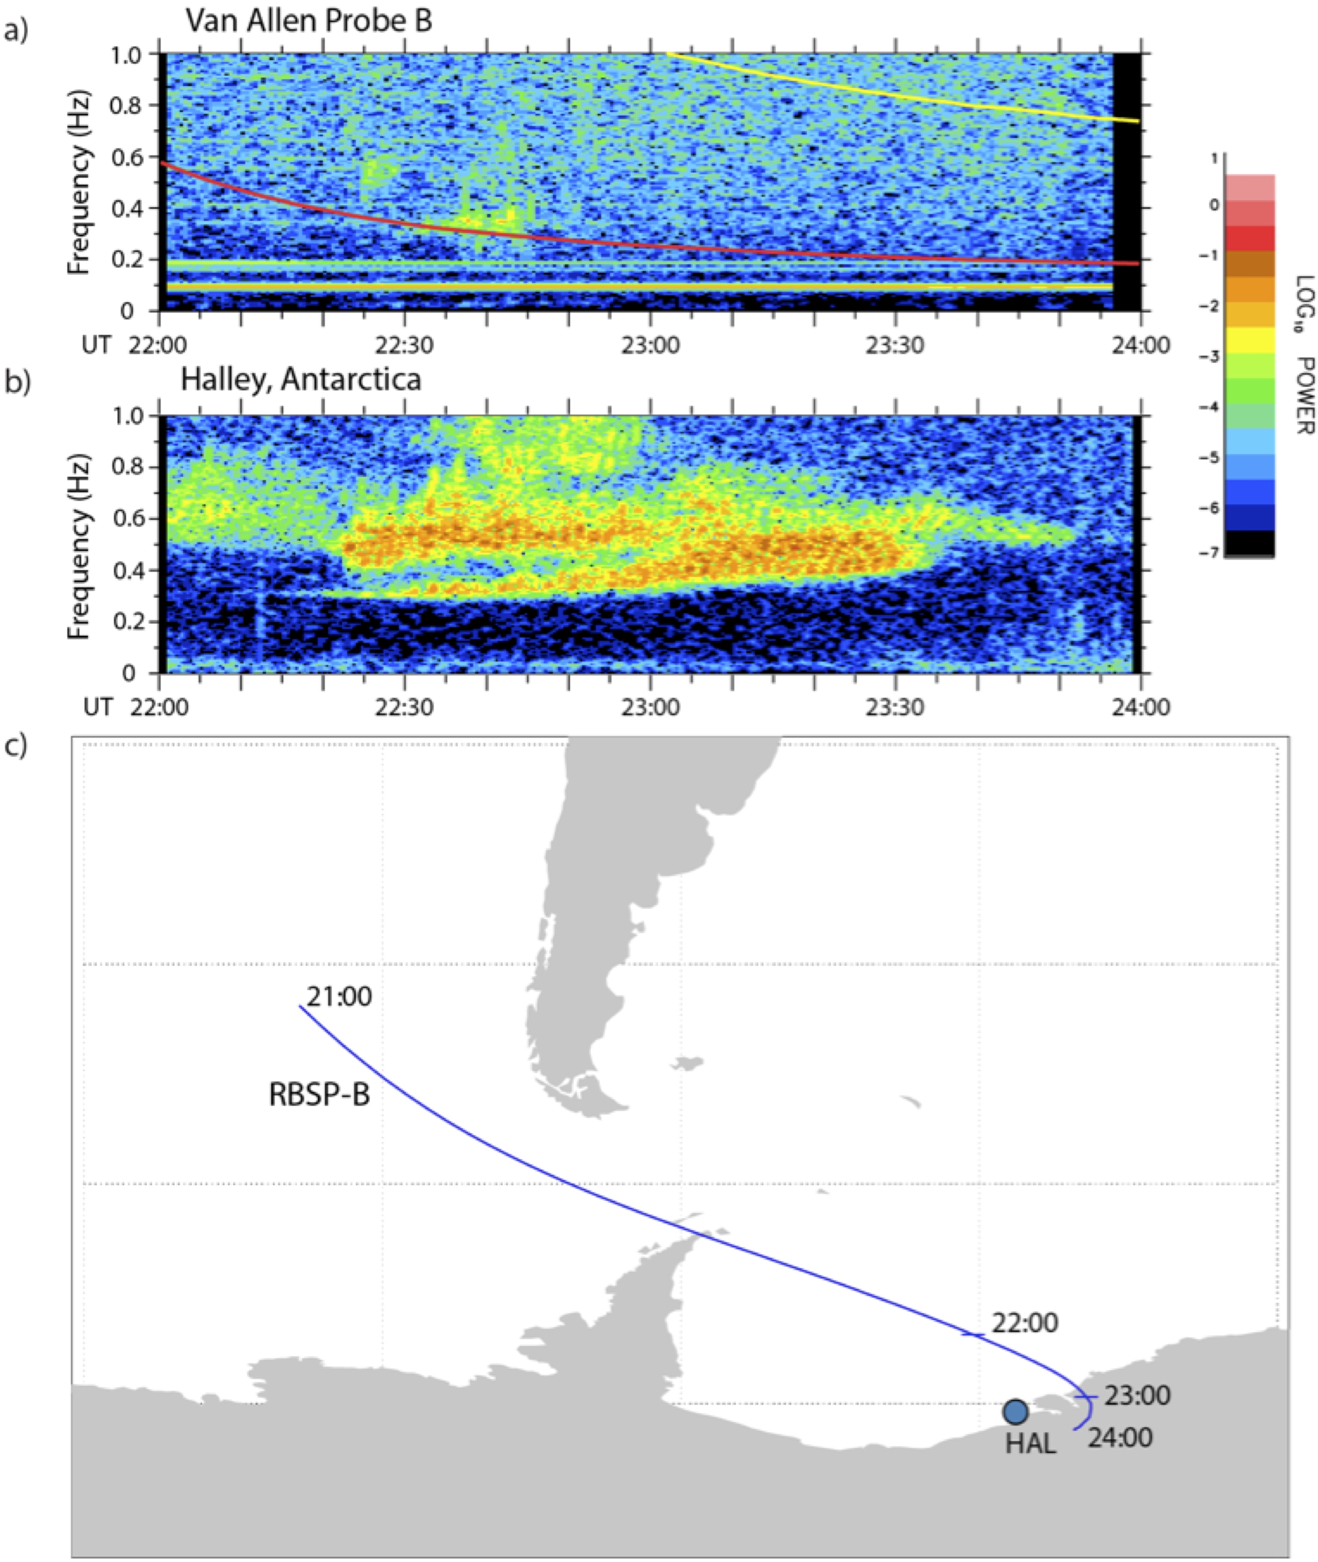
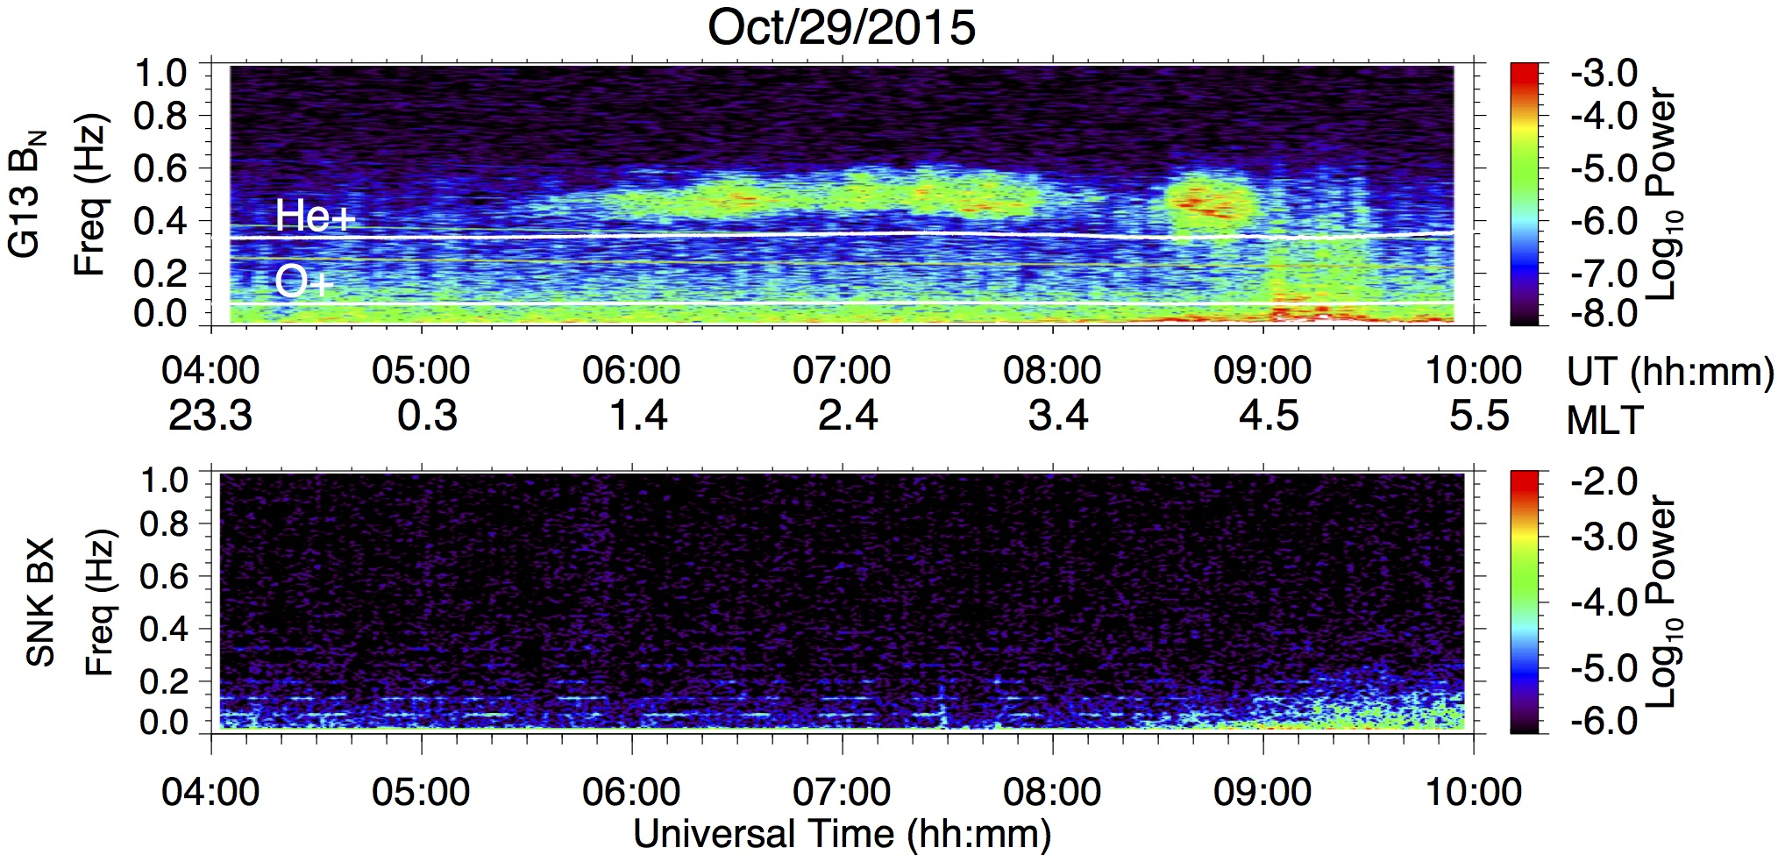
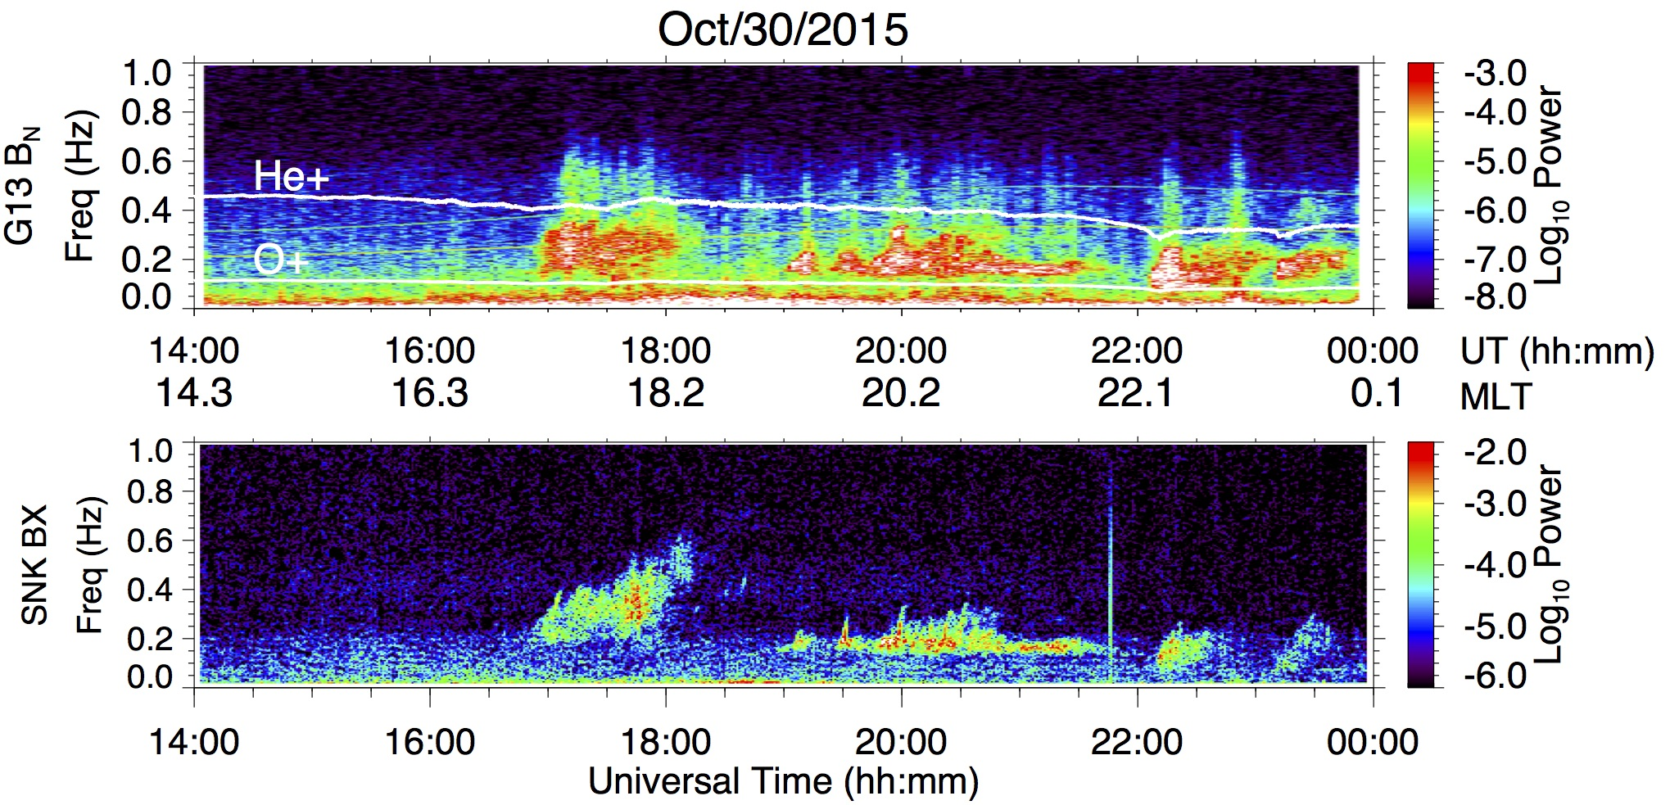
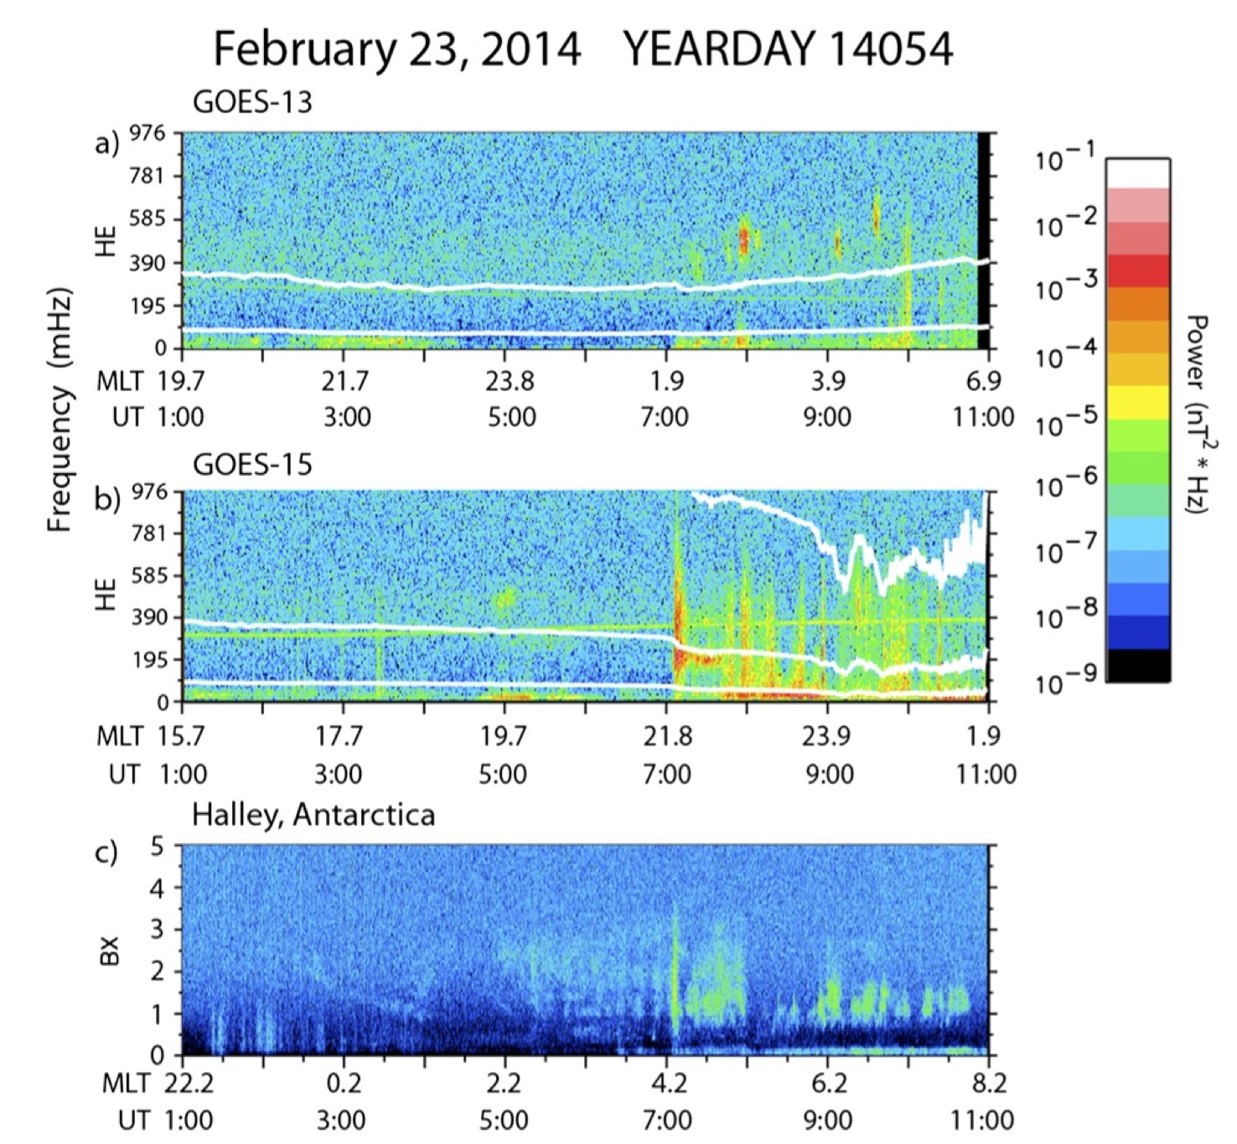
The Magnetic Induction Coil Array (MICA)
Marc Lessard¹, Mark Engebretson², Hyomin Kim³,
¹ Space Science Center, University of New Hampshire, Durham, NH., USA
²Department of Physics, Augsburg College, Minneapolis, MN, USA
³ Center for Solar-Terrestrial Research, New Jersey Institute of Technology, Newark, NJ., USA
Introduction
Station locations
Induction coil magnetometers have provided important data for space science studies for decades. Historically, various research groups around the world have installed similar versions of this instrument at different locations to target specific science objectives. The MICA effort has the purpose of integrating these data into a single database in order to simply the process needed to use these data and includes the participation of researchers from 6 different countries.
The photo above shows an example of one of these sensors. In this case, it uses 16 spools mounted on a high permeability core, each with 10,000 turns to obtain sensitivity the order of a less than a pT at frequencies near 1 Hz. Unlike a fluxgate magnetometer, induction coils do not provide a measure of the absolute field but have great sensitivities for frequencies greater than ~0.01 Hz. The figure on the right shows the measured frequency response of the coil. A separate coil is needed for each vertor compnent measured.
MICA-N(orth) station locations. In nearly every case, sites were selected to focus on specific science questions. Logistics also play a very important role, including the cost of access tothe various locations, the availability of on-site support, data transfer possibilities, etc.
In the northern hemisphere, stations on Svalbard are ideally located for studies of cusp phenomena (and are very well supported with other ground-based instruments there). The Sondrestromfjord system was placed there as part of the larger ISR effort, though it is now being removed. The Iqaluit site was selected for its conjugacy to the South Pole; Sanikiluaq was chosen for its conjugacy to GOES 13.
To a large degree, the MICA concept (in both hemispheres) has materialized from the existence of increasing numbers of these sites, with the realization that, in almost all studies, data from distributed arrays are much more scientifically useful than from single locations.
MICA-S(outh) station locations. Systems currently exist at the South Pole (SPA), McMurdo (MCM), Halley (HBA) and soon, Rothera (RTH). The U.S. AGO stations are marked as AGO1, AGO2 and AGO5. Neumayer III (VNA) was installed this past austral summer. Jang Bogo (JBS) was installed in the austral summer of 2016-17, King Sejong (KSS) is expected to be operational by 2019.
Locations marked in red show the magnetic footprints of some existing locations in the northern hemisphere. For perspective, SNK and IQA are in central Canada; SDY is in Greenland. The yellow highlighted region (with an apex at the southern magnetic pole) is included to show that these stations more or less encompass a region of a few hours in MLT.
The figure on the right includes the remote Autonomous Adaptive Low-Power Instrument Platform (AAL-PIP) locations (R. Clauer, Virginia Tech, PI). Each of these these solar powered observatories support a fluxgate magnetometer, induction coils and a GPS/TEC instrument.
MICA as an international effort
MICA supports the integration of data into a single database (although MICA is still in its infancy and many sites are not yet completely included). An important part of this interface is a web-based GUI that allows the user to select specific sites and to plot spectra with user-selected parameters.
MICA benefits greatly from the collaborative spirit of many countries. In the north, systems are hosted at two sites by Natural Resources Canada, at 3 sites in Svalbard by UNIS and King’s Bay (Royal Norwegian Ministry of Trade and Industry) and at Hornsund by the Institute of Geophysics, Polish Academy of Sciences.
In the southern hemisphere, MICA is supported at Halley and Rothera by the British Antarctic Survey. Additional support (Jan Bogo) is provided by Kyung Hee University. This group has also provided the ULF system that is now hosted at the German Von Neumeyer station.Future collaborations are expected to involve researchers from China, Japan and Australia.
The importance of combining ground- and satellite-based observations
1. Single Station Observations:
(a) In situ spacecraft make local measurements of magnetic fields.
(b) Horizontal ducting of EMIC waves allows a ground station (Halley, Antarctica) to detect intense EMIC waves that high-altitude spacecraft may miss.
(c) SSCWEB southern hemisphere magnetic footpoint of RBSP-B from 2100 to 2400 UT June 2, 2013.
Simultaneous observations of Pc1 pearl pulsations by both VA Probes in Bw component (spin axis) of spacecraft frame in conjunction with Halley Bay By (eastward magnetic) component pearl observations. The equatorial gyrofrequency lines for He+ and O+ are plotted in white. Essentially, the ground-based data suggest that the EMIC wave generation region is extended over many hours in MLT. The in-situ observations show that the radial extent of the generation region (in the magnetosphere) is quite narrow. From Paulson, K. W., C. W. Smith, M. R. Lessard, M. J. Engebretson, R. B. Torbert, and C. A. Kletzing (2014), In situ observations of Pc1 pearl pulsations by the Van Allen Probes, Geophys. Res. Lett., 41, doi:10.1002/2013GL059187.
Halley data confirm Van Allen Probe REPT Phase Space Density and Pitch Angle Distribution data showing a localized dropout of ultrarelativistic electrons at this time.
-- Engebretson et al. JGR, submitted 2018
In this event, EMIC waves were stimulated by large solar wind compressions that appeared over wide ranges of both local times and L shells. The figure shows Fourier spectrograms of differenced HE component (radially inward) magnetic ﬁeld data from GOES 13 (top) and GOES 15 (middle) and of differenced X component (north-south) search coil (dB/dT) data from Halley, Antarctica (bottom). The local He+ and O+ gyrofrequencies are shown as white overplotted lines (the middle panel shows these frequencies as well as the H+ gyrofrequency during the last 4 h of the time interval shown).
A solar wind pressure spike at 0708 UT caused wave bursts to appear at all five ground stations (not shown). No sustained EMIC wave activity appeared at GOES 13 during the interval. Except for the weak burst at 0708 UT, the wave activity showed no similarity to the waves observed at the GOES, RBSP or THEMIS spacecraft.
Engebretson, M. J., et al. (2015), Van Allen probes, NOAA, GOES, and ground observations of an intense E MIC wave event extending over 12 h in magnetic local time, J. Geophys. Res. Space Physics,120,5465–5488, doi:10.1002/2015JA021227.
The goal of this ongoing study is to understand differences in observations of EMIC waves observed by GOES 13 and at Sanikiluaq, a ground station at its magnetic footprint in Canada. In the panel on the left, when both platforms were located in the post-midnight (dark) region, EMIC waves are observed by GOES 13 but not on the ground at SNK. In the panel on the right, when the platforms are located near dusk and pre-midnight (but still sunlit), EMIC waves are recorded both by GOES 13 and at SNK.
Whether the difference in signatures is caused by ionospheric effects that might inhibit the transmission of the signal to the ground or whether it is the result of the wave being absorbed in the magnetosphere, understanding EMIC signatures is fundamentally important because of how these data are used in various studies.

