Slide 1


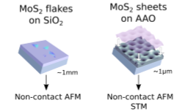
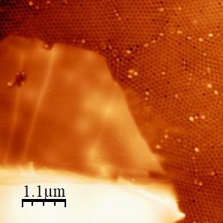

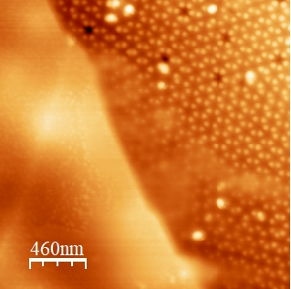
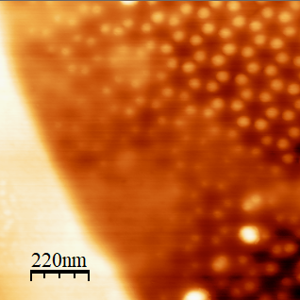
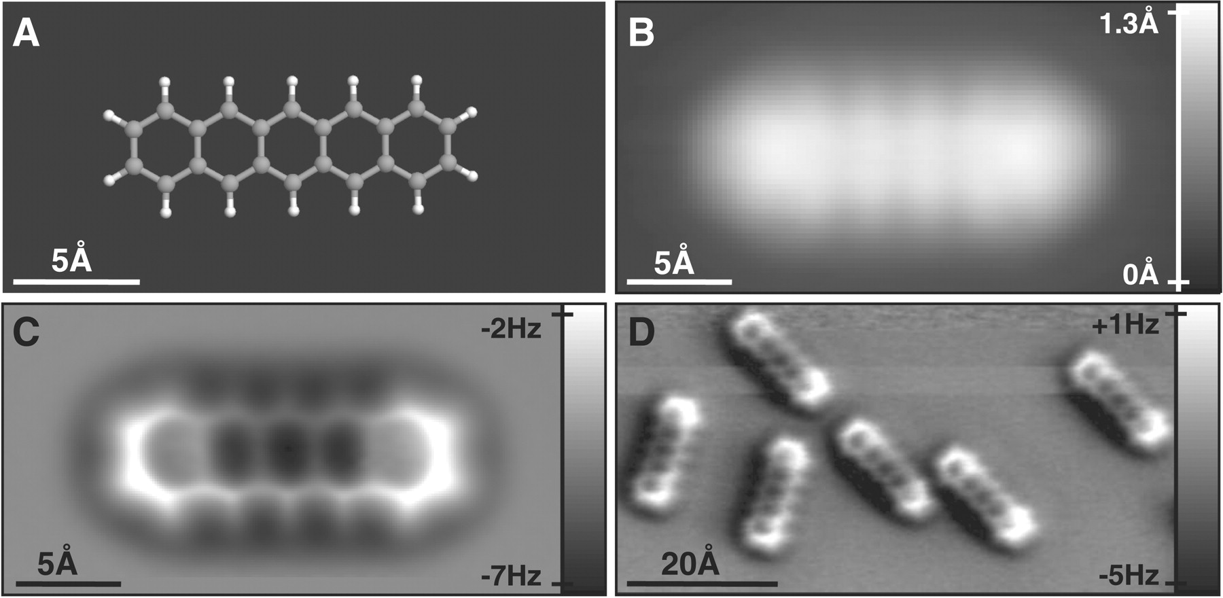
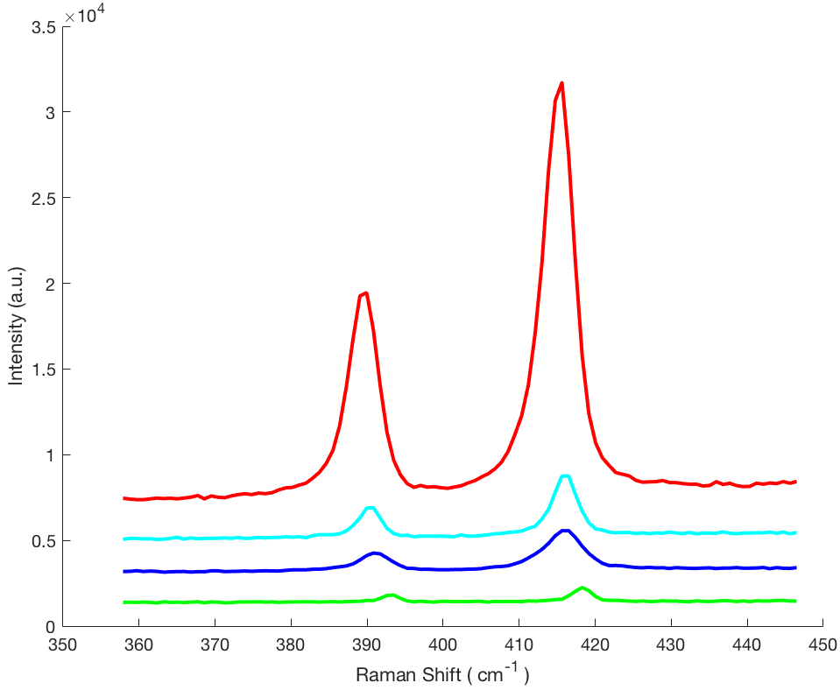
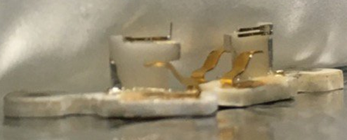
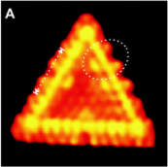
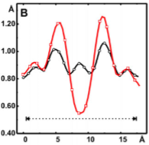
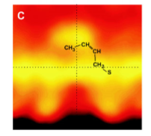
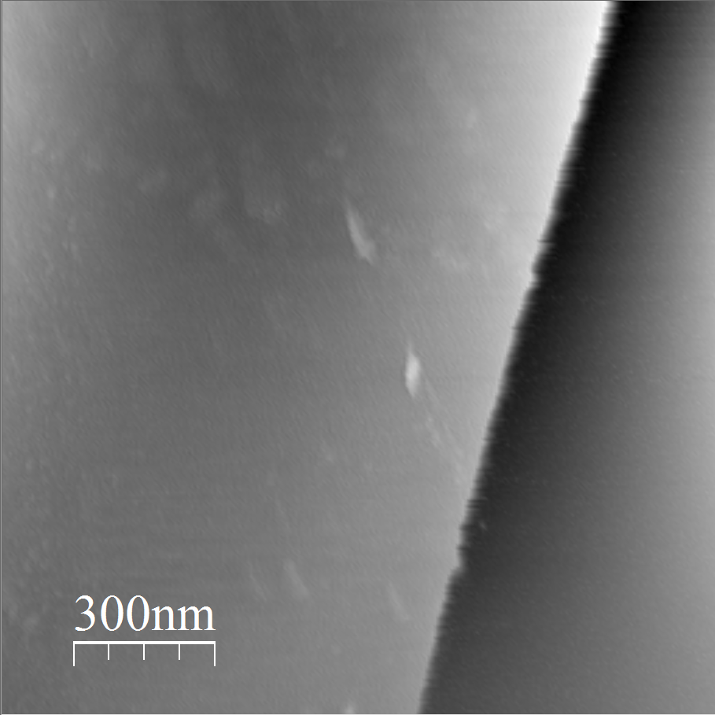
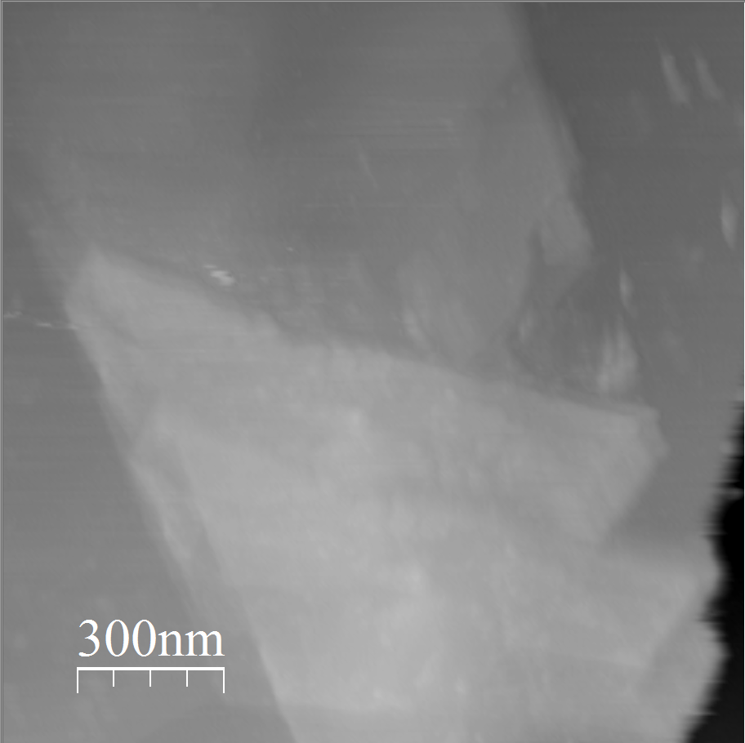
Scanned probe microscopy studies of MoS₂ catalysis on insulating substrates: investigating the impact of substrate, strain, and defects
Steven Arias, Tan Dao, Shawna Hollen
Department of Physics, University of New Hampshire, Durham, NH 03824
Ultra Low Sulfur Petroleum
Substrate Dependent Catalysis
Investigating Strain
Currently around 37% of the U.S. energy consumption is from petroleum.¹ Environmental concerns are now prompting stricter government regulations and motivating ultra-deep sulfur removal from petroleum products.
We investigate the role of substrate, strain, and lattice defects on the HDS reaction in two novel experimental systems using non contact Atomic Force Microscopy (nc-AFM):
MoS₂ flakes on AAO
MoS₂ sheets on anodized aluminum oxide (AAO):
Holes and Undulations.
Adds Strain
Adds areas for suspension.
Can be studied with nc-AFM or STM.
Atomic Force Microscopy images of a flake of MoS₂ on top of the AAO substrate. The holes and undulation pattern on the AAO are visible even through thin layers of the MoS₂
MoS₂ flakes on SiO₂/Si:
Flat.
Insulating.
Can be studied with nc-AFM.
qPlus Atomic Force Microscopy
Due to their performance and natural abundance, MoS₂ and WS₂ catalysts have been used on an industrial scale for hydrodesulfurization (HDS) of oil feedstock since World War II.^{2,3}
Despite more than 50 years of industrial use, the fundamental mechanisms for the HDS reaction on MoS₂ and the importance of the two-dimensional nature of the catalysts have only started to be understood in the last decade.
Atomic Force Microscopy (AFM) extends scanning probe techniques to non-conductive materials.​
Beyond simply being an alternative to STM for insulating samples, it has been shown that AFM with a properly functionalized tip is capable of higher spatial resolution than STM, for example, revealing the molecular structure of pentacene⁵.​
Raman Spectroscopy
From [5]. (A) Molecular model of pentacene. (B) STM scan.
(C-D) AFM images of pentacene, showing the molecular structure.
The left image shows the Raman peaks for 4 different flakes. Red being the thickest and green the thinnest.
MoS₂ Catalysis on Gold
In the Hollen Lab, we use a non-contact AFM technique, with a qPlus⁶ probe, in which a tuning fork with a sharp tip is driven to oscillate in proximity to the surface we want to study. ​
Subtle changes to the oscillation frequency result from changes in the height of the surface, allowing us to map the height with high precision.​
A_{1g}
Previous work done by the Besenbacher group at Aarhus University using Scanning Tunneling Microscopy (STM) revealed the role of the catalytically active MoS₂ edges. All STM experiments on MoS2 catalysis have used metal substrates.⁴
E¹_{2g}
Under strain we would expect to see phonon shifts in few layers of MoS₂ flakes using Raman.⁷
The non-resonant Raman spectrum of MoS₂ is dominated by two vibrational modes: E¹_{2g} and A_{1g}. These two modes are sensitive to the number of layers a flake has. As the layers increase the peaks shift away from each other.⁸
qPlus AFM sensors
The images to the left show the edge of a MoS₂ flake on SiO₂/Si. This edge is a promising area to observe the interactions between adsorbed thiophene molecules and MoS₂.
Similarly we will image MoS₂ on AAO to look for any changes.
These experiments will help us understand the role of MoS₂ as a catalyst in hydrodesulfurization reactions used in industry
References
From [4]. (A) Thiophene on Au(111), (B) Line scan of the STM image. Red line is an edge with an adsorbed molecule. Black line is a clean edge. (C) Cut out from image A showing the structure of the adsorbed molecule.
1.Image source: U.S Energy Information Administration
2. H. Topsøe, B. Clausen, and F. Massoth, “Hydrotreating Catalysis,” in Catalysis–Science and Technology, Vol. 11 (J. R. Anderson and M. Boudart, eds.), Berlin, Heidelberg: Springer Berlin Heidelberg, 1996.
3. A. Stanislaus, A. Maraﬁ, and M. S. Rana, “Recent advances in the science and technology of ultra low sulfur diesel (ULSD) production,” Catalysis Today, vol. 153, no. 1-2, pp. 1–68, 2010.
4. J. Lauritsen, M. Nyberg, R. Vang, M. Bollinger, B. Clausen, H. Topsøe, K. Jacobsen, E. Laegsgaard, J. Norskov, and F. Besenbacher, “Chemistry of one-dimensional metallic edge states in MoS2 nanoclusters,” Nanotechnology, vol. 14, no. 3, pp. 385–389, 2003.
5. L. Gross, F. Mohn, N. Moll, P. Liljeroth, G. Meyer. Science, 325, pp 1110--1114 (2009)
6. qPlus is a trademark of Professor Franz Gießibl
7. C. Rice, R. J. Young, R. Zan, U. Bangert, D. Wolverson, T. Georgiou, R. Jalil, K. S. Novoselov, “Raman-scatterin measurements and first principle calculations of strain-induced phonon shifts in monolayer MoS₂,”Physical Review B 87, 081307(R), 2013.
8. C. Lee, H. Yan, L. E. Brus, T. F. Heinz, J. Hone, S. Ryu, “Anomalous lattice vibrations of single- and few-layer MoS₂,” ACS Nano, 2010, 4(5), pp 2695-2700.
Acknowledgements
We would like to acknowledge the American Chemical Society Petroleum Research Fund for funding this project.
Collaborators: Todd Gross (UNH Mechanical Engineering), Young Jo Kim (UNH Electrical Chemical Engineering)
Nc-AFM images of MoS₂ flakes on SiO₂/Si

