Slide 1


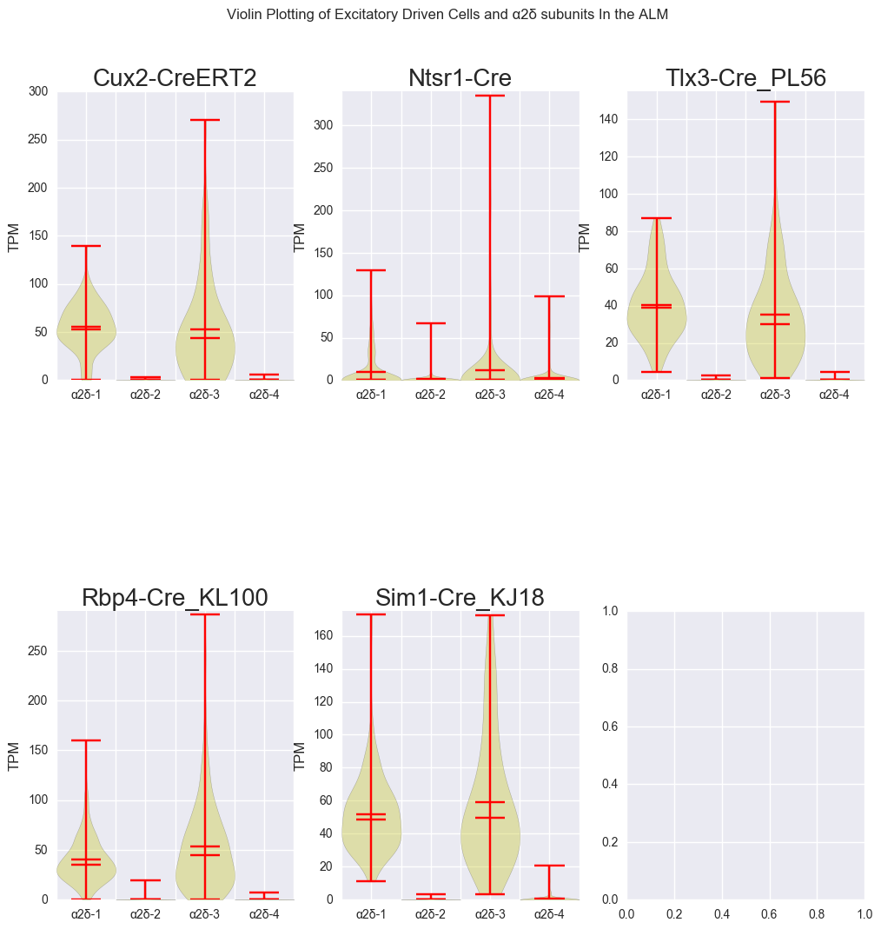
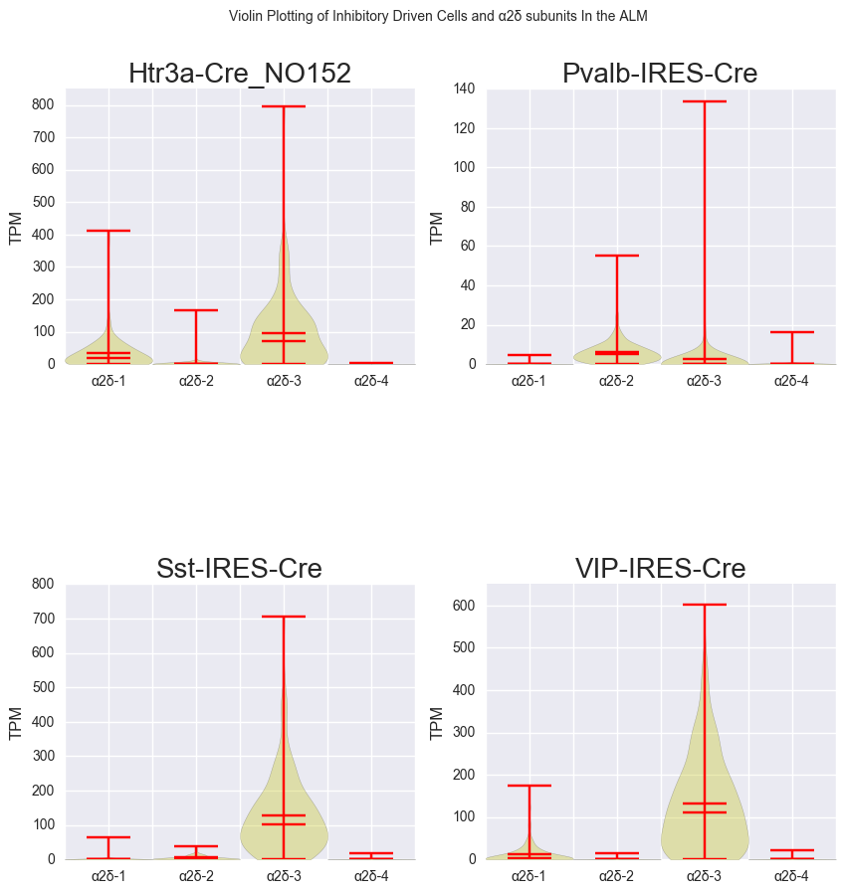
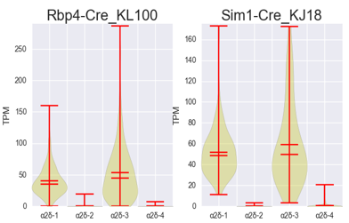
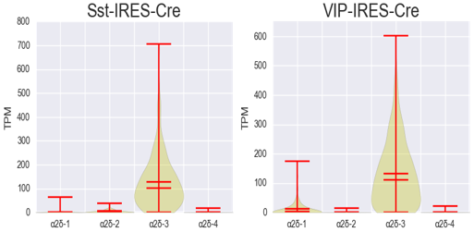
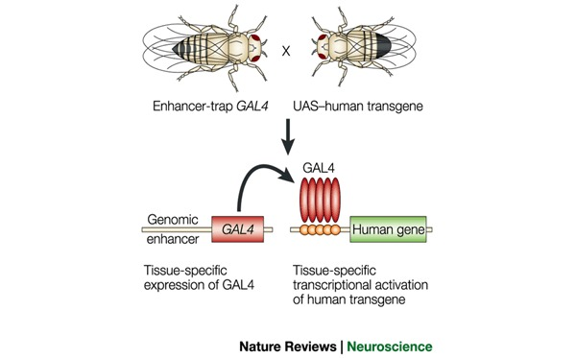
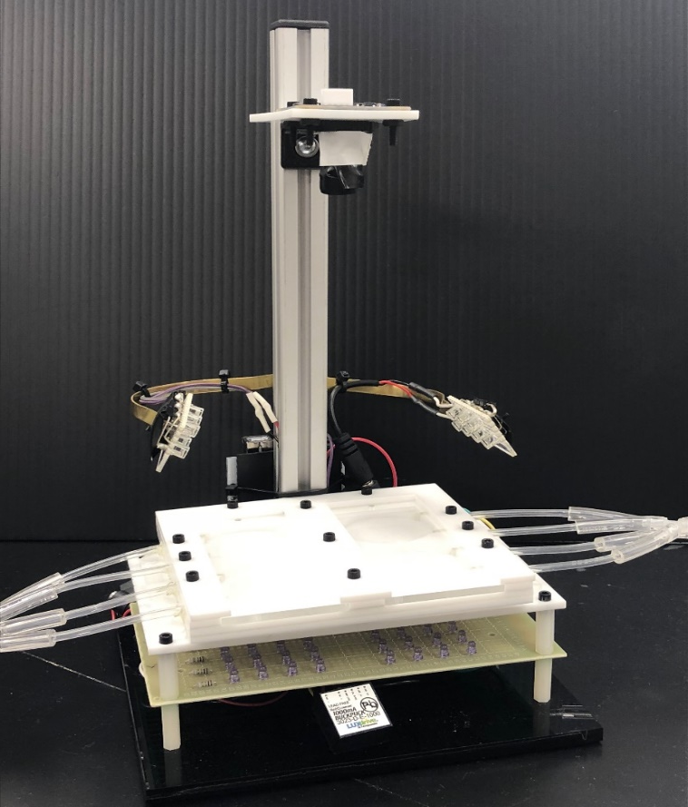
Dissecting the Cell-Specific Roles of α2δ proteins in
Seizure-like Activity of Drosophila melanogaster
Juan Gomez-Rivadeneira, Julian Brown & Arturo Andrade, PhD
Department of Biological Sciences, University of New Hampshire
Background
Methods
Expression Patterns of
α2δ proteins
α2δ Proteins
Encoded by CACNA2D genes in mammals
Extracellular proteins that regulate the activity of the α1 voltage-gated calcium channel subunit
Four α2δ protein isomers have been identified in Mammalia
Increased signaling from α2δ-1 drives cell death following neuropathic injury (Lau et al., 2013)
CACNA2D2 gene dysfunction has been linked to epileptic encephalopathies (EEs) (Pippucci et al., 2013).
Seizure-like activity
Synchronous neural activity that inhibit firing or cause excessive excitation occur during seizures
Glutamatergic and GABAergic neurons are hypothesized to be disrupted during seizures
Drosophila melanogaster
Has three α2δ proteins: Straightjacket, CG42817 and CG4587
Can be used as a powerful model organism due to the simplicity of the genomic structure and having several conserved behaviors with mammals
Figure 2
CG42817-RNAi UAS
CG42817-RNAi/ Elav-Gal4
CG4587-RNAi UAS
CG4587-RNAi/ Elav-Gal4
CG42817-RNAi /+
Elav-Gal4 / +
CG4587-RNAi /+
Elav-Gal4 / +
Excitatory
Inhibitory
A
Elav-Gal4
CG42817-RNAi UAS
CG42817-RNAi/ Vglut-Gal4
CG4587-RNAi UAS
CG4587-RNAi/ Vglut-Gal4
CG42817-RNAi /+
Vglut-Gal4 / +
CG4587-RNAi /+
Vglut-Gal4 / +
B
Vglut-Gal4
.
C
Gad1-Gal4
CG42817-RNAi UAS
CG42817-RNAi/ Gad1-Gal4
CG4587-RNAi UAS
CG4587-RNAi/ Gad1-Gal4
CG42817-RNAi /+
Gad1-Gal4 / +
CG4587-RNAi /+
Gad1-Gal4 / +
References go here
Fig. 2A: Cross schematic for the knockdown of both CG proteins in all neurons with controls.
Fig. 2B: Cross schematic for the knockdown of both CG proteins in glutamatergic neurons with controls.
Fig. 2C: Cross schematic for the knockdown of both CG proteins in GABAergic neurons with controls.
The Allen Institute for Brain Science© collected RNA-sequencing data from mice expressing TdTomato under cell specific drivers (2004)
Violin distribution plots were made of α2δ-mRNA expression patterns of in excitatory and inhibitory cell populations
  α2δ-1 is predominantly excitatory
  α2δ-2 is predominantly inhibitory
Gal4/UAS System
The yeast activator protein GAL4 and the upstream activating sequence (UAS) is used to target gene expression in D. melanogaster
RNA Interference (RNAi) will be used to target CG42817 and CG4587 at UAS sites to knockdown expression
Current Observations
Acknowledgements
To induce seizure-like activity, selected flies will be vortexed with air prior to testing
FlyGram records the activity of flies from 4 regions of interest (ROI)
Data recorded from FlyGram will be analyzed using R and Python
The video output will be analyzed using CTRAX and JAABA
Funded by the UNH McNair scholars and TRIO program
Thank you to Dr. Karla Kaun and her lab at Brown University for donating the FlyGram apparatus and assisting me throughout my research
Special thanks to Julian Brown for his assistance throughout this project
Figure 1: GAL4/UAS System schematic (Asakawa & Kawakami, 2008)
Objectives
References
  Knock-down expression of CG42817 and CG4587 genes in the central nervous system of D. melanogaster.
  Quantify expression of CG42817 and CG4587 with RT-qPCR to assess whether the CG proteins are being effectively knocked down.
  Measure seizure-like behavior of D. melanogaster with knocked down expression of CG proteins in all neurons.
  Knock-down expression of CG42817 and CG4587 in glutamatergic and GABAergic neurons.
  Measure seizure-like behavior of D. melanogaster with knocked down expression of CG proteins in GABAergic and glutamatergic neurons.
Figure 3: FlyGram
Asakawa, K., & Kawakami, K. (2008). Targeted gene expression by the Gal4-UAS system in zebrafish. Development, Growth & Differentiation,50(6), 391-399.
Dickman, D. K., Kurshan, P. T., & Schwarz, T. L. (2008). Mutations in a Drosophila α2δ Voltage-Gated Calcium Channel Subunit Reveal a Crucial Synaptic Function. Journal of Neuroscience, 28(1), 31-38.
Geisler, S., Schöpf, C. L., & Obermair, G. J. (2015). Emerging evidence for specific neuronal functions of auxiliary calcium channel α2δ subunits. General Physiology and Biophysics,34(02), 105-118. (Geisler, Schöpf & Obermair 2015)
Lau, L. A., Noubary, F., Wang, D., & Dulla, C. G. (2017). α2δ-1 Signaling Drives Cell Death, Synaptogenesis, Circuit Reorganization, and Gabapentin-Mediated Neuroprotection in a Model of Insult-Induced Cortical Malformation. Eneuro,4(5).
Pippucci, T., Parmeggiani, A., Palombo, F., Maresca, A., Angius, A., Crisponi, L., . . . Carelli, V. (2013). A Novel Null Homozygous Mutation Confirms CACNΑ2D2 as a Gene Mutated in Epileptic Encephalopathy. PLoS ONE, 8(12).
Scharfman, H. E. (2007) The neurobiology of epilepsy. Current Neurology and Nueroscience Reports, 7(4); 348-354.
Snutch, T. P., Peloquin, J., Mathews, E., & McRory, J. E. (2013). Molecular Properties of Voltage-Gated Calcium Channels. Voltage-Gated Calcium Channels Molecular Biology Intelligence Unit, 61-94.
Current Observations and
Future Directions
Flies with knocked-down expression of CG42817 appear to display a hyperactive phenotype
Flies with knocked-down expression of CG4587 appear to display an ataxic phenotype
FlyGram assays and RT-qPCR tests are scheduled to be completed in July and August to confirm these phenotypes

