Slide 1
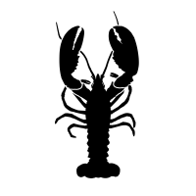
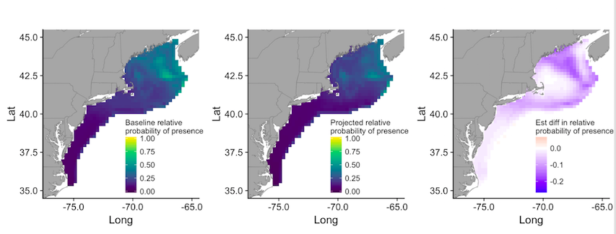
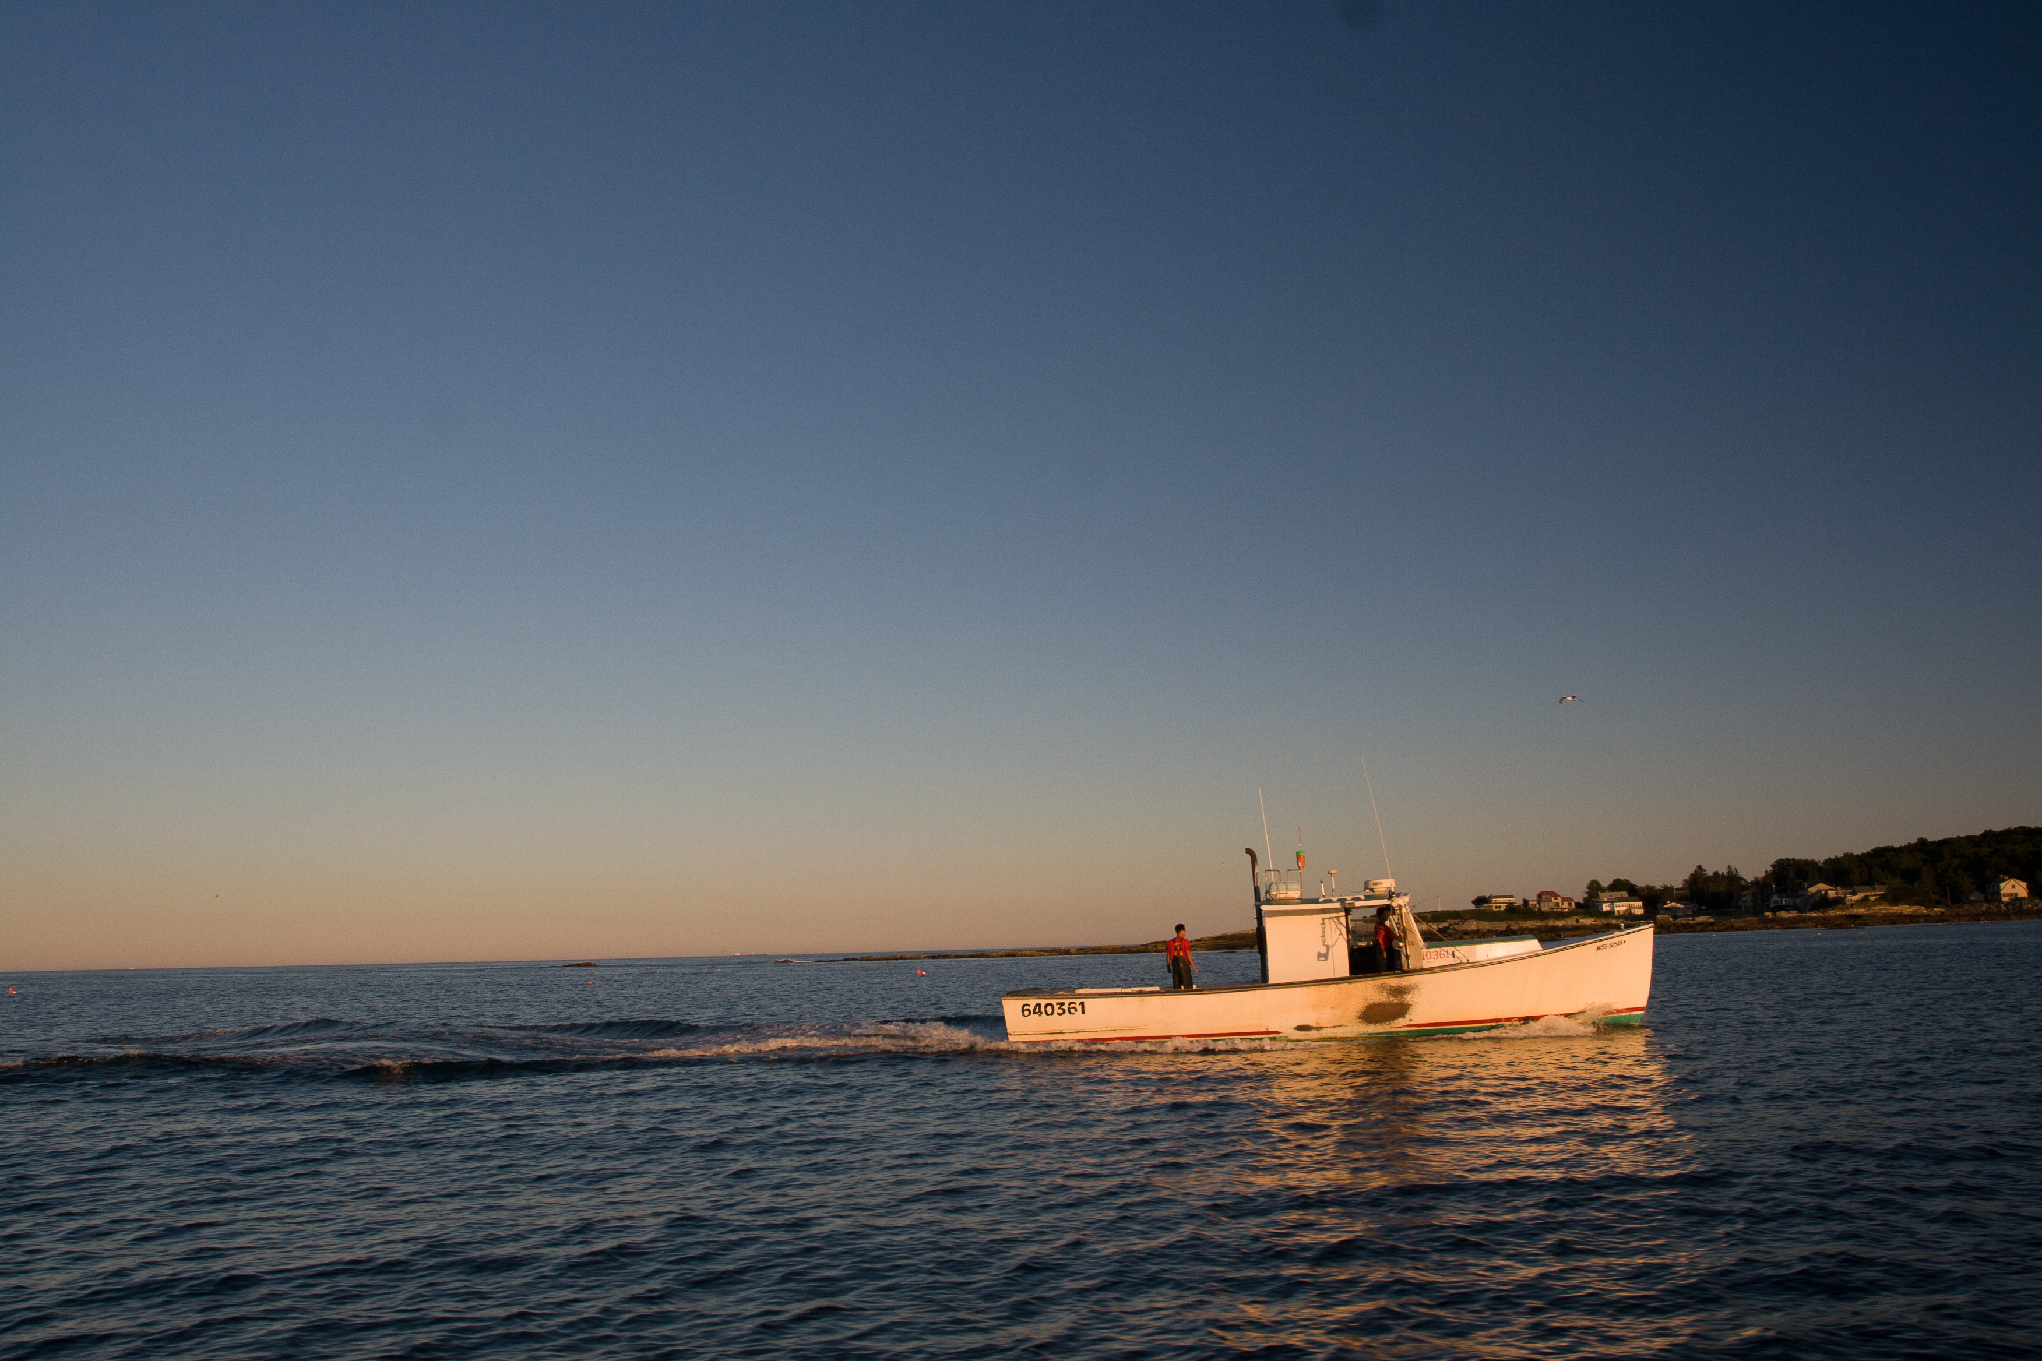
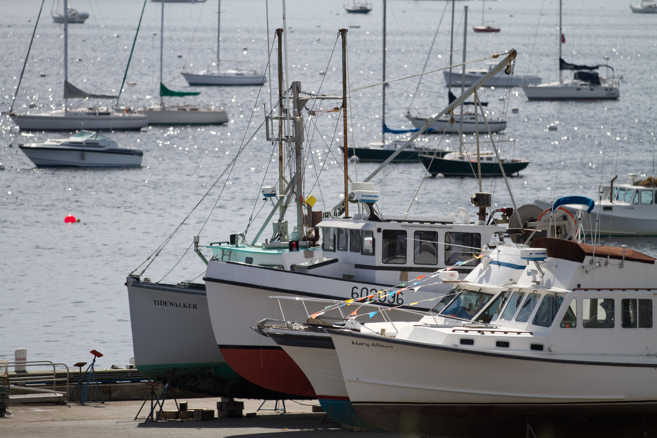
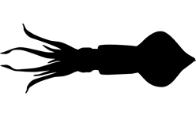
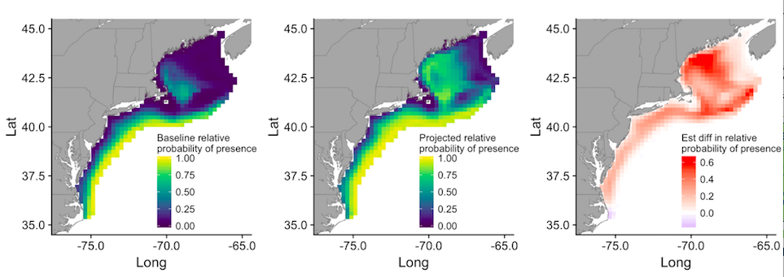
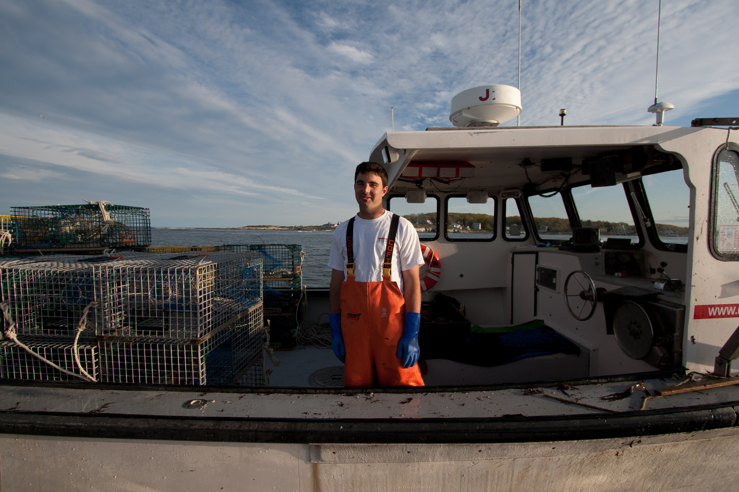
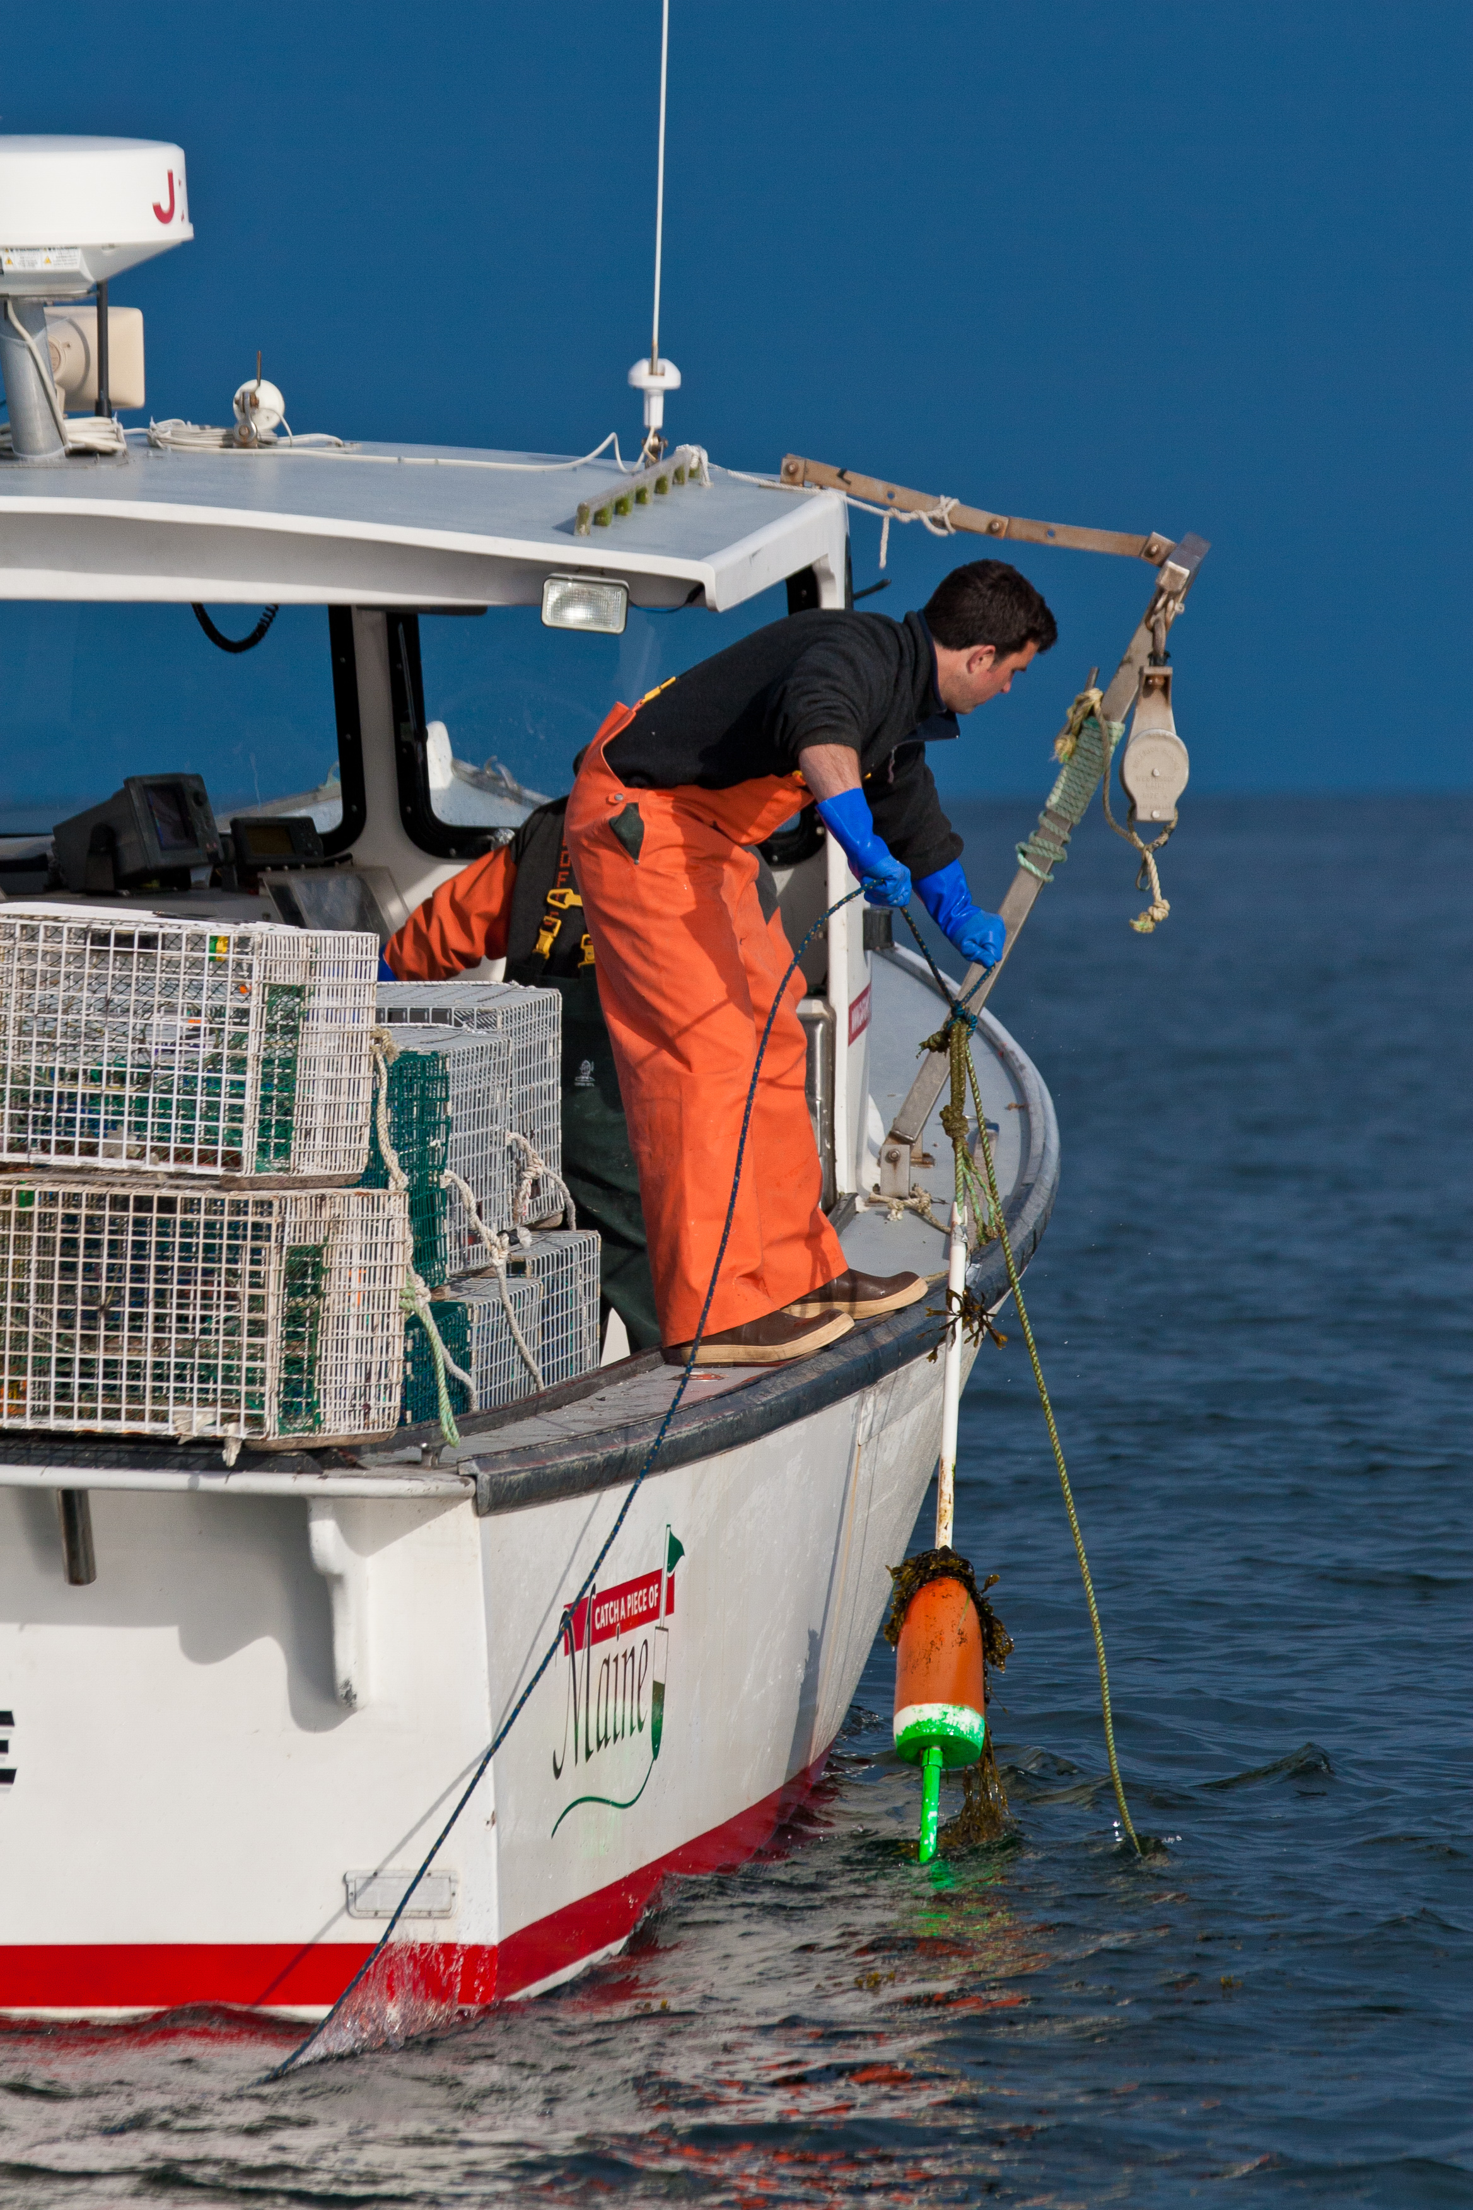
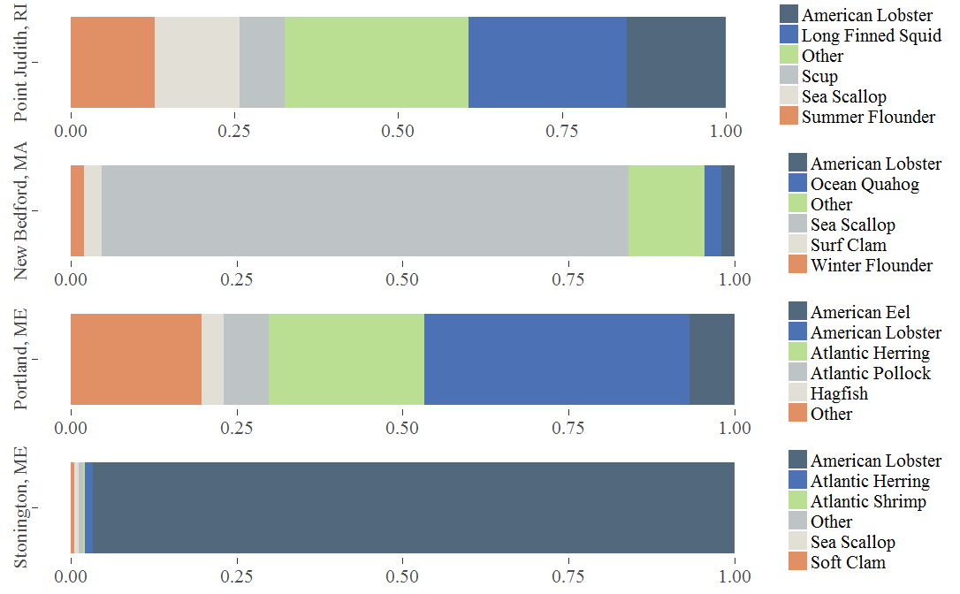
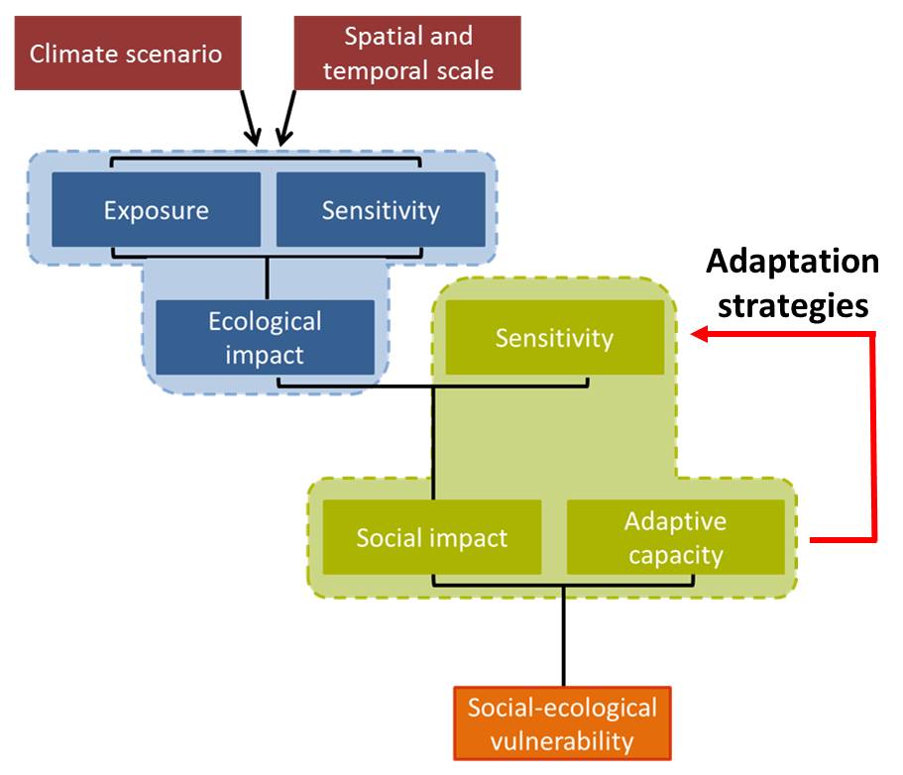
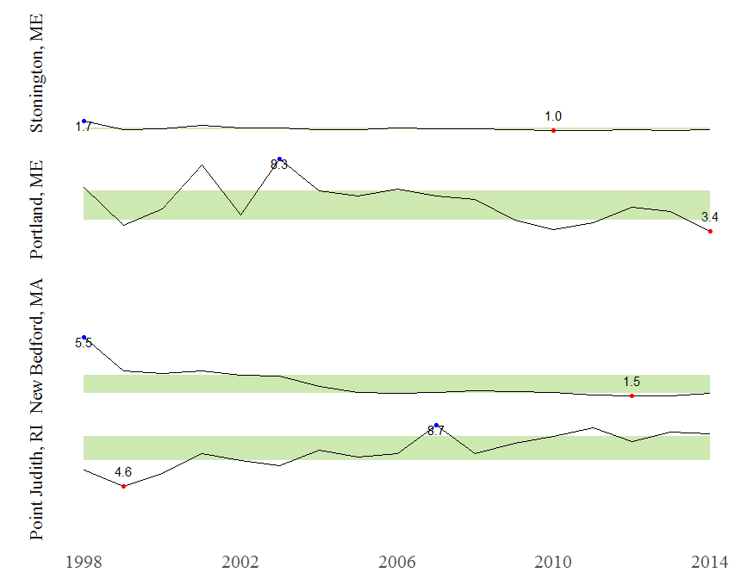
Climate Adaptation Information for Fishing Communities
Sabrina Kerin, UNH Sustainability Fellow
Mentors: Kathy Mills, Gulf of Maine Research Institute
Background
Climate change is already impacting fish populations, marine ecosystems, and fisheries. How fishing communities will be affected by climate change depends on the species they target and their capacity to adapt. GMRI is leading a Northeast-wide assessment of climate vulnerability and adaptation strategies for fishing communities. Four communities, Point Judith, RI; New Bedford, MA; Stonington, ME; and Portland, ME will be the subject of more intense investigation.
Project Goals
Develop prototypes for the 4 community-specific reports to synthesize and convey project results and contextual information
Garner stakeholder feedback & vet prototypes with fishermen and industry leaders to incorporate their input into revisions
Preliminary Results
Shifts in Species Distribution
Use of models to project changes in species distributions. These 2055 projections show a decrease in probability of presence of American Lobster and an increase in probability of presence for Longfin Squid.
“Changes in ocean temperatures due to climate change will affect the ability of some coastal communities to harvest fish, requiring an adaptive response that may include finding new fish grounds, exploiting different species, or seeking non-fishing dependent employment”
(Colburn et al. 2016)
Baseline relative probability of presence
Projected relative probability of presence
Est difference in relative probability of presence
American Lobster Spring
Qualitative Interview Results
Adaptation Facilitators
Protected Working Waterfront
Conservation Efforts & Ocean Stewardship by Fishermen
Local Marketing Efforts (Direct to Consumer)
Social Capital (Non profits, Coops, Dealers, Auctions) & Physical Infrastructure (Docks, Processing Facilities, Distribution Centers)
Adaptation Barriers
Management Structure and Regulatory Fragmentation
Time lags between Ecosystem Change, Data Collection, and Management Decisions
Fishery/Fleet Consolidation and Business Specialization
Rising Costs and Business Expenses
Longfin Squid Fall
Methods
Utilize a social-ecological vulnerability assessment framework which recognizes linkages between the ecological and social domains.
Assess vulnerability and evaluate benefits of specific adaptation strategies at a community level
Conduct in-depth interview with fishermen and industry leaders to understand community-specific barriers and facilitators to adaptation
Catch Composition
Catch Diversity
Current landings data show that ports like Point Judith and Portland have substantial catch diversity. Ports like New Bedford and Stonington are becoming increasingly consolidated, presenting a potential challenge for future adaptation.
Adapted from Marshall et al. 2013.
Challenges & Questions
How to best communicate complex ecological and economic models to communities
How to provide information that will be useful to communities in climate change adaptation planning
Identifying tangible adaptation options and strategies for fisheries
How will species availability change?
This figure uses Simpson’s Reciprocal Index to demonstrate changes in catch diversity at the port level. Lower values indicate less diversity and higher values indicate greater diversity.
“This lack of diversity may increase risks of ecological and economic disruptions” (Steneck et al. 2011).
How will local community be affected?
References
Marshall et al. 2013. Ecosystems 16: 797-809.
Colburn et al. 2016. Marine Policy 74: 323-333
Steneck et al. 2011. Conserv Biol. 5: 904-912
Special thanks to Brian Kennedy and Andrew Allyn for contributing figures to the poster.
Does the community have the ability to adapt to changes?

