Slide 1
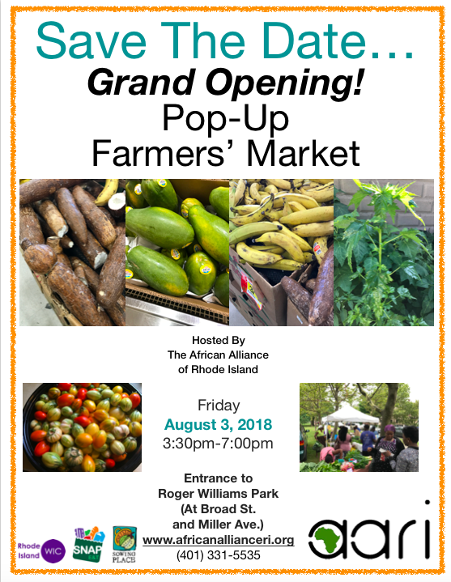
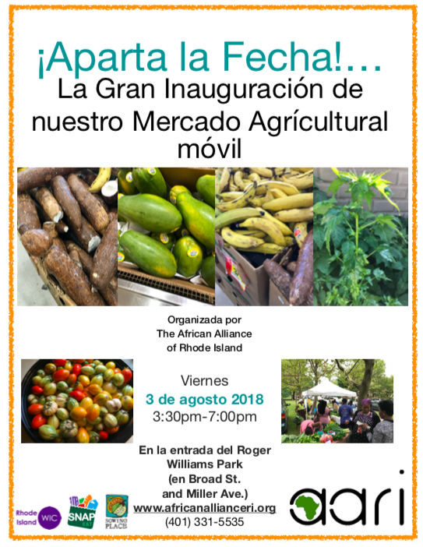
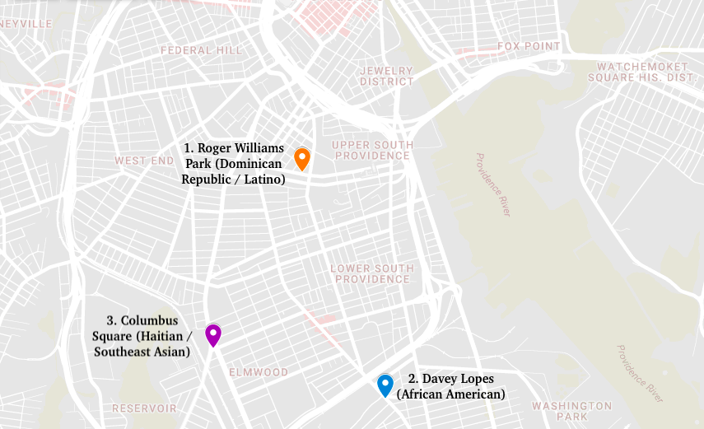
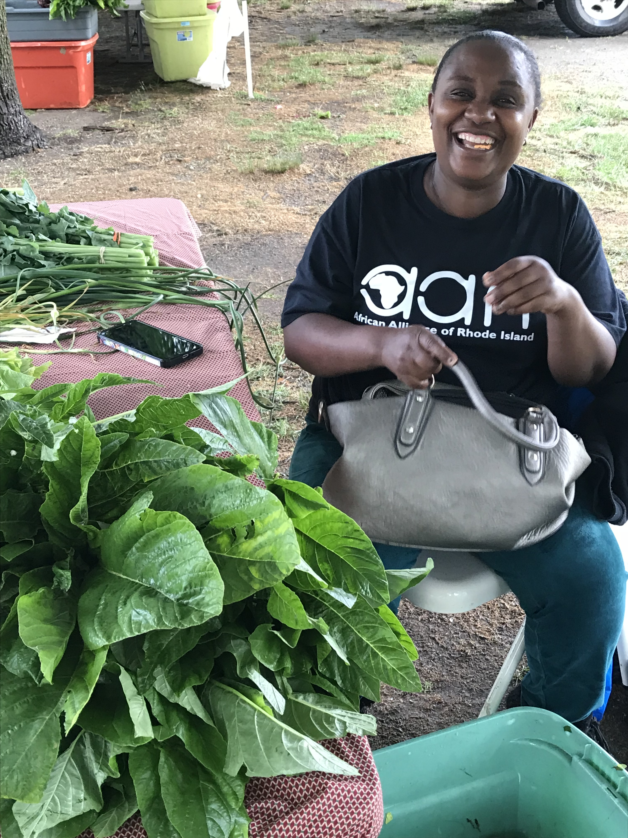
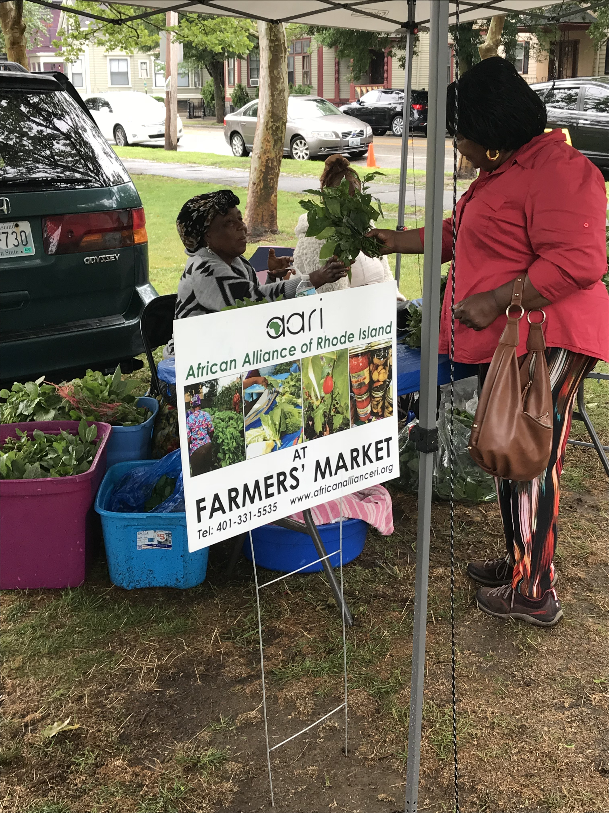
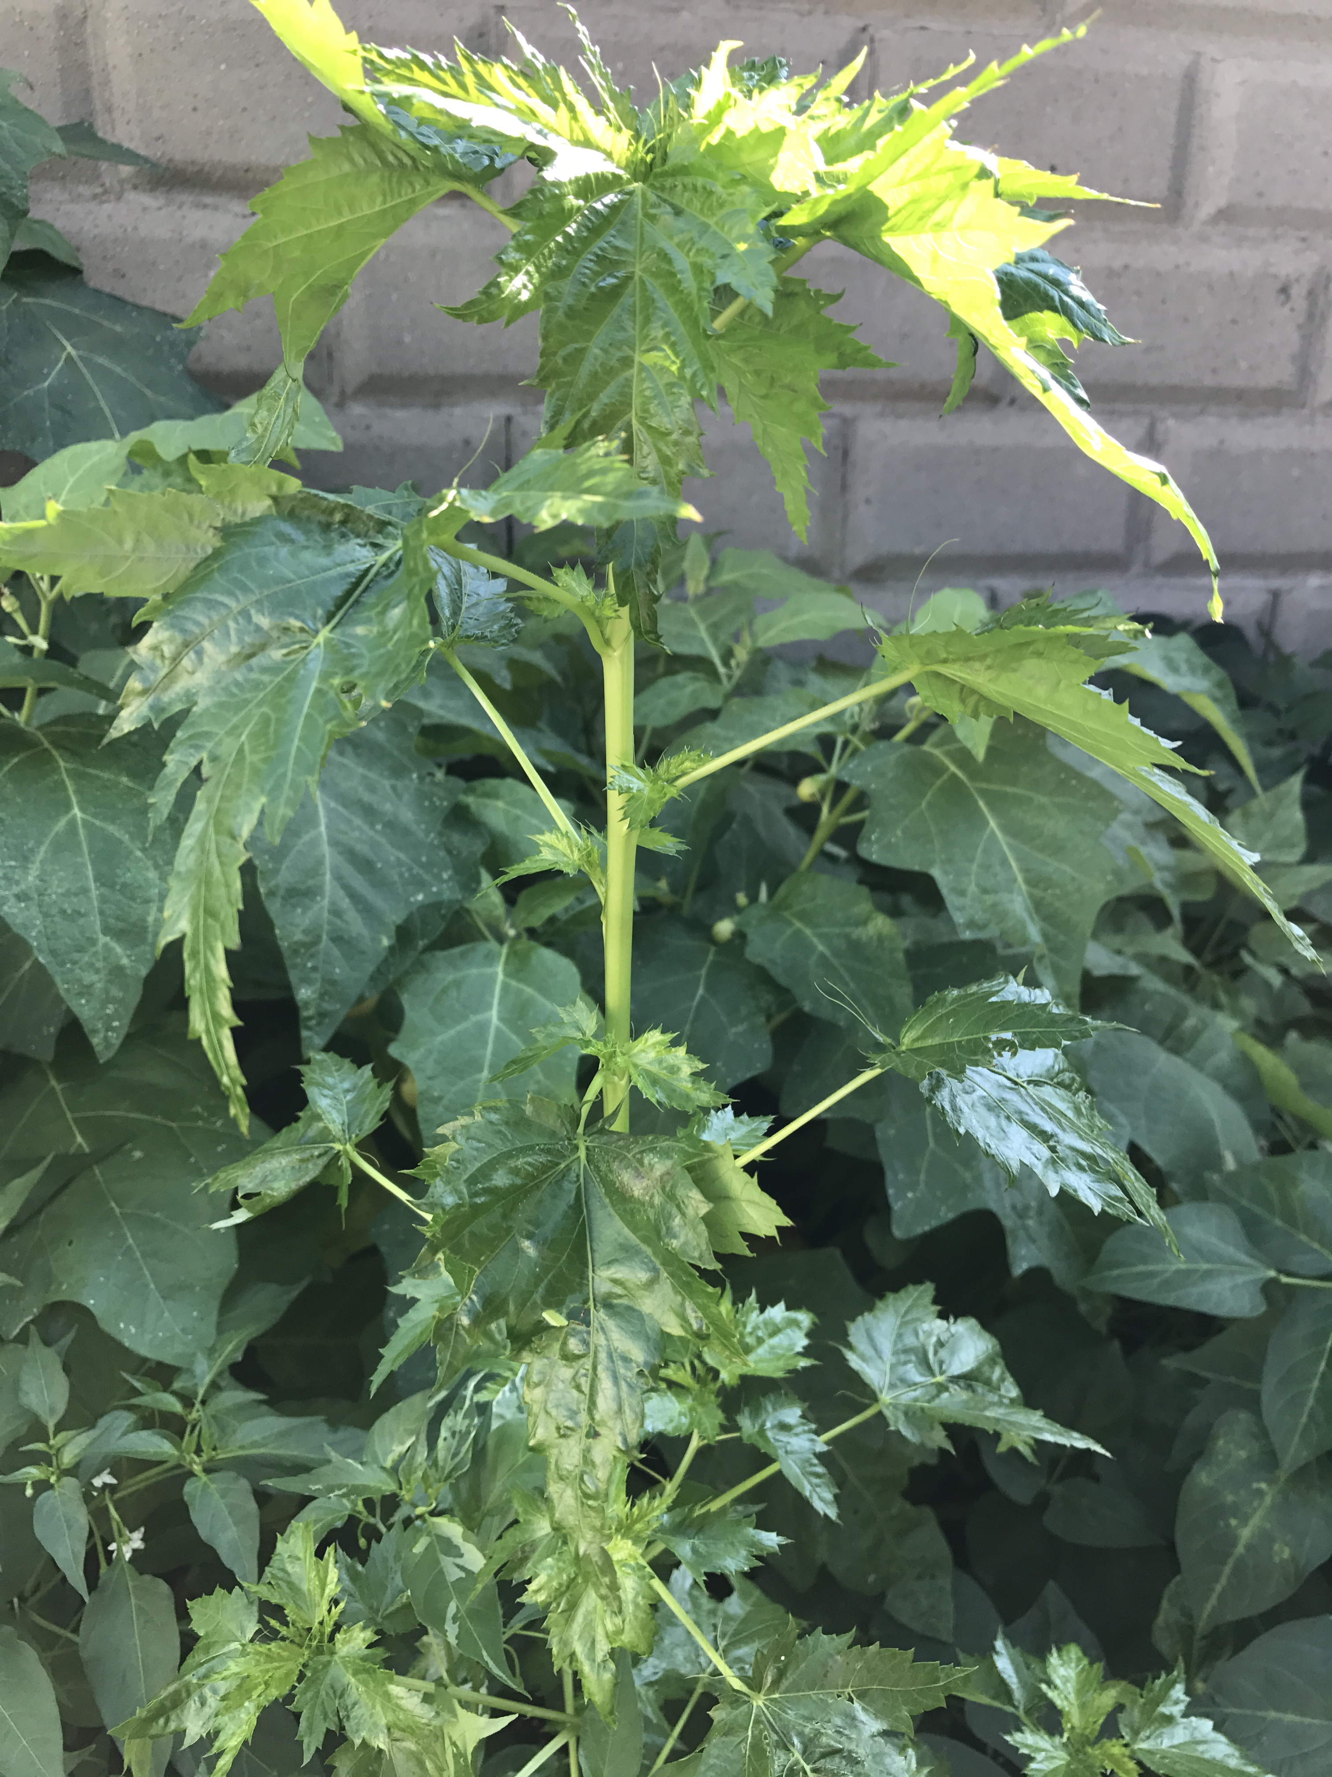
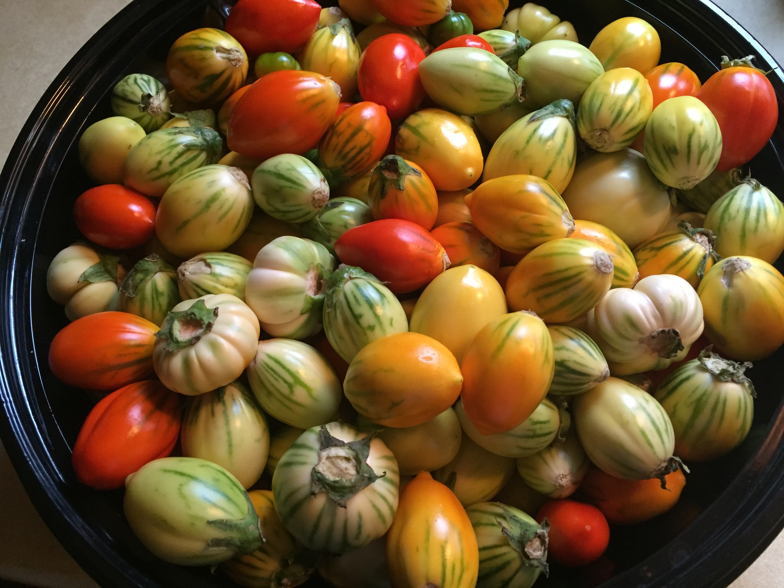
Establishing a New Farmers’ Market in South Providence, RI
Julia Nemy, UNH Sustainability Fellow
Mentors: Julius Kolawole, African Alliance of Rhode Island
1. Introduction
South Providence as a Food Desert
South Providence, Rhode Island, is characterized as a “food desert”, meaning there is unequal and inadequate access to healthy and nutritious foods. South Providence lacks a major grocery store and residents purchase much of their food from local corner stores and fast food restaurants. While these may be the most convenient and affordable options, these foods are often heavily processed and unhealthful. AARI seeks to combine their existing gardening program and experience participating in local farmers’ markets to create their own market. The market will be launched this summer through a series of three pop-up farmers’ markets at three different locations.
2. Objectives
Combatting Food Insecurity through a New Market
The pop-up markets will cater to the demographics living in each neighborhood and will bring culturally relevant produce and entertainment based off of the demographics in each community. The markets will accept food assistance benefits including SNAP and WIC benefits to make the market more accessible and affordable. Local businesses will be invited to participate in each market.
4. Preliminary Results
The Creation of a New Market: Launched at Roger Williams Park — August 3, 2018
Selected locations, dates, and cultural themes for each market.
  August 3: Roger Williams Park (Dominican Republic / Latino)
  September 14: Davey Lopes Center (African American)
  October 19: Columbus Square (Haitian / South East Asian
Permit application through the City of Providence Parks Department.
Collaboration with Farm Fresh to be able to accept SNAP / WIC benefits.
Creation of publicity materials and vendor rules in English and Spanish.
Collaboration with Urban Ventures to develop outreach strategy and develop entertainment plan.
Creation of information cards on African vegetables along with recipes to handout to customers.
Creation of Evite and Facebook events to advertise.
3. Approach
Creating a Market Catered to the Local Neighborhood
To begin, research on the demographics of South Providence neighborhoods was conducted and three sites were selected for the pop-up markets. Outreach will be done in English and Spanish to spread the word about the market across the area. All materials made will be available in English and Spanish to cater to the large Spanish speaking population. We are aiming to secure local vendors who can sell yucca, plantains, and papaya which are foods commonly eaten in the Latino community, but not available in other farmers’ markets. We hope to engage local artists, dancers, and musicians to feature a diverse array of cultures to create a communal meeting spot.
Proposed Pop-Up Market Locations.
This map shows where the series of three markets will be held throughout South Providence.
Pop-Up Market Locations
AARI’s Pop Up Markets will be held at Roger Williams Park, Davey Lopes Recreation Center, and Columbus Square. Each market will be catered to a dominant demographic in the neighborhood. The cultural themes we have selected will respectively be Dominican Republic / Latino, African American, and Haitian / Southeast Asian.
Research on Demographics of South Providence
Average salary in SP: $23, 655 vs. State Average: $50, 200.
Over 45% of SP residents are foreign born vs. 14.1% average in RI.
Over 55% of SP residents speak Spanish at home.
Over 60% of population are considered overweight or obese.
Over 70% of population reports not eating recommended servings of fruits and vegetables daily (Reference 1) .
5. Challenges
How To Effectively Reach the Community?
How to effectively do community outreach?
How to work in a new community and create an event that people will be interested in?
How to create a clear system that can be streamlined and replicated for future markets?
References
http://www.city-data.com/zips/02907.html

Slide 3


