Slide 1
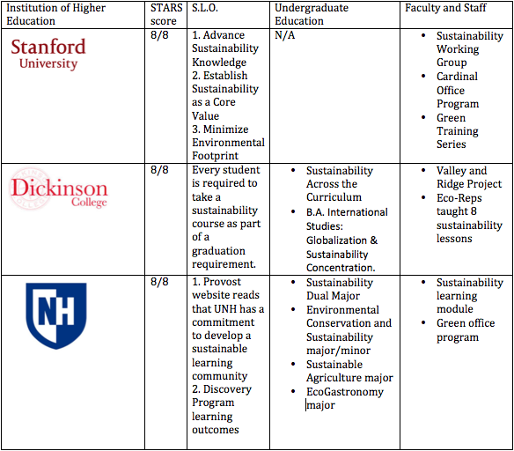
Sustainability Learning Outcomes in Higher Education
Sofia Rodriguez, UNH Sustainability Fellow
Mentor: Vanessa Levesque, UNH Sustainability Dual Major
Introduction
UNH is recognized leader in sustainability, yet does not have a holistic strategy for sustainability education and training. Universities have progressed much more on environmental management and greening of campus operations, while less focus has been on curriculum development (Cebrian, et al. 2015). Sustainability in Higher Education requires a whole university approach that connects curriculum, campus, community strategies and action (Müller-Christa, et al. 2014).
What are Sustainability Learning Outcomes?
Although UNH has them, we recognize that they are not apart of a holistic strategy for sustainability education. Sustainability Learning Outcomes are specific learning goals around sustainability that are articulated in order to target the audience's knowledge of sustainability (Bielefeldt, 2013).
Methods
Researching how other Institutes of Higher Education are incorporating sustainability learning to students, faculty and staff.
"Lay of the Landscape" (Table 1): Researched 41 Institutions of Higher Education through STARS and online research.
In-depth interviews with 7 Institutions that are exceling in at least one of the three ways to promote sustainability.
Created an on-going annotated bibliography of reports, websites and academic papers focusing on sustainability learning outcomes, educating students on sustainability, faculty and staff sustainability learning and much more.
Preliminary Findings
Three main ways to promote sustainability education on a campus:
  1. Having a University Wide Sustainability Learning Outcome
  2. Sustainability education program for undergraduates
  3. Faculty and Staff sustainability learning
  No institution of Higher Education have a comprehensive university wide sustainability learning outcome that applies to students, faculty and staff.
Many schools that received credit in STARS for having SLO's used preexisting learning outcomes that incorporate sustainability values, but do not explicitly define sustainability within the context of the outcomes.
Objectives
Why is this important?
This provides a great opportunity for the University of New Hampshire to be the first to create a holistic sustainability learning outcome.
Goals:
Identify the range of methods by which institutions of higher education promote sustainability learning throughout their campus.
Identify best practices that UNH can learn from and what UNH can do to excel in sustainability.
Table 1: Lay of Landscape example
Challenges
Just IRB received approval on 7/5.
Original project was a deep dive of only 2/3 schools, now it is 7 schools since few schools have a holistic strategy.
Expected challenge: Will people get back to me in time for me to complete all interviews?
Limitation: Only choosing school that report to STARS even though there are several that are leaders in sustainability.
Ex) Harvard University and UCLA
Next steps:
1. Conduct interviews for 7 schools
2. Create case studies for each school
3. Begin "Recommendations and Opportunities" report
References
1. Cebrian, Gisela., et al. (2015) “Academic staff engagement in education for sustainable development”, Journal of Cleaner Production 106, pp. 79-86
2. Müller Christa, G., Sterling, S., van Dam-Mierasc, R., Adomßent, M., Fischerd, D.,Rieckmann, M., (2014). The role of campus, curriculum, and community in higher education for Sustainable Development
3.Bielefeldt, R.A. (2013)." Pedagogies to Achieve Sustainability Learning Outcomes in Civil and Environmental Engineering Students", Sustainability, 5(10), 4479-4501.
Figure 1: Bar graph showing how schools promote sustainability

