Slide 1
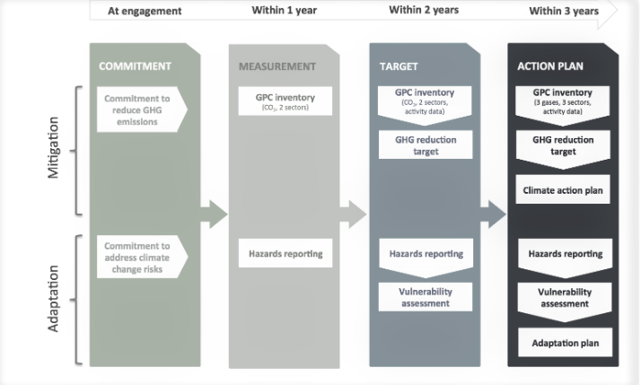
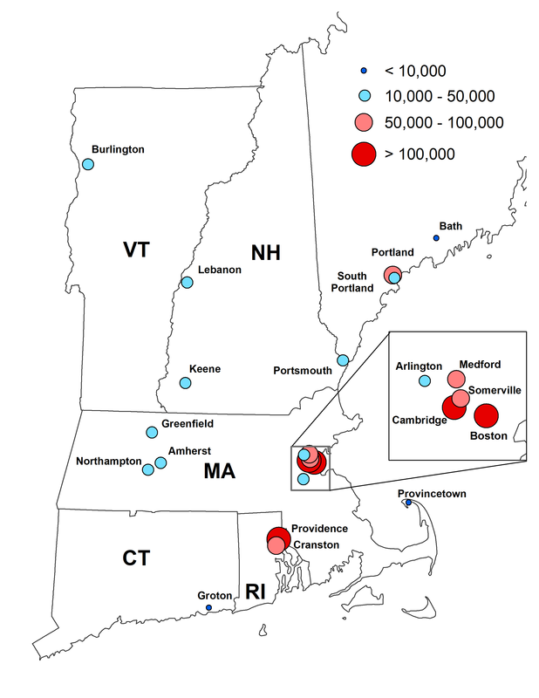
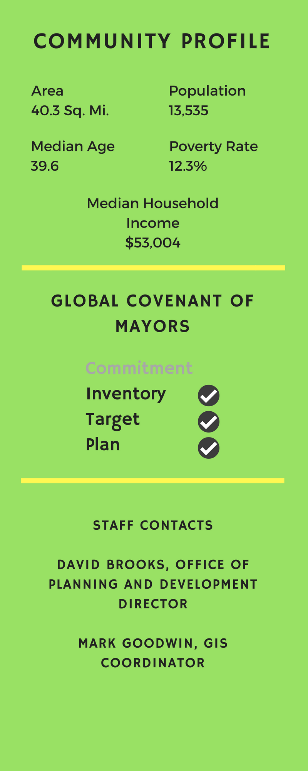

NEMS Network – Communications & Outreach
Erin Puglia, UNH Sustainability Fellow
Mentors: Dr. Dovev Levine & Jennifer Andrews, NEMSN
Overview
The NEMS Network
23 municipalities across New England
Representatives are municipal staff working on initiatives related to sustainability
Project Goals and Objectives
Demonstrate collective impact of the Network
Identify common themes and key priorities
Increase visibility
Build cohesion and areas for collaboration
Assess the Network’s progress in meeting the Global Covenant of Mayors Framework
Global Covenant of Mayors Framework
Commitment
Inventory
Target(s)
Action Plan
Next Steps
Continue scheduling interviews with NEMSN members to update profiles, confirm GCM progress, and clarify priorities
Construct a calendar-style chart documenting the progression of compliance with the GCM framework for NEMSN members
Analyze data for key priorities and barriers, as well as quantitative data from the GCM such as aggregated emissions and possible reduction totals
Write case studies to demonstrate the collaboration within the Network and best practices, starting with LED lighting, but potentially also including topics such as Plastic Bag Bans, Bike Shares, Equity and Sustainability, or Resiliency/Flooding
Update website content
2
Sustainability Profiles
Example of Sustainability Profile Template
Challenges & Areas for Feedback
I just started conducting interviews, so I will have to move quickly to complete them and leave plenty of time for analysis and marketing materials. The GCM regulations for compliance are also a bit complex, so understanding and applying them to the work of the municipalities is a learning process.
In terms of feedback, I am looking for suggestions about using data visualization tools to construct the calendar-style chart of Network members’ progress with the GCM. I am considering using a combination of Canva, Excel, and/or Tableau. Additional suggestions for calculating the aggregated total numbers by year are also welcome.
NEMSN Member Municipalities₁
References
New England Municipal Sustainability Network (2018). NEMSN Membership. Retrieved from: https://www.nemsnetwork.org/membership.html
Global Covenant of Mayors (2015, July). Compact of Mayors: Compliance Definition. Retrieved from: https://www.globalcovenantofmayors.org/wp-content/uploads/2015/07/Compact-of-Mayors_Definition-of-Compliance.pdf
Methods
Using existing literature and reports, update sustainability profiles and GCM matrix
Conduct interviews with member municipalities
Analyze data for key priorities, case study areas, and total Network impact
Produce marketing materials and final assessment with findings and compliance with GCM
Preliminary Findings
The top barriers for municipalities include funding, staffing, political will, and/or community support, which can affect GCM compliance as well. Many towns have GCM compliance steps in progress, though only a select few have officially committed.

