Slide 1
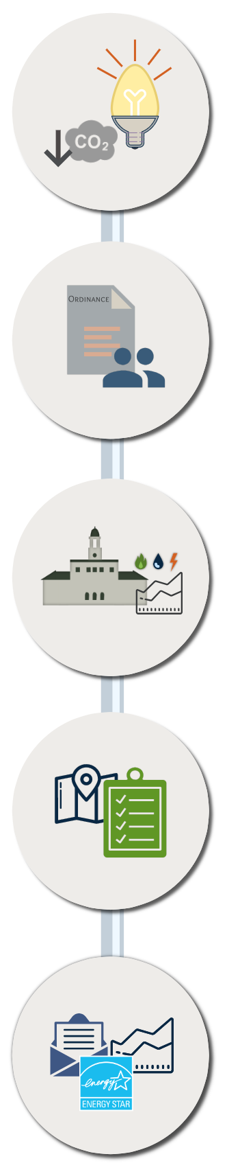
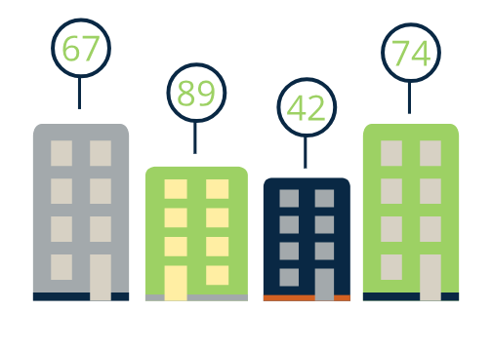
Implementation of Energy Benchmarking Ordinance
Ayden Eickhoff, UNH Sustainability Fellow
Mentor: Troy Moon, City of Portland
Benchmarking Basics
Energy Benchmarking policies initiate virtuous cycles of resource usage awareness and consumption reduction. They create and allow for:
A rating system similar to “Mpg” but for buildings
An "apples to apples” comparison
Measures of ongoing progress
Idea
Building energy use currently accounts for about 40% of total energy consumption in the U.S.
-U.S. Energy Information Administration
Portland committed to reducing greenhouse gas emissions 80% by 2050. To reach this goal, a baseline has to be established.
Objectives
Create easy to read, useful, and effective compliance guides for property owners.
Efficiently collect municipal energy and water use data for benchmarking purposes.
Enable property owners to make more educated decisions about energy usage and efficiency projects.
Measure
Plan
Collect
Analyze
Implement
Virtuous Cycle
Action
On November 7th, 2016 the City of Portland passed the Building Energy Use
Disclosure ordinance requiring all covered properties to report monthly water and energy usage.
Methods
The process for this project is largely structured by the requirements of the ordinance. Roughly “all covered properties need to annually report monthly energy and water use data”. However, before that could happen we first need(ed) to:
Clarify what the ordinance actually requires of all actors;
Identify covered properties;
Comply with all deadlines for municipal benchmarking and notification of covered properties;
Create guides for data collection and reporting; and
Assist property owners with compliance
Adoption
Before the general reporting date (December 8th, 2018), all municipal covered properties are required to report their energy and water usage.
Apples to Apples Comparison
Assistance
The municipal reporting process allows for a “best practices” guide to be created to facilitate the reporting process for all covered properties.
Challenges
Utility interfaces are not always user-friendly
Around 800 properties have to comply with the ordinance. In order to avoid 800 frustrated phone calls, guides and tutorials provided need to be detailed but not overwhelming.
For some properties, attaining whole-building utility data will be difficult if not impossible.
Working efficiently in Excel and Portfolio Manager
Creating resources for a future employee to easily continue this work
Tracking Progress
Compliance
All covered properties are notified of their benchmarking obligation and will begin the reporting process. Online and staff support will be provided.

