Slide 1
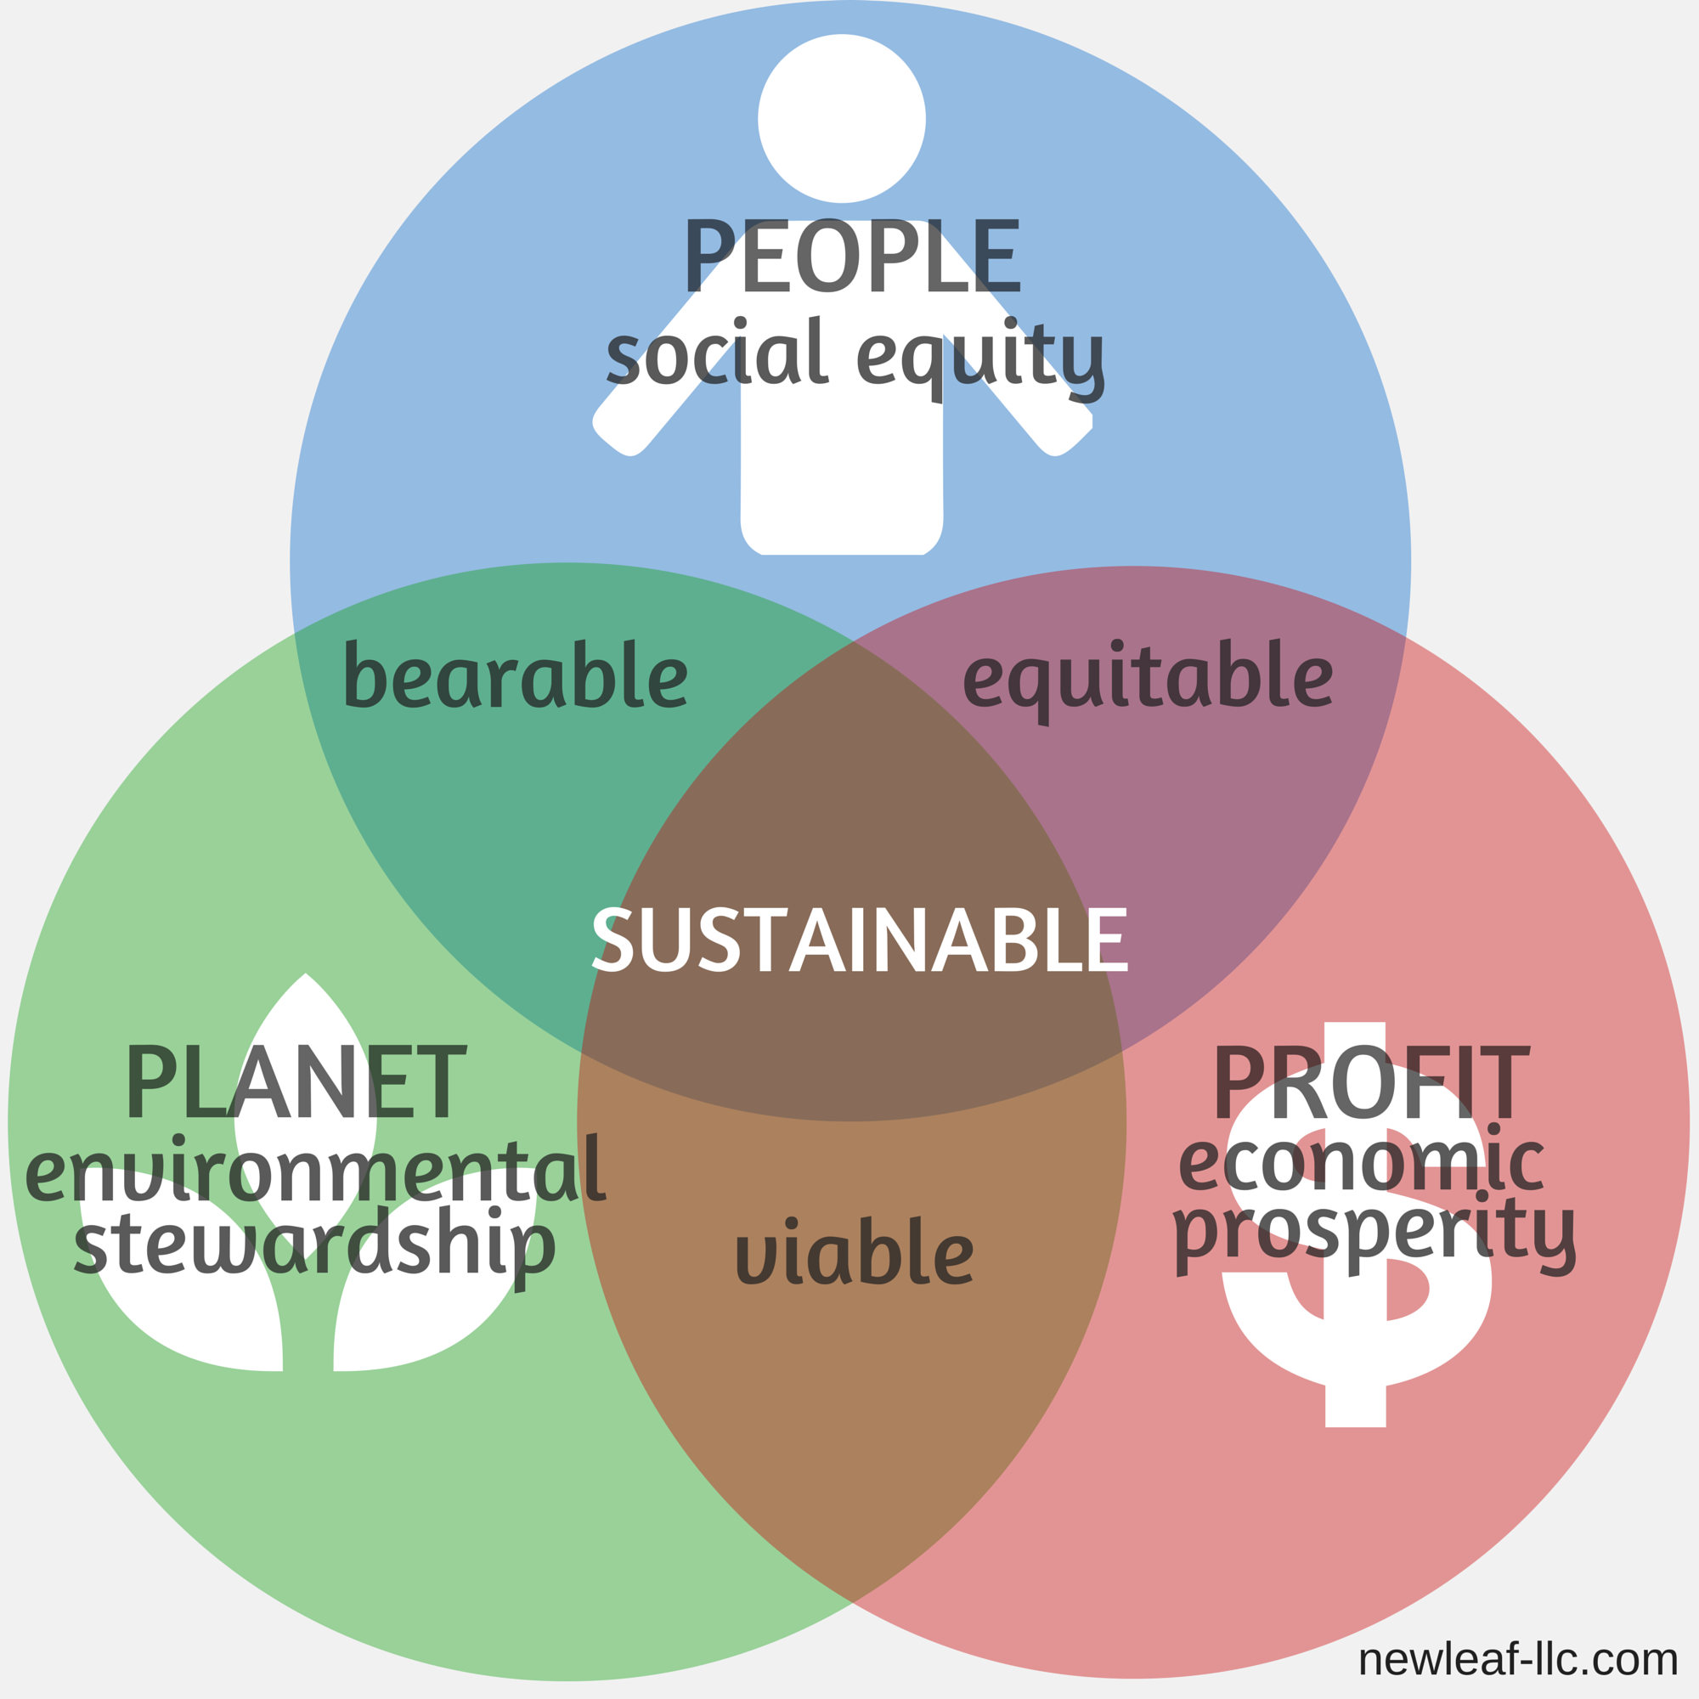
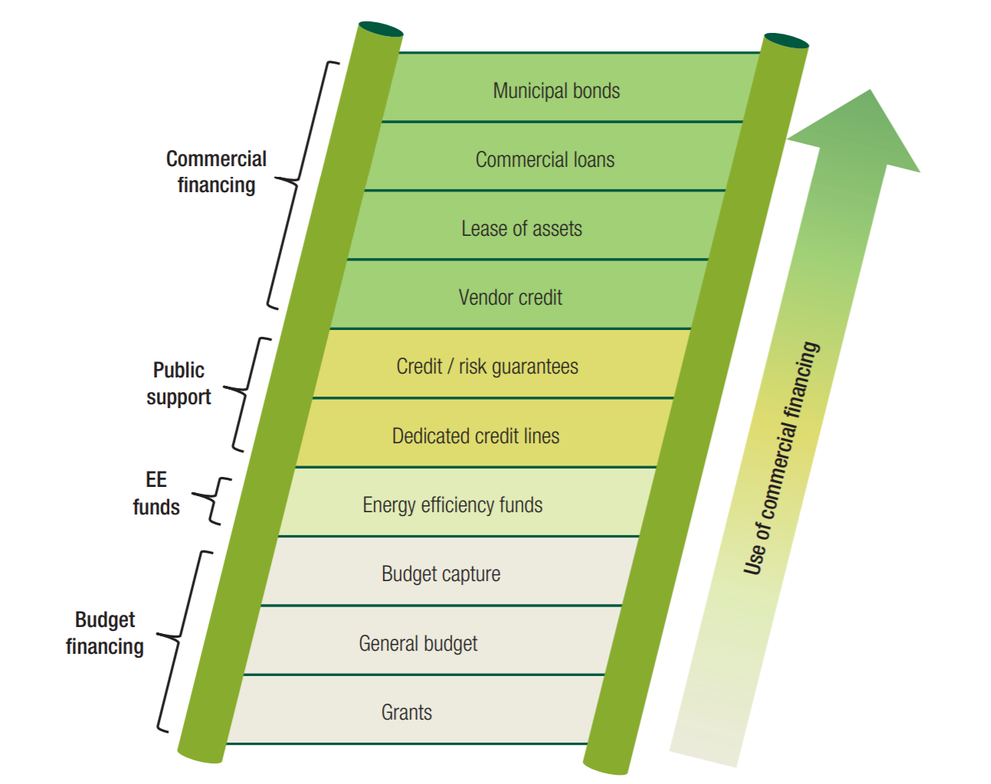
Understanding and Reducing Barriers to “Impact Investment” Opportunities
Claire McCarthy, UNH Sustainability Fellow
Mentors: Michael Swack, Henry Herndon, UNH Center for Impact Finance
This project analyzes the current demand for “green” financing, the barriers these projects will face when finding sources of financing and funding, and what can be accomplished to lessen the effects of these barriers.
Objectives of the research
Gauge the demand for sustainable project financing in New England
Understand the projects that in the planning process throughout New England
Understand the tools that are available to fund and/or finance sustainable projects
Understand the common barriers faced by municipalities or entities carrying out sustainable projects
Analyze the ability of current sustainable financing and funding methods as a tool for paying for sustainable projects
Address how municipalities can minimize barriers to financing and/or funding projects
Methods and Approach
Background information:
  Researched methods of green financing and funding: bonds, loans, grants, equity investment
  Researched general barriers to utilizing these types of financing/ funding instruments
Demand for green financing and understanding barriers:
  Reaching out to NEMS Network members via surveys and interviews
  Contacting other municipal leaders regarding projects in pipeline and completed projects
Understanding barriers, political and financial:
  Contacting leaders from various organizations in NE (public and private) regarding state policies and state financial incentives and potential barriers from a policy perspective
Preliminary Findings
Major Common Barriers:
Hesitancy or inability (for reasons which are the barriers) to engage in long-term debt producing projects and a tendency to focus on smaller, shorter-run, quick payback projects
Diminished federal incentives and support
New Hampshire Specific Barriers:
  Many political barriers Ex) Opposition of solar energy legislation from the Governors office (two recent vetos of bi-partisan legislation)¹
  With very small communities, difficulty financing and/or funding small projects: How can towns collaborate to gain access to financing and bring down costs for sustainable projects?
Massachusetts Specific Barriers:
  Contradicting, complex and lack of cohesive regulations and programs
  Possible lack of knowledge of all programs available and regulations
Other Findings:
Untapped potential in equity investment
The green bond market is growing and emerging to the mainstream→ bonds potentially seen as less risky
Challenges
New England is such a large area with diverse polices:
  Massachusetts has many government policies and financial incentives, NH is lacking in this area
  Do I need to know each state’s policies and programs regarding sustainable project financing and funding?
  Should I narrow my focus? It may be too soon—NEMS Network survey is out which covers each state in NE
2. So much I want to do, so little time
  Due to the potential size of project, I feel I want to do more than possible in the time available
  Possibly this project will continue past summer
Figure 2: Triple Bottom Line
References
Figure 1: Energy Sectoral Management Assistance Program: Financing Municipal Energy Efficiency Projects, 2014
Figure 2: Newleaf Sustainability Consulting, 2013
¹ Forcey, Charles, “barriers to sustainability projects in NH”, Message to: Claire McCarthy, June 27th, email.
Figure 1: The Financing Ladder

