Slide 1
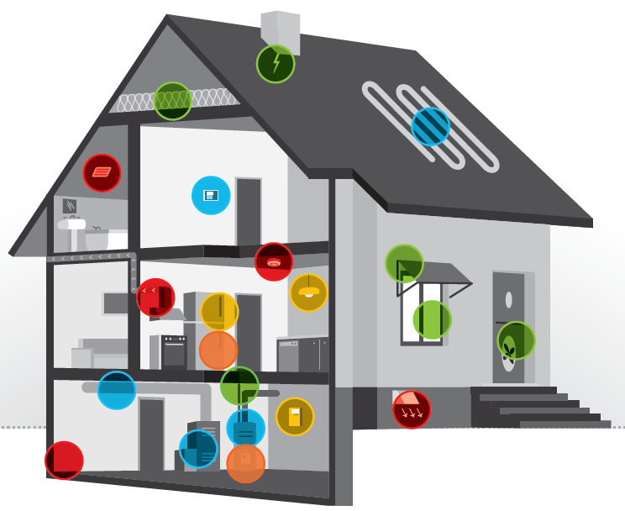









Promoting Better Health Through
Climate Change Mitigation
Abby Gates, UNH Sustainability Fellow
Mentor: Jared Ulmer, Vermont Department of Health Climate & Health Program
Objectives
Assess health co-benefits of building weatherization (Wx) measures
Estimate potential impacts of Wx measures on the health of Vermonters
Communicate health co-benefits of Wx to partners and stakeholders
Weatherization Measures²
Mechanical
Repair/replace heating/cooling system
Duct/pipe repairs & insulation
Water heater tank & pipe insulation
Building Shell
Repair roof/wall leaks
Install insulation
Perform air sealing
Repair/replace windows/doors
Install awnings or solar screens
Healthy & Safety
Safety testing of heating systems & combustion appliances
Install/repair/replace ventilation systems
Install/replace smoke and carbon monoxide alarms
Evaluate presence of mold and moisture levels
Additional
Install energy efficient lighting & low-flow showerheads
Replace appliances with energy efficient models
Education of household members regarding hazards of indoor air quality, safe use of any new mechanical equipment installations
Preliminary Results
Table 1. Summary, Health Co-Benefits of Wx
Health Outcome | Improved by Wx?
Physical Health
General Health | ✔️ | ✔️
Lower Respiratory (e.g. asthma) | ✔️ | ✔️
Upper Respiratory (e.g. allergies) | ✔️ | ✔️
Cardiovascular (e.g. heart disease, hypertension) | ✔️ | ✔️
Neurological (e.g. headaches) | ✔️ | ✔️
Infectious Disease (e.g. colds) | ✔️ | ✔️
Accidental Injury (e.g. trips/falls) | ✔️ | ✔️
Mental Health
General Health | ✔️ | ✔️
Productivity (e.g. absences from school/work) | ✔️ | ✔️
Social Health (e.g. ability to build relationships)
General Health | ✔️ | ✔️
Healthcare
Utilization | ✔️ | ✔️
Costs | ✔️ | ✔️
Introduction
What is Wx?
  Home performance improvement process that addresses energy efficiency issues by way of cost-effective building improvements
Vermont’s 2016 Comprehensive Energy Plan¹
  Priority: Improve the health of indoor environments and reduce energy bills through improved building weatherization
  Priority: Reduce negative health impacts expected to occur as a result of climate change
  Goal: Weatherize 25% of the state’s housing stock (~80,000 units) by 2020
Wx offers benefits for climate change mitigation and adaptation
  Reduces GHG emissions and pollutants
  Enhances household resiliency against effects of climate change
Wx offers numerous health co-benefits via improved health outcomes and reduced healthcare costs
Weatherization Outcomes
Fewer temperature extremes
Reduce relative humidity
Reduce mold
Eliminate pest intrusion
Reduce indoor air pollutants (VOCs, radon, particulate matter)
Reduce allergens
Enhanced safety (eliminate trip/fall, electrocution hazards)
Preliminary Conclusions
Evidence is growing that supports an association between weatherization measures and positive health co-benefits
Wx is likely to have greater impacts for vulnerable populations
  Minority populations
  Households of low socioeconomic status
  Residents with preexisting chronic health conditions
Methods
Conduct a literature review of Wx measures and associated health co-benefits, including health impacts and outcomes, potential healthcare cost savings and reductions in healthcare utilization
Interview relevant stakeholders and partners to investigate local examples where relevant actions are taking place
Apply findings of evidence and assessment methods to estimate possible health co-benefits of Wx within the state of Vermont
Produce technical documentation of the aforementioned findings
Produce clear, concise summarized findings for partner and stakeholder communication purposes
Challenges
Absence of uniformity in trial and survey design across studies leads to difficulty in comparison of results
Lack of precedent of health economic analysis and limited existing data poses a challenge for quantification of potential Wx + Health impacts in Vermont
Incohesive foundation of evidence creates a challenge for effectively communicating Wx + Health co-benefits to stakeholders
References
Vermont Department of Public Service (2016). Comprehensive Energy Plan 2016.
U.S. Department of Energy Office of Energy Efficiency & Renewable Energy (2018). Weatherization Works!

