Slide 1
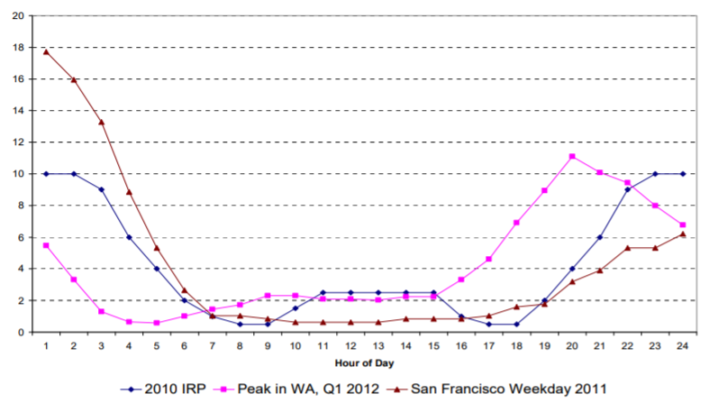
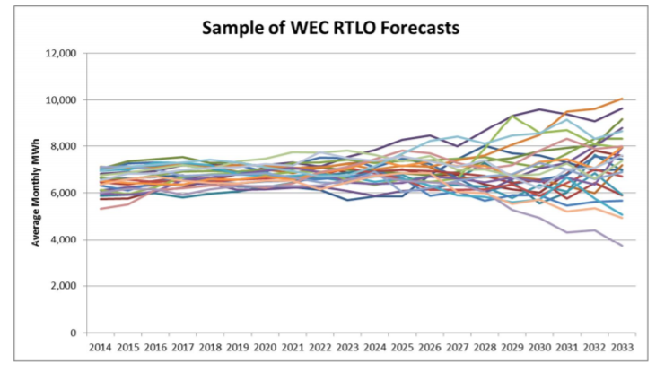
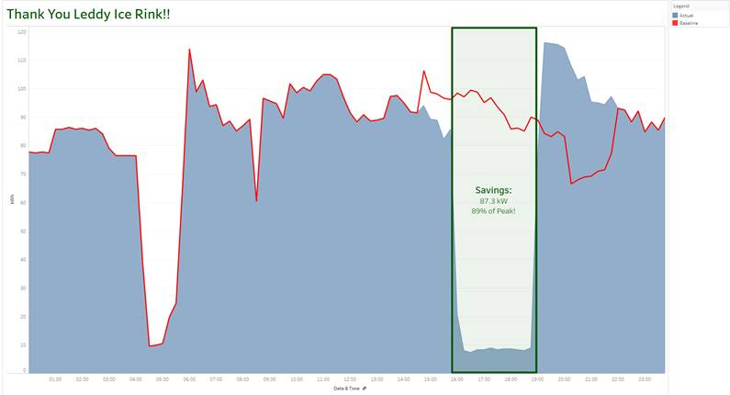
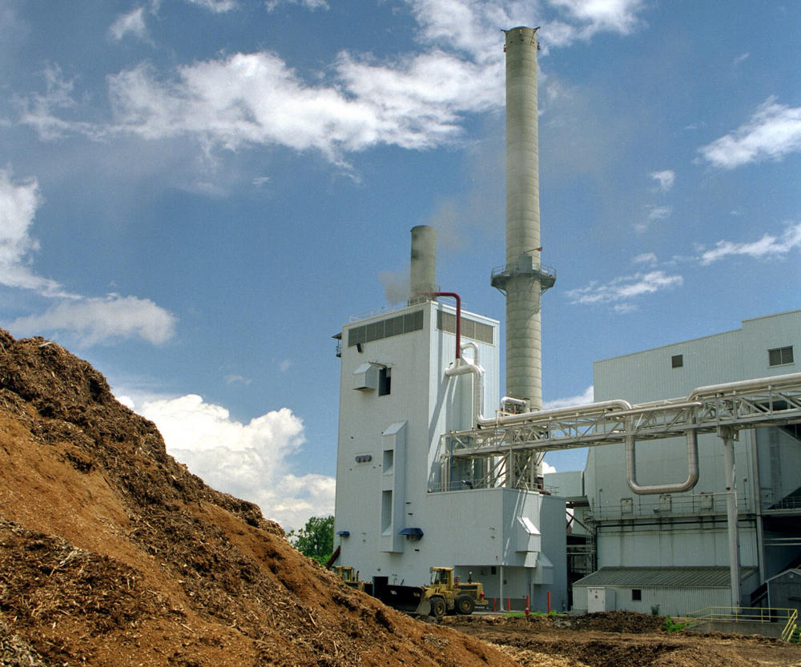
Integrated Resource Planning and Load Flexibility Analysis
Michaela Levine, UNH Sustainability Fellow
Mentors: James Gibbons, Burlington Electric Department
For BED’s next IRP…
Introduction
An Integrated Resource Plan (IRP) is an electric utilities’ plan to meet the future energy needs of its customers at the lowest cost, including both economic and environmental costs. Vermont utilities are required to file an IRP with the Department of Public Service (DPS) every 3 years. Following its 2016 IRP, the Public Utilities Commission (PUC) asked Burlington Electric Department (BED) to:
research measures to control customer loads remotely or through incentive programs,
analyze the costs of energy transformation (Tier 3) projects in terms of first year acquisition costs and discuss how incentive levels for Tier 3 projects were established,
provide an economic analysis of the performance of the McNeil Power Plant, and
provide an assessment of pilot projects for the next IRP that is due in 2020.¹
In addition, BED is exploring opportunities to streamline the IRP process, new technology options, robust uncertainty analyses, market modelling, and the land impact of energy resources in advance of the next IRP.
The objective of this project is to identify or create models that BED could use in the next IRP to address the requests of the PUC. In addition, this report seeks to make recommendations on how BED could improve their IRP process in general.
Methods
The following resources are being used to identify or develop models to address the issues described above and improve BED’s IRP process:
IRPs from other utilities
White papers and peer reviewed literature
Interviews with BED staff and external experts
Results
Tier 3 incentives: Willingness-To-Pay surveys and statistical regression analysis can be used to assess the barriers to technology adoption in developing incentive structures.
Load Controls: Direct load control (smart meters, building energy management systems, etc.), electric thermal storage, and dynamic pricing (time of use rates) have been incorporated into IRPs either as a resource option, bundled into demand side management portfolios, or factored into load projections.
McNeil Power Plant: Develop a
review methodology that incorporates
metrics other than the economic
performance of the plant including the
impact to the local/regional economy,
environmental goals of BED, and portfolio Figure 1. McNeil Power Plant
diversity
Pilot Projects: Data collected through pilot projects can be used to gain insight into Tier 3 technologies’ impact to load.
Figure 2. From Seattle City Light’s IRP showing how data from EV charging station pilot project (pink line) could be used to analyze effect of dynamic rates on load profile. San Francisco (red line) has a dynamic rate, but Seattle does not. Data is compared to forecast from 2012 (blue line).²
Integration:
Technology options: Geothermal heat pumps, battery storage, and concentrated solar heating should be analyzed as Tier 3 energy options/capacity resources.
Uncertainty analysis: Monte Carlo analyses can be used to assess the entire range of possible future outcomes and their probability.
Figure 3. Figure from Washington Electric Co-op’s IRP demonstrating Monte Carlo analysis of load projections Each line represents a simulation of load growth.³
Market Modelling: Larger utilities have used modelling software, rather than the spreadsheet-based approach BED uses, to forecast energy prices. The applicability of these software options will be evaluated for their usefulness to BED.
Next Steps
BED will be meeting with external experts and DPS staff to solicit their feedback on how to improve BED’s IRP process. The final list of recommendations for how BED can improve their IRP process will be developed focusing on what BED can do to meet the requests of the PUC and other approaches to improving their IRP that are either easy to implement or would require more time and capacity to achieve.
Load Flexibility
Introduction
Load flexibility involves shifting energy use from periods of high demand and high energy prices to periods of lower demand.
This allows for less curtailment and greater integration of renewable energy as weather patterns driving renewable production do not perfectly match demand. Additionally, load flexibility also allows energy use to be shifted away from peak times, which reduces capacity and transmission costs.
Methods
Distributed Energy Resources (DER)—such as batteries, electric thermal storage, and building energy management systems—can be used to shift customer loads and provide demand response (DR) capabilities. BED is working with municipal customers to identify opportunities to implement DERs or other operational changes at their facilities.
Results and Next Steps
So far we have had meetings with Public Works and the Airport to discuss DR opportunities in their facilities. Additional meetings with the school department and the water department are planned. More research into DERs is needed to identify opportunities to improve the performance of the city’s buildings. This research and future meetings will hopefully yield a report covering the business case and ideal program design for implementing DERs.
Figure 4. Graph showing the performance of Burlington’s rink, which changed its operations during a peak load event. Red line shows the baseline energy consumption and blue line shows actual consumption during the peak day.⁴
Tier 3
Load Forecast
(energy and demand)
Energy Services
References
State of Vermont PUC. 2017. Petition of City of Burlington Electric Department for approval of its 2016 Integrated Resource Pan.
Seattle City Light 2012 Integrated Resource Plan, Appendix 3.
Washington Electric Cooperative, Inc. 2014 Integrated Resource Plan: 2014-2033.
Figure created by Freddie Hall, Burlington Electric Department, July 2018.

