Slide 1
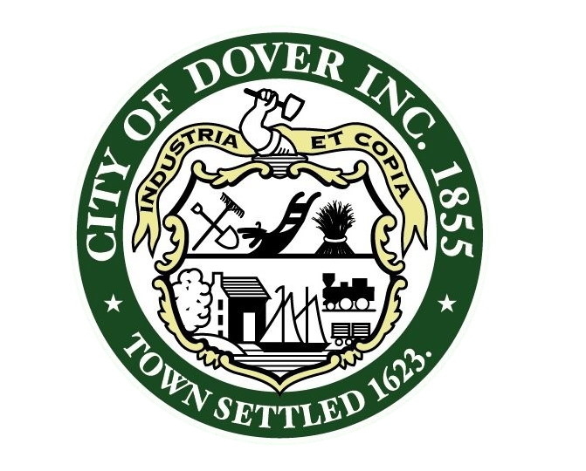

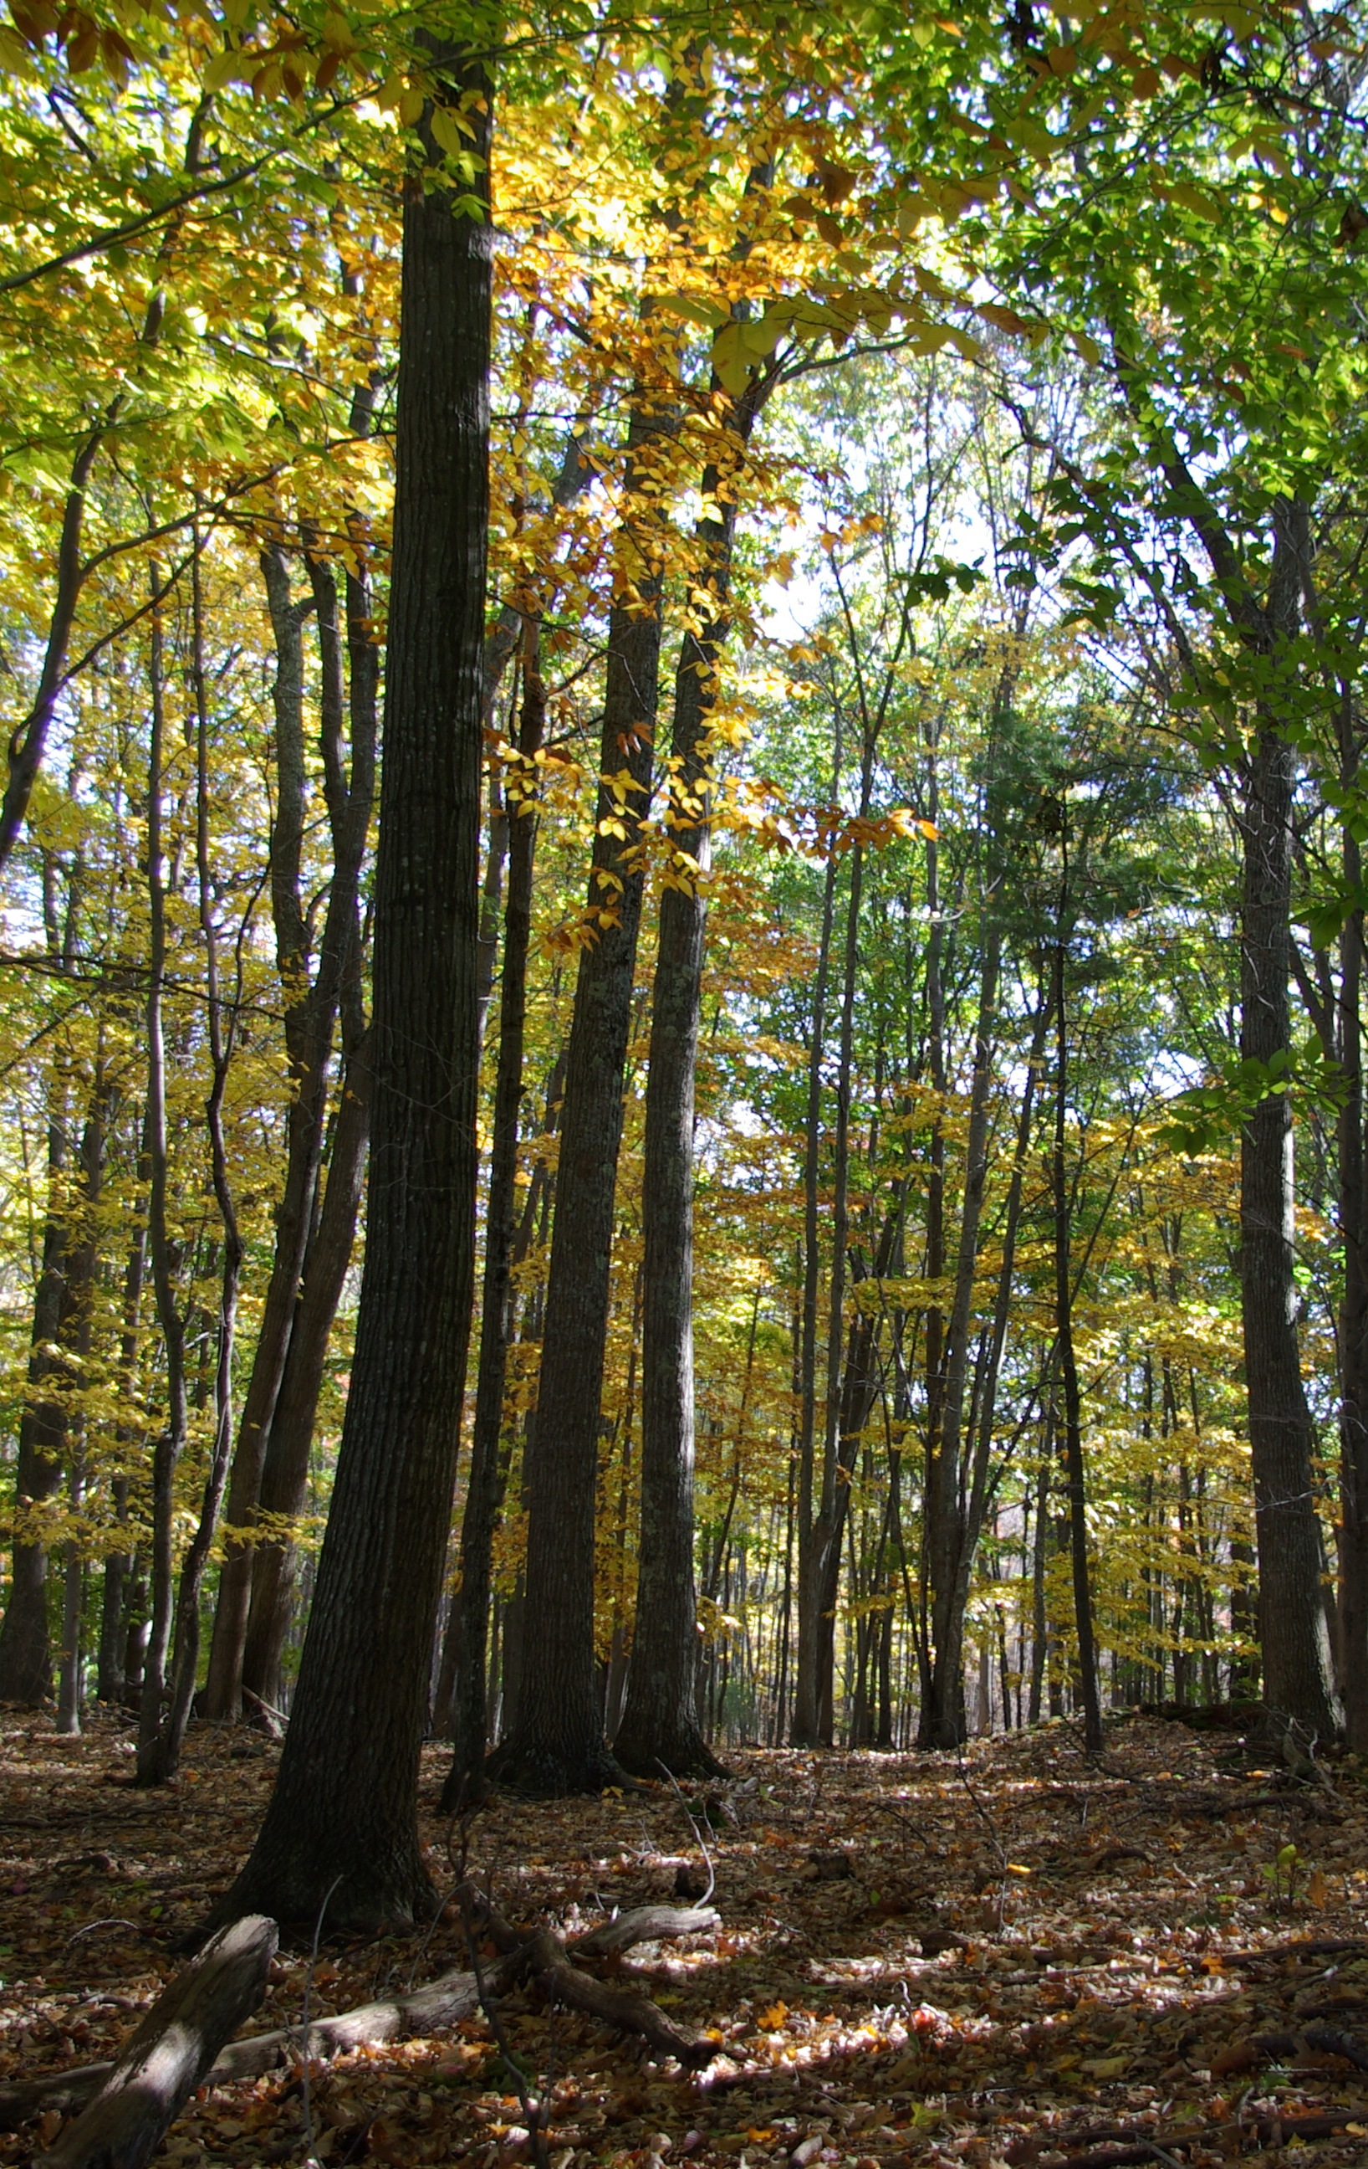

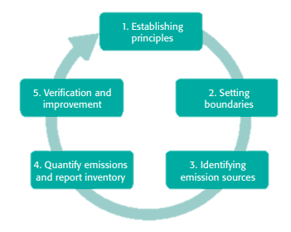


Measuring Municipal Carbon and Nitrogen Footprints
Jackson Kaspari, UNH Sustainability Fellow
Mentor: Elena Piekut, City of Dover, NH Planning Department
As a result of this project, Dover will become the first city to establish a combined GHG and nitrogen inventory for its local government operations (LGO)
Introduction
Energy
GHG Emissions
Carbon Footprint: Total amount of greenhouse gases (GHGs) produced to directly and indirectly support human activities.¹
Nitrogen Footprint: The amount of reactive nitrogen released to the environment as a result of an organizations resource consumptions.²
Footprint Baseline: A selected time period to which future footprints are compared.³
1 MT of CO₂ is enough to fill an average 2 story home (or ~ 1400 ft²) ⁶
LGO Baseline Benefits ³
Leads to the identification of opportunities to improve energy efficiency
Demonstrates climate change leadership
Allows reduction targets to be set and executed in a cost effective manner
https://pngtree.com/freepng/cartoon-two-story-room_2855120.html
https://www.nrcs.usda.gov/wps/portal/nrcs/main/nh/technical/landuse/forestry/
https://www.cbc.ca/news/canada/how-canada-s-provinces-are-tackling-greenhouse-gas-emissions-1.3030535
Figure 2. A comparison of Dover’s energy use by source between 2016 and 2017.
7,925 acres of fully developed forest were required to sequester Dover’s 2017 LGO GHG emissions ⁷
Scope | Description ³
1 | Emissions from sources that are directly owned or controlled by the organization. Example: Fossil fuel combustion
2 | Indirect emissions such as those produced from the consumption of electricity
3 | Emissions that are a consequence of the organization’s operations. Example: Employee commuting or business travel
9.3%
Increase
Figure 5. Total GHG emissions normalized by carbon dioxide equivalence for 2016 and 2017 as a result of Dover’s LGO.
7,925 acres of forest is equivalent to ~ 46% of Dover’s total land area
Goals
Completed EPA Portfolio Manager profile for City and School facilities
Baseline carbon and nitrogen footprint calculations for the City of Dover’s municipal operations via Portfolio Manager and the SIMAP tool
Reports, including recommended goals, to be presented to City leaders, staff and the general public
Recommendations for adaptations to SIMAP methodologies and the user interface to allow a version that can support municipal calculations while being aligned with the Greenhouse Gas Protocols best practices for LGOs.
Future Work
Figure 3. A comparison of Dover’s cost by source between 2016 and 2017.
Input food use, water treatment and fertilizer data into SIMAP
Input employee travel information
Generate a complete carbon and nitrogen footprint baseline using SIMAP
Draft GHG and nitrogen inventory report
Identify and suggest improvements to SIMAP so it better suits municipalities
Analyze and review reduction scenarios
Work with City leaders to establish reduction targets
Streetlights
LED
Methodology
⁴
References
Time for Change. What is a carbon footprint – definition. https://timeforchange.org/what-is-a-carbon-footprint-definition (accessed June 15, 2018)
Galloway, J. N.; Winiwarter, W.; Leip, A.; Leach, A. M.; Bleeker, A.; Erisman, J. W.; Nitrogen footprints: past, present and future. Environ. Res. Lett. 2014, 9.
Fong, W. K.; Sotos, M.; Doust, M.; Schultz, S.; Marques, A.; Deng-Beck, C.; Global Protocol for Community-Scale Greenhouse Gas Emission Inventories.
Energy Star Portfolio Manager. https://www.energystar.gov/buildings/facility-owners-and-managers/existing-buildings/use-portfolio-manager (accessed June 8, 2018).
Sustainability Indicator Management & Analysis Platform. https://unhsimap.org/ (accessed June 27, 2018)
AECOM. City of Somerville Greenhouse Gas Inventory Report. Somerville, MA, 2017.
Greenhouse Gas Equivalencies Calculator. https://www.epa.gov/energy/greenhouse-gas-equivalencies-calculator. (accessed July 6, 2018)
⁵
Figure 1. GHG Protocols five major steps for conducting a local government operations inventory. ³
Figure 4. The impact of the conversion to LED streetlights.

