Slide 1
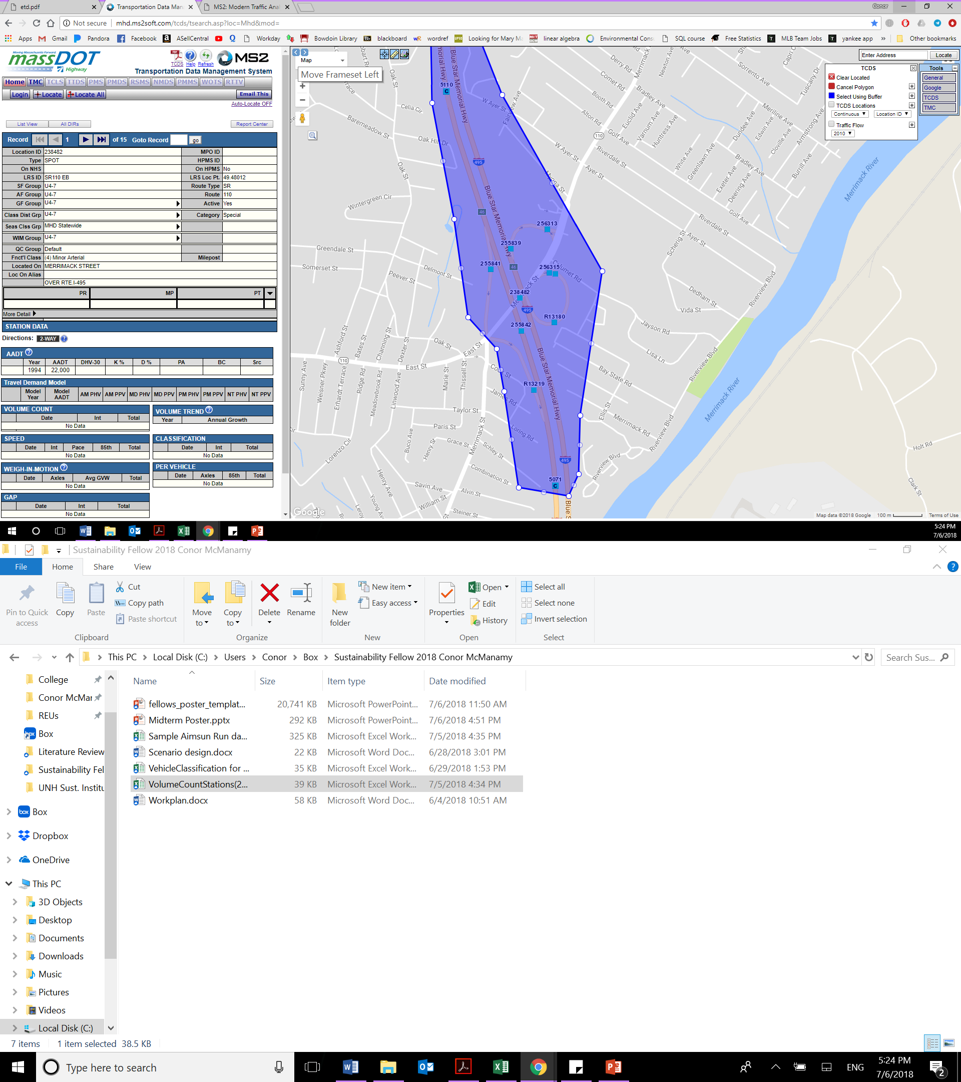
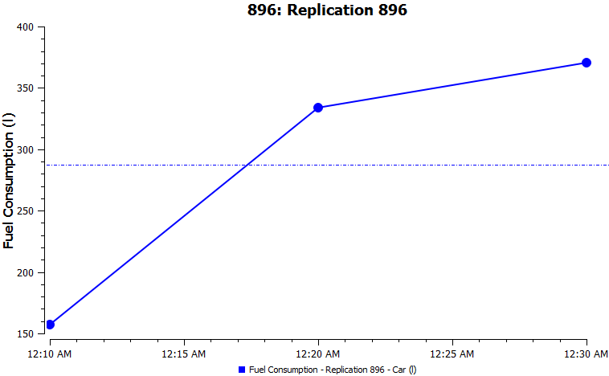
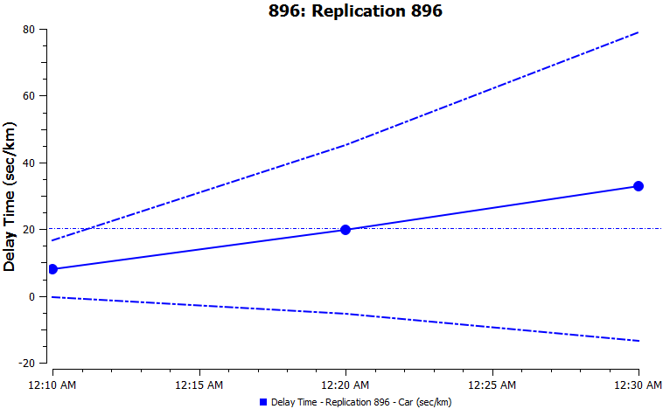
Agent-Based Traffic Modeling for Transportation LCA
Conor McManamy, UNH Sustainability Fellow
Mentors: Weiwei Mo and Eshan Dave, UNH Dept. of Civil and Environmental Engineering
Introduction
Goal: Quantify varying environmental impacts from maintenance-based congestion and roughness changes due to pavement type
Extend over-simplified, existing life cycle analyses (LCAs) to include neglected user costs which depend on road degradation and high-resolution travel profiles
Model approach to incorporate accurate traffic modeling within pavement evaluations for transportation planning
Process
Simulation
  Develop realistic demand from Mass DOT database
  Apply speed profile to AIMSUN built-in emissions models
  Vary road type and flow scenario within AIMSUN model
Agent-Based Traffic Model Comparison
Table 1: Selected results from a comprehensive comparison of leading proprietary traffic microsimulators.
Evaluation Category | AIMSUN | VISSIM
Theoretical Model | Gipps (1981, 1986) | Weidemann (1974)
Ease of Use (out of 5) | 4 | 2
Scripting Available | C++ | Java, Python, C++, Basic
Validation Data Input | Yes | No*
Native Emissions Models | Consumption, Londen, Panis, QUARTET | EmissionModel (extra fee)
Strengths | Accessibility of Output, Scenarios | Network Detail, Pedestrians, 2D/3D animation
Data Extraction
Emissions Analysis
Volume Continuity for Demand
Table 2: Proof of Rough Volume Continuity using upstream and downstream traffic sensors from traffic database.
Preliminary Results
Figure 1: Sample AIMSUN output of a) Fuel consumption against time and b) average delay time against time under a generic three lane highway with a demand of 6,000 vehicles over a 30 minute time period, 65 mph speed limit, and a continuous, single lane closure.
 | Exit 46 | Exit 41 | Exit 41
Upstream | 57809 | 53788 | 56691
Outflow | 4749 | 7224 | 4700
Inflow | 7142 | 8394 | 0
Change | 2393 | 1170 | -4700
Downstream | 64679 | 58099 | 54111
Projected Downstream | 60202 | 54958 | 51991
% Difference | 6.92 | 5.41 | 3.92
Direction | SB | SB | NB
Upstream
A
B
Outflow
Inflow
Downstream
Next Steps
Install AIMSUN software
Import Test-Bed Road Network
Extract Demand Data from MassDOT MS2 Host
Begin Scenario Implementation
Scenario Design
Free Flow (No Maintenance)
Continuous Lane Closure (Full-Time Maintenance)
Low-Volume Closure (Smart Maintenance)
Research will also consider four typical pavement types which vary by mixture and layer thickness.
References
http://mhd.ms2soft.com/tcds/tsearch.asp?loc=Mhd&mod=
P. M. Ejercito, K. G. E. Nebrija, R. P. Feria and L. L. Lara-Figueroa, "Traffic simulation software review," 2017 8th International Conference on Information, Intelligence, Systems & Applications (IISA), Larnaca, 2017, pp. 1-4.

