Slide 1
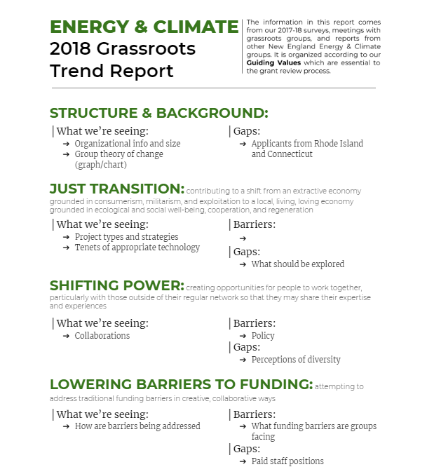
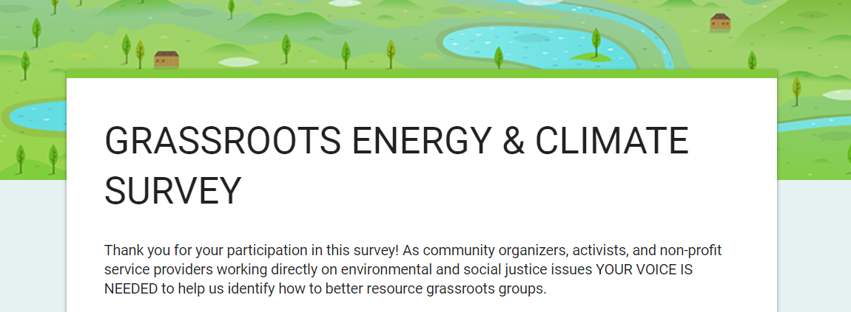
Democratic Grant Making and Grassroots Trend Reports
Shannon Seigal, UNH Sustainability Fellow
Mentors: Leigh Cameron & Julia Dundorf, New England Grassroots Environment Fund
Background: Guiding Values
Just Transition & Strategic Considerations
Shifting Power: Transparency, Accountability, Democracy
Lowering Barriers to Funding
Flexibility & Risk-taking
Change vs. Charity
Community-based Fundraising
Process is the Product
What does democratic grant-making look like and how can we facilitate its success?
Objectives
Revise and release Energy & Climate and Food issue area surveys to glean trends, barriers, and opportunities in grassroots organizing
Create 2018 Energy & Climate and Food Grassroots Trend Reports using qualitative and quantitative data gathered from a variety of sources
Coordinate the planning of a participatory Catalyst Conversation event in New Hampshire
Approach
Trend Reports
I read reports and watch webinars from New England Energy & Climate and Food groups, analyze 2017 survey response, update and distribute 2018 surveys, read grant applications and reviewer feedback, and meet with innovative organizations for deeper conversations.
New Hampshire Catalyst Conversation
I invite diverse New Hampshire environmental justice stakeholders to be part of the Planning Committee, set meeting agendas, and facilitate Committee meetings.
“This survey really helped me to look at where we are and where we should be going.”
-Survey Respondent
Challenges
Maximizing impact
How can I get more people to spend 30 minutes filling out a survey?
How can I more effectively glean trends from dozens of individually written responses?
How can we best create materials and facilitate events that are valuable to all audiences?
Efficiency
How can we balance our desire for deep participation from a wide array of stakeholders with our need for time efficiency?
How can I make an informative report that’s an accessible and engaging?
Trend Report Outline
A short report used to inform our democratic grant review process
Emerging Results
Energy & Climate and Food Trend Reports
I distributed the updated Energy & Climate and Food surveys and received 23 responses so far.
I partnered with the New Hampshire Sustainable Energy Association on a more specific survey for New Hampshire municipalities who have implemented solar projects.
I arranged 4 in-person meetings with organizers.
I proposed a structure and outline for the trend reports.
New Hampshire Catalyst Conversation
I contacted numerous New Hampshire stakeholders and confirmed a 12 member planning committee.
2018 Energy & Climate Survey
Used to glean energy & climate trends from grantees and partner organizations
“We leverage existing social capital.” -Interviewee

